Slide 1
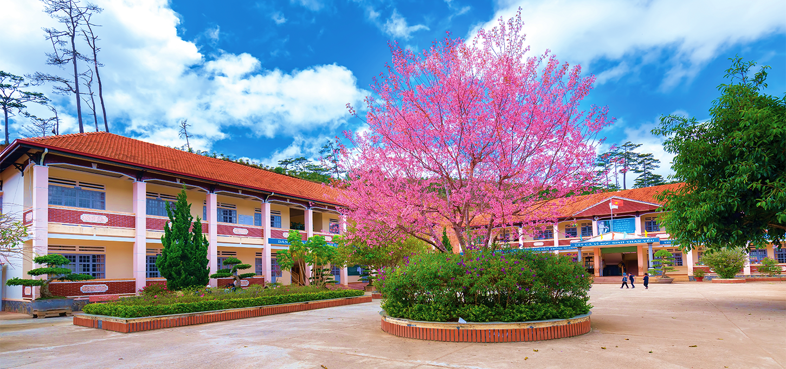
Monday, October 10th 2022
Our school
Unit
6
Lesson 3
Facebook : Bùi Liễu
0968142780
Notes:
Facebook : Bùi Liễu
Mobile phone: 0968142780

Slide 2
Warm-up

Slide 3
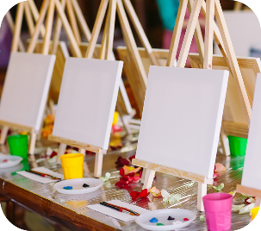
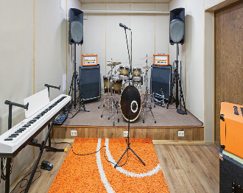
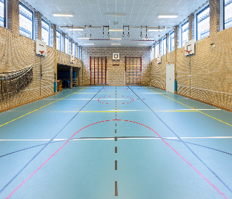
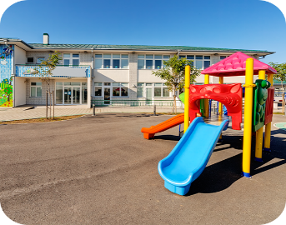
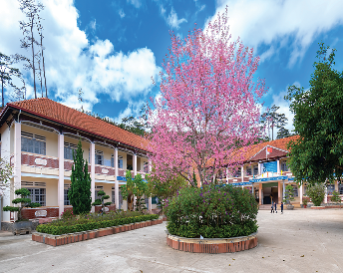
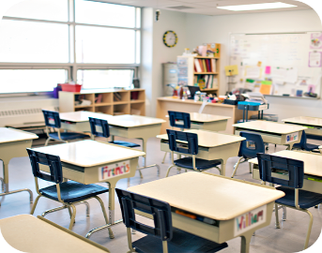
Let’s play.
What and where?

Slide 4
Contents
Facebook : Bùi Liễu
0968142780
Listen and repeat.
Listen and circle.
Let’s chant.
Read and complete.
Let’s write.
Project.
Notes:
Facebook : Bùi Liễu
Mobile phone: 0968142780

Slide 5
1. Listen and repeat.

Slide 6
2. Listen and circle.

Slide 7
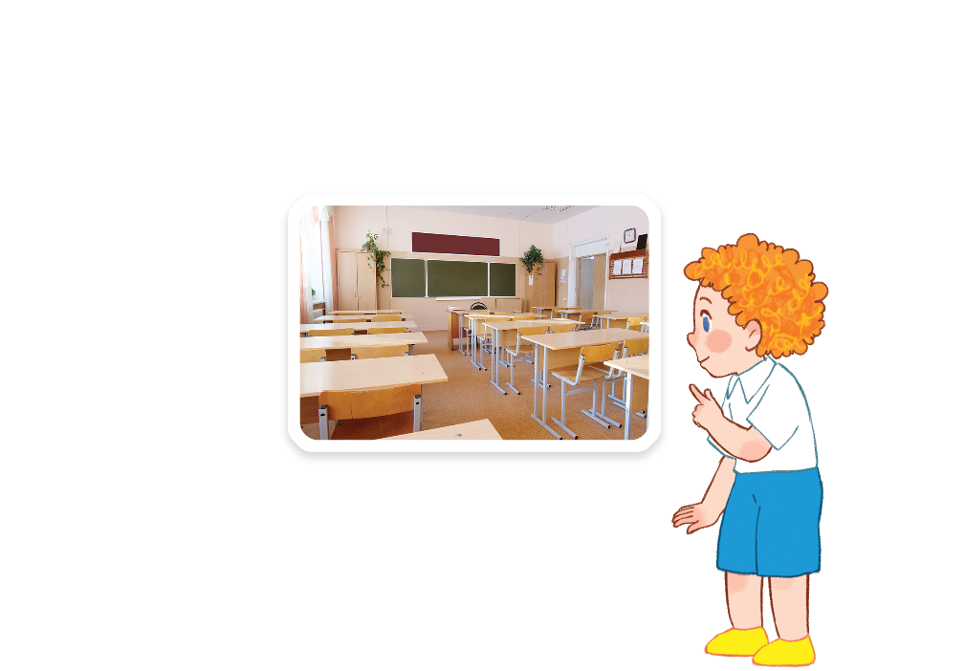
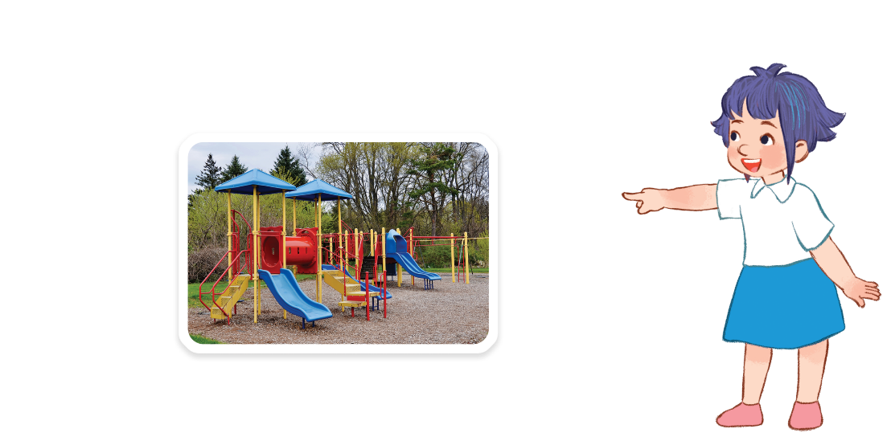
Facebook : Bùi Liễu
3. Let’s chant.
Classroom,
classroom.
Is that your classroom?
Yes, it is. Yes, it is.
Facebook : Bùi Liễu
Let’s go to your classroom.
Playground, playground.
Is that our playground?
Yes, it is. Yes, it is.
Let’s go to our playground.

Slide 8
Facebook : Bùi Liễu
3. Let’s chant.
Classroom,
classroom.
Is that your classroom?
Yes, it is. Yes, it is.
Let’s go to your classroom.
Playground, playground.
Facebook : Bùi Liễu
Is that our playground?
Yes, it is. Yes, it is.
Let’s go to our playground.

Slide 9
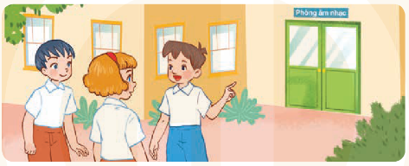
4. Read and complete.
Hi. My name’s Minh. Welcome to our school! This is my (1) _________. Now, let’s (2) ___ to the music room. Here is the (3) ____ room. We like (4) ____ school very much.
classroom
go
art
our

Slide 10
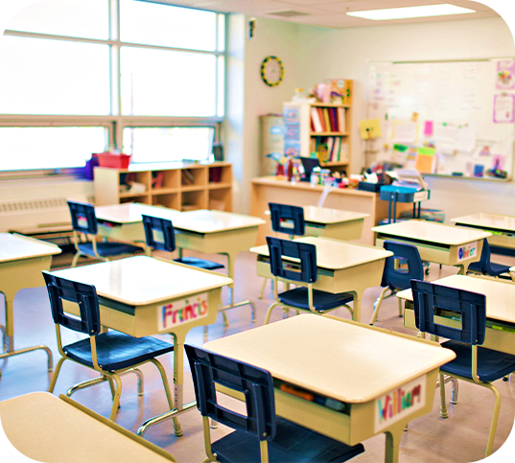
5. Let’s write.
Welcome to my school! This is my _________.
This is our ______. Now, let’s go to the ______.
classroom
gym
library

Slide 11
6. Project.

Slide 12
Facebook : Bùi Liễu
0968142780
Let’s talk!
Notes:
Facebook : Bùi Liễu
Mobile phone: 0968142780

Slide 13
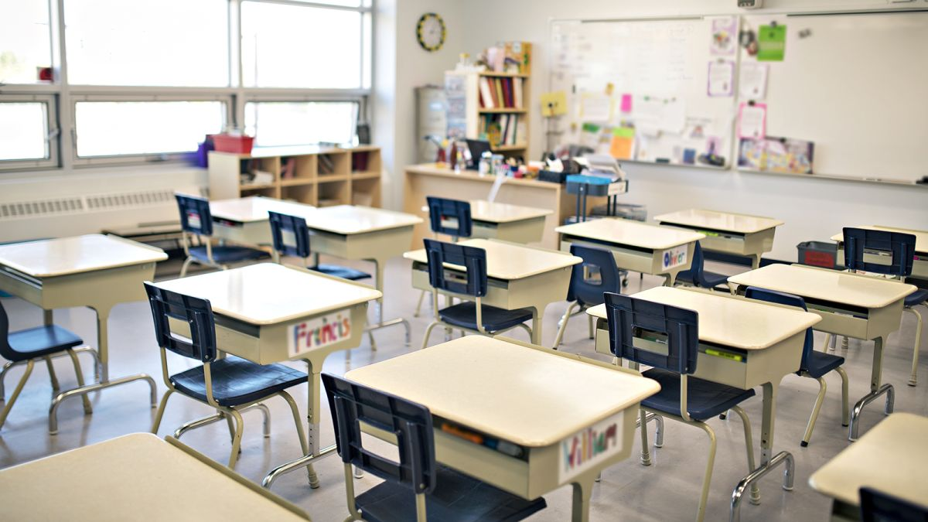
Is this our _________?
classroom
Yes, it is.
No, it isn’t.

Slide 14
Is this our _________?
library
Yes, it is.
No, it isn’t.

Slide 15
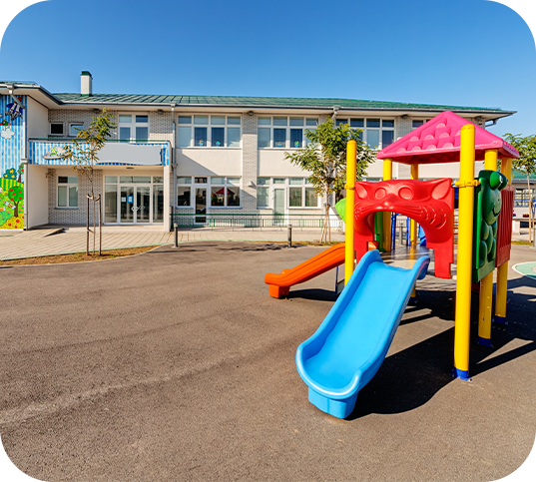
Is this our __________?
playground
Yes, it is.
No, it isn’t.

Slide 16
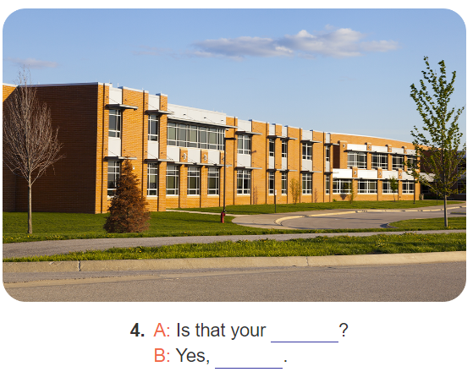
Is this our _________?
school
Yes, it is.
No, it isn’t.

Slide 17
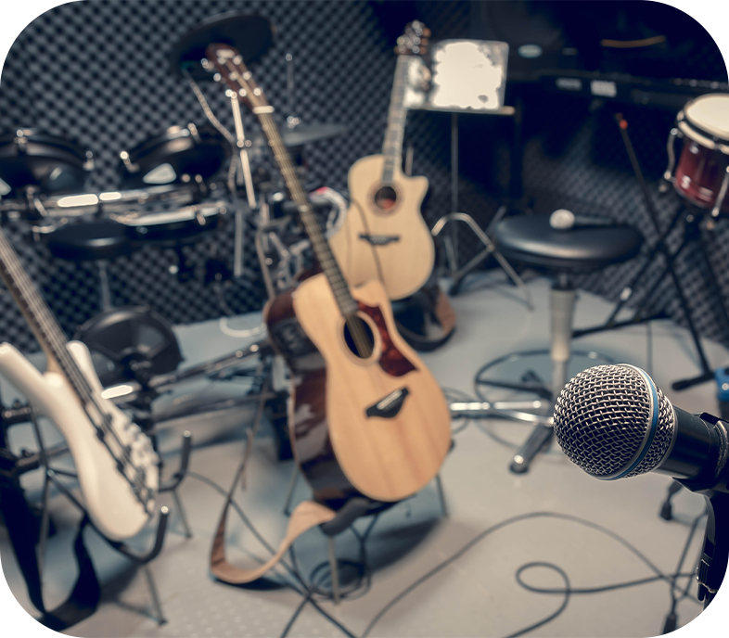
Let’s go to the __________.
music room
OK, let’s go.

Slide 18
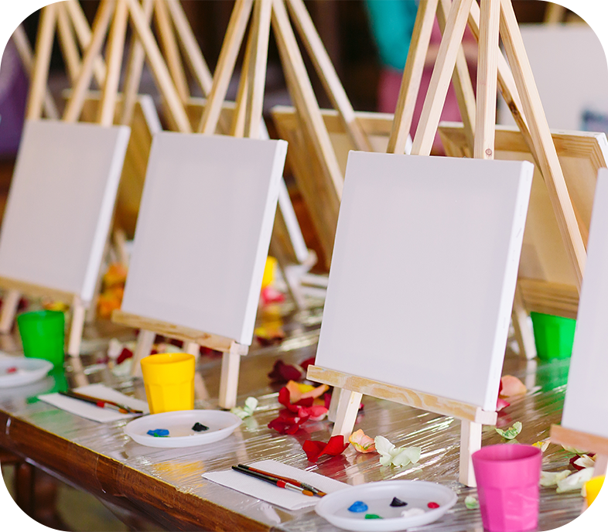
Let’s go to the ________.
art room
OK, let’s go.

Slide 19
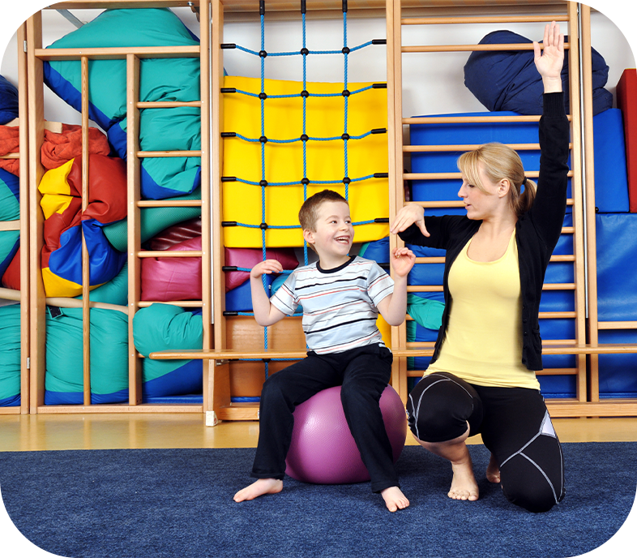
Let’s go to the ______.
gym
OK, let’s go.

Slide 20
Let’s go to the_____________?
computer room
OK, let’s go.

Slide 21
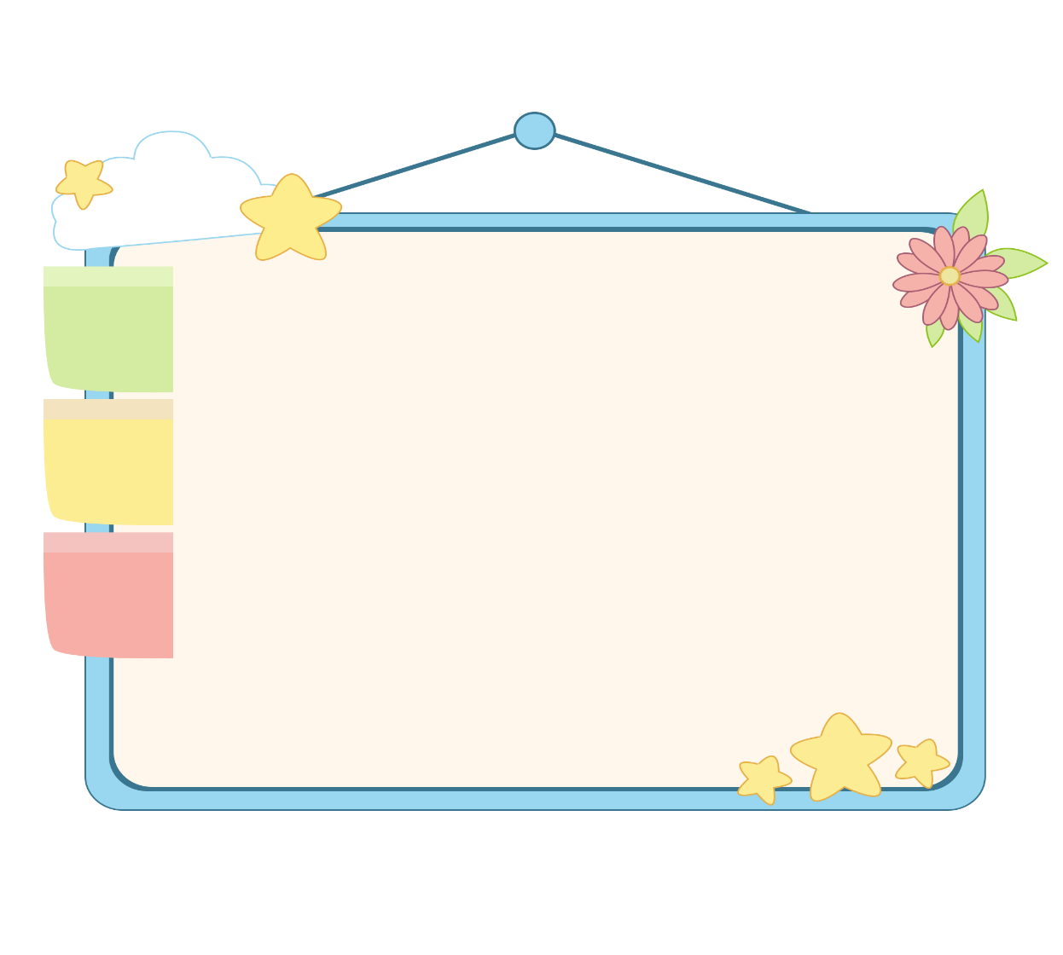
Facebook : Bùi Liễu
0968142780
WELL DONE!

Slide 22
Wrap up unit 4
Notes:
Facebook : Bùi Liễu
0968142780

Slide 23
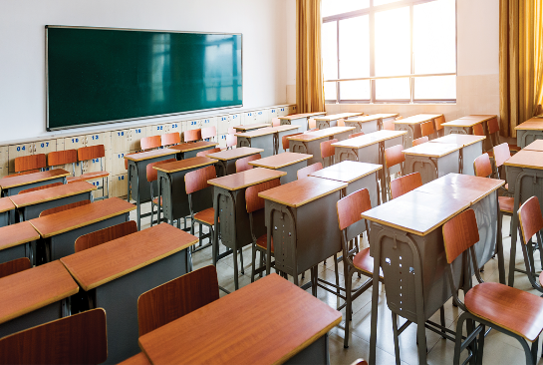
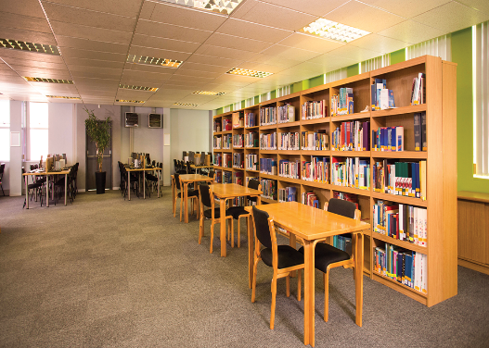
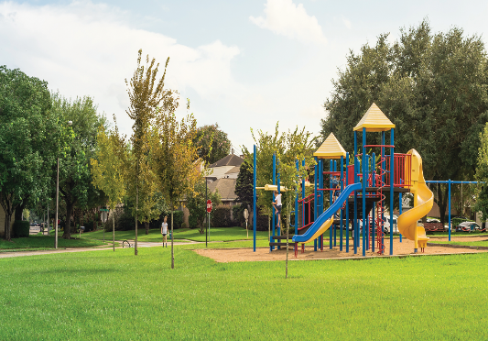
Vocabulary
school
classroom
library
playground
Notes:
Facebook : Bùi Liễu
Mobile phone: 0968142780

Slide 24
Structures
Hỏi và trả lời về các phòng ở trường học.
- Is this our _____?
+Yes, it is/ No, it isn’t.
isn’t = is not
(Đây có phải là ____ của chúng ta không?)
(Vâng, đúng rồi./Không, không phải.

Slide 25
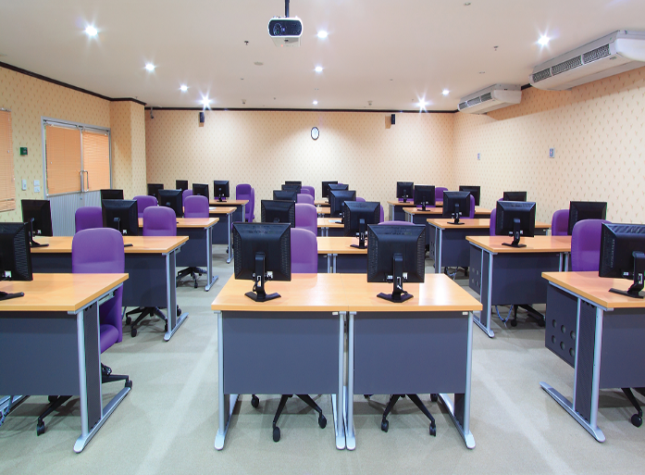
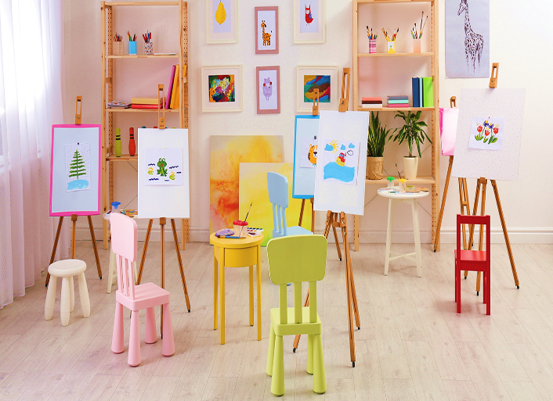
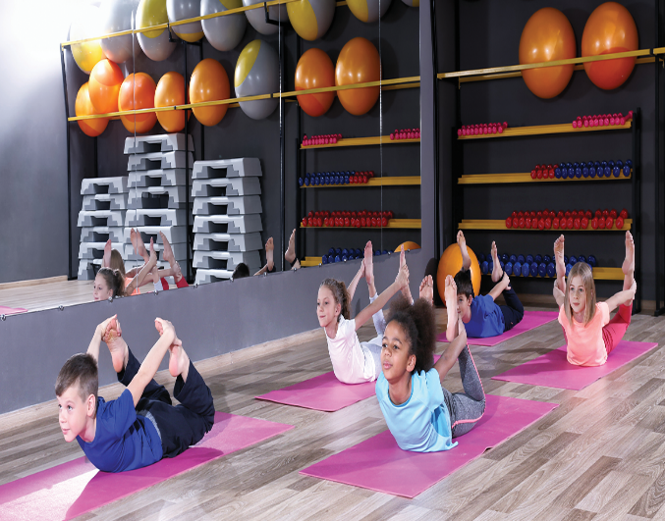
Vocabulary
computer room
art room
music room
gym

Slide 26
Structures
*Câu gợi ý đi tới một nơi trong ngôi trường và diễn đạt sự đồng ý.
Let’s go to the _______!
- OK, let’s go!
(Chúng ta đi tới _____ nhé!)
(Đồng ý, chúng ta đi thôi!
Example:
A: Let’s go to the computer room!
B: OK, let’s go!

Slide 27
Homework
Learn by heart all the new words.
Notes:
Facebook : Bùi Liễu
0968142780

Slide 28
Thank you!
Facebook : Bùi Liễu
0968142780
Notes:
Facebook : Bùi Liễu
0968142780

