Slide 1
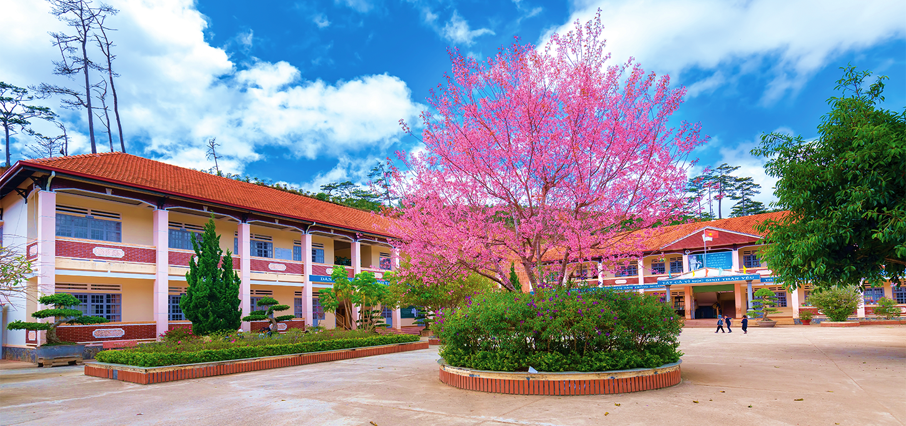
Monday, October 10th 2022
Our school
Unit
6
Lesson 1
Facebook : Bùi Liễu
0968142780
Notes:
Facebook : Bùi Liễu
Mobile phone: 0968142780

Slide 2
Warm-up

Slide 3
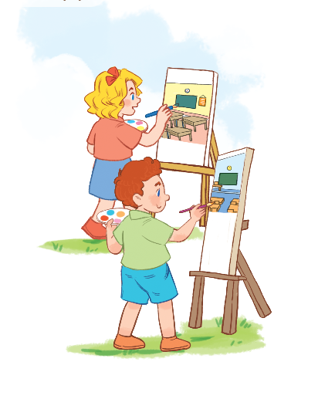
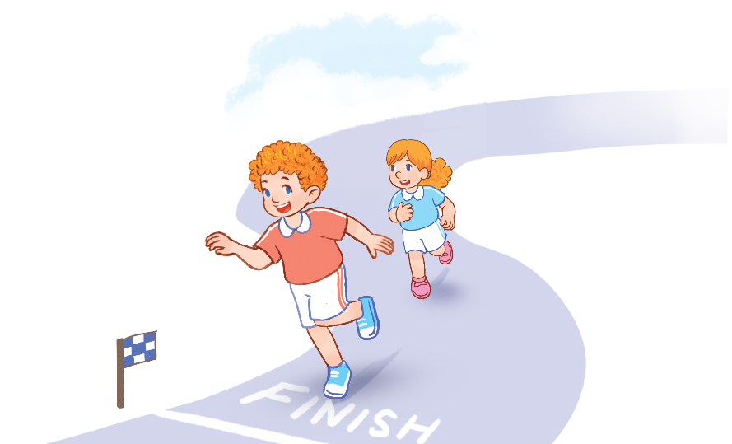
Let’s chant.
Painting.
Painting.
I like painting.
Running.
Running.
I like running.
Painting?
Running?
I like painting.
I like running.

Slide 4
Contents
Facebook : Bùi Liễu
0968142780
Look, listen and repeat.
Listen, point and say.
Let’s talk.
Listen and tick.
Look, complete and read.
Let’s sing.
Notes:
Facebook : Bùi Liễu
Mobile phone: 0968142780

Slide 5
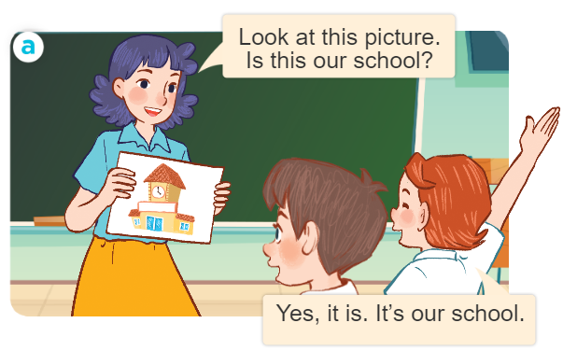
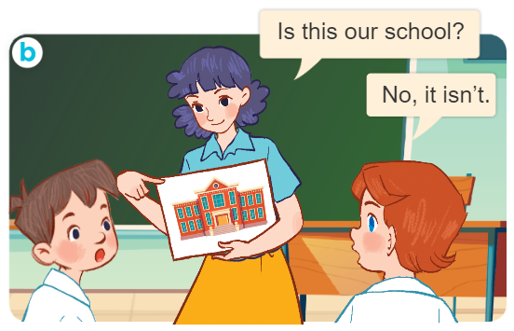
1. Look, listen and repeat.
What are they doing?
Where are they?
Who are they?
Notes:
Facebook : Bùi Liễu
Mobile phone: 0968142780

Slide 6
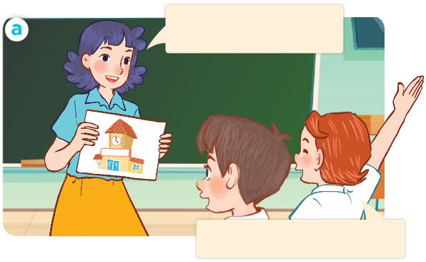
1. Look, listen and repeat.
Look at this picture.
Is this our school?
Facebook : Bùi Liễu
0968142780
Yes, it is. It’s our school.
Notes:
Facebook : Bùi Liễu
Mobile phone: 0968142780

Slide 7
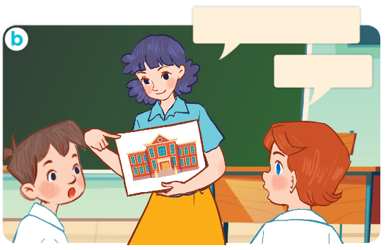
1. Look, listen and repeat.
Is this our school?
Facebook : Bùi Liễu
0968142780
No, it isn’t.
Notes:
Facebook : Bùi Liễu
Mobile phone: 0968142780

Slide 8
Vocabulary
Notes:
Facebook : Bùi Liễu
Mobile phone: 0968142780

Slide 9
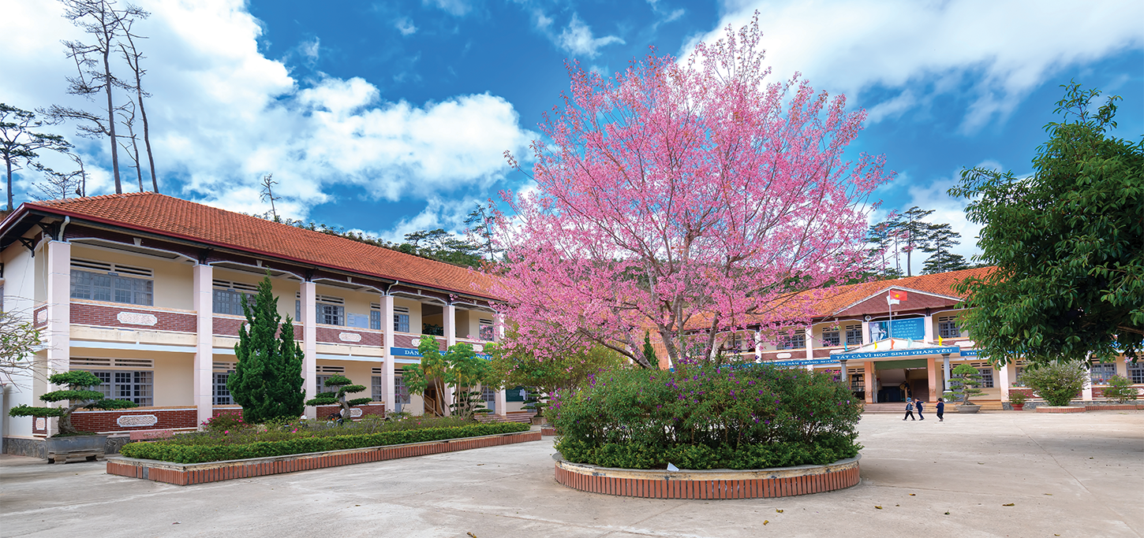
Vocabulary
school
/skuːl/
trường học
Notes:
Facebook : Bùi Liễu
Mobile phone: 0968142780

Slide 10
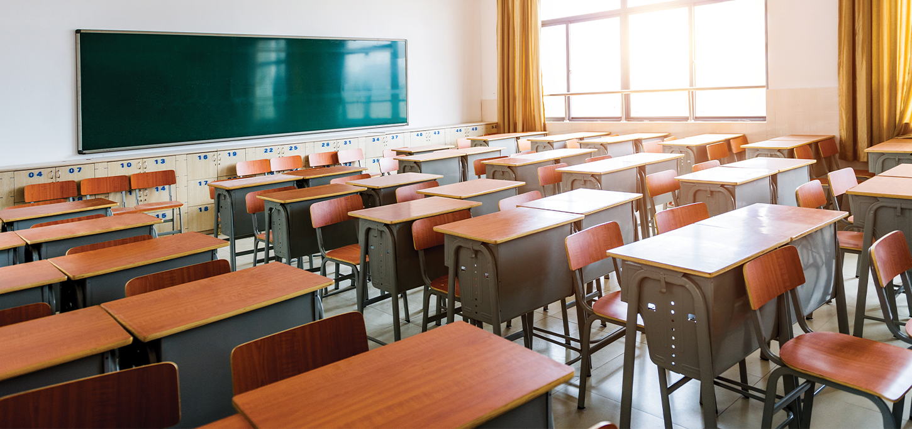
Vocabulary
classroom
/ˈklɑːs.ruːm/
lớp học
Notes:
Facebook : Bùi Liễu
Mobile phone: 0968142780

Slide 11
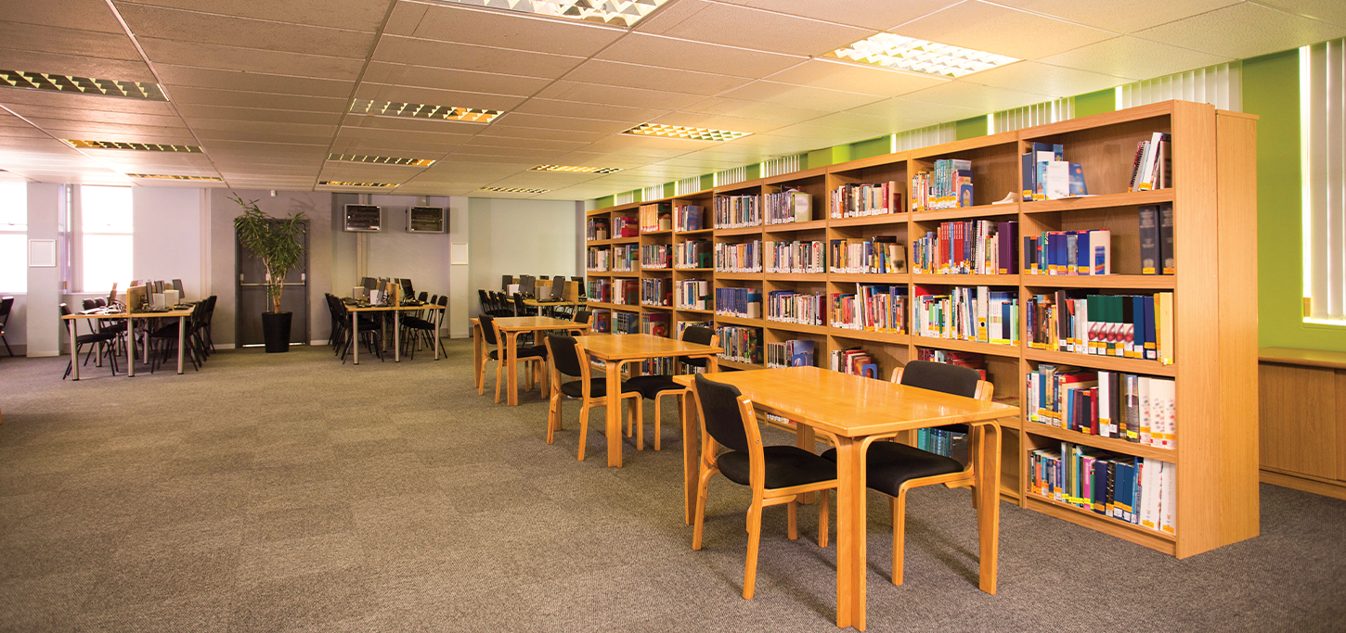
Vocabulary
library
/ˈlaɪ.brər.i/
thư viện
Notes:
Facebook : Bùi Liễu
Mobile phone: 0968142780

Slide 12
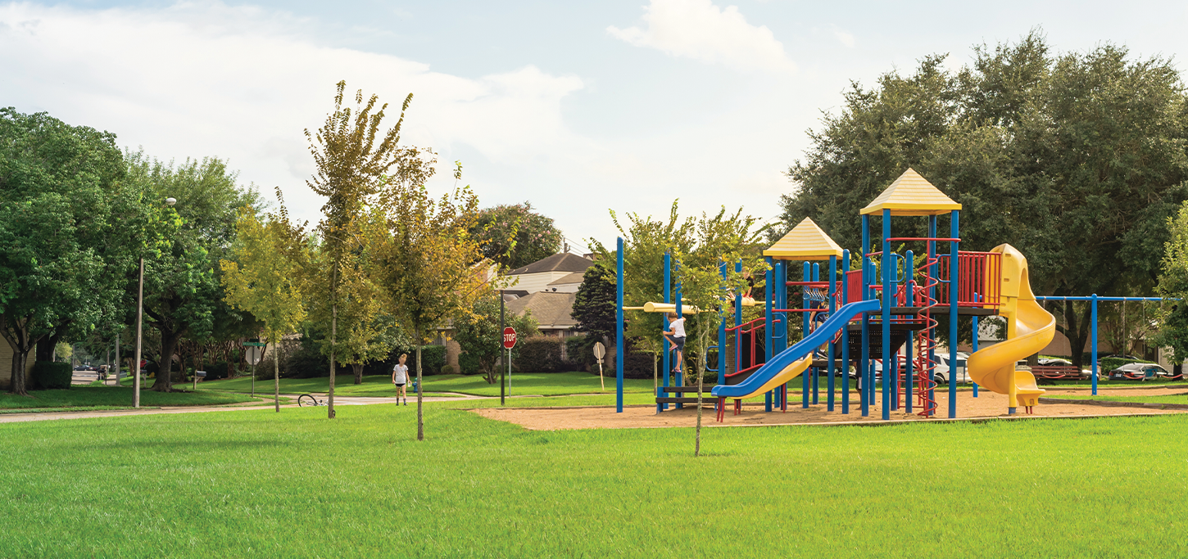
Vocabulary
playground
/ˈpleɪ.ɡraʊnd/
sân chơi
Notes:
Facebook : Bùi Liễu
Mobile phone: 0968142780

Slide 13
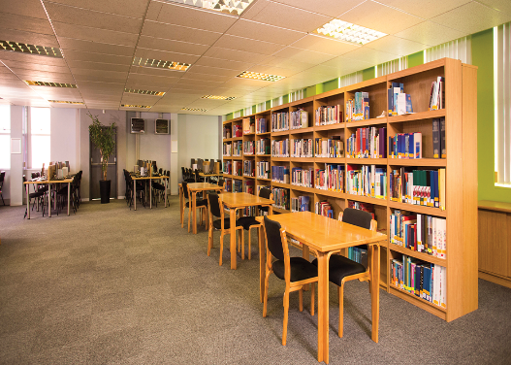
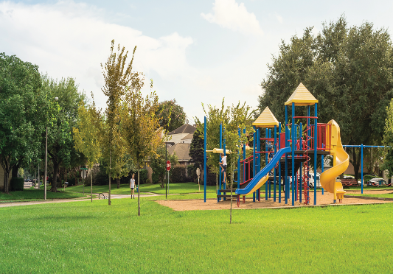
Review
school
classroom
library
playground
Notes:
Facebook : Bùi Liễu
Mobile phone: 0968142780

Slide 14
Vocabulary
school: trường học
classroom: lớp học
library: thư viện
playground: sân chơi
Notes:
Facebook : Bùi Liễu
Mobile phone: 0968142780

Slide 15
Structures
Notes:
Facebook : Bùi Liễu
Mobile phone: 0968142780

Slide 16
Structures
Hỏi và trả lời về các phòng ở trường học.
- Is this our _____?
+Yes, it is/ No, it isn’t.
isn’t = is not
(Đây có phải là ____ của chúng ta không?)
(Vâng, đúng rồi./Không, không phải.

Slide 17
Facebook : Bùi Liễu
0968142780
Let’s play!
Notes:
Facebook : Bùi Liễu
Mobile phone: 0968142780

Slide 19
Is this our _______?
Yes, it is.
Next
playground
school
library
classroom

Slide 20
Is this your ______?
Next
classroom
playground
library
school

Slide 21
Is this your ______?
Next
playground
library
school
classroom

Slide 22
Is this your ______?
Next
classroom
playground
library
school

Slide 23
Is this your school?
_______________.
Next
What’s your name?
How old are you?
No, it isn’t.
Yes, it is.

Slide 24
Is this your playground?
_______________.
Next
I’m fine.
I’m nine.
No, it isn’t.
Yes, it is.

Slide 25
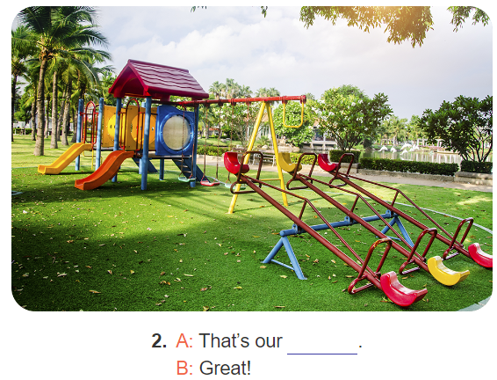
_______________?
Yes, it is.
Next
Is this our classroom?
Is this our library?
Is this our school?
Is this our playground?

Slide 26
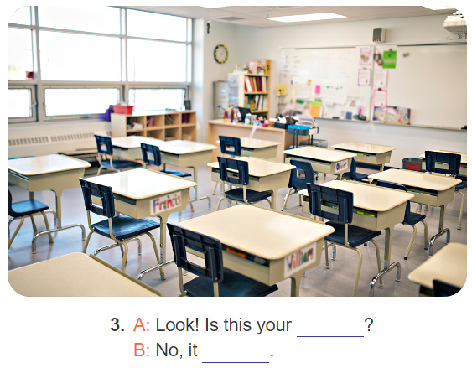
Is this your ______?
Next
school
playground
classroom
library

Slide 27
_______________?
Yes, it is.
Next
Is this our playground?
Is this our classroom?
Is this our school?
Is this our library?

Slide 29
Facebook : Bùi Liễu
0968142780
Thank you!
Notes:
Facebook : Bùi Liễu
Mobile phone: 0968142780

Slide 30
2. Listen, point and say.
a
b
Is this our _______?
Yes, it is.
school/yes
classroom/no
No, it isn’t.
c
d
library/yes
playground/no

Slide 31
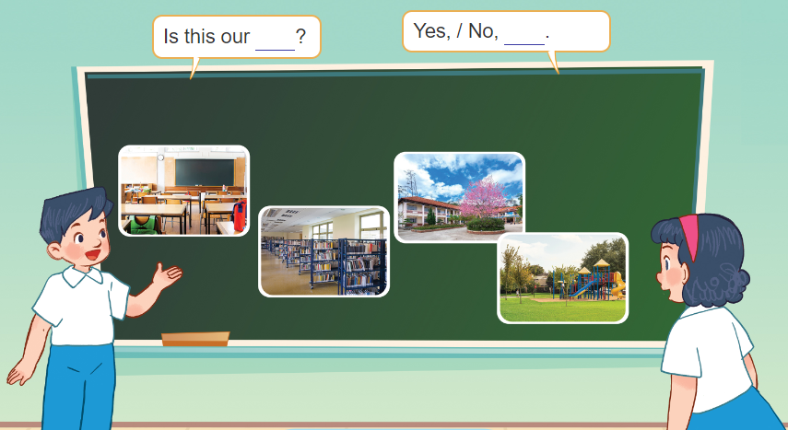
3. Let’s talk.

Slide 32
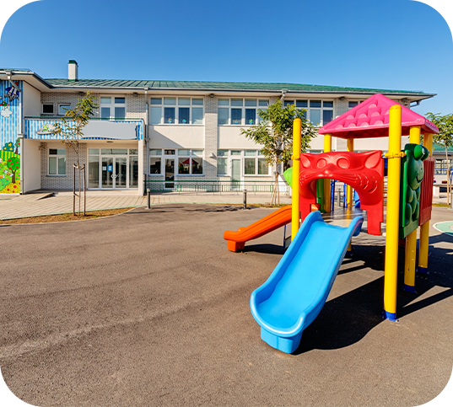
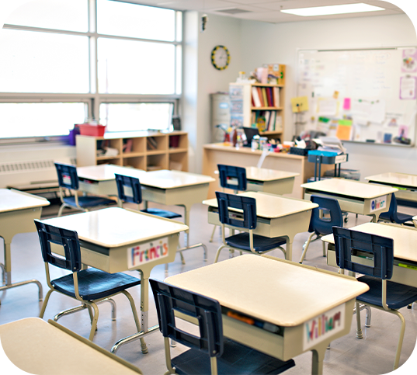
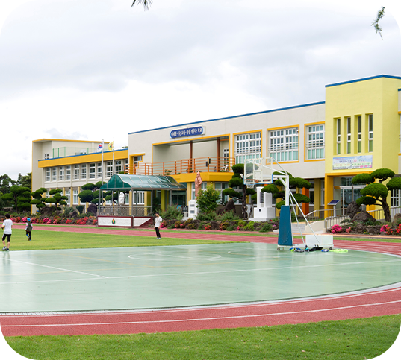
4. Listen and tick.
1
a
b
2
c
d
Notes:
Facebook : Bùi Liễu
Mobile phone: 0968142780

Slide 33
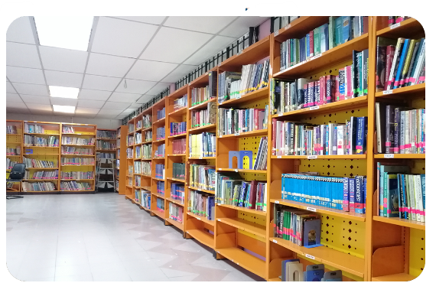
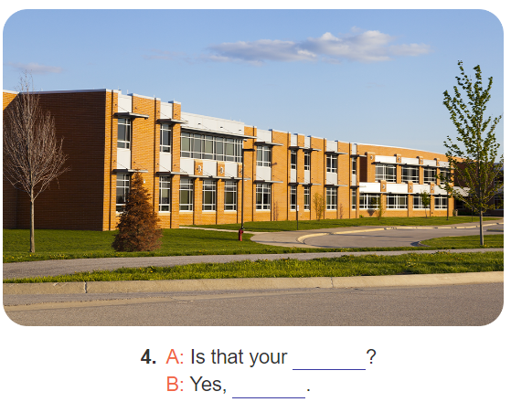
5. Look, complete and read.
1. A: Is this our ____?
B: Yes, it is.
2. A: That’s our ____?
B: Great!
3. A: Look! Is this your ___?
B: No, it ________.
4. A: Is that your _____?
B: Yes, _______.
Notes:
Facebook : Bùi Liễu
Mobile phone: 0968142780

Slide 34
5. Look, complete and read.
1. A: Is this our ______?
B: Yes, it is.
library
Notes:
Facebook : Bùi Liễu
Mobile phone: 0968142780

Slide 35
5. Look, complete and read.
playground
2. A: That’s our __________?
B: Great!
Notes:
Facebook : Bùi Liễu
Mobile phone: 0968142780

Slide 36
5. Look, complete and read.
3. A: Look! Is this your _________?
B: No, it _____.
classroom
isn’t
Notes:
Facebook : Bùi Liễu
Mobile phone: 0968142780

Slide 37
5. Look, complete and read.
4. A: Is that your _______?
B: Yes, _______.
school
it is
Notes:
Facebook : Bùi Liễu
Mobile phone: 0968142780

Slide 38
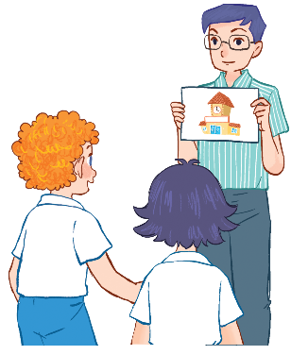
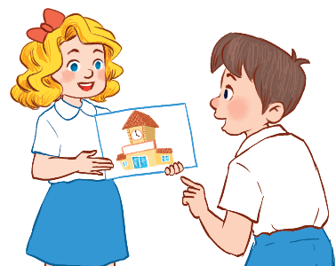
6. Let’s sing.
Our school
Is this your school?
Yes, it is. Yes, it is.
This is my school.
I like my school.
Is this our school?
Yes, it is. Yes, it is.
This is our school.
We like our school.
Notes:
Facebook : Bùi Liễu
Mobile phone: 0968142780

Slide 39
6. Let’s sing.
Our school
Is this your school?
Yes, it is. Yes, it is.
This is my school.
I like my school.
Is this our school?
Yes, it is. Yes, it is.
This is our school.
We like our school.
Notes:
Facebook : Bùi Liễu
Mobile phone: 0968142780

Slide 40
Wrap up

Slide 41
Review
school
classroom
library
playground
Notes:
Facebook : Bùi Liễu
Mobile phone: 0968142780

Slide 42
Structures
Hỏi và trả lời về các phòng ở trường học.
- Is this our _____?
+Yes, it is/ No, it isn’t.
isn’t = is not
(Đây có phải là ____ của chúng ta không?)
(Vâng, đúng rồi./Không, không phải.

Slide 43
Homework
Facebook : Bùi Liễu
0968142780
Learn by heart all the new words.
Read again the dialogue in part 1.

Slide 44
Facebook : Bùi Liễu
0968142780
Thank you!
Notes:
Facebook : Bùi Liễu
0968142780

