Slide 1
Travelling with Doraemon
By Huyen Trang

Slide 2
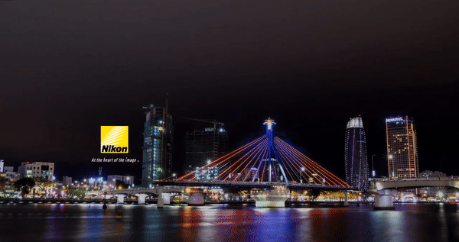
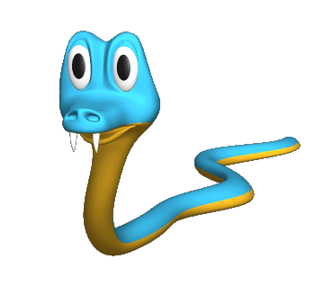
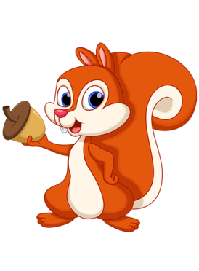
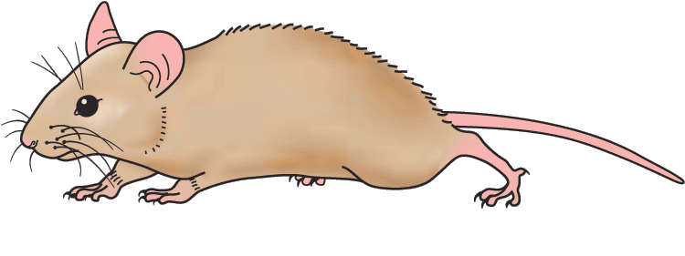
Han River bridge
Danang Vietnam
Question
A.
B.
A. wrong
B. right

Slide 3
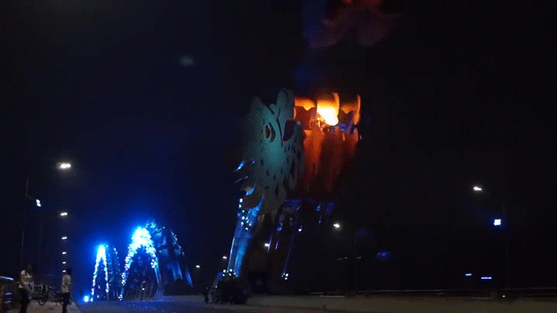
Question
A.
B.
Dragon bridge
Danang Vietnam
A. right
B. wrong

Slide 4
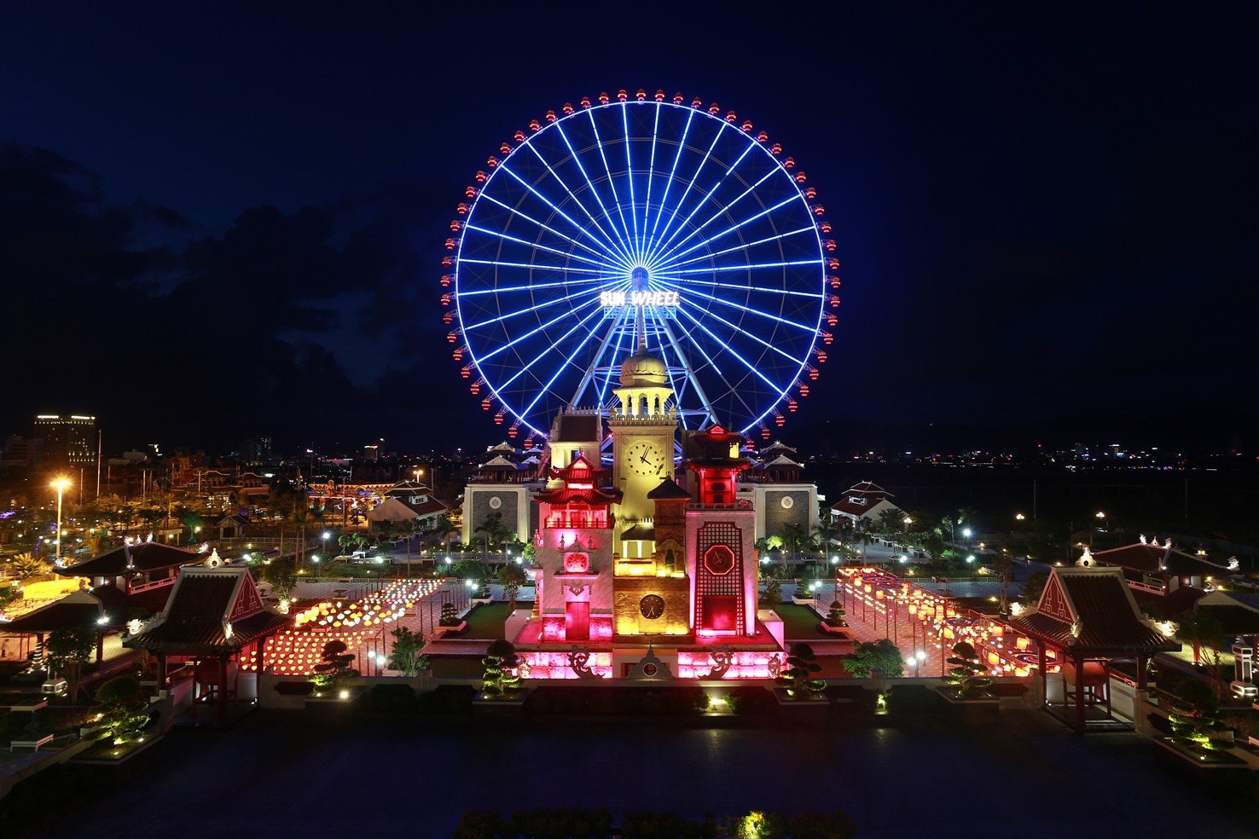
Question
A.
B.
Asia Park
Danang Vietnam
A. right
B. wrong

Slide 5
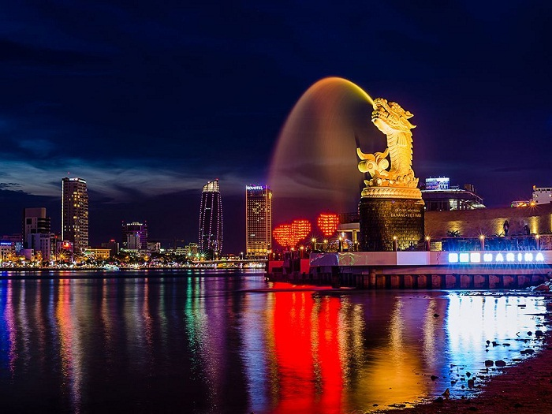
Love bridge
Danang Vietnam
Question
A.
B.
A. wrong
B. right

