Slide 1


Slide 2
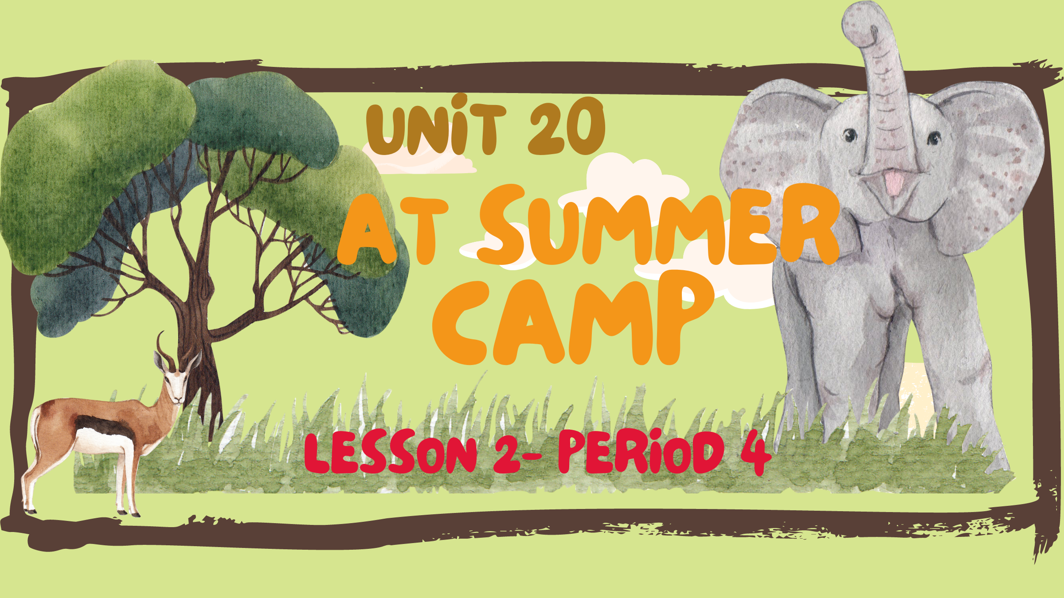

Slide 3


Table of Contents
Listen and tick.
Look, complete
and read.
01
02
03
Warm-up
04
Let’s sing.
05
Fun corner

Slide 4
01
Warm-up

Slide 5
What are they doing?

Slide 6
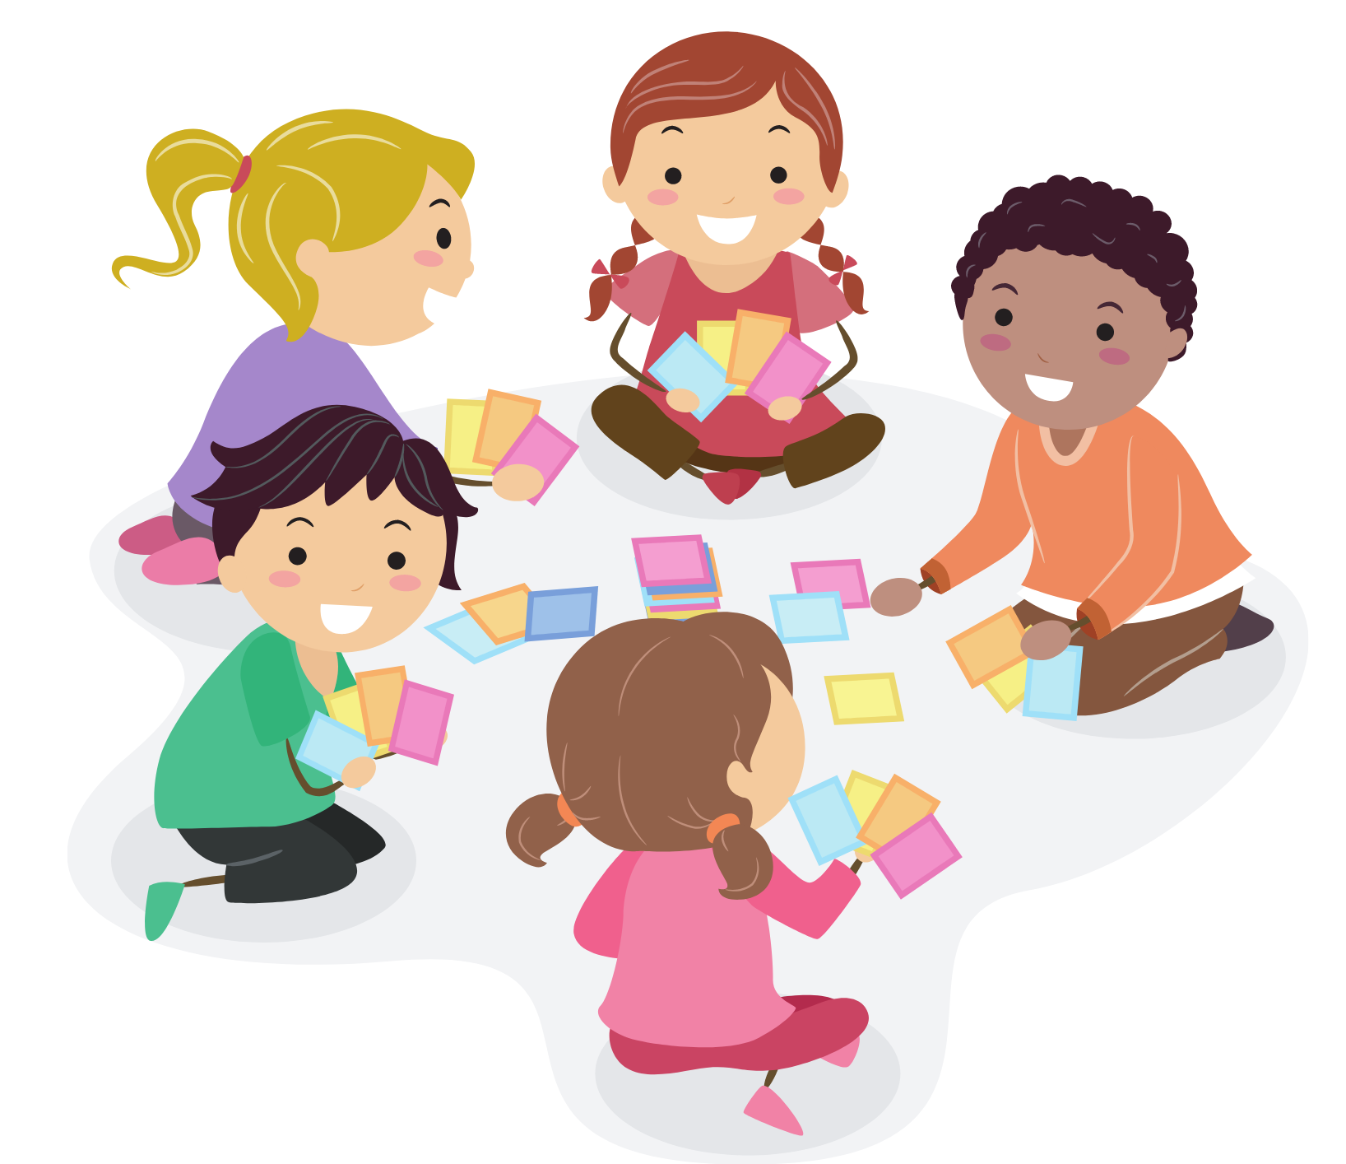
They’re playing card games.

Slide 7
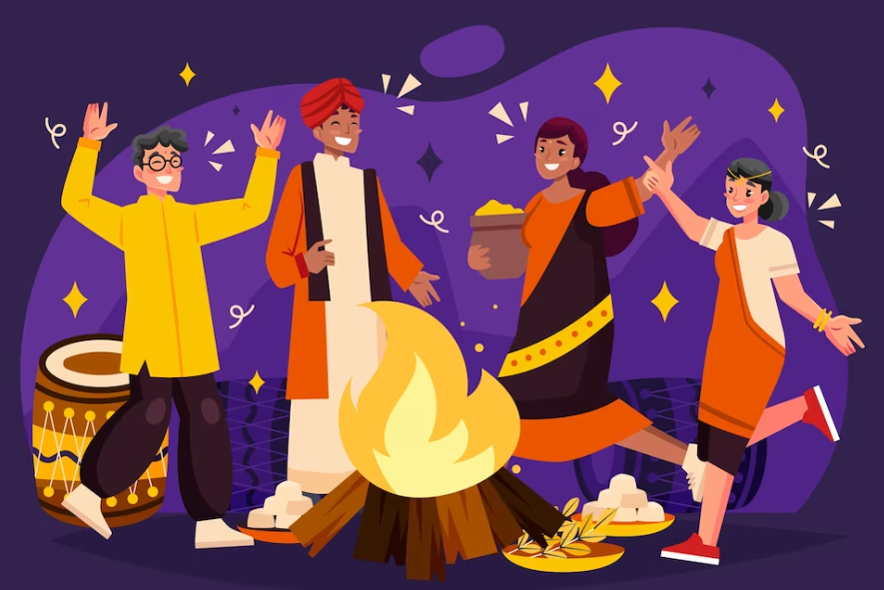
They’re dancing around the campfire.

Slide 8
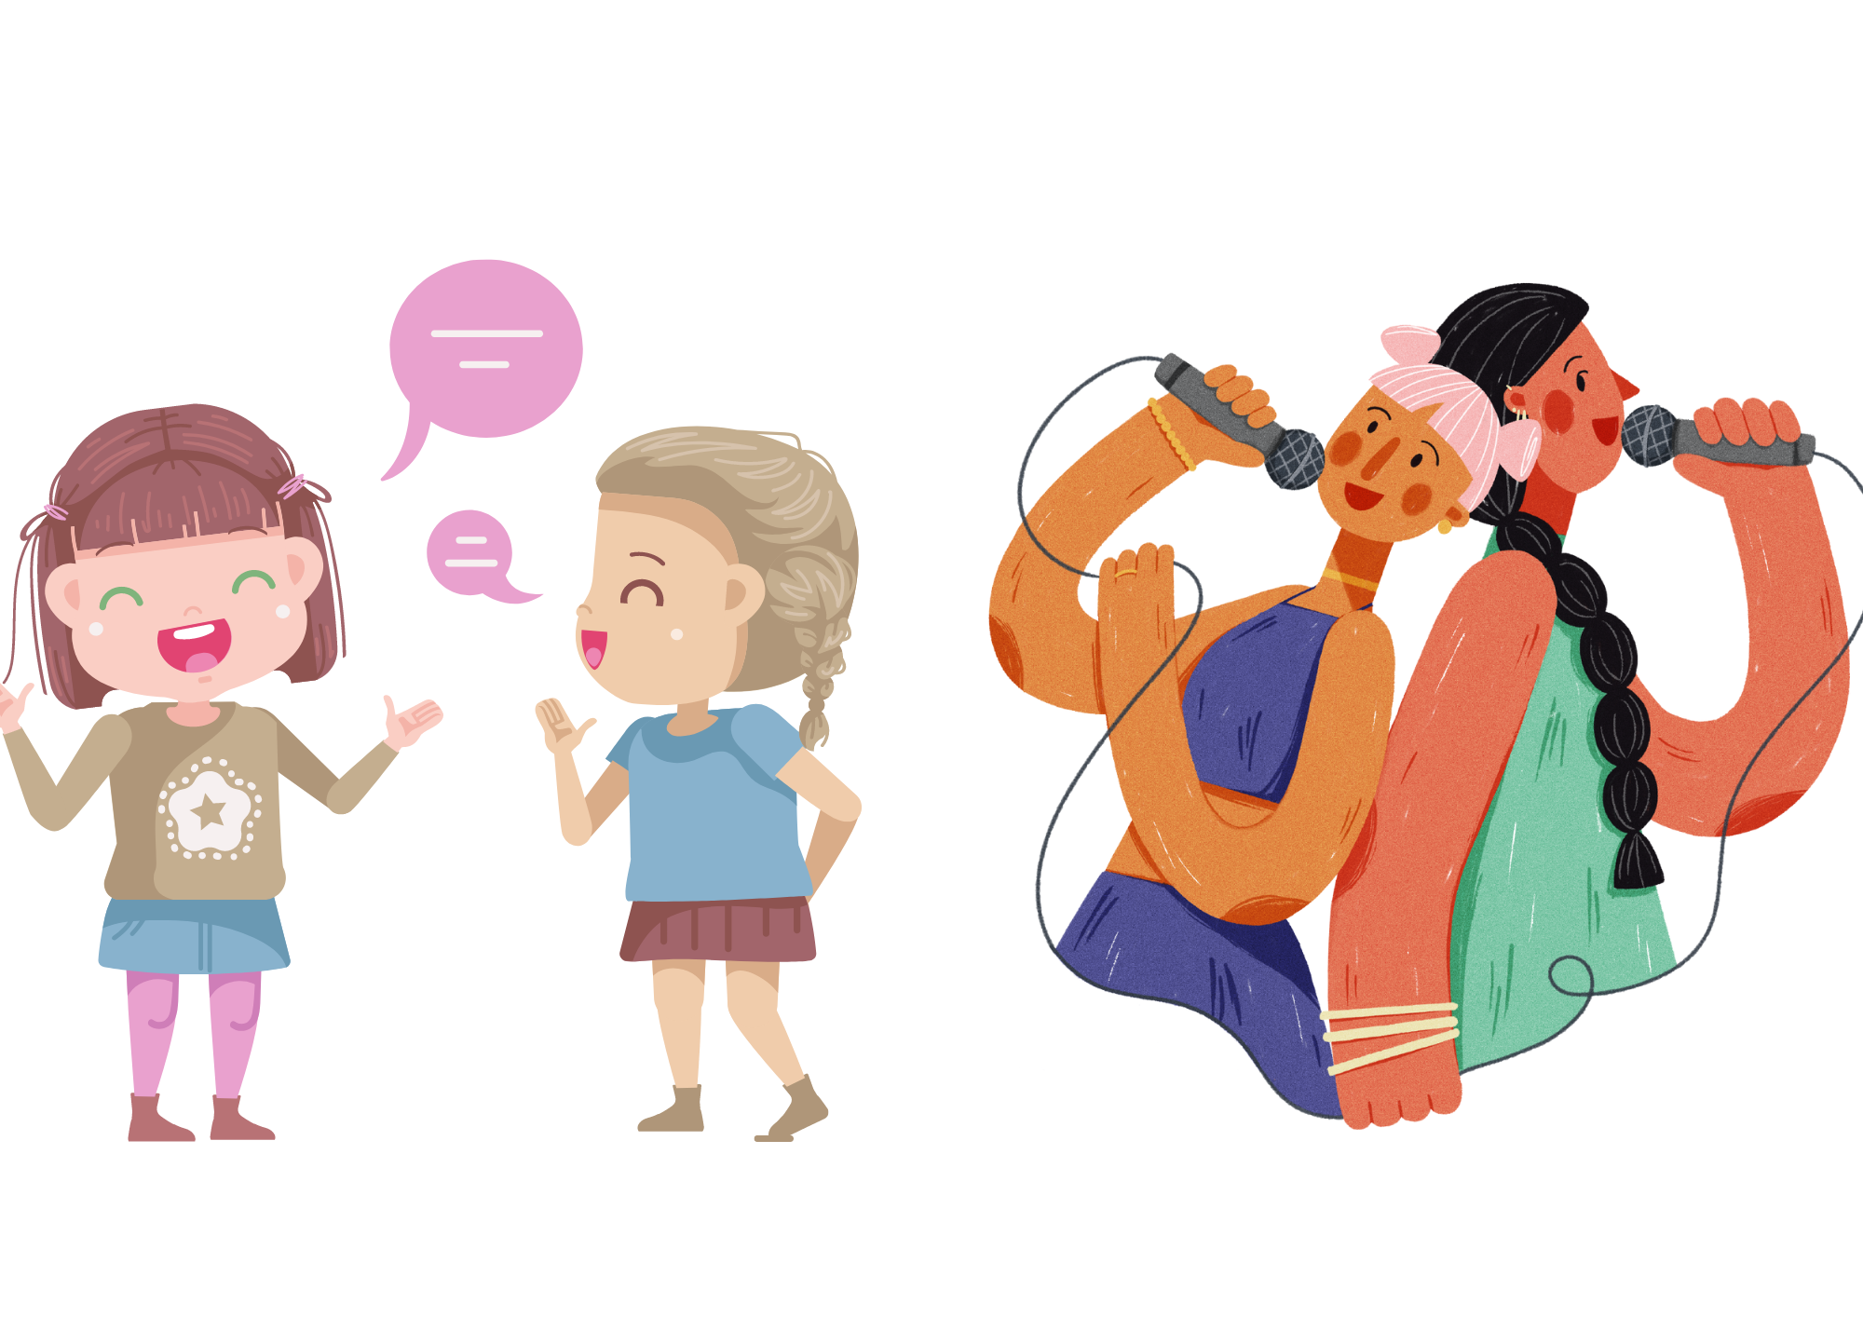
They’re singing songs.

Slide 9
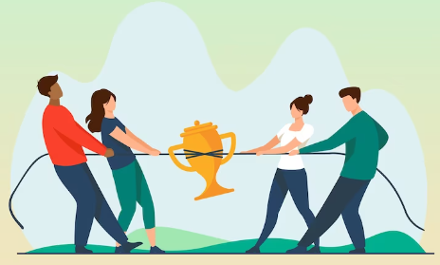
They’re playing
tug of war.

Slide 10
02
Activity 4
Listen and tick.

Slide 11


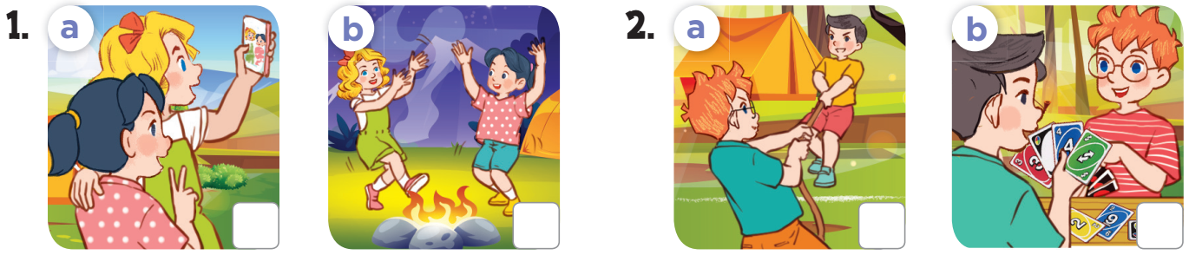


Slide 12
03
Activity 5
Look, complete and read.

Slide 13

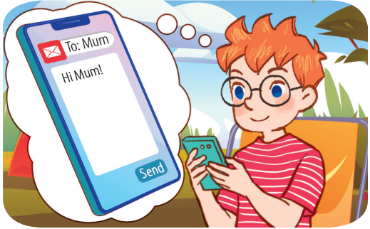
1. A: Where’s Ben?
B: He’s at the
________.
A: What’s he ____?
B: He’s emailing his
mother.
campsite
doing

Slide 14
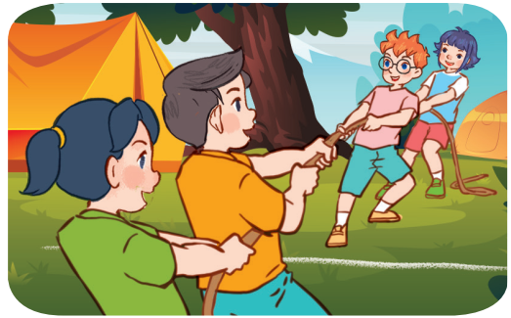
1. A: I want to see Nam and Mai.
_____ are they?
B:They’re at the
campsite.
A: ____ are they
doing?
B: They’re _______________.
Where
What
playing tug of war

Slide 15
04
Activity 6
Let’s sing.

Slide 16

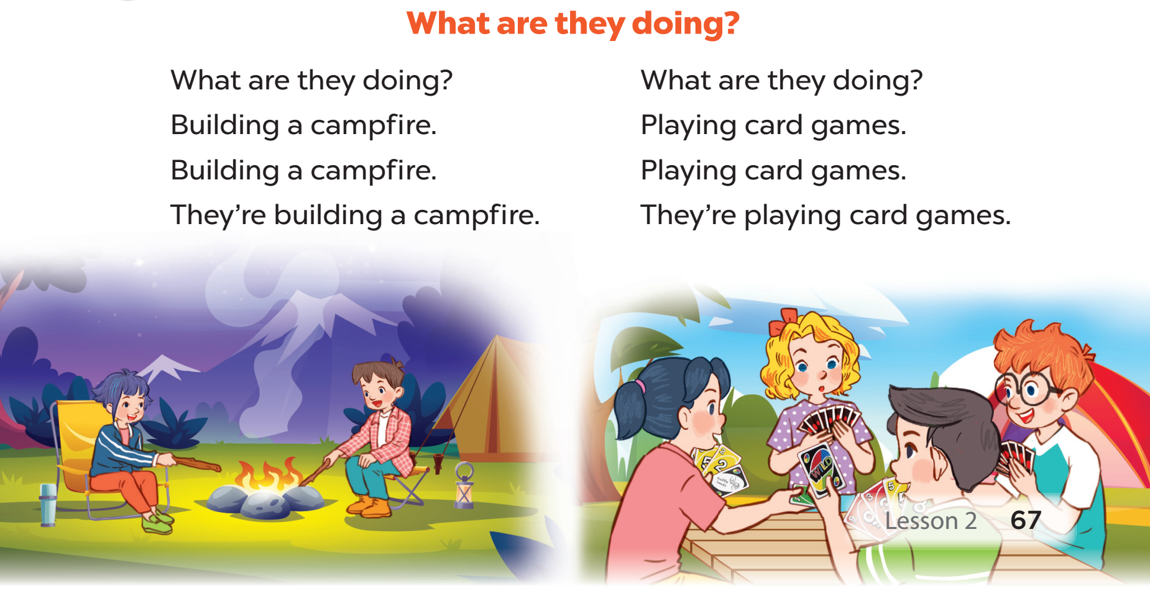

Slide 17
05
FUN CORNER

Slide 18


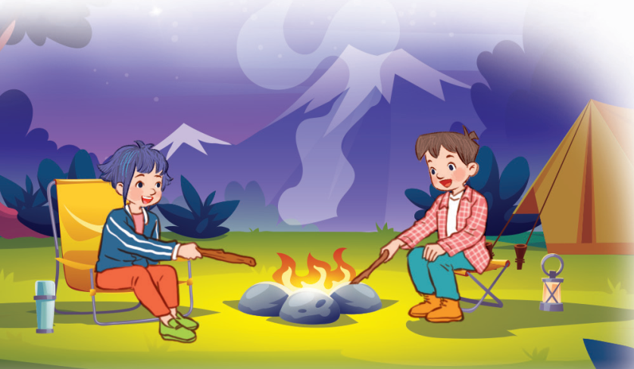




What are they doing?
Building a campfire.
Playing card games.
Dancing.

Slide 19
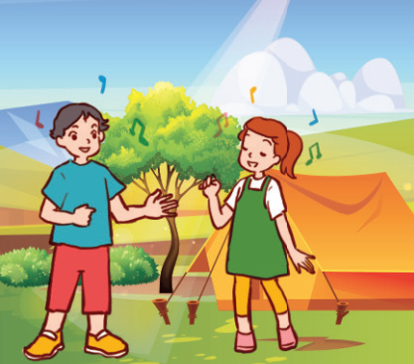
Where are they?
At the campsite.
At school.
At home.

Slide 20
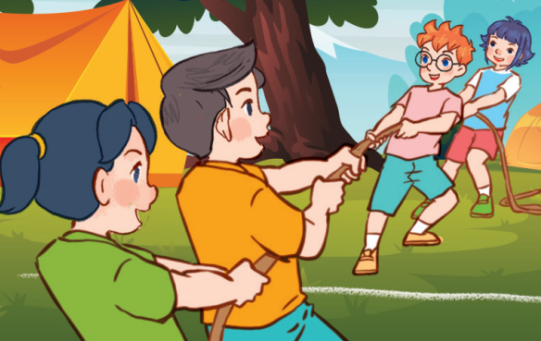
What are they doing?
Doing homework.
Playing tug of war.
Playing card games.

Slide 21
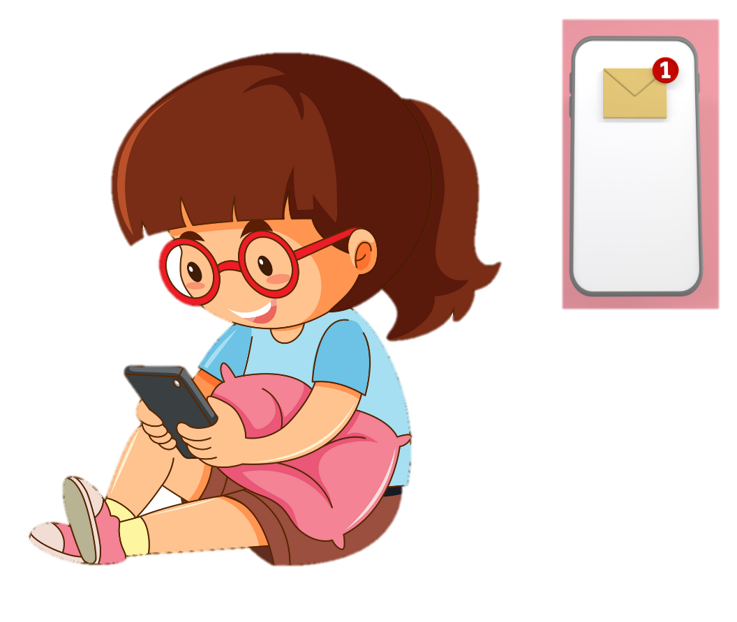
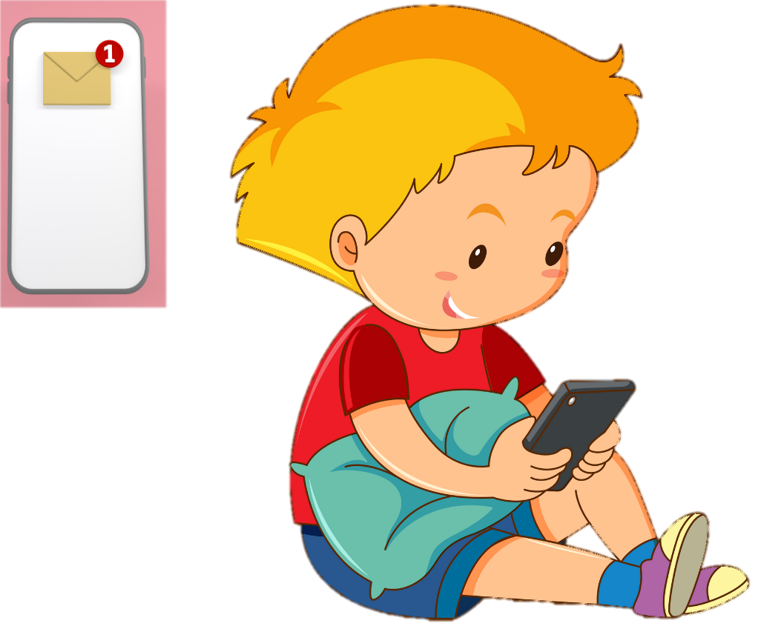
What are they doing?
Playing.
Singing.
Emailing.

Slide 22

Website: hoclieu.vn
Fanpage: facebook.com/www.tienganhglobalsuccess.vn

