Slide 1
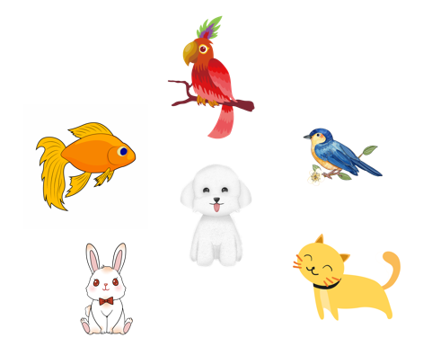
..................................
My pets
Unit
16
Lesson 3 (1+2+3)
Facebook : Bùi Liễu
0968142780

Slide 2


Warm-up

Slide 3



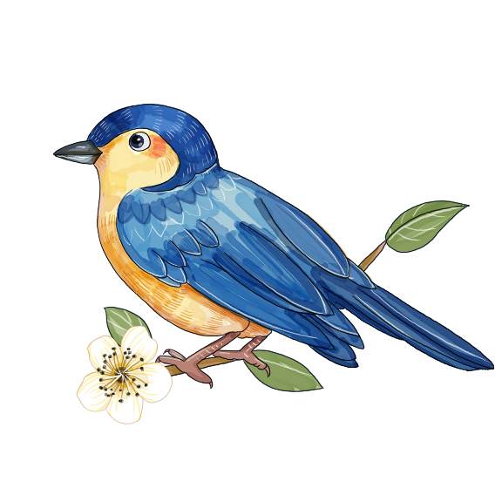
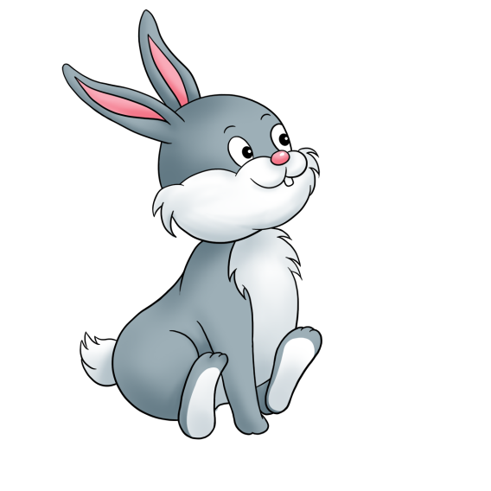



10
Game: Listen and choose
Time’s up
A B C

Slide 4


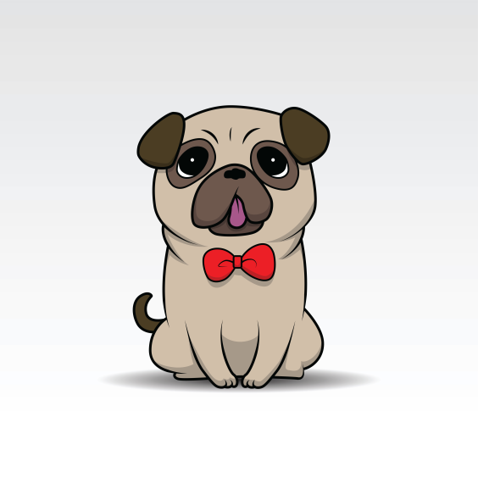

10
Time’s up
A B C

Slide 5
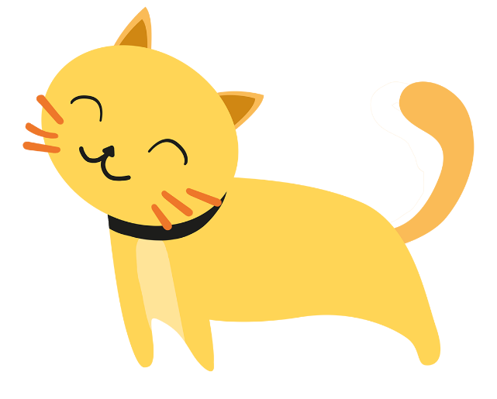
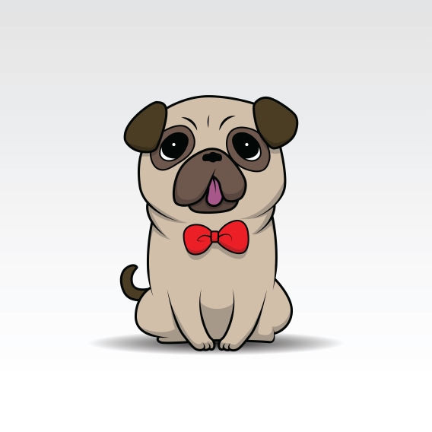

10
Time’s up
A B C

Slide 6


10
Time’s up
A B C

Slide 7
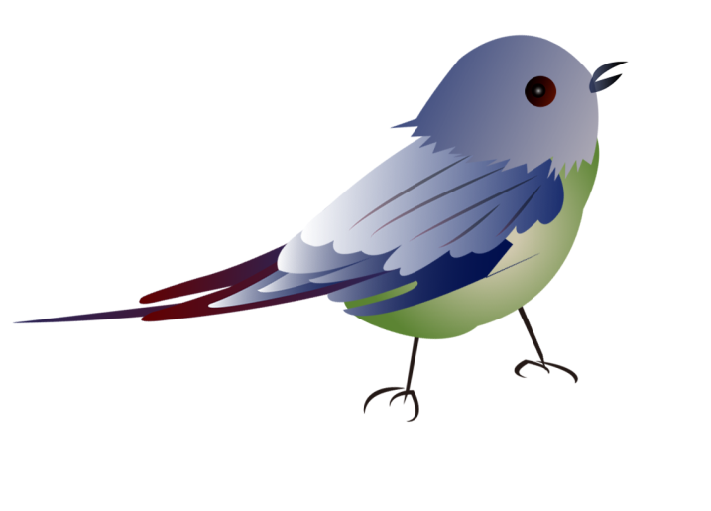

10
Time’s up
A B C

Slide 8
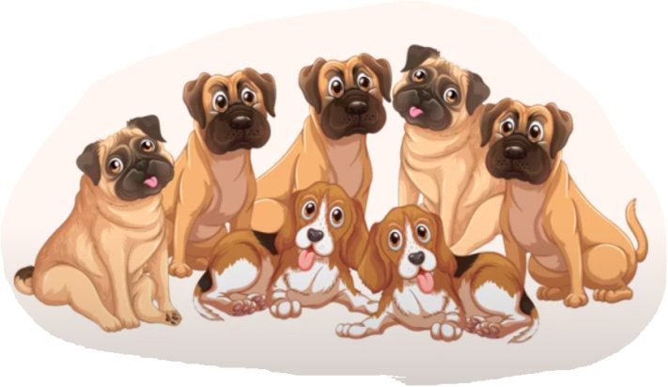
10
Time’s up
Bùi Liễu
A B C

Slide 9
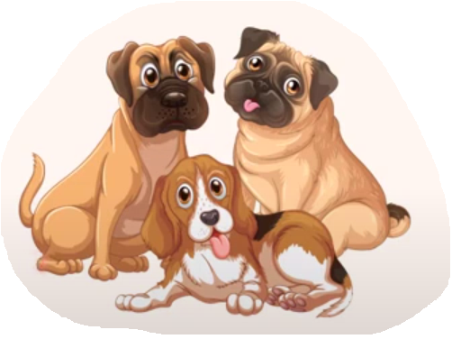
10
Time’s up
A B C

Slide 10

10
Time’s up
dog
A B C

Slide 11


10
Time’s up
goldfish
A B C

Slide 12

10
How many dogs do you have?
I have some.
Time’s up
A B C

Slide 13

10
How many dogs do you have?
I have many.
Time’s up
A B C

Slide 14
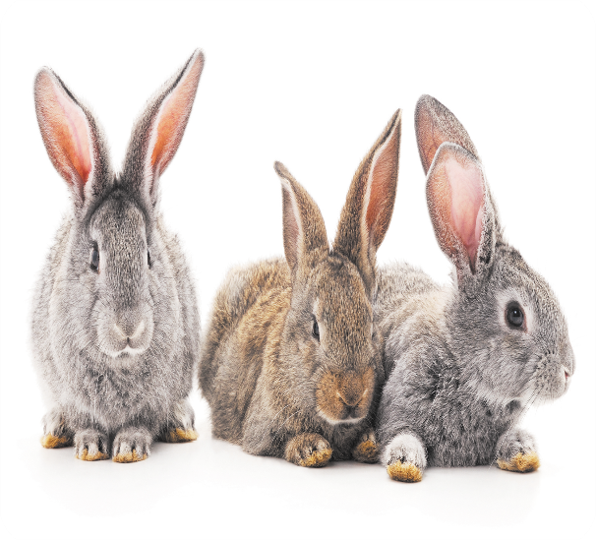
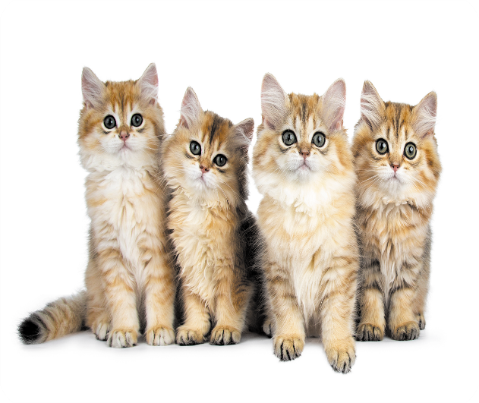
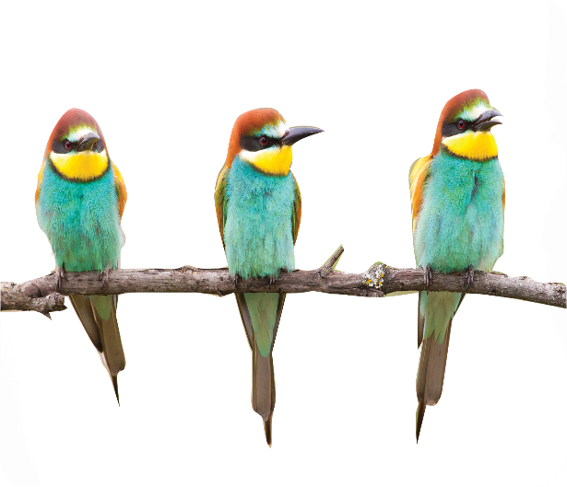
10
Do you have any rabbits?
Yes, I do.
Time’s up
Bùi Liễu
A B C

Slide 15

Thank you!

Slide 16



Contents
Facebook : Bùi Liễu
0968142780
Listen and repeat.
Listen and circle.
Let’s chant.

Slide 17

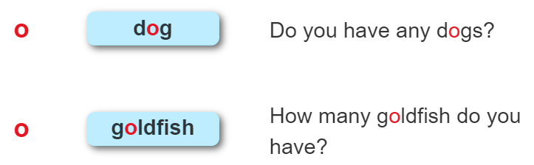
1. Listen and repeat.

Slide 18
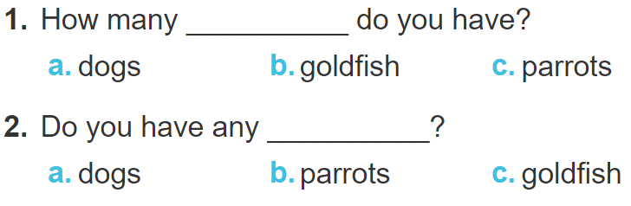
2. Listen and circle.

Slide 19
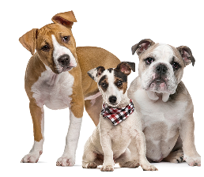
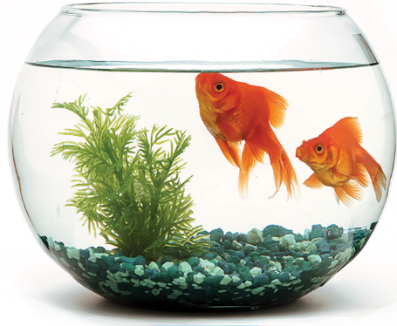
3. Let’s chant.
Dogs, dogs, dogs.
Do you have any dogs?
Do you have any dogs?
Goldfish, goldfish, goldfish.
Yes, I do.
How many goldfish do you have?
Yes, I do.
How many goldfish do you have?
I have some goldfish.
I have some goldfish.

Slide 20

Wrap up

Slide 21

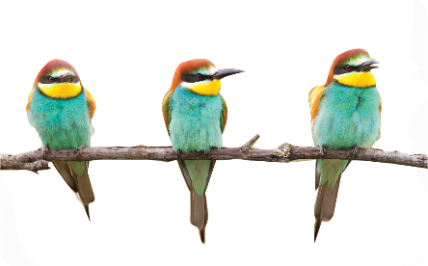
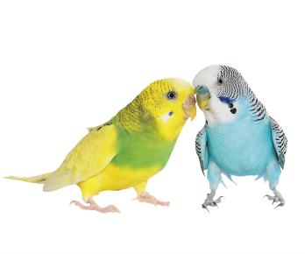
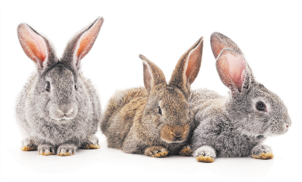
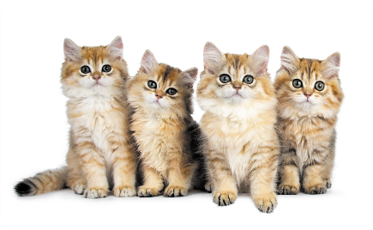
Vocabulary
pets
birds
parrots
rabbits
cats

Slide 22
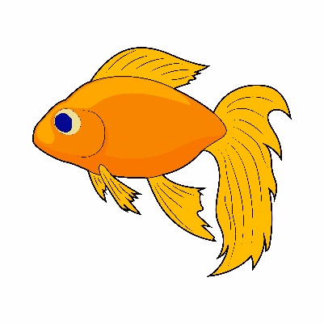
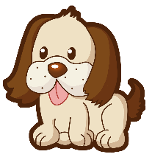

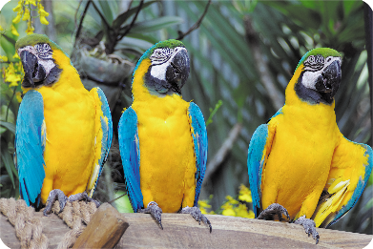
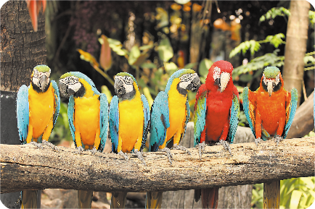
Vocabulary
dogs
goldfish
some
many

Slide 23
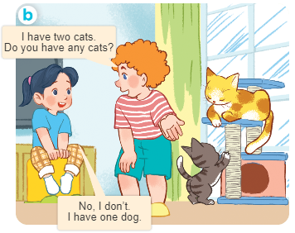
Structures
Cách hỏi bạn có loại thú cưng nào không.
- Do you have any ________?
+ Yes, I do.
+ No, I don’t.

Slide 24
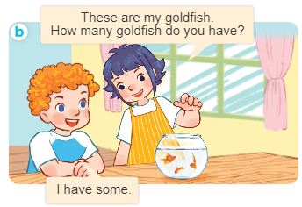
Structures
Cách hỏi và trả lời về số lượng vật nuôi.
- How many _____ do you have?
I have __________.

Slide 25

Facebook : Bùi Liễu
0968142780
Thank you!

