Slide 1
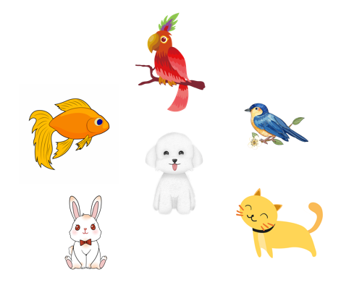
..................................
My pets
Unit
16
Lesson 2 (1+2+3)
Facebook : Bùi Liễu
0968142780

Slide 2

Warm-up

Slide 3

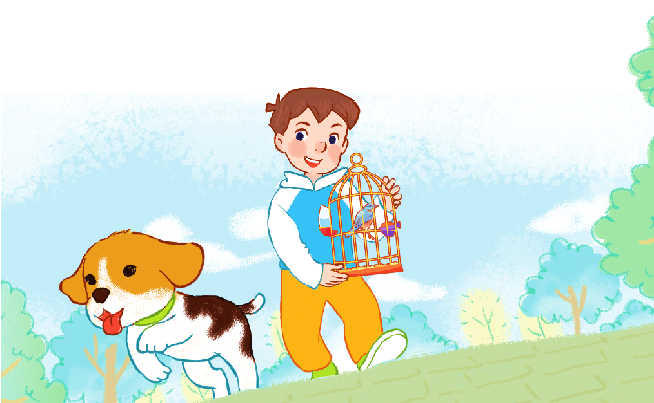
Let’s sing.
My pets
Do you have any dogs?
Do you have any cats?
Do you have any dogs?
Do you have any cats?
Yes, I do.
No, I don’t.
Yes, I do.
No, I don’t.
I have one dog.
I have one bird.

Slide 4



Contents
Facebook : Bùi Liễu
0968142780
Look, listen and repeat.
Listen, point and say.
Let’s talk.

Slide 5

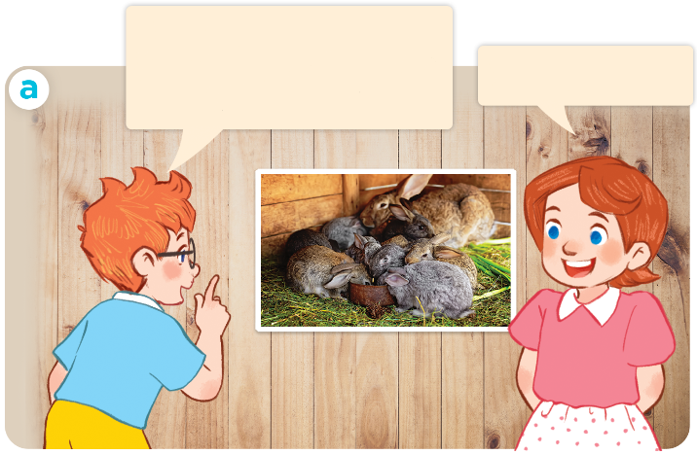
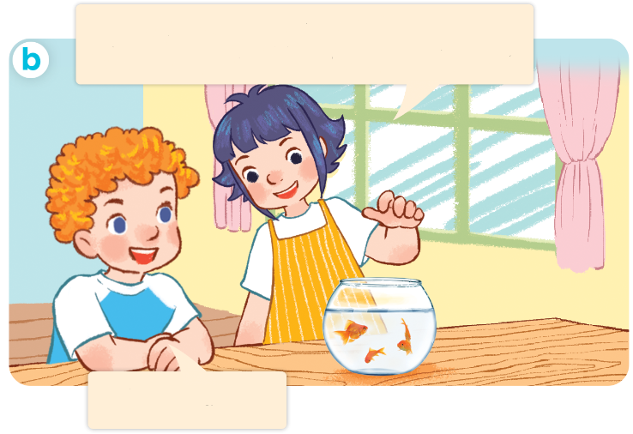
I have two rabbits. How many rabbits do you have?
1. Look, listen and repeat.
Click on the sentences to hear.
I have two rabbits.
How many rabbits do you have?
These are my goldfish. How many goldfish do you have?
I have many.
I have some.
Who are they?
Where are they?
What are they doing?

Slide 6
Vocabulary

Slide 7



dog
dogs
/dɒɡ/
/dɒɡz/
con chó
những con chó

Slide 8

goldfish
/ˈɡəʊld.fɪʃ/
con cá vàng

Slide 9
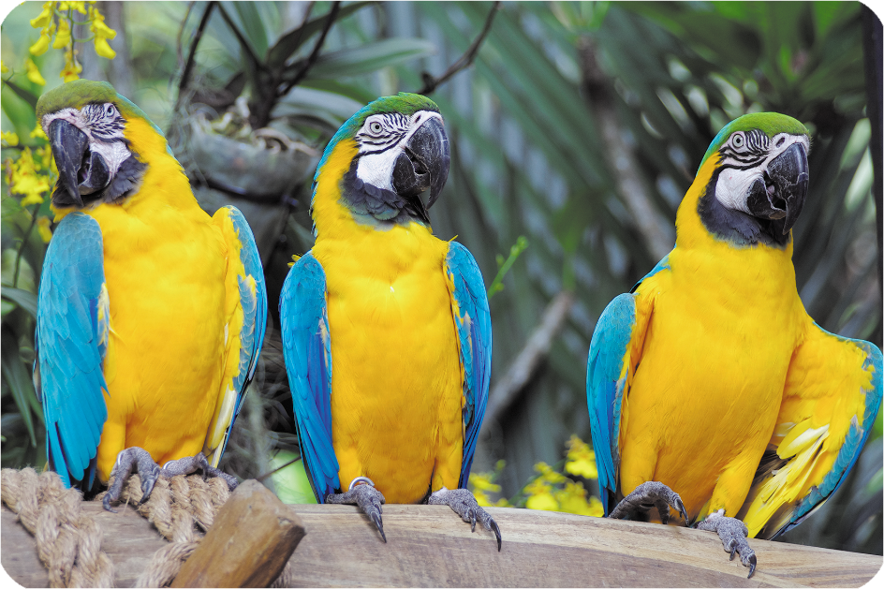
some
/sʌm/
một vài

Slide 10
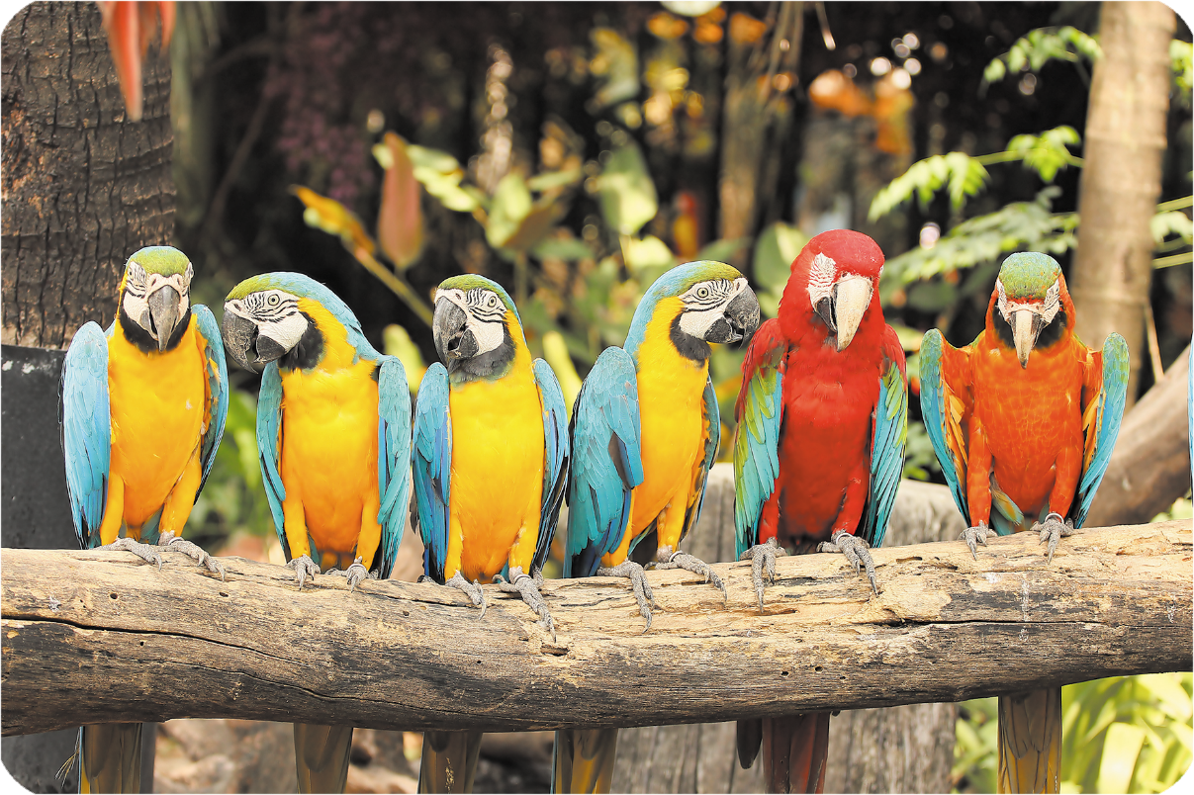
many
/ˈmen.i/
nhiều

Slide 11





Review
dogs
goldfish
some
many

Slide 12
Checking vocabulary
dogs
các con chó
goldfish
cá vàng
some
một vài
many
nhiều

Slide 13
Structures

Slide 14
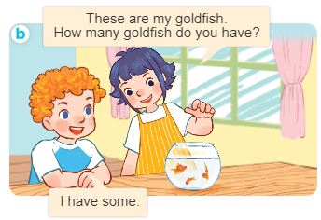
Structures
Cách hỏi và trả lời về số lượng vật nuôi.
- How many _____ do you have?
I have __________.

Slide 15


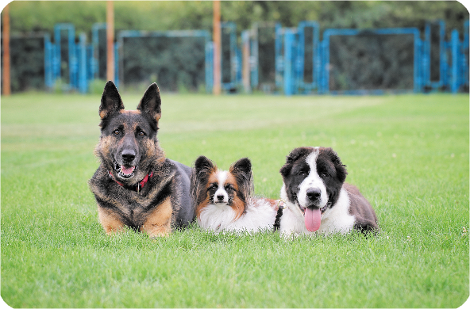
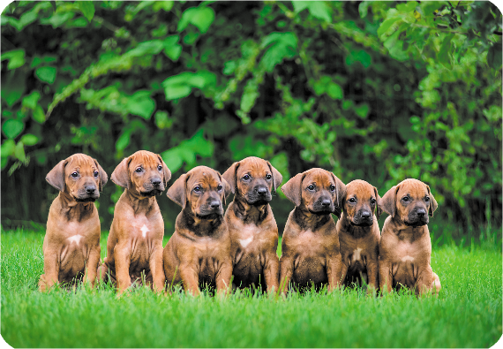
2. Listen, point and say.
How many _____ do you have?
a
b
parrots / some
parrots / many
I have ____.
c
d
dogs / some
dogs / many

Slide 16
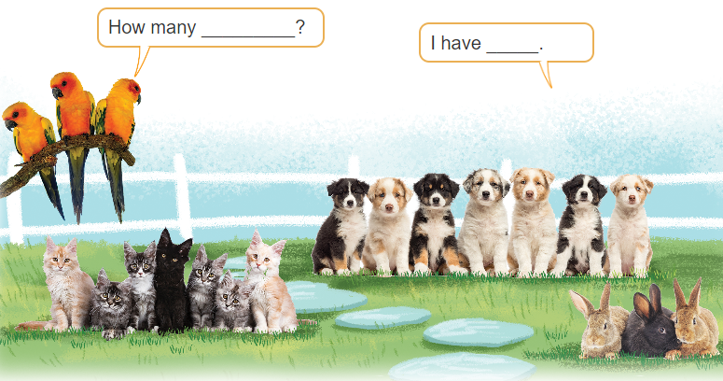
3. Let’s talk

Slide 17

Facebook : Bùi Liễu
0968142780
Let’s play!

Slide 18



1
2
3
✔
dog

Slide 19

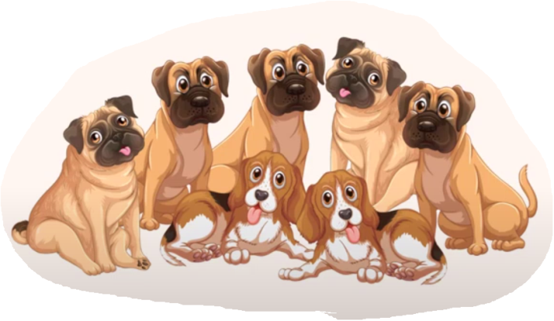
1
2
3
✔
goldfish

Slide 20
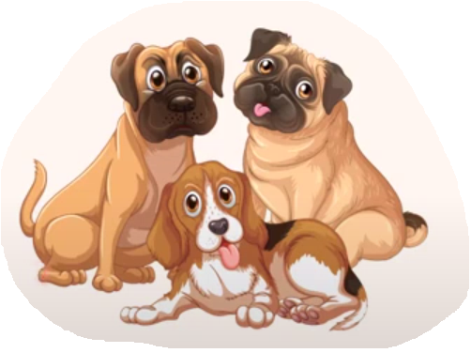

1
2
3
✔
many

Slide 21

1
2
3
✔
some

Slide 22

1
2
3
some
many
goldfish
✔

Slide 23
a. cat
b. goldfish
c. dog

Slide 24
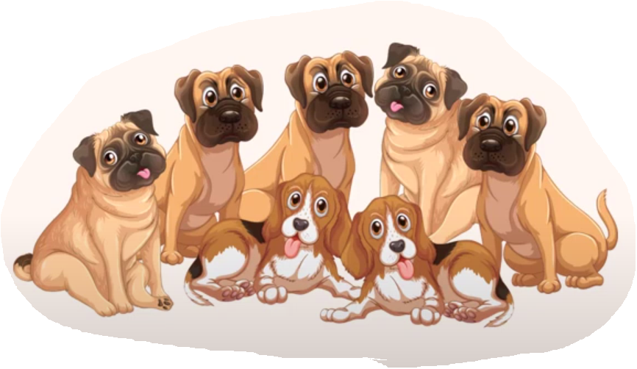
a. some
b. many
c. cat

Slide 25
a. goldfish
b. many
c. some

Slide 26
How many dogs do you have?
a. I have many.
b. I have dogs.
c. I have some.

Slide 27

How many dogs do you have?
a. I have many.
b. I have cat.
c. I have some.

Slide 28

Facebook : Bùi Liễu
0968142780
WELL DONE!

Slide 29

Wrap up

Slide 30
Review
dogs
goldfish
some
many

Slide 31
Structures
Cách hỏi và trả lời về số lượng vật nuôi.
- How many _____ do you have?
I have __________.

Slide 32

Facebook : Bùi Liễu
0968142780
Thank you!

