Slide 1
..................................
At the dining table
Unit
15
Lesson 3 (1+2+3)
Facebook : Bùi Liễu
0968142780

Slide 2

Warm up

Slide 3
Let’s play!

Slide 4





PLAY

Slide 5

Ms Huyền Phạm
0936.082.789

Slide 6

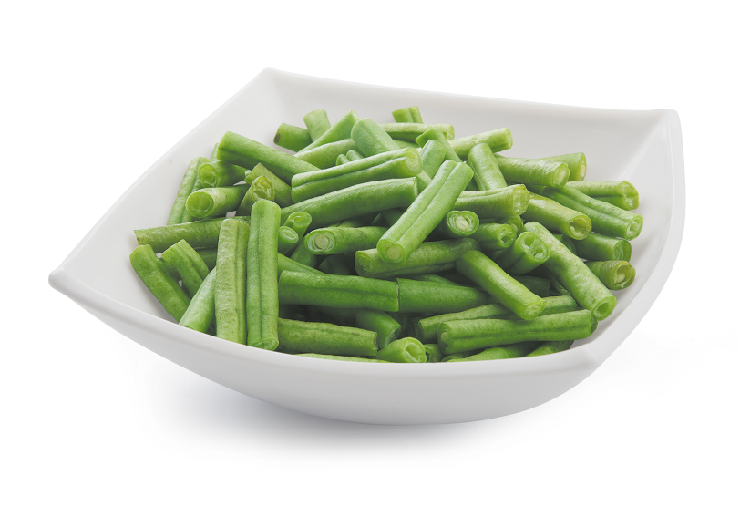

B. beans
Click the clock to start the timer.
A. chicken
C. meat
Time out

Slide 7
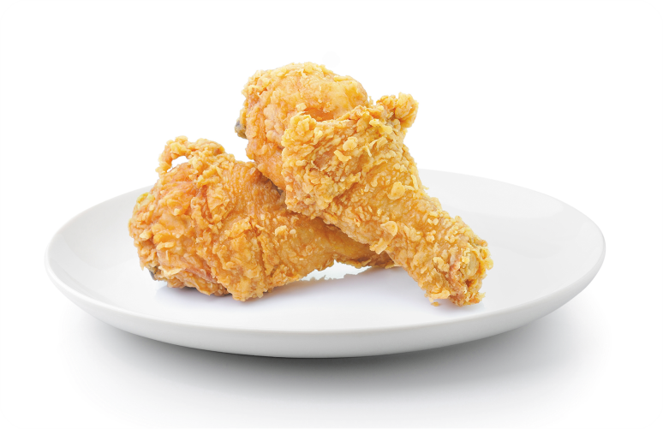
B. e
Click the clock to start the timer.
A. a
C. i
Time out
ch_cken

Slide 8

B. milk
Click the clock to start the timer.
A. chicken
C. fish
Time out

Slide 9

B. milk
Click the clock to start the timer.
A. juice
C. egg
Time out

Slide 10
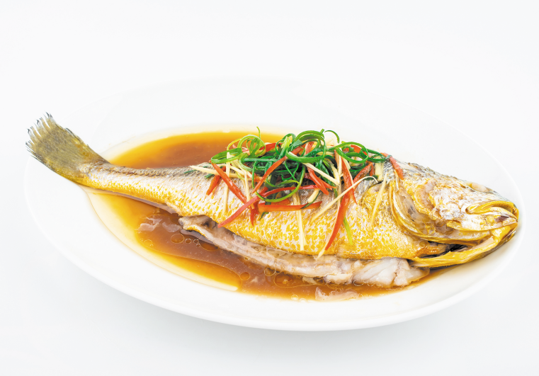
B. i
Click the clock to start the timer.
A. a
C. e
Time out
f_sh

Slide 11
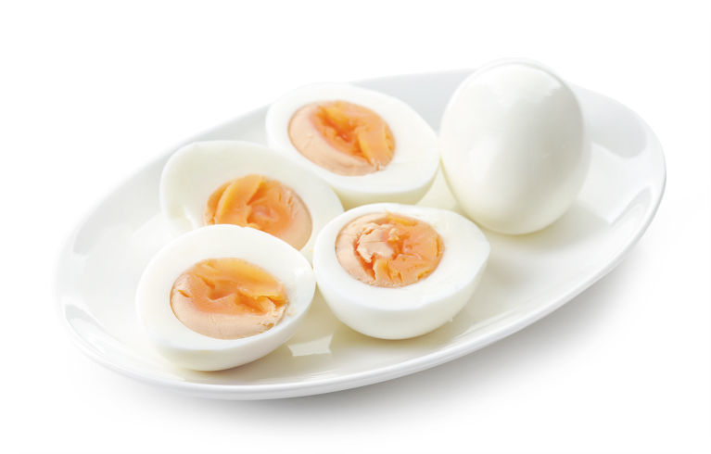
B. milk
Click the clock to start the timer.
A. chicken
C. eggs
Time out

Slide 12

Click the clock to start the timer.
A. I’d like some water, please.
B. I’d like some milk, please.
Time out
What would you like to drink?

Slide 13

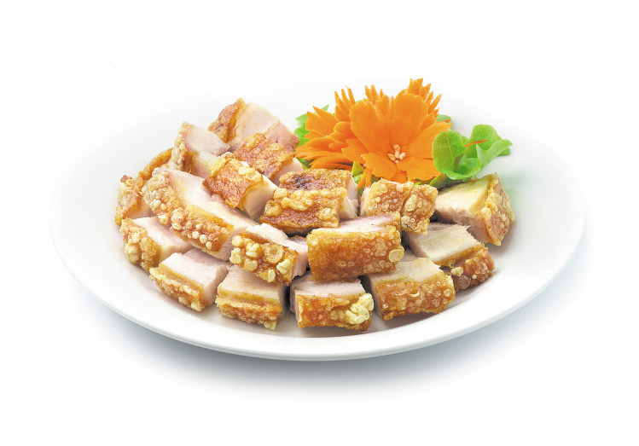
Click the clock to start the timer.
A. Yes, please.
B. No, thanks.
Time out
Would you like some meat?

Slide 14


Click the clock to start the timer.
A. No, thanks.
B. Yes, please.
Time out
Would you like some water?

Slide 15

B. chicken
Click the clock to start the timer.
A. egg
C. milk
Time out
What would you like to eat?
I’d like some____, please.

Slide 16

Click the clock to start the timer.
A. drink
B. eat
Time out
What would you like to___?
I’d like some fish, please.

Slide 17

Click the clock to start the timer.
A. What would you like to eat?
B . What would you like to drink?
Time out
____________________?
I’d like some eggs, please.

Slide 18
Click the clock to start the timer.
A. What
B . Where
Time out
____ would you like to eat?
I’d like some eggs, please.

Slide 19




EXIT

Slide 20



Contents
Facebook : Bùi Liễu
0968142780
Listen and repeat.
Listen and tick.
Let’s chant.

Slide 21

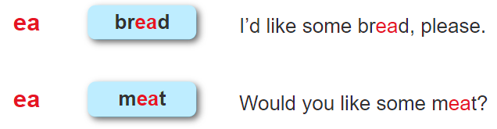
1. Listen and repeat.

Slide 22
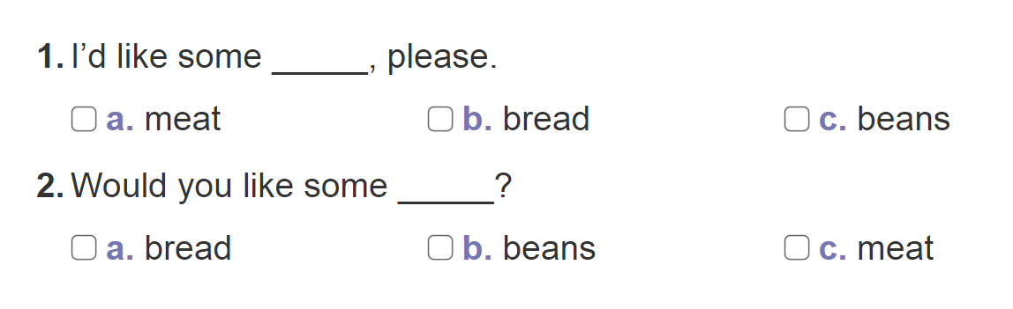


2. Listen and tick.

Slide 23
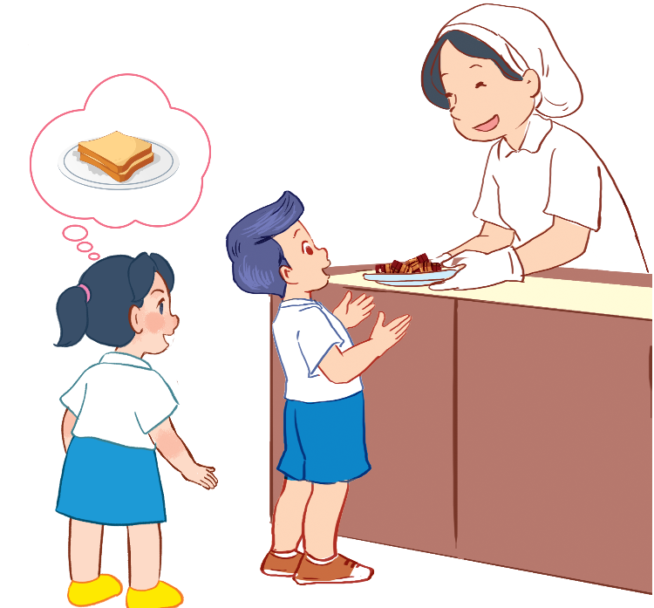
Facebook : Bùi Liễu
0968142780
3. Let’s chant.
Bread, bread, bread.
What would you like to eat?
Some bread, please.
Bread, bread, bread.
Meat, meat, meat.
Would you like some meat?
Yes, please. Yes, please.
Meat, meat, meat.

Slide 24

3. Let’s chant.
Bread, bread, bread.
What would you like to eat?
Some bread, please.
Bread, bread, bread.
Meat, meat, meat.
Would you like some meat?
Yes, please. Yes, please.
Meat, meat, meat.
Facebook : Bùi Liễu
0968142780

Slide 25

Wrap up

Slide 26








Review
food
rice
fish
meat
bean
beans
juice

Slide 27
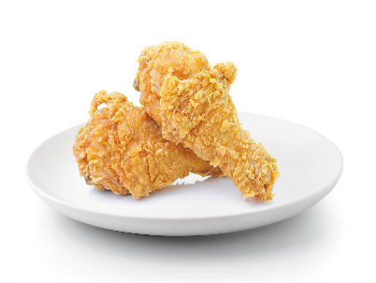







Review
eat
drink
bread
egg
chicken
drink
water
milk

Slide 28
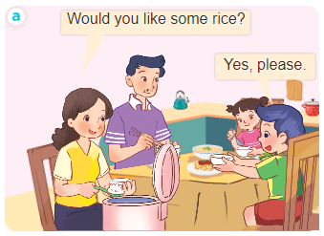
Structures
Mời ai ăn (uống) đồ ăn/nước uống.
- Would you like some ______?
+ Yes, please.
+ No, thanks.

Slide 29
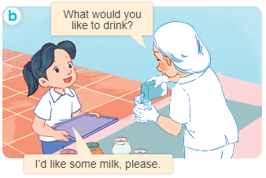
Structures
Hỏi người khác muốn ăn/uống gì.
- What would you like to eat/drink?
+ I’d like some ___, please.

Slide 30

Facebook : Bùi Liễu
0968142780
Thank you!

