Slide 1
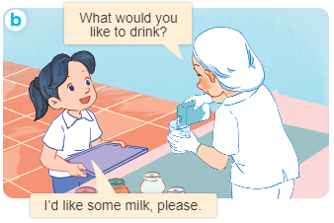
..................................
At the dining table
Unit
15
Lesson 2 (4+5+6)
Facebook : Bùi Liễu
0968142780

Slide 2
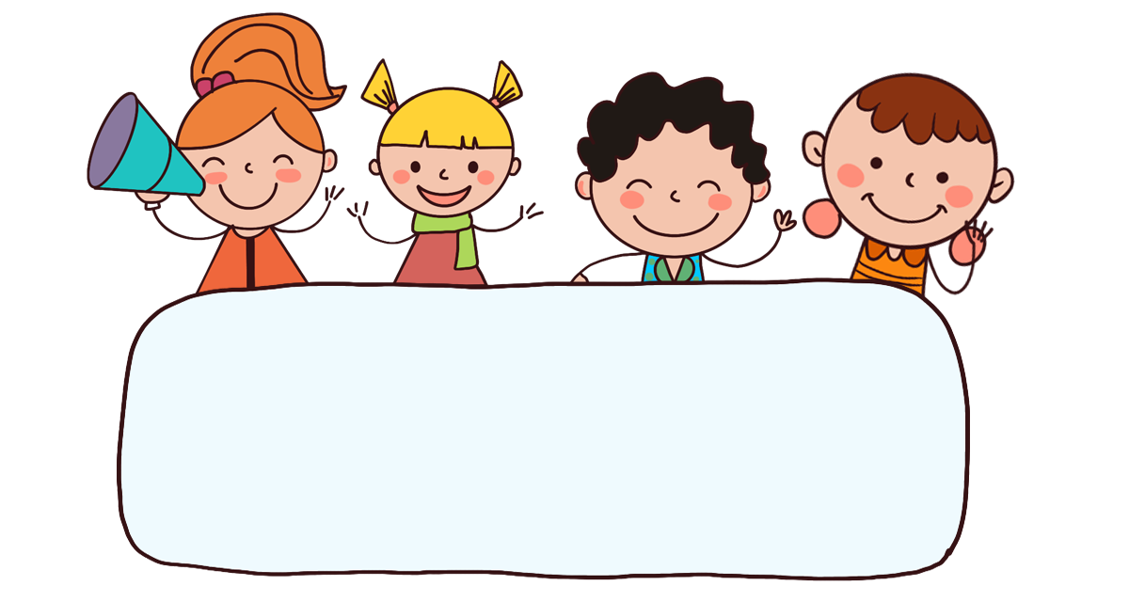
Warm-up

Slide 3


Facebook : Bùi Liễu
0968142780
Let’s play!

Slide 4







Slide 5







br_ad
Time out
5
4
3
2
1
A. a
B. e
C. u

Slide 6
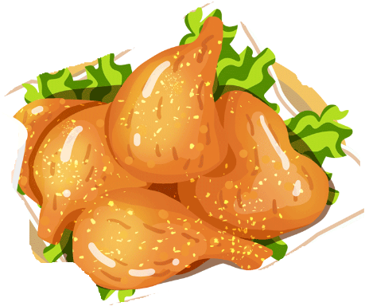
ch_ken
Time out
5
4
3
2
1
A. a
B. e
C. i

Slide 7

Time out
5
4
3
2
1
A. egg
B. water
C. milk

Slide 8

Time out
5
4
3
2
1
A. bread
B. milk
C. water

Slide 9



Time out
5
4
3
2
1
A.
B.
C.

Slide 10

What would you like to eat?
I’d like some ____, please.
Time out
5
4
3
2
1
A. chicken
B. milk
C. bread

Slide 11

_____ would you like to eat?
I’d like some egg, please.
Time out
5
4
3
2
1
A. What
B. Where
C. Who

Slide 12

What would you like to drink?
I’d like some ____, please.
Time out
5
4
3
2
1
A. egg
B. water

Slide 13
What would you like to __?
I’d like some egg, please.
Time out
5
4
3
2
1
A. eat
B. drink

Slide 14

What would you like to eat?
I’d like some ____, please.
Time out
5
4
3
2
1
A. egg
B. milk
C. chicken

Slide 15


Slide 16

Facebook : Bùi Liễu
0968142780
Thank you!

Slide 17



Contents
Facebook : Bùi Liễu
0968142780
Listen and number.
Look, complete and read.
Let’s play.

Slide 18
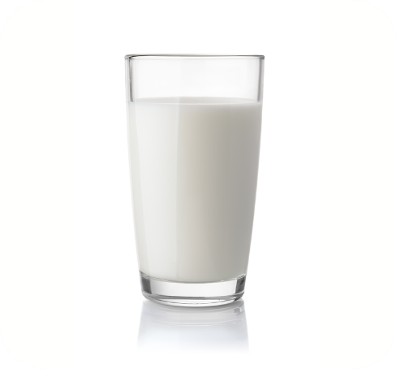

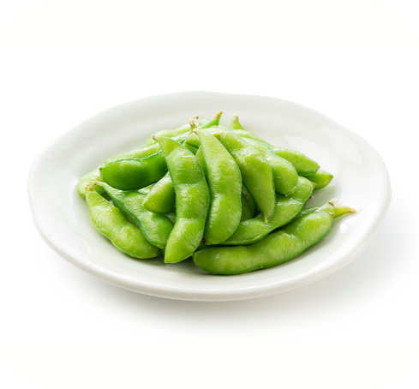
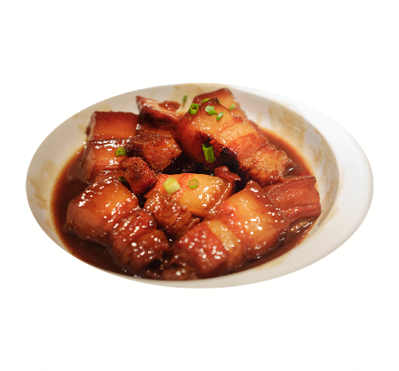





4. Listen and number.
a
b
c
d
3
4
1
2

Slide 19
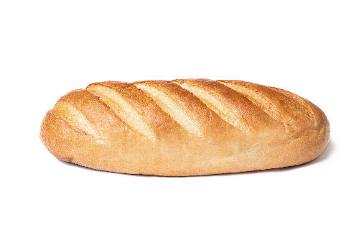
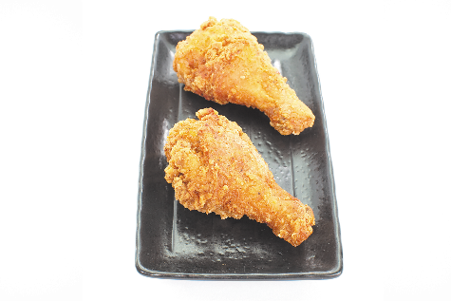


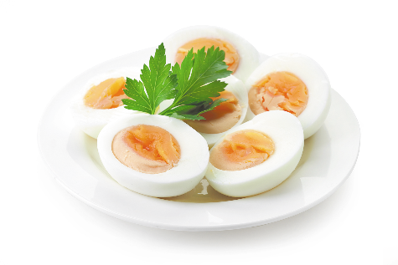
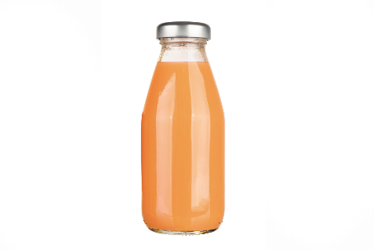
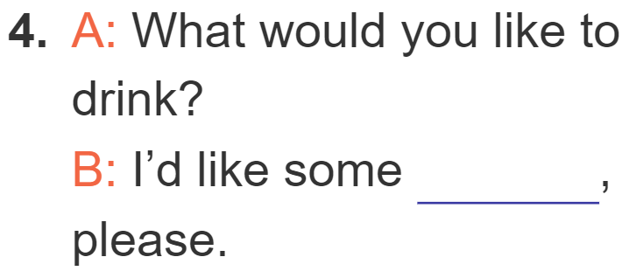
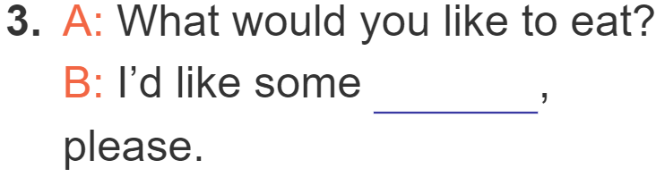
5. Look, complete and read.
bread
chicken
eggs
juice

Slide 20
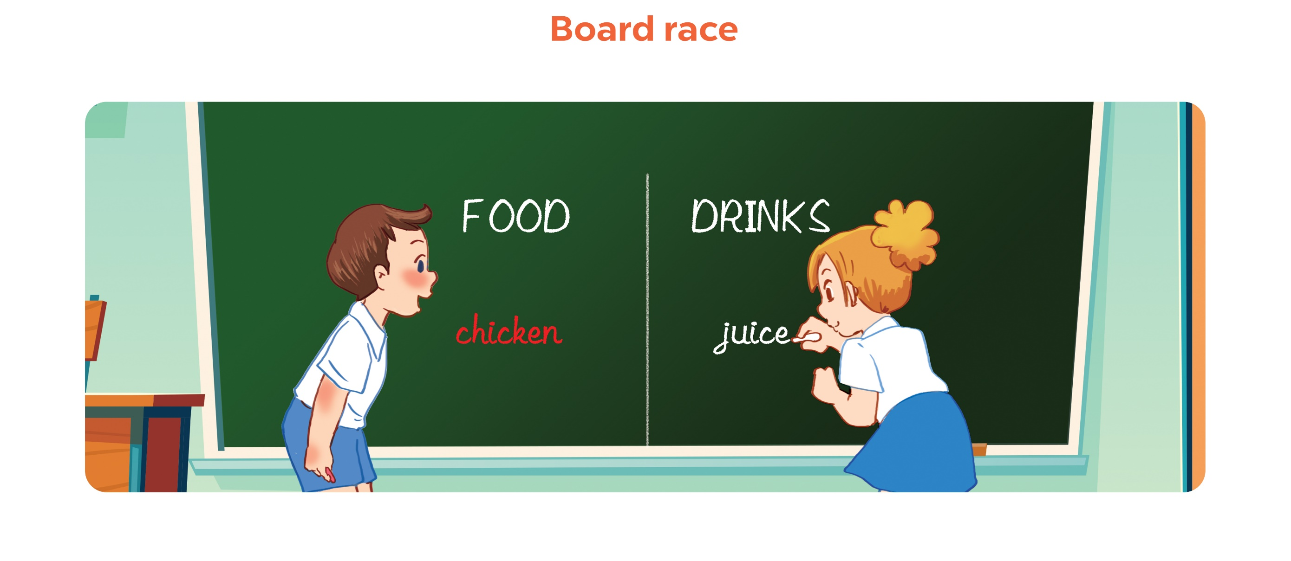
6. Let’s play.

Slide 21
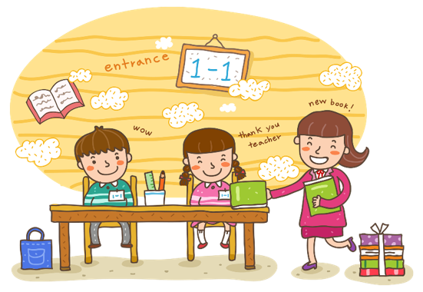
Wrap up

Slide 22
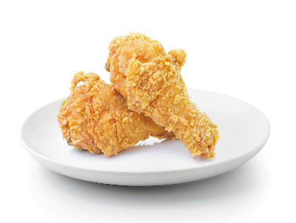
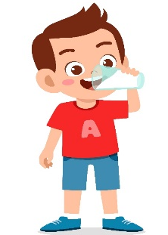






Review
eat
drink
bread
egg
chicken
drink
water
milk

Slide 23
Structures
Hỏi người khác muốn ăn/uống gì.
- What would youlike to eat/drink?
+ I’d like some ___, please.

Slide 24
Facebook : Bùi Liễu
0968142780
Thank you!

