Slide 1
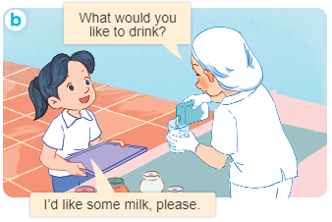
..................................
At the dining table
Unit
15
Lesson 2 (1+2+3
)
Facebook : Bùi Liễu
0968142780

Slide 2
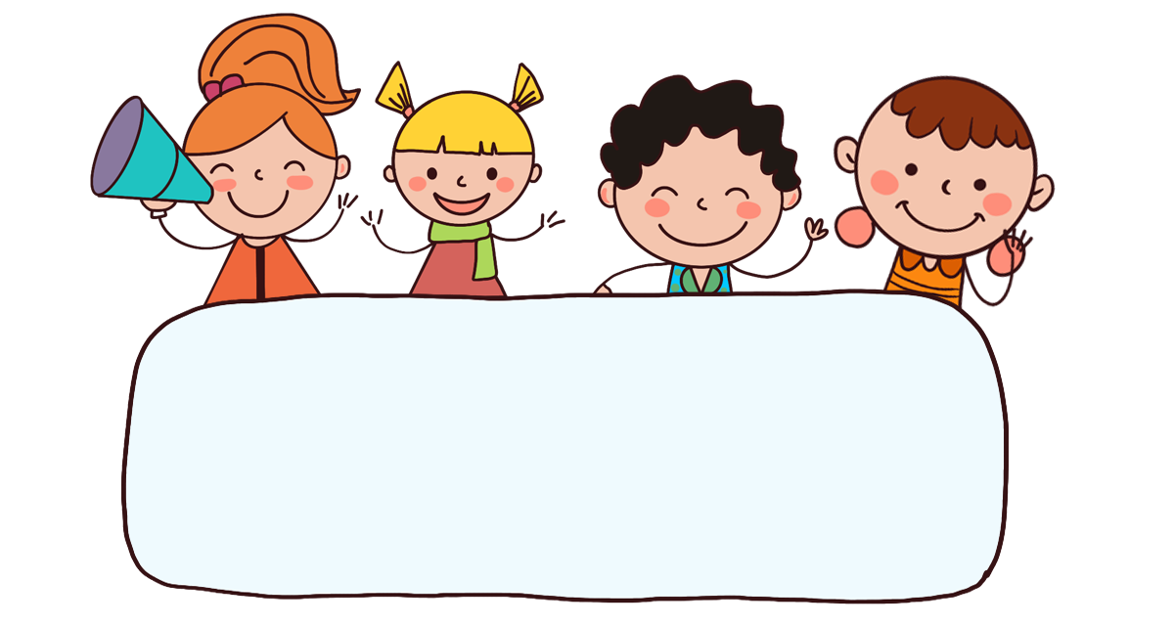
Warm-up

Slide 3

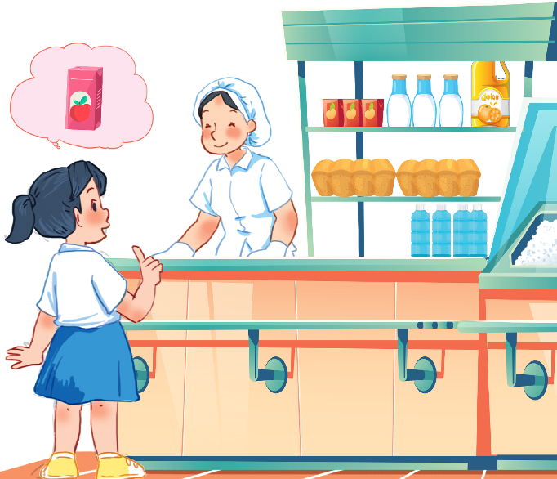
Let’s sing.
Would you like some …?
Would you like some rice?
No, thanks.
No, thanks.
Would you like some juice?
Yes, please.
Yes, please.

Slide 4



Contents
Facebook : Bùi Liễu
0968142780
Look, listen and repeat.
Listen, point and say.
Let’s talk.

Slide 5

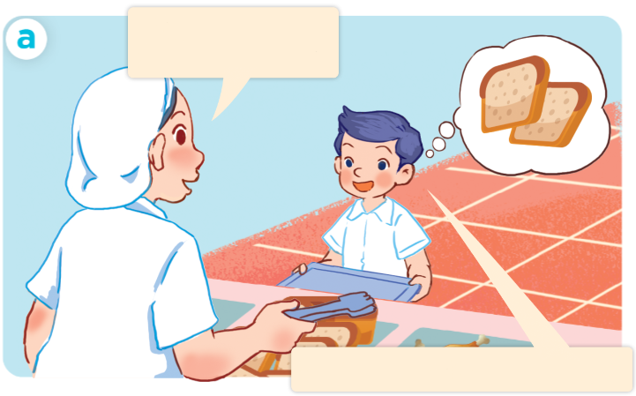
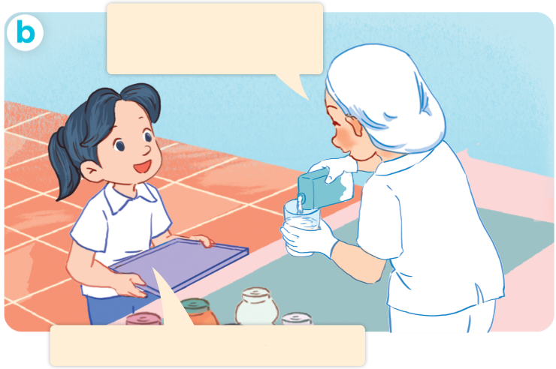
1. Look, listen and repeat.
What would you
like to eat?
What would you
like to drink?
I’d like some bread, please.
I’d like some milk, please.
Who are they?
Where are they?
What are they doing?

Slide 6
Vocabulary

Slide 7
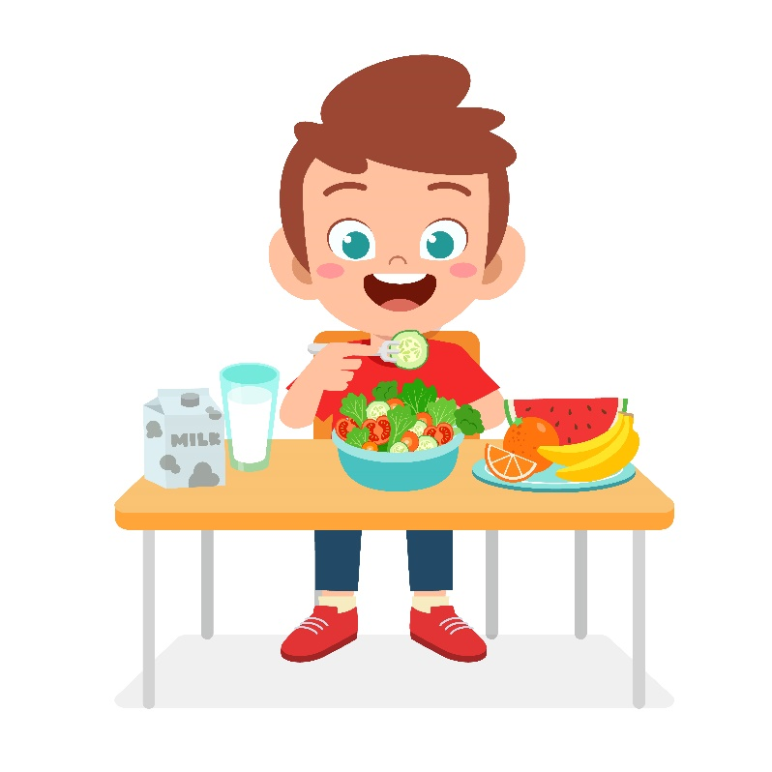

eat
/iːt/
ăn

Slide 8
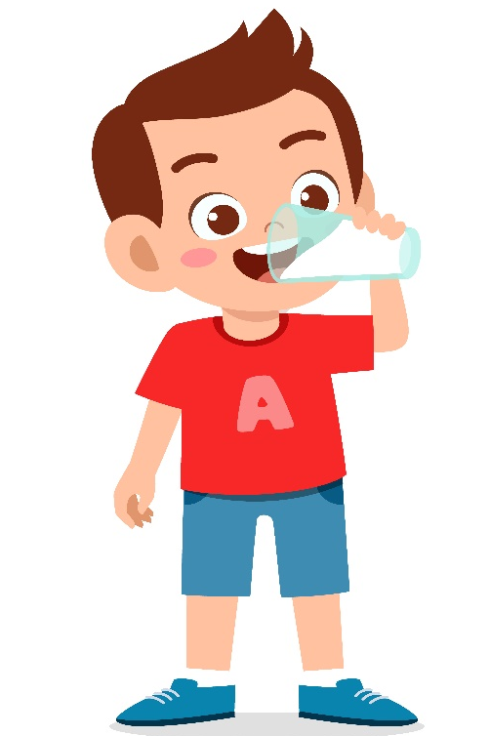
drink
/drɪŋk/
uống

Slide 9

bread
/bred/
bánh mì

Slide 10

egg
/eɡ/
quả trứng

Slide 11
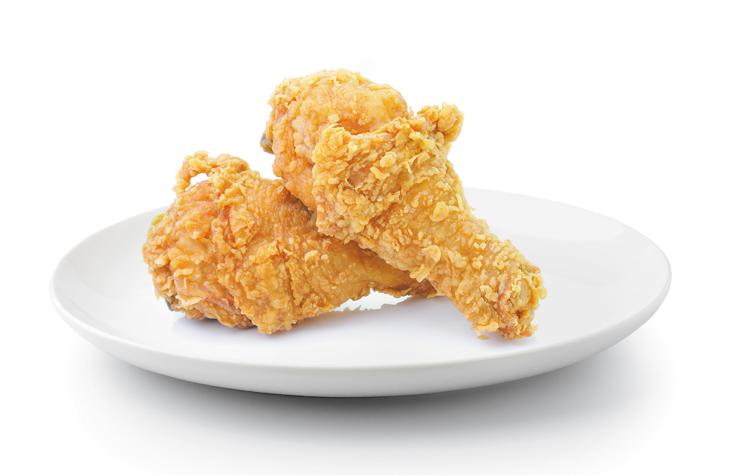
chicken
/ˈtʃɪk.ɪn/
thịt gà

Slide 12

drink
/drɪŋk/
đồ uống/thức uống

Slide 13

water
/ˈwɔː.tər/
nước

Slide 14
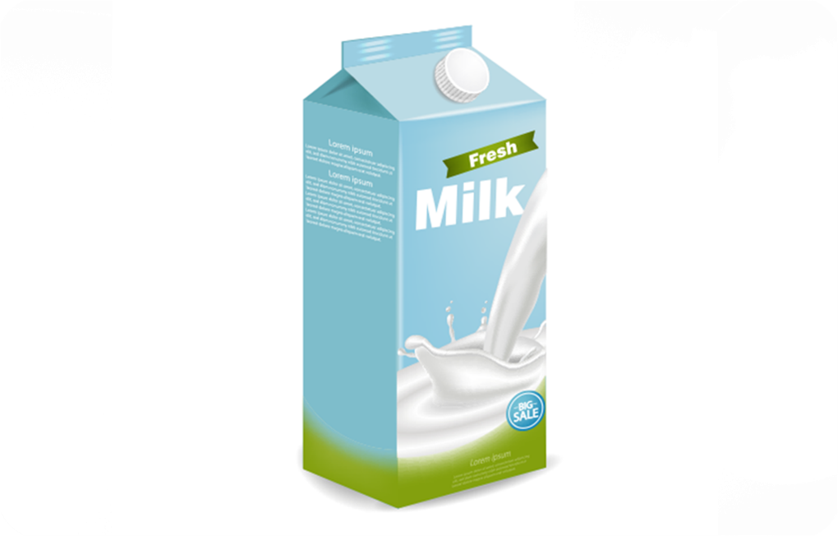
milk
/mɪlk/
sữa

Slide 15
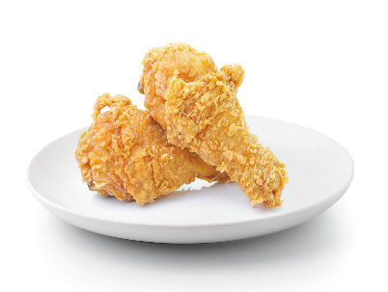
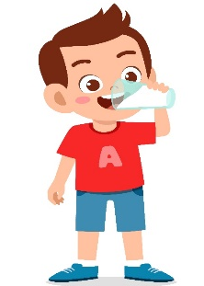



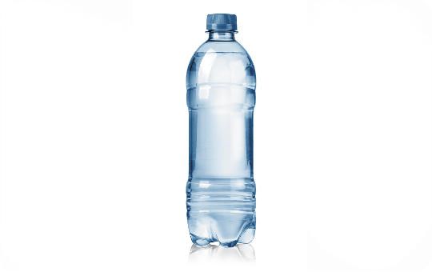

Review
eat
drink
bread
egg
chicken
drink
water
milk

Slide 16
Checking vocabulary
eat
ăn
drink
thức uống, uống
bread
bánh mì
egg
trứng
chicken
thịt gà
water
nước
milk
sữa

Slide 17
Structures

Slide 18
Structures
Hỏi người khác muốn ăn/uống gì.
- What would you like to eat/drink?
+ I’d like some ___, please.
I’d = I would

Slide 19

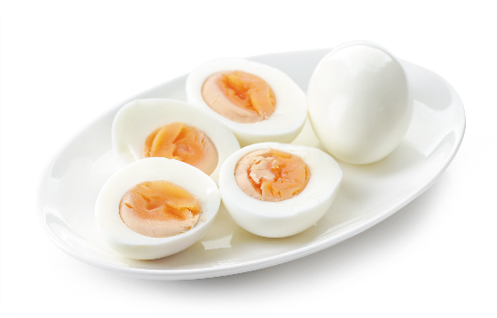


2. Listen, point and say.
What would you like to
eat / drink?
a
b
eggs
chicken
I’d like some ______.
c
d
water
milk

Slide 20
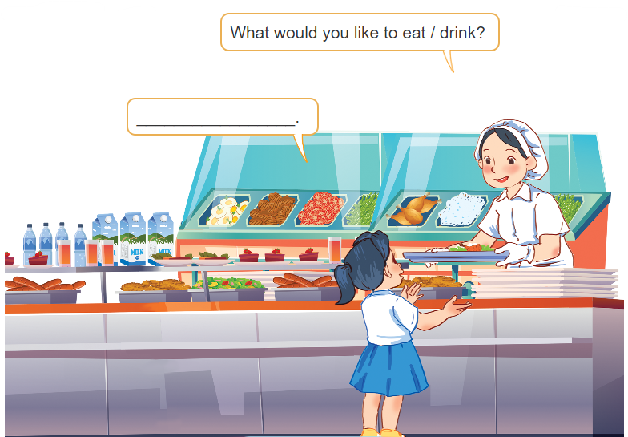
3. Let’s talk.

Slide 21


Facebook : Bùi Liễu
0968142780
Let’s play!

Slide 22









Choose the right answer.
a
b
c
Next
egg

Slide 23


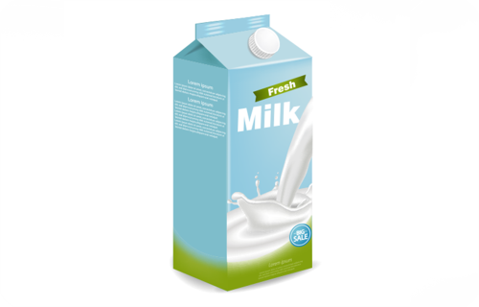
a
b
c
Next
bread

Slide 24


a
b
c
Next
milk

Slide 25

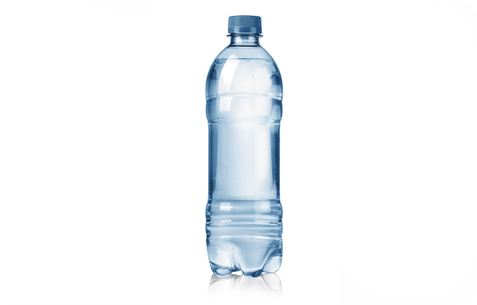

a
b
c
Next
chicken

Slide 26

a
b
c
Next
water

Slide 27
a
b
c
Next

Slide 28
a
b
c
Next

Slide 29

I’d like some milk, please.
I’d like some water, please.
I’d like some egg, please.
a
b
c
Next
What would you like to drink?

Slide 30


a
b
c
Next
drink

Slide 31
a
b
c
Next
drink

Slide 32



a
b
c
Next
What would you like to eat?
I’d like some egg, please.

Slide 33



a
b
c
Next
What would you like to eat?
I’d like some chicken, please.

Slide 34
Where
What
Who
a
b
c
Next
____ would you like to eat?
I’d like some egg, please.

Slide 35


a
b
c
Next
What would you like to drink?
I’d like some water, please.

Slide 36

Thank you!

Slide 37
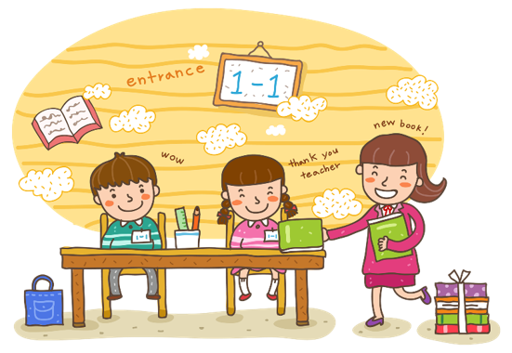
Wrap up

Slide 38
Review
eat
drink
bread
egg
chicken
drink
water
milk

Slide 39
Structures
Hỏi người khác muốn ăn/uống gì.
- What would youlike to eat/drink?
+ I’d like some ___, please.

Slide 40

Facebook : Bùi Liễu
0968142780
Thank you!

