Slide 1
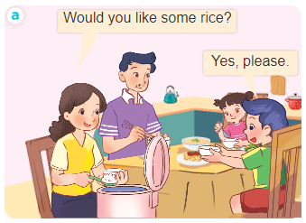
..................................
At the dining table
Unit
15
Lesson 1 (4+5+6)
Facebook : Bùi Liễu
0968142780

Slide 2
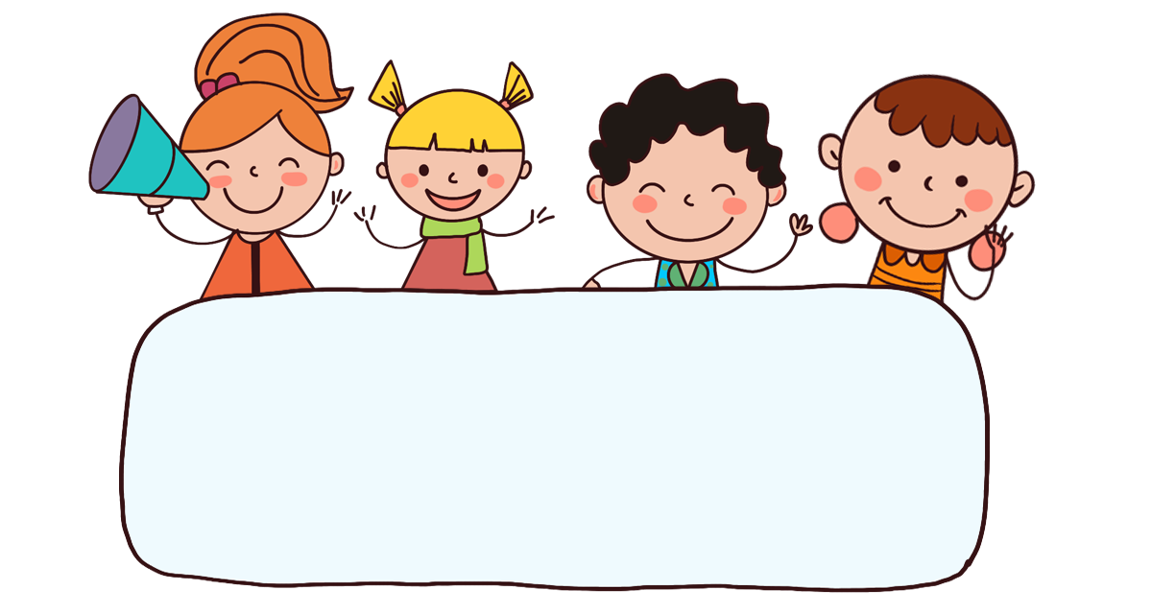
Warm-up

Slide 3


Facebook : Bùi Liễu
0968142780
Let’s play!

Slide 4
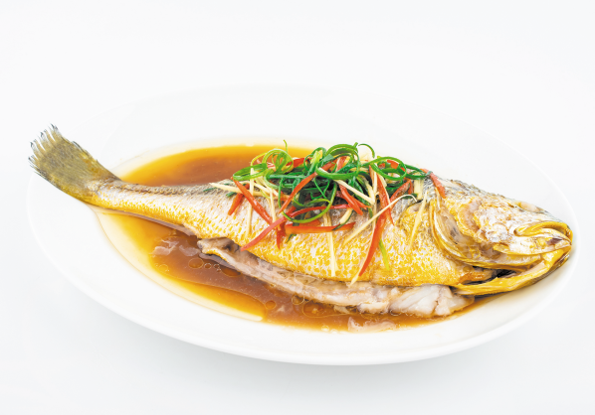
f_sh
Question 2/10
Click the clock to start the timer.
Time out
A. a
B. o
C. i
D. e
Notes:
Click the clock to start the timer.

Slide 5
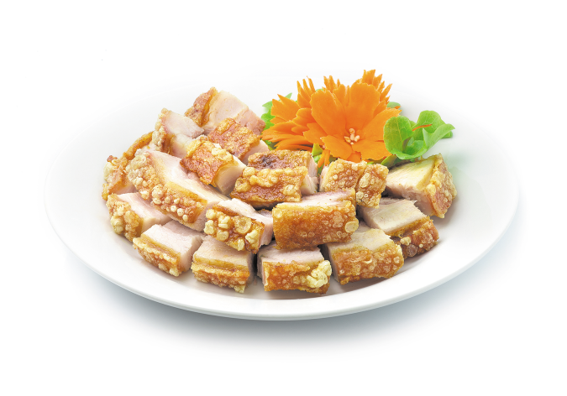
Question 3/10
Click the clock to start the timer.
Time out
A. meat
B. rice
C. fish
D. beans
Notes:
Click the clock to start the timer.

Slide 6

Question 4/10
Time out
A. beans
B. meat
C. rice
D. juice
Notes:
Click the clock to start the timer.

Slide 7

Question 5/10
Click the clock to start the timer.
Time out
A. rice
B. juice
C. fish
D. beans
Notes:
- Click the clock to start the timer.

Slide 8
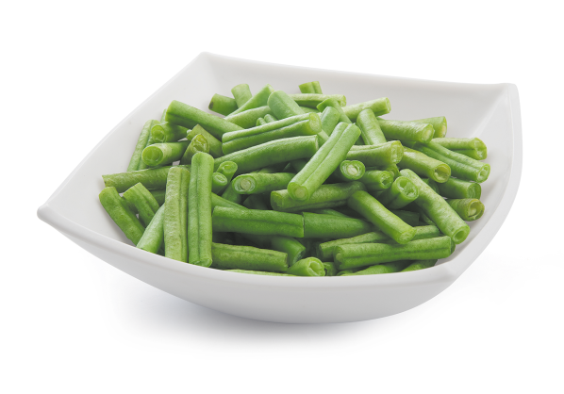
be_ns
Question 6/10
Click the clock to start the timer.
Time out
A. t
B. u
C. a
D. o
Notes:
Click the clock to start the timer.

Slide 9


Would you like some beans?
Question 7/10
Click the clock to start the timer.
Time out
A. No, thanks.
B. Yes, please.
Notes:
Click the clock to start the timer.

Slide 10

Would you like some rice?
Question 8/10
Click the clock to start the timer.
Time out
A. No, thanks.
B. Yes, please.
Notes:
Click the clock to start the timer.

Slide 11

Question 9/10
Would you like some juice?
Yes, please.
Click the clock to start the timer.
Time out
A.
B.
Notes:
- Click the clock to start the timer.

Slide 12


Question 10/10
Would you like some rice?
No, thanks.
Click the clock to start the timer.
Time out
A.
B.
Notes:
- Click the clock to start the timer.

Slide 13

Facebook : Bùi Liễu
0968142780
Thank you!

Slide 14



Contents
Facebook : Bùi Liễu
0968142780
Listen and tick.
Look, complete and read.
Let’s sing.

Slide 15

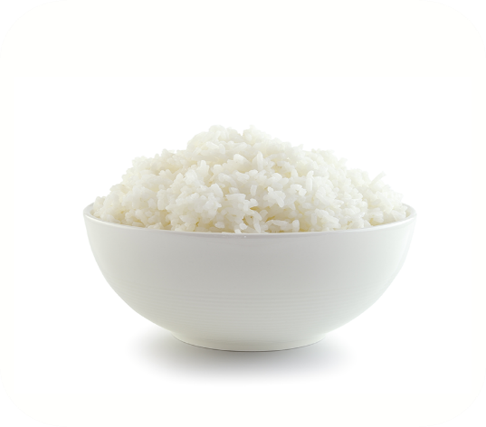
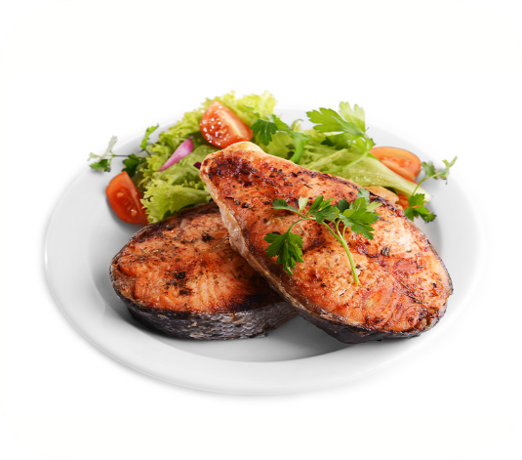

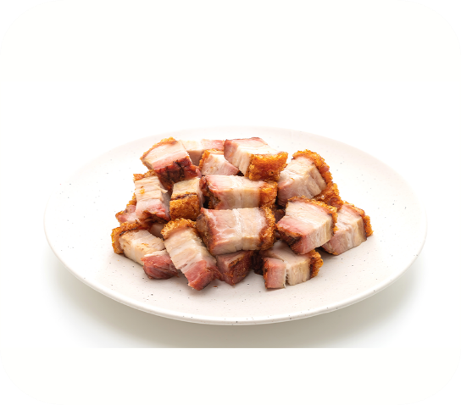

4. Listen and tick.
a
b
1
a
b
2

Slide 16
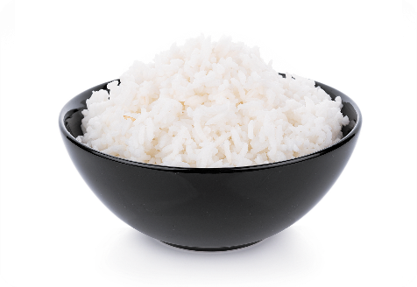
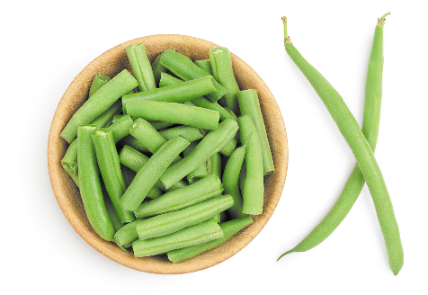
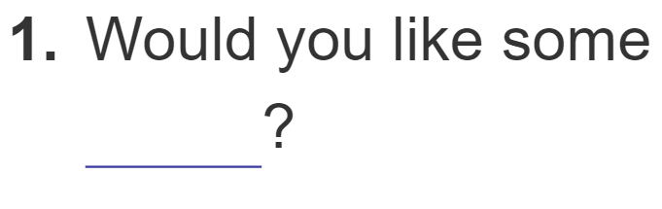
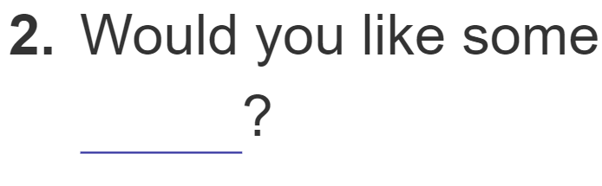
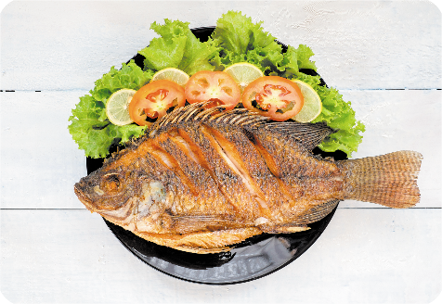
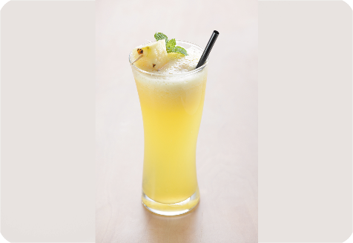
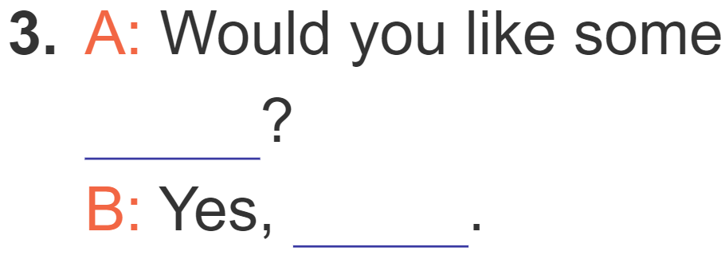
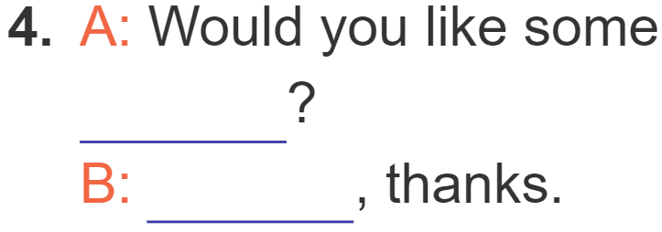
5. Look, complete and read.
rice
beans
fish
juice
please
No

Slide 17
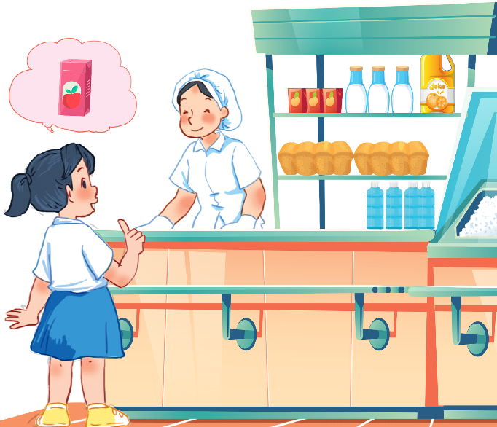
6. Let’s sing.
Would you like some …?
Would you like some rice?
No, thanks.
No, thanks.
Would you like some juice?
Yes, please.
Yes, please.

Slide 18

6. Let’s sing.
Would you like some …?
Would you like some rice?
No, thanks.
No, thanks.
Would you like some juice?
Yes, please.
Yes, please.

Slide 19

Wrap up

Slide 20
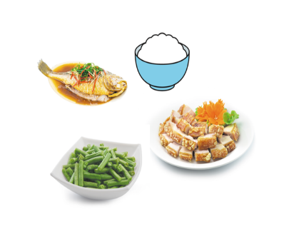
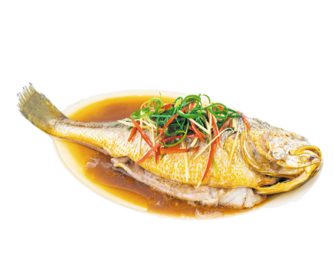

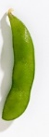



Review
food
rice
fish
meat
bean
beans
juice

Slide 21
Structures
Mời ai ăn (uống) đồ ăn/nước uống.
- Would you like some ______?
+ Yes, please.
+ No, thanks.

Slide 22
Facebook : Bùi Liễu
0968142780
Thank you!
Facebook : Bùi Liễu
0968142780

