Slide 1
Unit 18
What will the weather
be like tomorrow?
Lesson 3

Slide 2
Warm-up

Slide 3


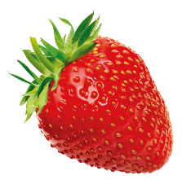


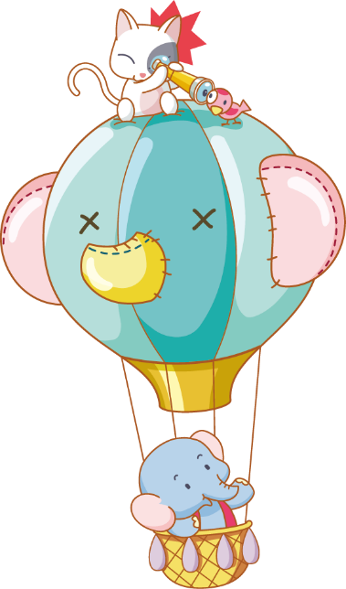



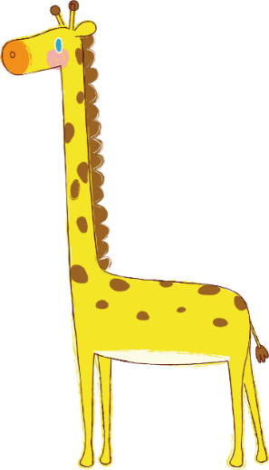

Luật chơi:
Chia lớp thành các đội
Bấm nút để quay, màu để dừng
Trả lời đúng được cộng điểm, nhường quyền trả lời cho đội bạn.
Kết thúc trò chơi đội nhiều điểm hơn giành chiến thắng.
PLAY
Notes:
Ms Huyền Phạm - 0936.082.789 – YOUTUBE: MsPham. Facebook: Dạy và học cùng công nghệ.

Slide 4




27
How many seasons are there in your country?
20
There are four.
There are three.
A.
B.
QUESTION
There is four.
There is one.
C.
D.
Notes:
Ms Huyền Phạm - 0936.082.789 – YOUTUBE: MsPham. Facebook: Dạy và học cùng công nghệ.

Slide 5
What's your favourite season?
10
I’d like spring.
I like spring.
A.
B.
QUESTION
C.
I would like spring.
D.
I’m like spring.
Notes:
Ms Huyền Phạm - 0936.082.789 – YOUTUBE: MsPham. Facebook: Dạy và học cùng công nghệ.

Slide 6
What ___the weather like today?
It’s warm.
10
are
do
A.
B.
QUESTION
will
is
C.
D.
Notes:
Ms Huyền Phạm - 0936.082.789 – YOUTUBE: MsPham. Facebook: Dạy và học cùng công nghệ.

Slide 7
What ___ the weather be like tomorrow?
It will be cold and rainy.
20
Will be
is
A.
B.
QUESTION
will
are
C.
D.
Notes:
Ms Huyền Phạm - 0936.082.789 – YOUTUBE: MsPham. Facebook: Dạy và học cùng công nghệ.

Slide 8
What will ____ be like tomorrow?
It will be cold and rainy.
10
weather
weather forecast
A.
B.
QUESTION
the weather
the weather forecast
C.
D.
Notes:
Ms Huyền Phạm - 0936.082.789 – YOUTUBE: MsPham. Facebook: Dạy và học cùng công nghệ.

Slide 9
It’s uasually cold. There are a lot of rain.
20
What’s spring like in your country?
What’s the weather like in your country?
A.
B.
QUESTION
What’s summer like in your country?
What will the weather be like tomorrow?
C.
D.
Notes:
Ms Huyền Phạm - 0936.082.789 – YOUTUBE: MsPham. Facebook: Dạy và học cùng công nghệ.

Slide 10
It will be warm and cloudy.
20
What will the weather be like next Friday?
What’s autumn like in your country?
A.
B.
QUESTION
What’s the weather like today?
What’s your favourite season?
C.
D.
Notes:
Ms Huyền Phạm - 0936.082.789 – YOUTUBE: MsPham. Facebook: Dạy và học cùng công nghệ.

Slide 11
What’s winter like in your country?
10
It’s usually hot and snowy.
It’s usually hot and sunny.
A.
B.
QUESTION
It’s usually cold and snowy.
It’s usually cold and sunny.
C.
D.
Notes:
Ms Huyền Phạm - 0936.082.789 – YOUTUBE: MsPham. Facebook: Dạy và học cùng công nghệ.

Slide 12
What’s summer like in your country?
It’s usually hot. ________.
20
There is a lot of flowers.
There is a lot of snow.
A.
B.
QUESTION
There are a lot of flowers.
There are a lot of snow.
C.
D.
Notes:
Ms Huyền Phạm - 0936.082.789 – YOUTUBE: MsPham. Facebook: Dạy và học cùng công nghệ.

Slide 13
What's the weather like in your favourite season?
100
It’s cool and windy.
It will be cool and windy.
A.
B.
QUESTION
It’s cool and wind.
It will be cool. There are a lots flowers.
C.
D.
Notes:
Ms Huyền Phạm - 0936.082.789 – YOUTUBE: MsPham. Facebook: Dạy và học cùng công nghệ.

Slide 14

Notes:
Ms Huyền Phạm - 0936.082.789 – YOUTUBE: MsPham. Facebook: Dạy và học cùng công nghệ.

Slide 15
Pronunciation

Slide 16

1. Listen and repeat.
1. | What will the weather be like tomorrow? ↷ It will be hot and sunny. ↷
2. | What's spring like in your country? ↷ It's usually cold and windy. ↷
3. | What's summer like in your country? ↷ It's usually hot and sunny. ↷
4. | What's autumn like in your country? ↷ It's usually cool and foggy. ↷

Slide 17
2. Listen and circle a or b
1. What will the weather be like tomorrow?
It will be ___________ and ______.
2. What's spring like in your country?
It's usually ___________ and ______.
3. What's autumn like in your country?
It's usually ___________ and ______.
4. What's winter like in your country?
It's usually ___________ and ______.
a. cold, cloudy
b. cool, windy
a. cold, foggy
b. cool, foggy
a. cool, windy
b. cool, stormy
a. cold, windy
b. cool, windy

Slide 18
Practice

Slide 19
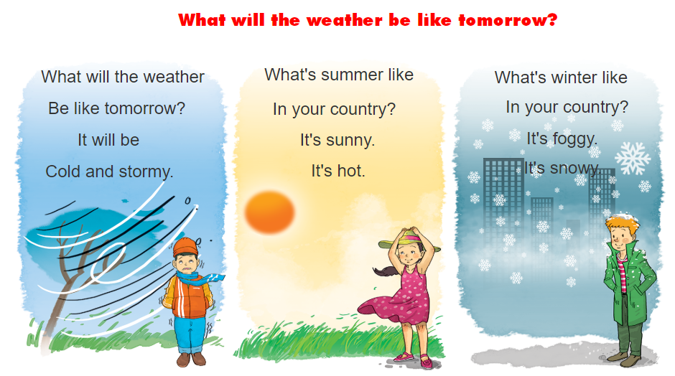


3. Let’s chant

Slide 20

4.1. Complete the passage
My name is Quang. I live in Can Tho. It is in the (1) ________ of Viet Nam. There are only two seasons here. They are the dry season and the rainy season. The dry season lasts from (2) ________ to April. It is usually cool and dry in this time of the year. This is my favourite season because I can go for a (3) ______ with my friends. The rainy (4) ________ lasts from May to October. It is usually hot and wet. There is a lot of (5) ______ too.
season
south
picnic
wind
November
south
November
picnic
season
wind

Slide 21
4.2. Answer the questions.
1. How many seasons are there in Can Tho?
There are two.
2. What are they?
They're the dry season and the rainy season.
3. What is the dry season like?
It's usually cool and dry.
4. What is the rainy season like?
It's usually hot and wet.
5. Why does Quang like the dry season?
Because he can go for a picnic with his friends.

Slide 22
5. Write about the seasons and weather
I live in ______________.
There are ______________ seasons in my place.
They're ______________.
My favourite season is______________.
It's usually .
There is/are ______________.

