Slide 1

TO CLASS
Made by Thanh Tam

Slide 2
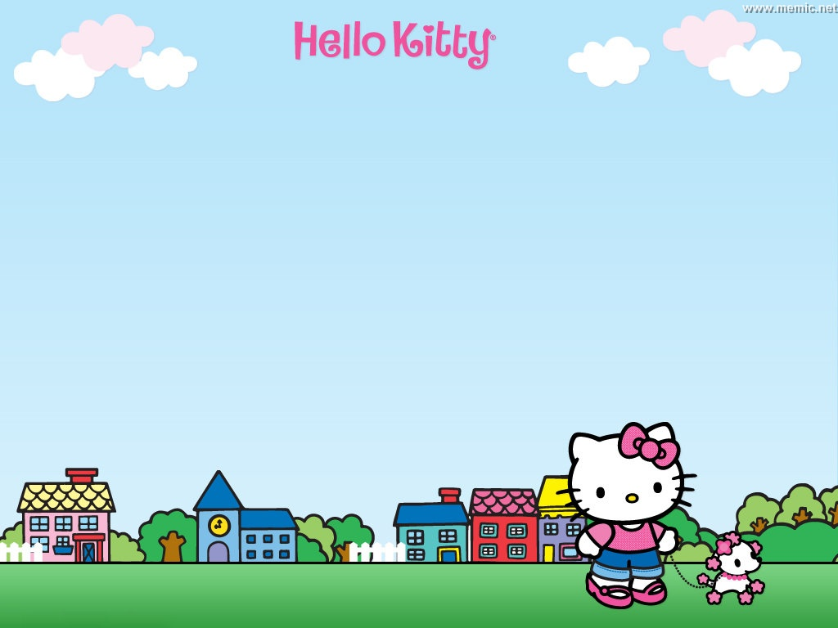
WARM-UP
Made by Thanh Tam

Slide 3


Slide 4
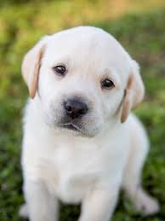
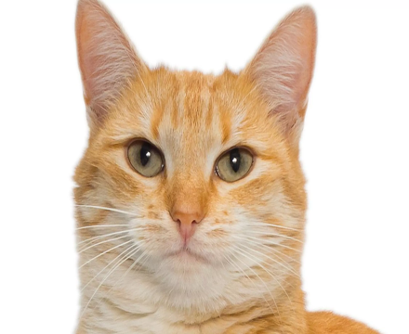

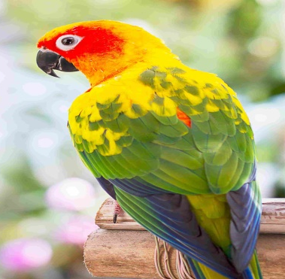
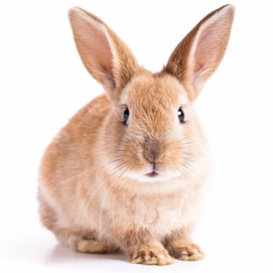

“Secret box”

Slide 5










Count from 0 to 9

Slide 6


Unit 14:
WHAT HAPPENED IN THE STORY?
Lesson 3

Slide 7
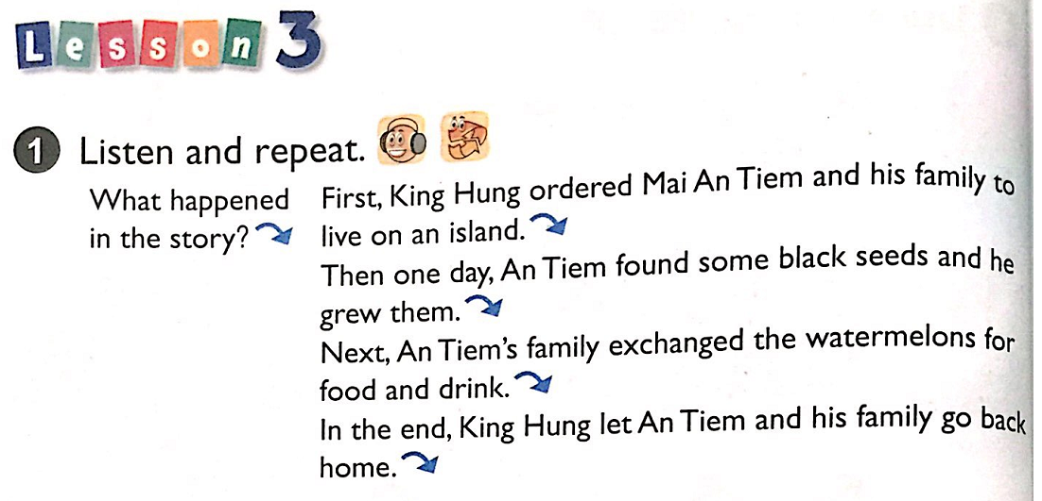


Slide 8
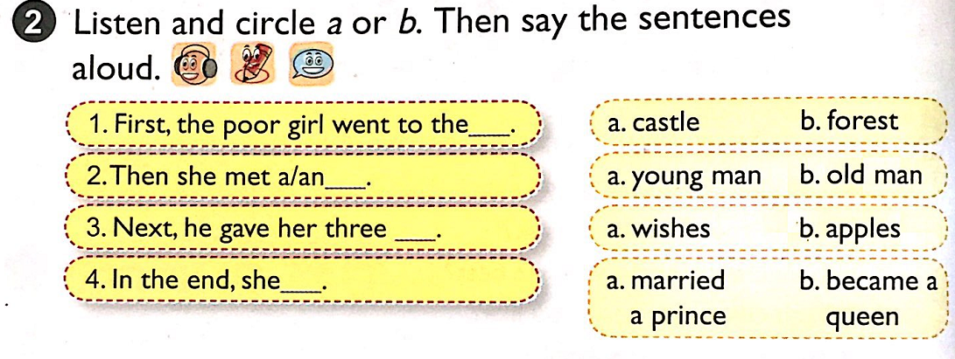

Slide 9
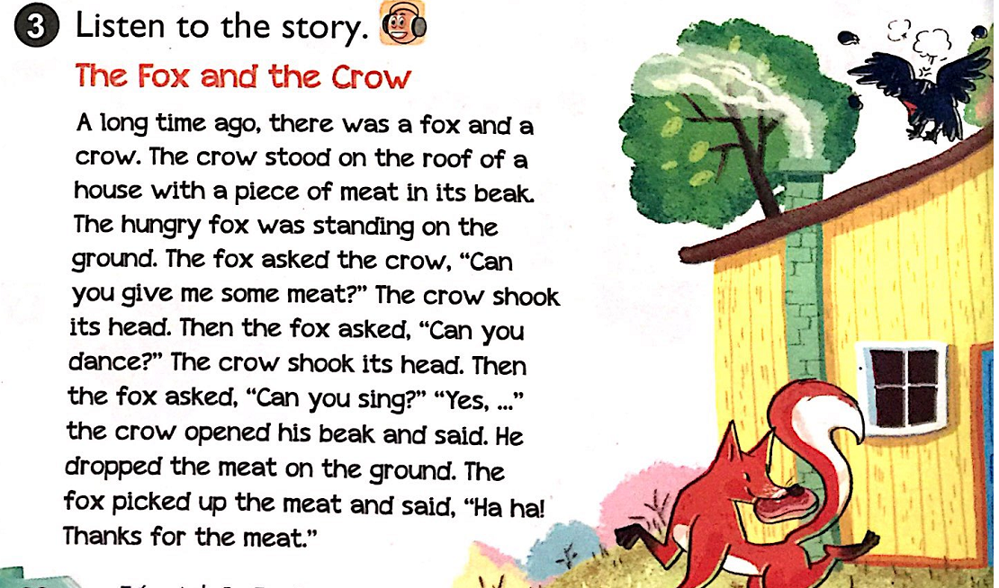

Slide 10
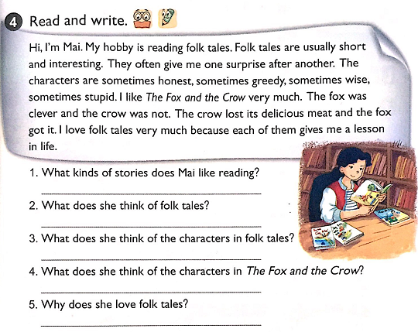
She likes reading folk tales
Folk tales are usually short and interseting
The characters are sometimes honest, sometimes greedy, sometimes wise, sometimes stupid.
The fox was clever and the crow was not.
Because each of them gives her a lesson in life.

Slide 11
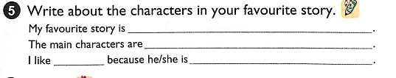
The story of Mai An Tiem
Mai An Tiem
hardworking
him

Slide 12
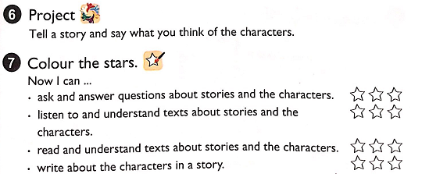

Slide 13
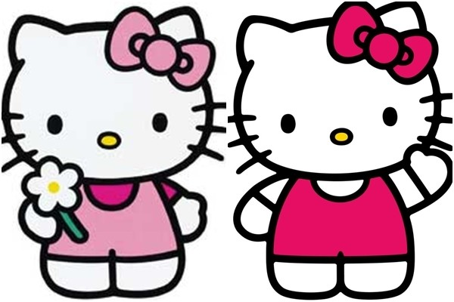

Thanks for your attention!

Slide 14
Game:
Who's a milionaire?

Slide 15




Who's a milionaire?
1.Complete the sentence: The cow…….., “Yes”
50:50
A. say
B.said
B. said
C. ask
D. asked

Slide 16
Who's a milionaire?
2. Fill in the blank:
The teacher ……: “ Can you speak English?”
50:50
A. say
B. said
C. ask
D. asked
D. asked

Slide 17
Who's a milionaire?
3.Complete the sentence:
The fox …….., “Ha ha ! Thanks for your meat”
50:50
A. say
B.said
B. said
C. ask
D. asked

Slide 18
Who's a milionaire?
4. What happened next?
50:50
A. The man said, “You do well”
The man said, “You do well”
B. The man say, “ You do well”
C. The man ask, “ You do well”
D.The man asked “You do well”

Slide 19
Who's a milionaire?
5. Reorder the sentence:
She/ What/then/happen?/ “ ”/ asked
50:50
A. She says, “ What happen then?”
B. She said, “ What happen then?”
C. She asked, “ What happen then?”
C. She asked, “ What happen then?”
D. She ask , “ What happen then?”

Slide 20


Homelink
Learn by heart New words and structure
Prepare Lesson unit 15 leson 1

Slide 21
