Slide 1



Monday, November 27th 2023
Facebook : Bùi Liễu
0968142780
Unit
8
My favourite subjects
Lesson 1

Slide 2
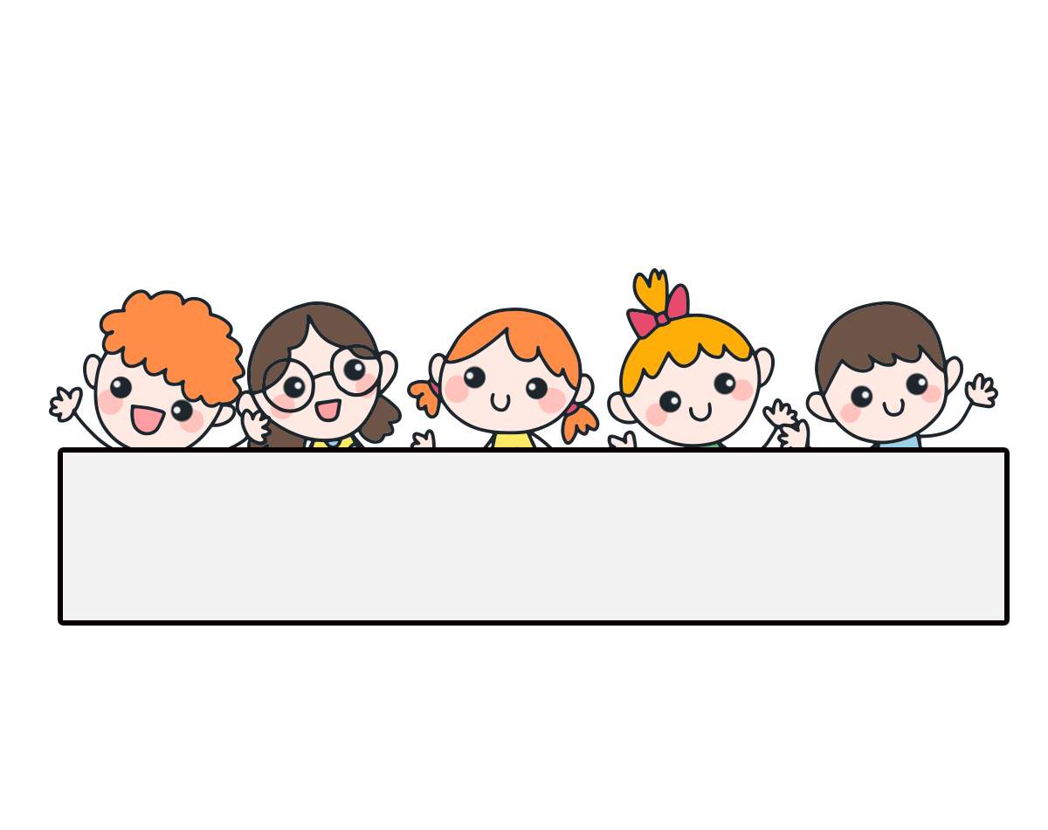
Warm-up

Slide 3


Facebook : Bùi Liễu
0968142780
Let’s play!

Slide 4

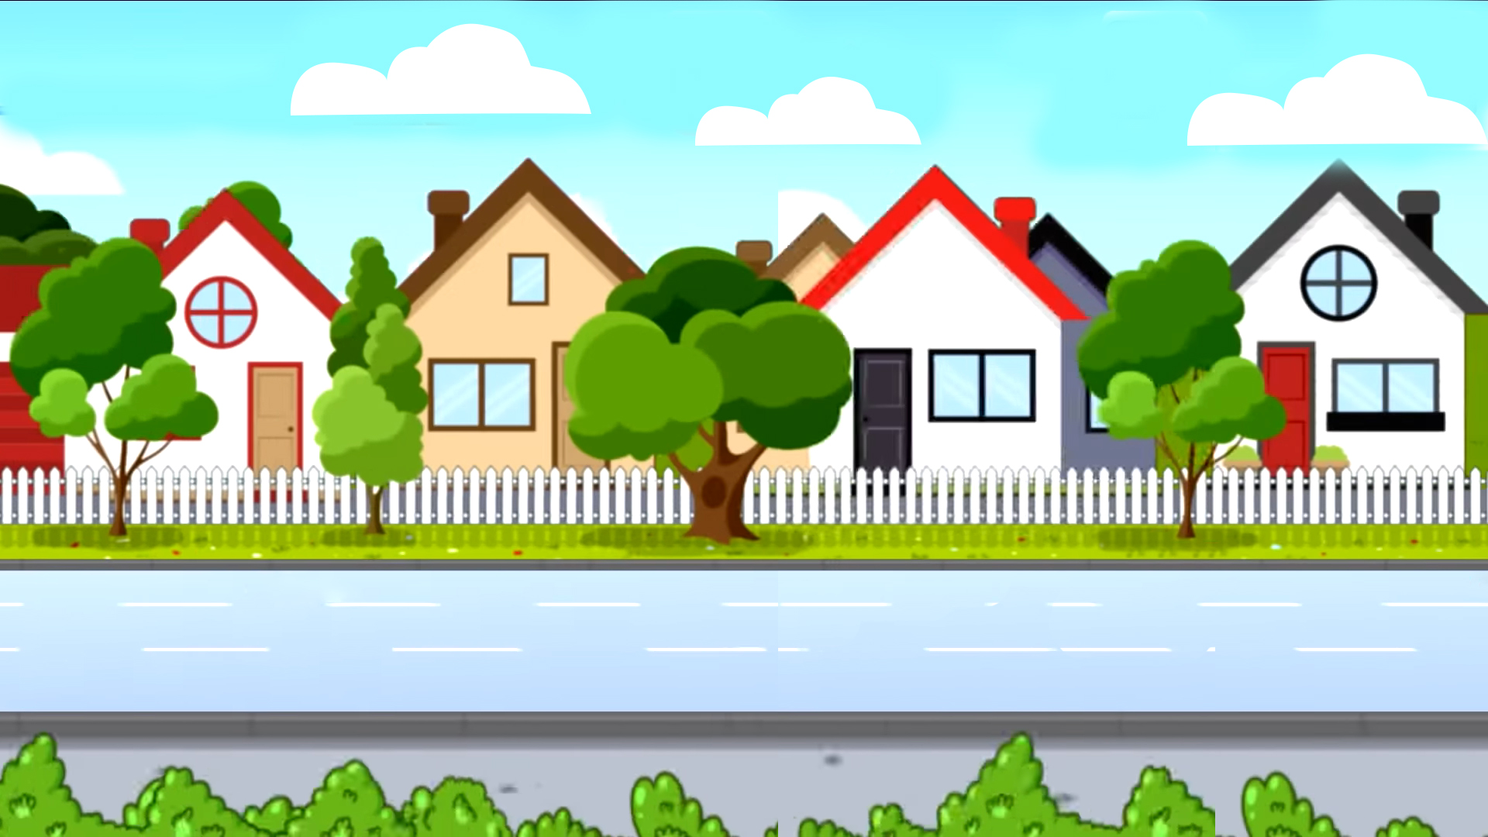






School bus
Play

Slide 5


H/s nhìn hình và nói, cô giáo nhấn “check” để hiển thị đáp án.
Question 1/8
English
Check
Next

Slide 6

Question 2/8
history and geography
Check
Next

Slide 7

Question 3/8
art
Check
Next
Notes:
Facebook : Bùi Liễu
Mobile phone: 0968142780

Slide 8

Question 4/8
music
Check
Next

Slide 9

Question 5/8
maths
Check
Next
Notes:
Facebook : Bùi Liễu
Mobile phone: 0968142780

Slide 10

Question 6/8
science
Check
Next

Slide 11

Question 7/8
Vietnamese
Check
Next
Notes:
Facebook : Bùi Liễu
Mobile phone: 0968142780

Slide 12


Question 8/8
science and art
Check
Next

Slide 13


End

Slide 14






Contents
Look, listen and repeat.
Listen, point and say.
Let’s talk.
Listen and tick or cross.
Look, complete and read.
Let’s sing.

Slide 15

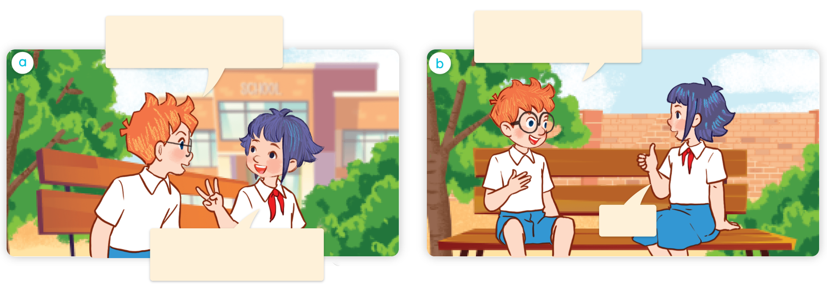
1. Look, listen and repeat.
Hi, Linh. What subjects do you have today?
I like art. What’s your favourite subject?
a
b
It’s PE.
I have English, science and maths.
Where are they?
What are they talking about?
Who are they?

Slide 16
Vocabulary

Slide 17

Vocabulary
PE (physical education)
/ˌpiː ˈiː/ (/ˌfɪzɪkl edʒuˈkeɪʃn/)
môn Thể dục,
môn Giáo dục thể chất

Slide 18

Vocabulary
IT (information technology)
/aɪ ˈtiː/ (/ˌɪnfəˌmeɪʃn tekˈnɒlədʒi/)
môn Tin học,
môn Công nghệ thông tin

Slide 19


Review
PE (physical education)
IT (information technology)

Slide 20




Match
1
2
3
4
PE
IT
music
art
a
b
c
d

Slide 21
Structures

Slide 22
Structures
Hỏi “môn học yêu thích của bạn”:
What’s your favourite subject?
It’s _______.
it’s = it is
(Môn học yêu thích của bạn là gì?)
(Đó là ______.)

Slide 23


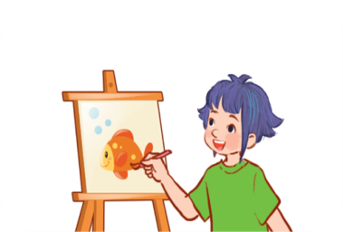

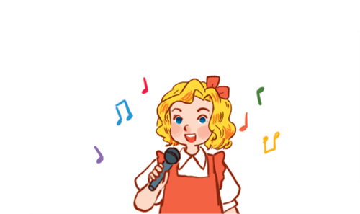

Unit 8 lesson1
What’s your favourite subject?
It’s ______.
IT
art
music
PE

Slide 24
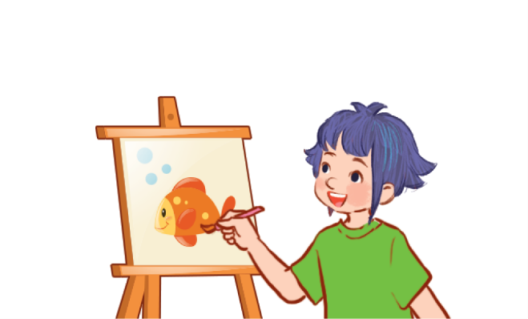
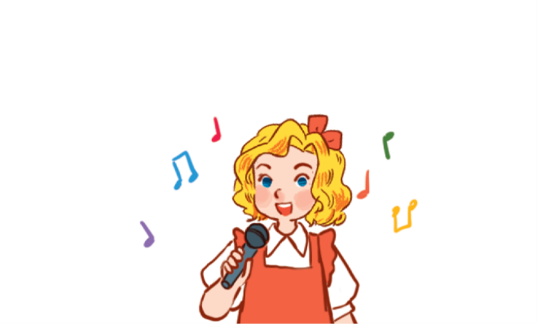
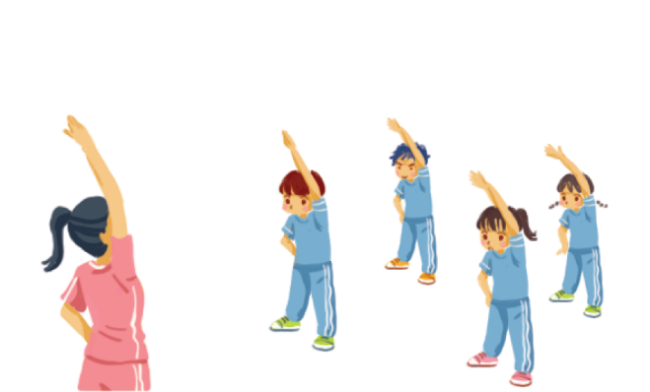

2. Listen, point and say.
a
b
What’s your favourite subject?
art
music
It’s ______.
c
d
PE
IT

Slide 25



2. Listen, point and say.
art
What your favourite subject?
It’s art.

Slide 26

2. Listen, point and say.
music
What’s your favourite subject?
It’s music.

Slide 27

2. Listen, point and say.
PE
What’s your favourite subject?
It’s PE.

Slide 28

2. Listen, point and say.
IT
What’s your favourite subject?
It’s IT.

Slide 29
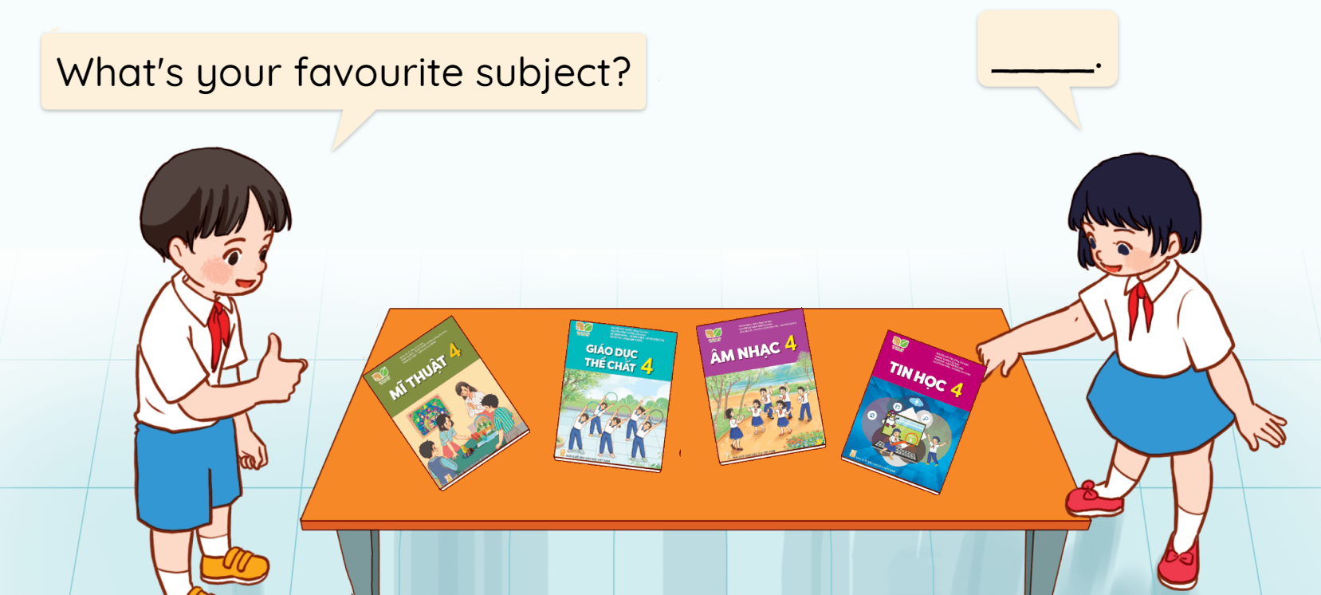
3. Let’s talk.

Slide 30








4. Listen and tick or cross.
1.
2.
3.
4.

Slide 31
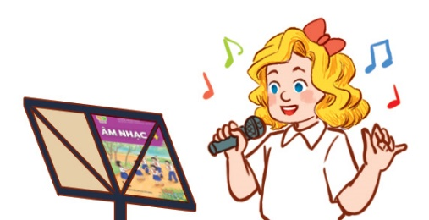
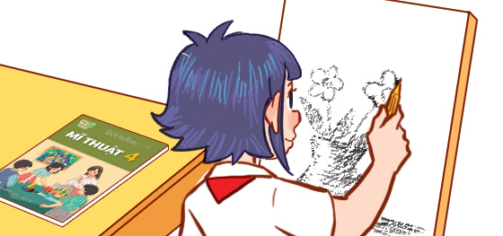

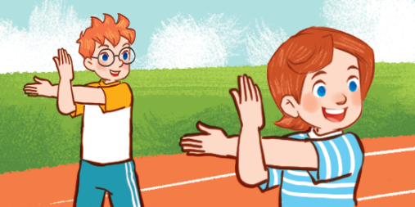
5. Look, complete and read.
1.
A: What’s your favourite subject?
B: It’s _______.
2.
A: ______ your favourite subject?
B: It’s _____.
What’s
music
art
4.
A: What’s your ______________?
B: It’s _______.
3.
A: What’s your favourite ______?
B: It’s ____.
favourite subject
subject
IT
PE

Slide 32

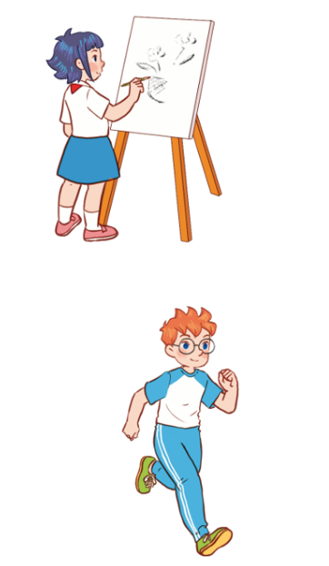

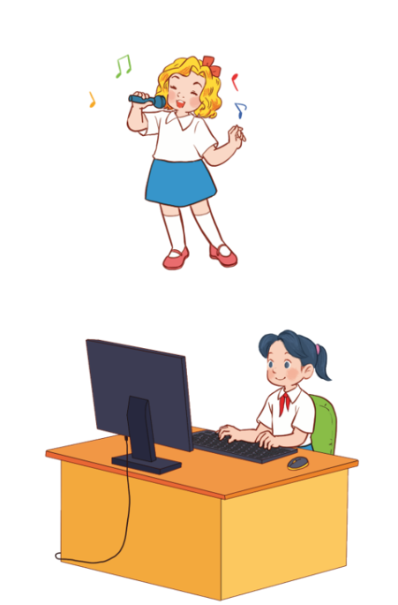







6. Let’s sing.
My favourite subject
I like drawing.
My favourite subject is art.
I like singing.
My favourite subject is music.
I like running.
My favourite subject is PE.
I like computers.
My favourite subject is IT.

Slide 33

6. Let’s sing.
My favourite subject
I like drawing.
My favourite subject is art.
I like singing.
My favourite subject is music.
I like running.
My favourite subject is PE.
I like computers.
My favourite subject is IT.

Slide 34

Let’s play!

Slide 35
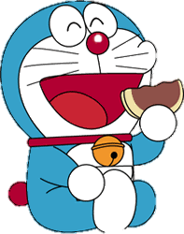
DORAEMON

Slide 36



Facebook : Bùi Liễu
0968142780
A: IT
B: art
C: music
D: PE

Slide 37
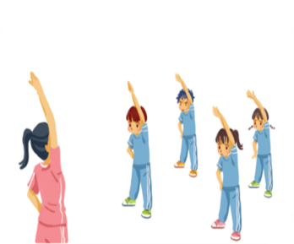
A: art
B: PE
C: music
D: IT
Notes:
Facebook : Bùi Liễu
Mobile phone: 0968142780

Slide 38
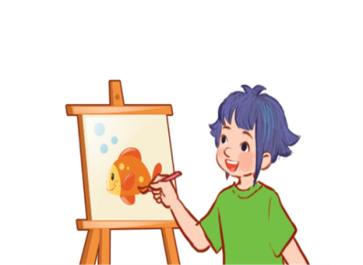

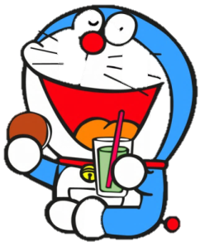
A: IT
B: PE
C: art

Slide 39
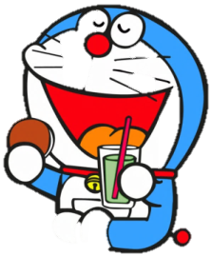
A: art
B: PE
D: music

Slide 40
Facebook : Bùi Liễu
0968142780
What’s your favourite _______?
It’s PE.
A: food
B: subjects
C: drink
D: subject

Slide 41


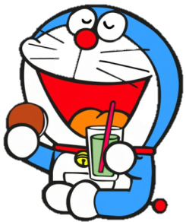
_______ your favourite subject?
It’s IT.
A: Who’s
B: Where’s
C:When’s
D: What’s

Slide 42
PE
physical ___cation
A: edu
B: adu
C: egu
D: idy

Slide 43
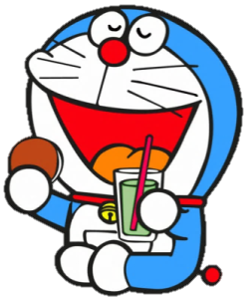


IT
Information techno____
A: logi
B: logy
C: loge
D: nogy

Slide 44
Good job!

Slide 45
Wrap up

Slide 46
Unit 8 lesson1
What’s your favourite subject?
It’s ______.
IT
art
music
PE

Slide 47
Homework
Learn by heart all the new words.
Read again the dialogue in part 1.

Slide 48

Thank you!

