Slide 1
Monday, October 10th 2022
Classroom
instruction
Unit
7
Facebook : Bùi Liễu
0968142780
Lesson 1
Notes:
Facebook : Bùi Liễu
Mobile phone: 0968142780

Slide 2
Contents
Facebook : Bùi Liễu
0968142780
Look, listen and repeat.
Listen, point and say.
Let’s talk.
Listen and tick.
Look, complete and read.
Let’s play.
Notes:
Facebook : Bùi Liễu
Mobile phone: 0968142780

Slide 3
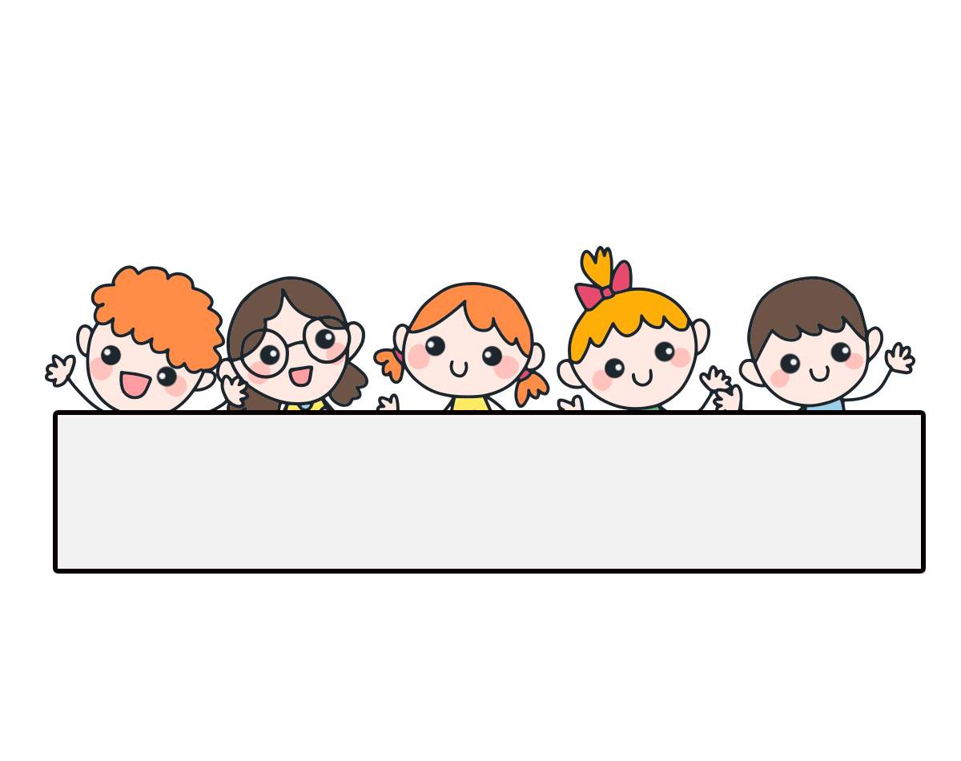
Warm-up

Slide 4
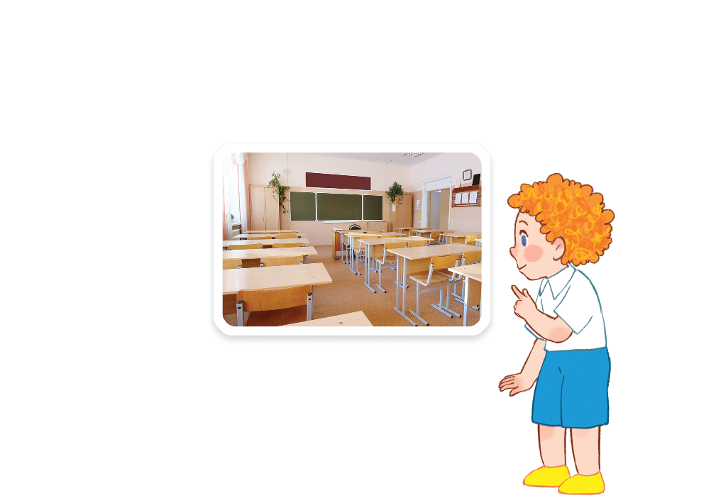
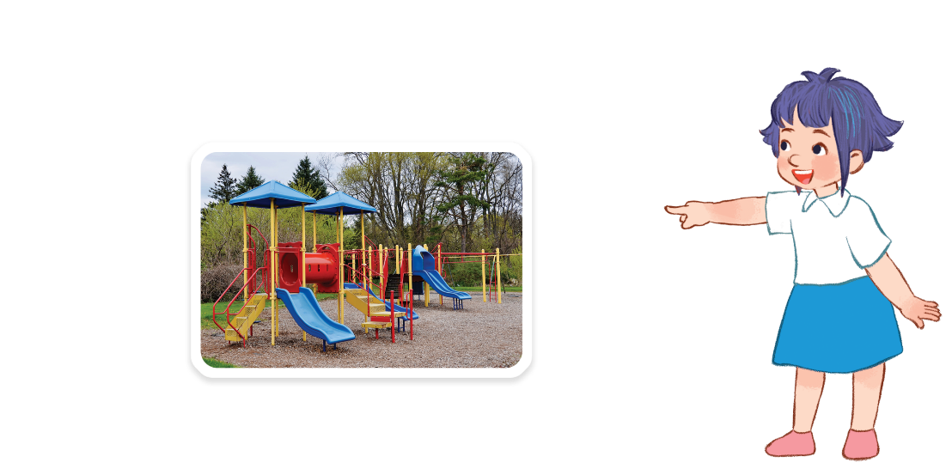
Facebook : Bùi Liễu
Let’s chant.
Classroom,
classroom.
Is that your classroom?
Yes, it is. Yes, it is.
Let’s go to your classroom.
Playground, playground.
Facebook : Bùi Liễu
Is that our playground?
Yes, it is. Yes, it is.
Let’s go to our playground.

Slide 5
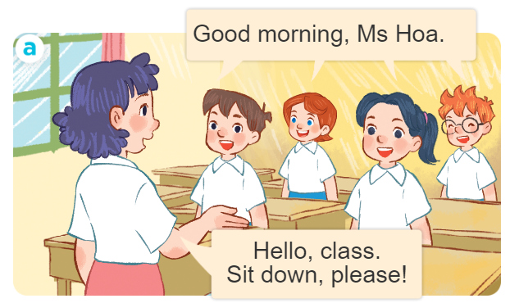
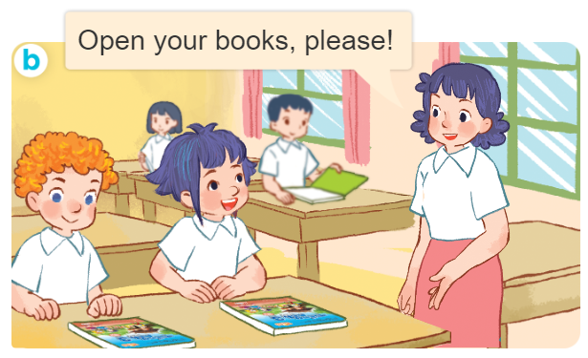
1. Look, listen and repeat.
Slide hội thoại đầu tiên là giới thiệu.
What are they doing?
Where are they?
Who are they?
Notes:
Facebook : Bùi Liễu
Mobile phone: 0968142780

Slide 6
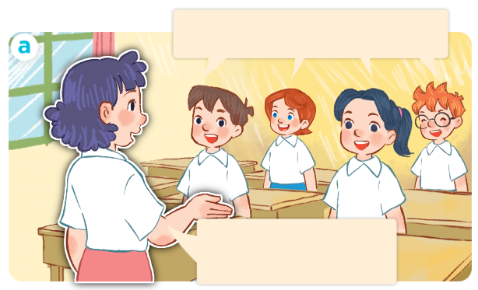
1. Look, listen and repeat.
Click on the sentences to hear.
Good morning, Ms Hoa.
Facebook : Bùi Liễu
0968142780
Hello, class.
Sit down, please!
Notes:
Facebook : Bùi Liễu
Mobile phone: 0968142780

Slide 7
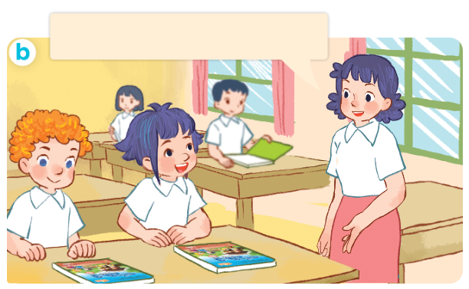
1. Look, listen and repeat.
Click on the sentences to hear.
Open your books, please!
Facebook : Bùi Liễu
0968142780
Notes:
Facebook : Bùi Liễu
Mobile phone: 0968142780

Slide 8
Vocabulary
Notes:
Facebook : Bùi Liễu
Mobile phone: 0968142780

Slide 9
Vocabulary
Facebook : Bùi Liễu
0968142780
open your book
/ˈəʊpən jɔː bʊk/
mở, giở sách

Slide 10
Vocabulary
Facebook : Bùi Liễu
0968142780
close your book
/kləʊz jɔː bʊk/
gập sách

Slide 11
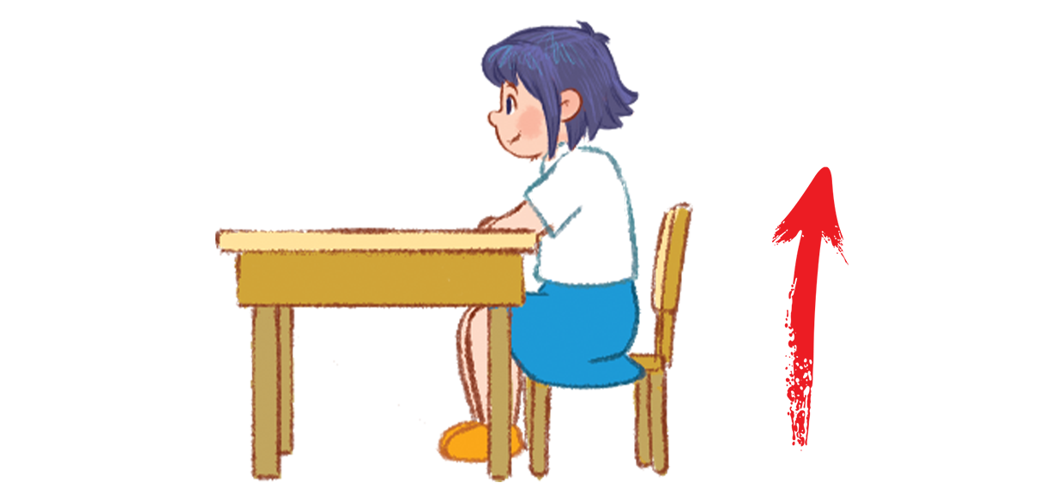
Vocabulary
Facebook : Bùi Liễu
0968142780
stand up
/stænd ʌp/
đứng lên

Slide 12
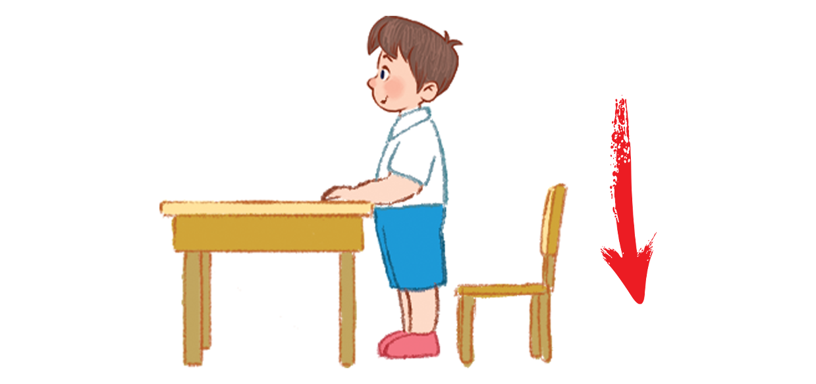
Vocabulary
Facebook : Bùi Liễu
0968142780
sit down
/sɪt daʊn/
ngồi xuống

Slide 13
Review
open your book
close your book
stand up
sit down
Notes:
Facebook : Bùi Liễu
Mobile phone: 0968142780

Slide 14
Vocabulary
open your book: mở, giở sách
close your book: gập sách
stand up: đứng lên
sit down: ngồi xuống
Notes:
Facebook : Bùi Liễu
Mobile phone: 0968142780

Slide 15
Facebook : Bùi Liễu
0968142780
Let’s play!
Notes:
Facebook : Bùi Liễu
Mobile phone: 0968142780

Slide 16
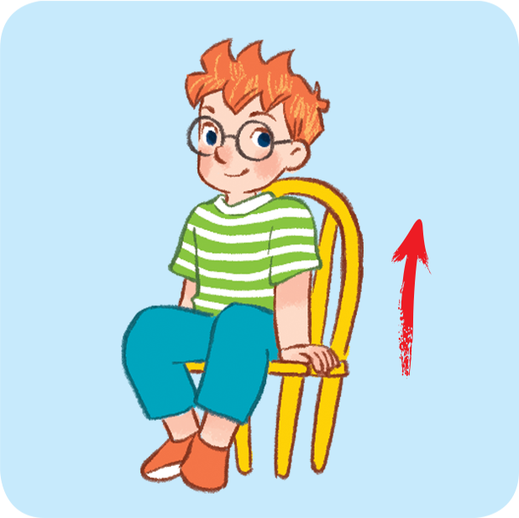
Can you guess?
Nhấn vào ống nhòm lần thứ nhất để chuyển động.
Nhấn lần thứ 2 để hiển thị đáp án.
stand up
Notes:
Facebook : Bùi Liễu
Mobile phone: 0968142780

Slide 17
Can you guess?
Nhấn vào ống nhòm lần thứ nhất để chuyển động.
Nhấn lần thứ 2 để hiển thị đáp án.
open your book
Notes:
Facebook : Bùi Liễu
Mobile phone: 0968142780

Slide 18
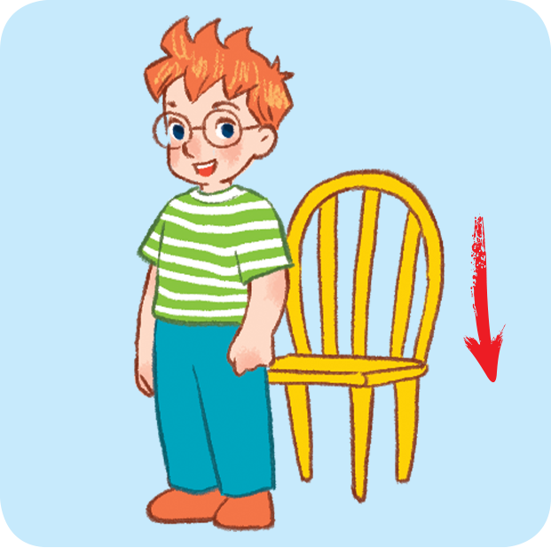
Can you guess?
Nhấn vào ống nhòm lần thứ nhất để chuyển động.
Nhấn lần thứ 2 để hiển thị đáp án.
sit down
Notes:
Facebook : Bùi Liễu
Mobile phone: 0968142780

Slide 19
Can you guess?
Nhấn vào ống nhòm lần thứ nhất để chuyển động.
Nhấn lần thứ 2 để hiển thị đáp án.
close your book
Notes:
Facebook : Bùi Liễu
Mobile phone: 0968142780

Slide 20
Well done!

Slide 21
Structures

Slide 22
Structures
Câu mệnh lệnh/yêu cầu.
______, please!
Ví dụ:
Sit down, please!
Open your book, please!

Slide 23
2. Listen, point and say.
____, please!
a
b
open your book
close your book
c
d
stand up
sit down

Slide 24
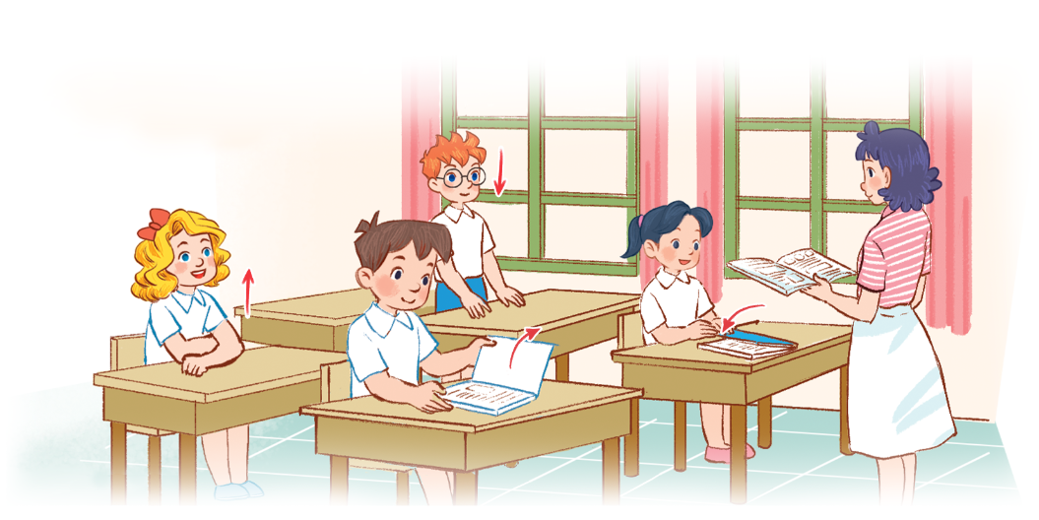
3. Let’s talk.
________, please!

Slide 25
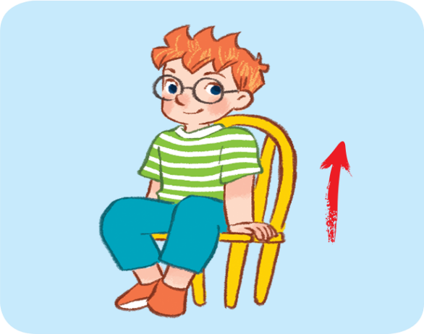
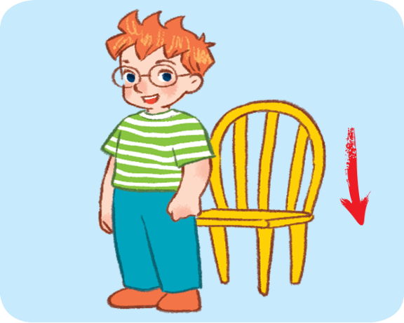
4. Listen and tick.
1
a
b
2
a
b

Slide 26
Facebook : Bùi Liễu
0968142780
Let’s play!
Notes:
Facebook : Bùi Liễu
Mobile phone: 0968142780

Slide 27
Look, say
and do!
10
20
Open your book, please!
Close your books, please!
30
70
Stand up, please!
Open your books, please!
A
Spin &
Stop
40
Sit down, please!
Close your book, please!
B
60
Hello, class.
Sit down, please!
80
50
Good morning, teacher!

Slide 28
Good job!
Notes:
Facebook : Bùi Liễu
Mobile phone: 0968142780

Slide 29
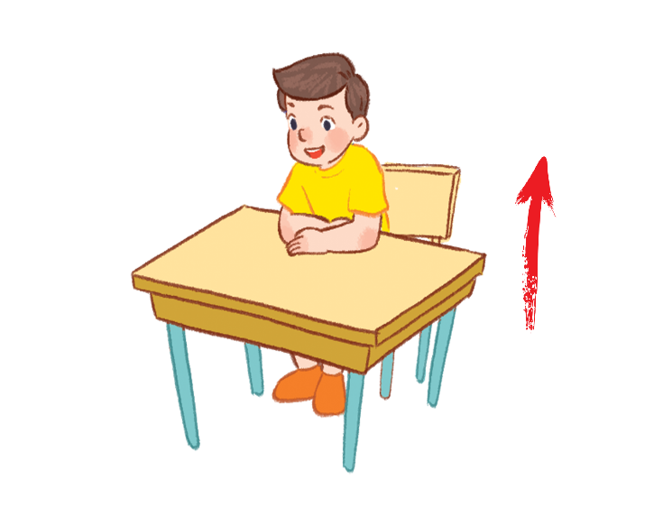
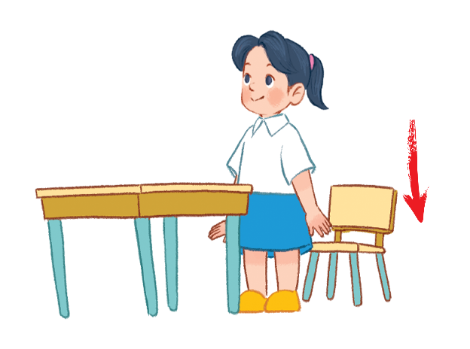
5. Look, complete and read.
1. ______your book, please!
2. ______your book, please!
3. ________, please!
4. ________, please!
Notes:
Facebook : Bùi Liễu
Mobile phone: 0968142780

Slide 30
Open
5. Look, complete and read.
1. ______your book, please!
Notes:
Facebook : Bùi Liễu
Mobile phone: 0968142780

Slide 31
Close
5. Look, complete and read.
2. ______your book, please!
Notes:
Facebook : Bùi Liễu
Mobile phone: 0968142780

Slide 32
Stand up
5. Look, complete and read.
3. ________, please!
Notes:
Facebook : Bùi Liễu
Mobile phone: 0968142780

Slide 33
Sit down
5. Look, complete and read.
4. ________, please!
Notes:
Facebook : Bùi Liễu
Mobile phone: 0968142780

Slide 34
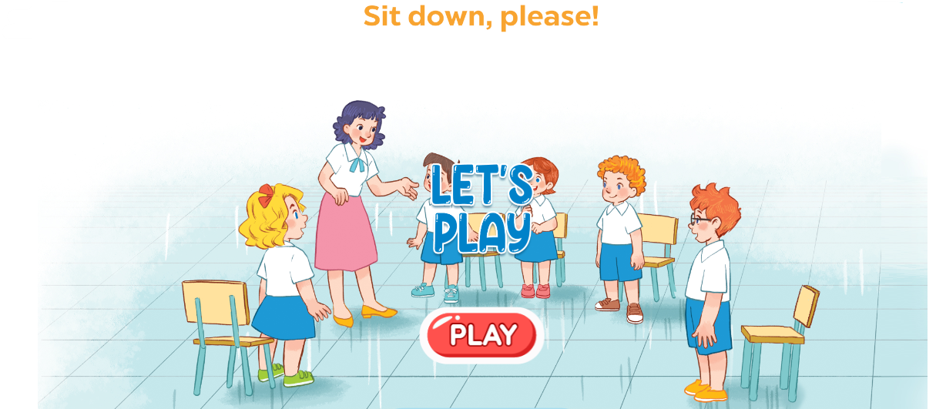
6. Let’s play.
Notes:
Facebook : Bùi Liễu
Mobile phone: 0968142780

Slide 35
Wrap up

Slide 36
Vocabulary
open your book
close your book
stand up
sit down
Notes:
Facebook : Bùi Liễu
Mobile phone: 0968142780

Slide 37
Structures
Câu mệnh lệnh/yêu cầu.
______, please!
Ví dụ:
Sit down, please!
Open your book, please!

Slide 38
Homework
Learn by heart all the new words.
Read again the dialogue in part 1.

Slide 39
Facebook : Bùi Liễu
0968142780
Thank you!
Notes:
Facebook : Bùi Liễu
0968142780

