Slide 1
Monday, November 13th 2023
Unit
7
Our timetables
Lesson 1

Slide 2
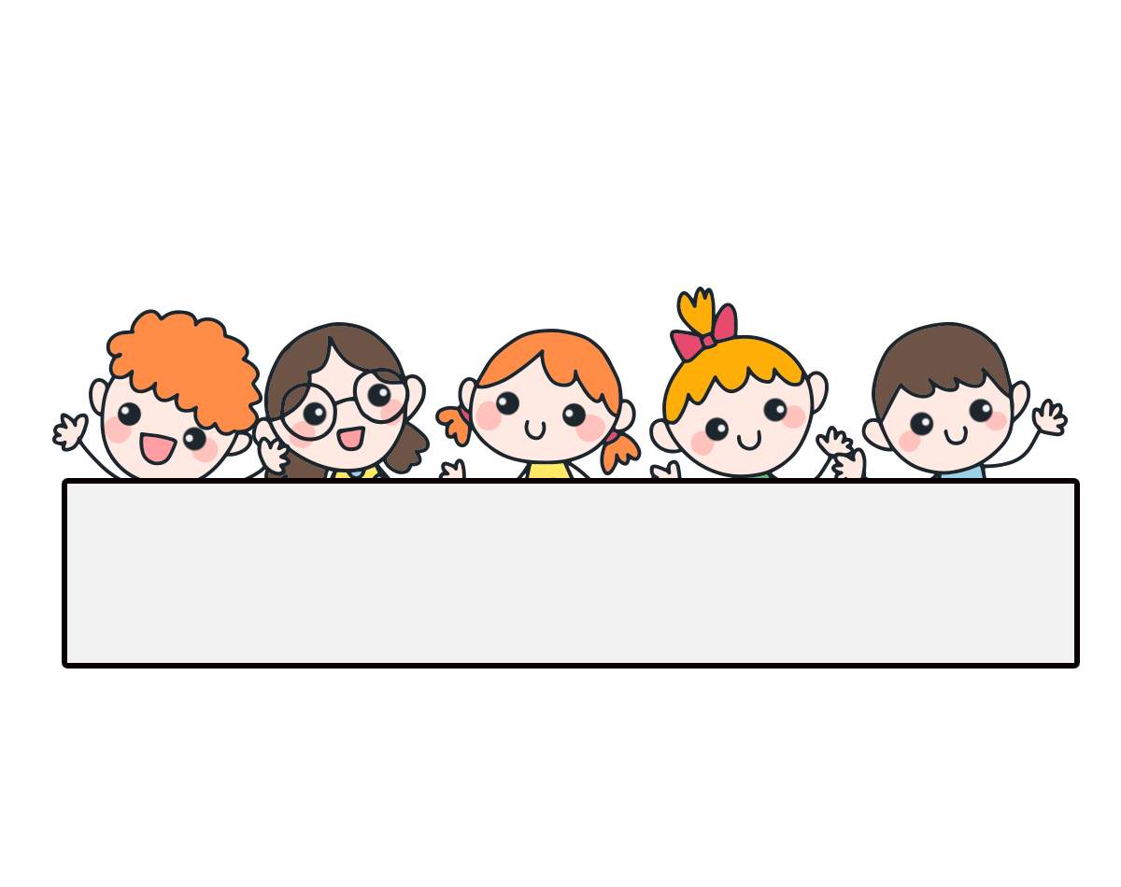
Warm-up

Slide 3
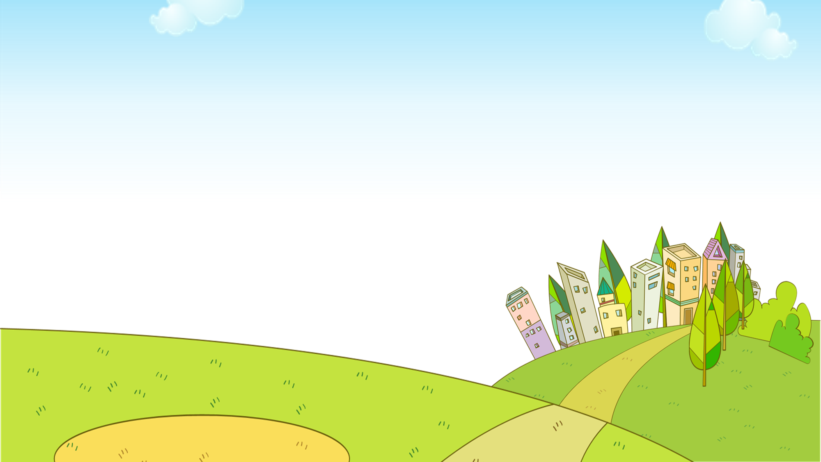
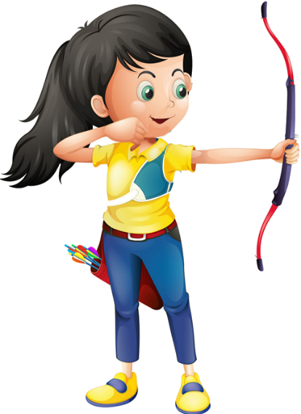
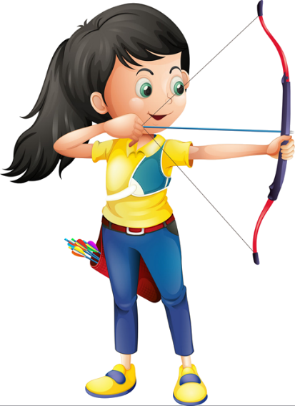
Ms Huyền Phạm
0936.082.789

Slide 4
How many _____ are there at your school?
playgrounds
gardens
Ms Huyền Phạm
0936.082.789

Slide 5
____ many garden are there at your school?
How
What
Ms Huyền Phạm
0936.082.789

Slide 6
How many ____ there at your school?
is
are
Ms Huyền Phạm
0936.082.789

Slide 7
How many buildings
are there at your school?
How many computer rooms
are there at your school?
Ms Huyền Phạm
0936.082.789

Slide 8
Our school is near two ____.
village
villages
Ms Huyền Phạm
0936.082.789

Slide 9
There are two ____ not far from my ____.
town- house
towns - school
Ms Huyền Phạm
0936.082.789

Slide 10
What subjects do you have today?
___________
I have Vietnamese.
I have science.
Ms Huyền Phạm
0936.082.789

Slide 11
What ______ do you have today?
subjects
subject
Ms Huyền Phạm
0936.082.789

Slide 12
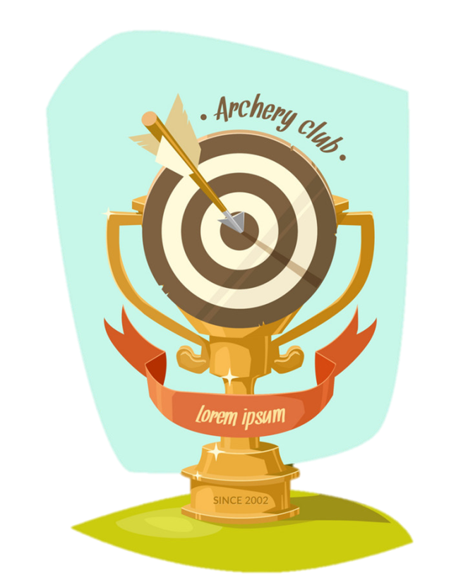
Good job!
Ms Huyền Phạm
0936.082.789

Slide 13
Contents
Look, listen and repeat.
Listen, point and say.
Let’s talk.
Listen and tick or cross.
Look, complete and read.
Let’s play.

Slide 14
1. Look, listen and repeat.
What time do you have class today, Minh?
What subjects do you have today?
a
b
At eight, Mum.
I have English and maths.
What are they talking about?
Where are they?
Who are they?

Slide 15
Vocabulary

Slide 16
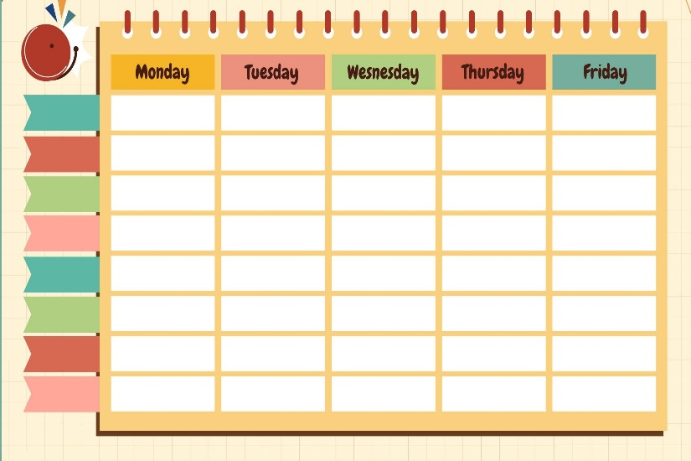
timetable
/ˈtaɪmˌteɪbəl/
thời khóa biểu

Slide 17
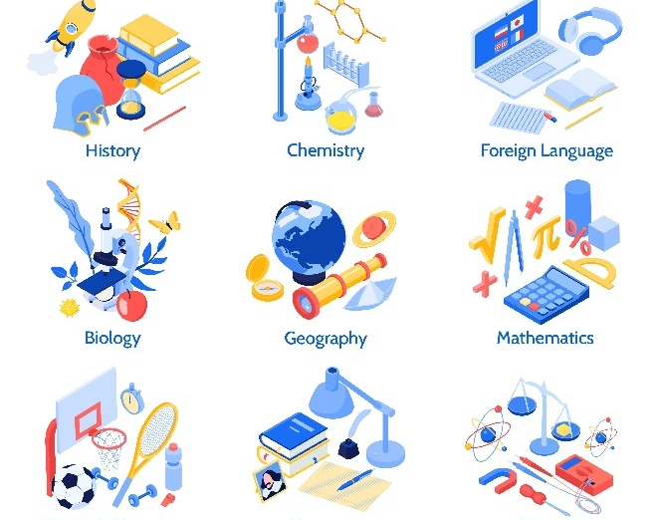
subjects
/ˈsʌb.dʒekts/
các môn học

Slide 18
Vietnamese
/ˌviːetnəˈmiːz/
môn Tiếng Việt

Slide 19
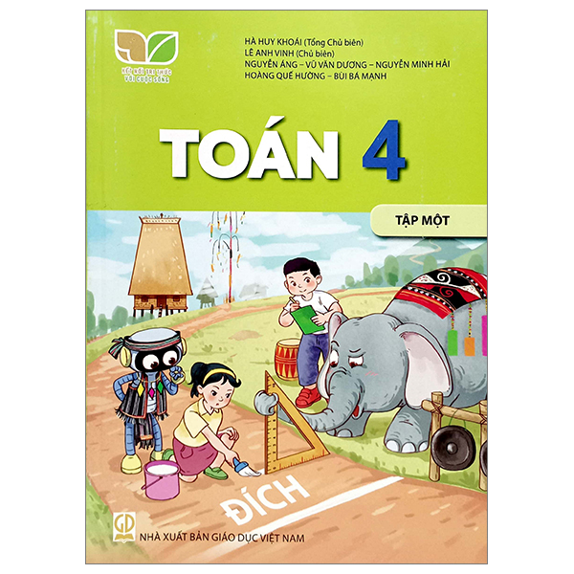
maths
/mæθs/
môn Toán, toán học

Slide 20
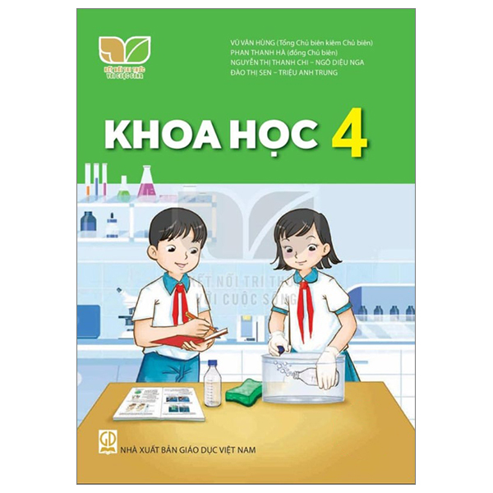
Vocabulary
science
/ˈsaɪəns/
môn Khoa học

Slide 21
Vocabulary
English
/ˈɪŋɡlɪʃ/
môn Tiếng Anh

Slide 22
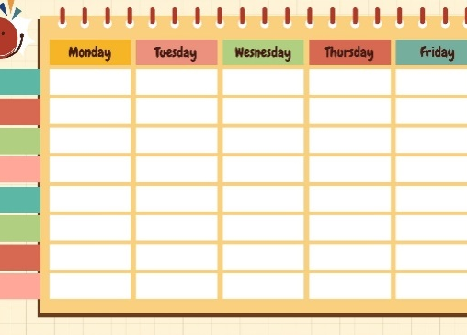
Review
timetable
subjects
Vietnamese
maths
science
English

Slide 23
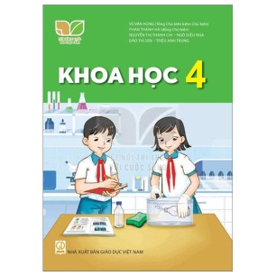
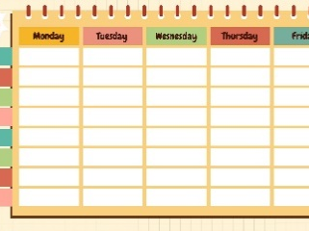
Match
1
2
3
4
5
6
a
b
c
d
e
f
science
English
maths
Vietnamese
subjects
timetable

Slide 24
timetable
thời khóa biểu
subjects
môn học
Vietnamese
môn Tiếng Việt
maths
môn Toán
science
môn Khoa học
English
môn Tiếng Anh

Slide 25
Structures

Slide 26
Structures
Hỏi “ngày hôm nay bạn có môn học gì”:
What subjects do you have today?
I have _______.
(Hôm nay bạn có môn học gì?)
(Tôi có ______.)

Slide 27
Unit 7.1
What subjects do you have today?
I have______.
Vietnamese
maths
science
English

Slide 28
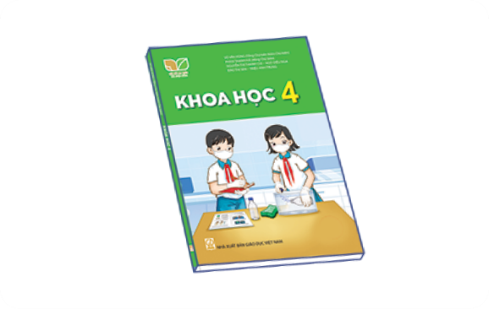
2. Listen, point and say.
a
b
What subjects do you have today?
Vietnamese
English
I have______.
c
d
maths
science

Slide 29
2. Listen, point and say.
Vietnamese
What subjects do you have today?
I have Vietnamese.

Slide 30
2. Listen, point and say.
English
What subjects do you have today?
I have English.

Slide 31
2. Listen, point and say.
maths
What subjects do you have today?
I have maths.

Slide 32
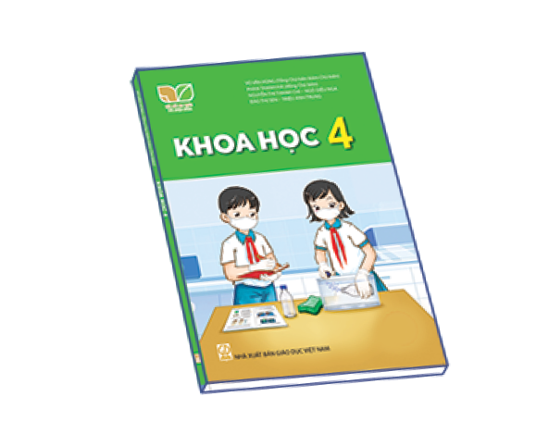
2. Listen, point and say.
science
What subjects do you have today?
I have science.

Slide 33
3. Let’s talk.

Slide 34
Facebook : Bùi Liễu
0968142780
Let’s play!

Slide 35
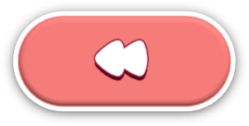
Find Pikachu
Facebook : Bùi Liễu
0968142780

Slide 36
Facebook : Bùi Liễu
0968142780
A. English
B. Vietnamese
C. science

Slide 37
A. science
Facebook : Bùi Liễu
0968142780
B. maths
C. Vietnamese

Slide 38
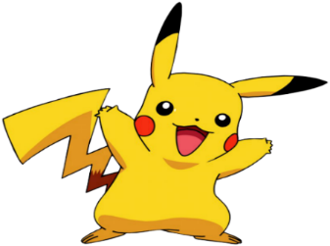
A. maths
B. science
C. English

Slide 39
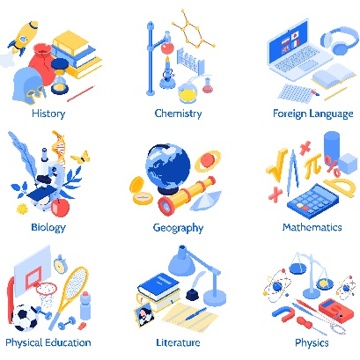
Facebook : Bùi Liễu
0968142780
A.timetables
B. subjects
C. science

Slide 40
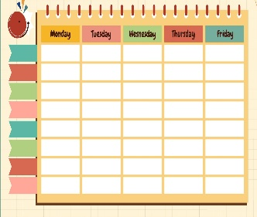
Facebook : Bùi Liễu
0968142780
a
b
c

Slide 41
Facebook : Bùi Liễu
0968142780
a
b
c

Slide 42
a
b
c

Slide 43
Facebook : Bùi Liễu
0968142780
a
b
c

Slide 44
What subjects do you have today?
A. I have maths.
B. I have English.
C. I have science.

Slide 45
A. I have maths and English.
What subjects do you have today?
B. I have science and maths.
C. I have English and science.

Slide 46
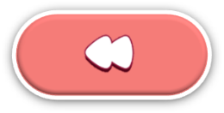
Excellent!

Slide 47
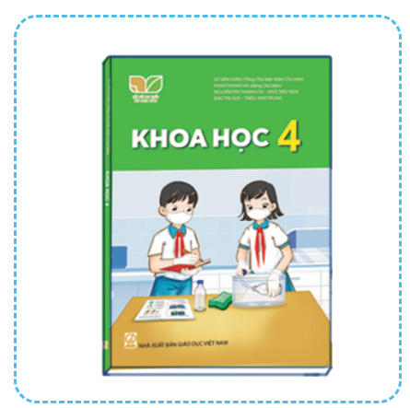
4. Listen and tick or cross.
1.
2.
3.
4.

Slide 48
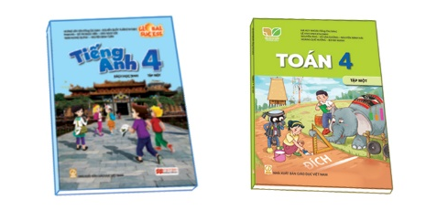
5. Look, complete and read.
1.
A: What subjects do you have today?
B: I have ___________.
Vietnamese
2.
A: What subjects do you have today?
B: I ________________.
have maths
3.
A: ______ subjects do you have today?
B: I have English and _________.
What
science
4.
A: What subjects ___________ today?
B: I have ________and ________.
do you have
English
maths

Slide 49
6. Let’s play.

Slide 50
Wrap up

Slide 51
Unit 7.1
What subjects do you have today?
I have______.
Vietnamese
maths
science
English

Slide 52
Homework
Learn by heart all the new words.
Read again the dialogue in part 1.

Slide 53
Facebook : Bùi Liễu
0968142780
Thank you!

