Slide 1
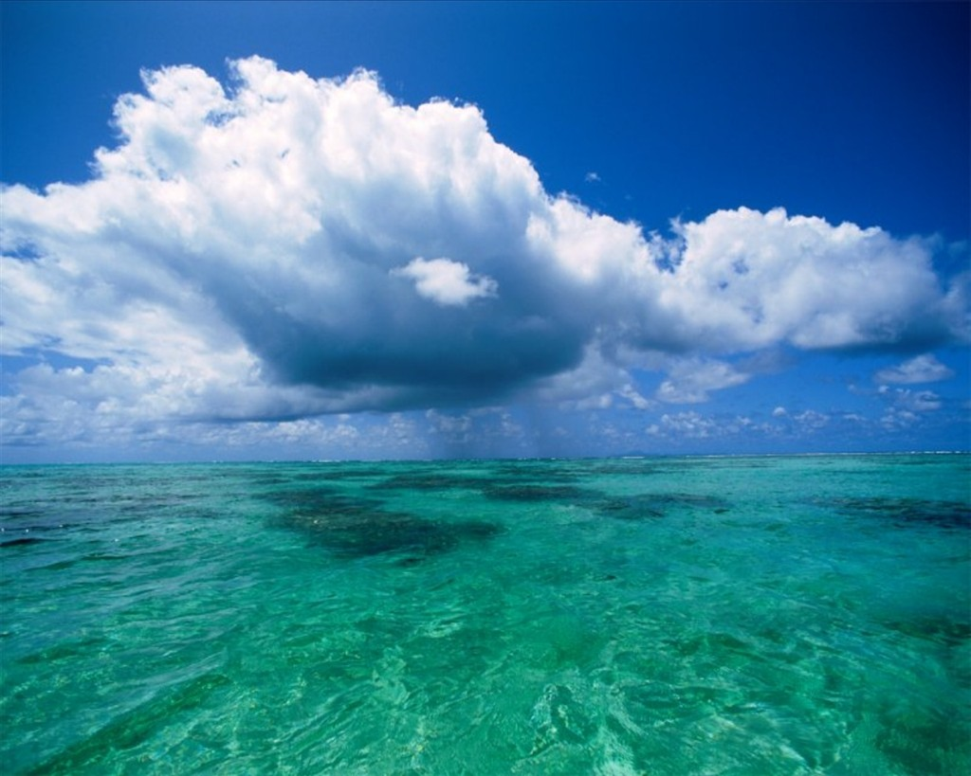
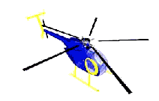
DAI LOC DEPARTMENT OF EDUCATION AND TRAINING
NGUYEN CONG SAU PRIMARY SCHOOL
WELCOME TO OUR CLASS
Subject: English
Class: 5B
Teacher: Ngo Hang Thao

Slide 2
Warm up
Remembering pictures

Slide 3
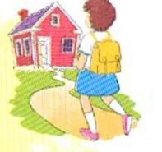
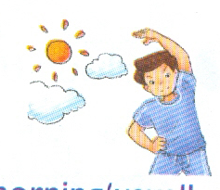
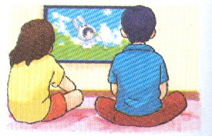
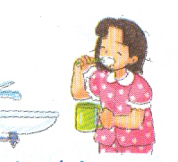
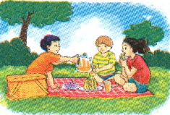
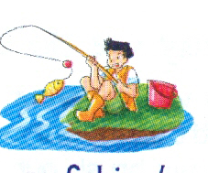
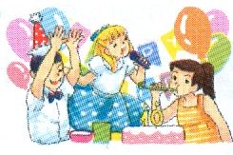
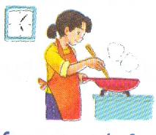

Slide 4
go to school
do morning exercise
watch cartoon
brush teeth
go on a picnic
go fishing
enjoy the party
cook dinner

Slide 5
Review 1
Part: 3- 4- 5
New lesson

Slide 6
Part 3. Listen and tick Yes(Y) or No (N)
1. Mai often goes to the cinema.
2. Nam went to the countryside.
Y N
N
Y

Slide 7
Content
1. What do you do in your free time, Mai?
I usually read book and watch cartoon on T V.
How often do you go to the cinema?
Oh, I never go to the cinema. I only watch films on TV.
2. What did you do last weekend, Nam?
I visited my grandparents.
Where do they live?
They live in the countryside.

Slide 8
Part 4: Read and circle a or b.
Linda usually goes to school in the morning. Yesterday, she didn’t go to school because it was Sunday. She went shopping with her mother after breakfast. They shopped for food and drink and a lot of things for the family. In the afternoon, the family visited Linda’s grandprents in the countryside. The grandprents were very happy to see them. The family enjoyed their day in the countryside and went back home in the evening. Next week, they will visit Linda’s grandparents again.

Slide 9
1.What does Linda usually do in the morning?
She does morning exercise.
B. She goes to school.
2. Did she go to school yesterday?
Yes, she did.
No, she didn’t.
3. Where did she go in the morning?
She went shopping.
She went to the countryside.
4. Where do Linda’s grandparents live?
In the city.
In the countryside.
5. When will the family visit Linda’s grandparents?
Next week.
Next month.

Slide 10
1.What does Linda usually do in the morning?
She does morning exercise.
B. She goes to school.
2. Did she go to school yesterday?
Yes, she did.
No, she didn’t.
3. Where did she go in the morning?
She went shopping.
She went to the countryside.
4. Where do Linda’s grandparents live?
In the city.
In the countryside.
5. When will the family visit Linda’s grandparents?
Next week.
Next month.
Linda usually goes to school in the morning. Yesterday, she didn’t go to school because it as Sunday. She went shopping with her mother after breakfast. They shopped for food and drink and a lot of things for the family. In the afternoon, the family visited Linda’s grandprents in the countryside. The grandprents were very happy to see them. The family enjoyed their day in the countryside and went back home in the evening. Next week, they will visit Linda’s grandparent again.

Slide 11
1.What does Linda usually do in the morning?
She does morning exercise.
She goes to school.
2. Did she go to school yesterday?
Yes, she did.
No, she didn’t.
3. Where did she go in the morning?
She went shopping.
She went to the countryside.
4. Where do Linda’s grandparents live?
In the city.
In the countryside.
5. When will the family visit Linda’s grandparents?
Next week.
Next month.
Linda usually goes to school in the morning. Yesterday, she didn’t go to school because it as Sunday. She went shopping with her mother after breakfast. They shopped for food and drink and a lot of things for the family. In the afternoon, the family visited Linda’s grandprents in the countryside. The grandprents were very happy to see them. The family enjoyed their day in the countryside and went back home in the evening. Next week, they will visit Linda’s grandparent again.
b
b
a
b
a

Slide 12
Part 5: Write about you. Then tell the class.
What’s your address?
What’s your place like?
How often do you do morning exercise?
What did you do last summer?
What will you do at the weekend?
Answer the questions.
Tell the class.

Slide 13
Homelink:
Review unit 1 to Unit 5

Slide 14
Thanks for your attendance.
Good bye!

