Slide 1
Unit 5
What will you do this weekend?
Lesson 2

Slide 2
VOCABULARY

Slide 3
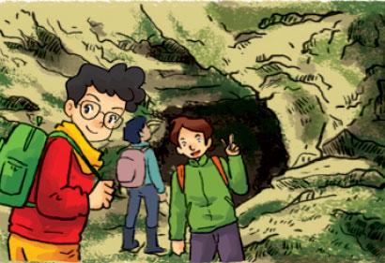
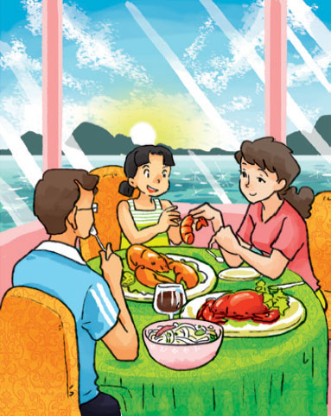
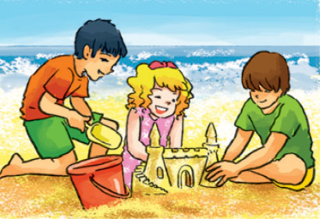
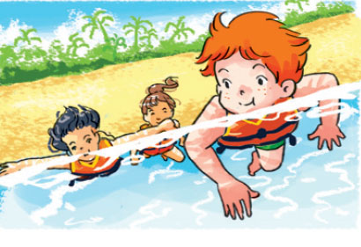
A. Vocabulary
explore the caves
take a boat trip
eat seafood
Khám phá hang động
Đi tham quan bằng thuyền
Ăn đồ biển
build sandcastles
swim in the sea
Xây lâu đài cát
Bơi ở biển

Slide 4
Look read and match
eat
seafood
swim
in the sea
explore
the caves
take
a boat trip
build
sandcastles

Slide 5
GRAMMAR

Slide 6
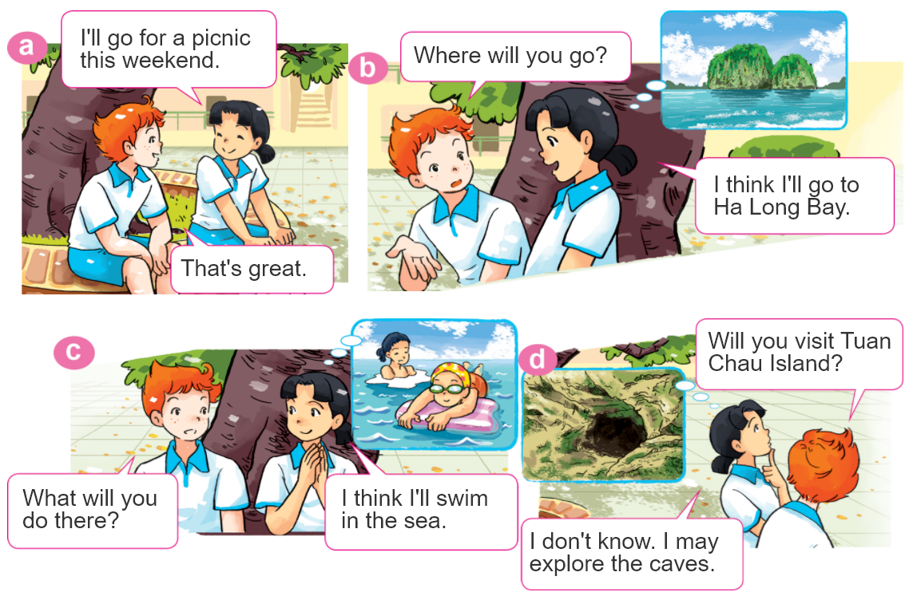
1. Look, listen and repeat

Slide 7
2. Point and say
What will you do at Ha Long Bay?
I think I'll ____________.
explore
the caves
swim
in the sea
take a boat trip
around the islands
build sandcastles
on the beach

Slide 8
2. Point and say
What will you do at Ha Long Bay?
I don’t know. I may ________.
explore
the caves
swim
in the sea
take a boat trip
around the islands
build sandcastles
on the beach

Slide 9
3. Let’s talk.
Where will you be next week?
I think I'll ____________.
I don't know. I may _____________.
What will you do?

Slide 10
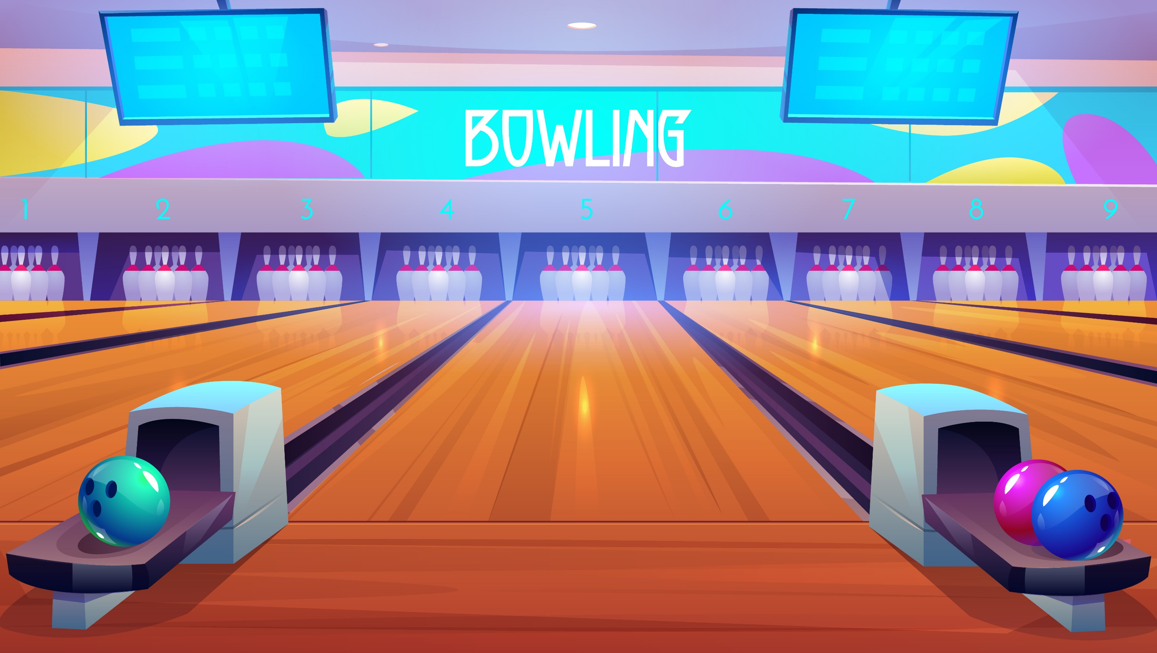
Notes:
Ms Huyền Phạm - 0936.082.789 – YOUTUBE: MsPham. Facebook: Dạy và học cùng công nghệ.

Slide 11
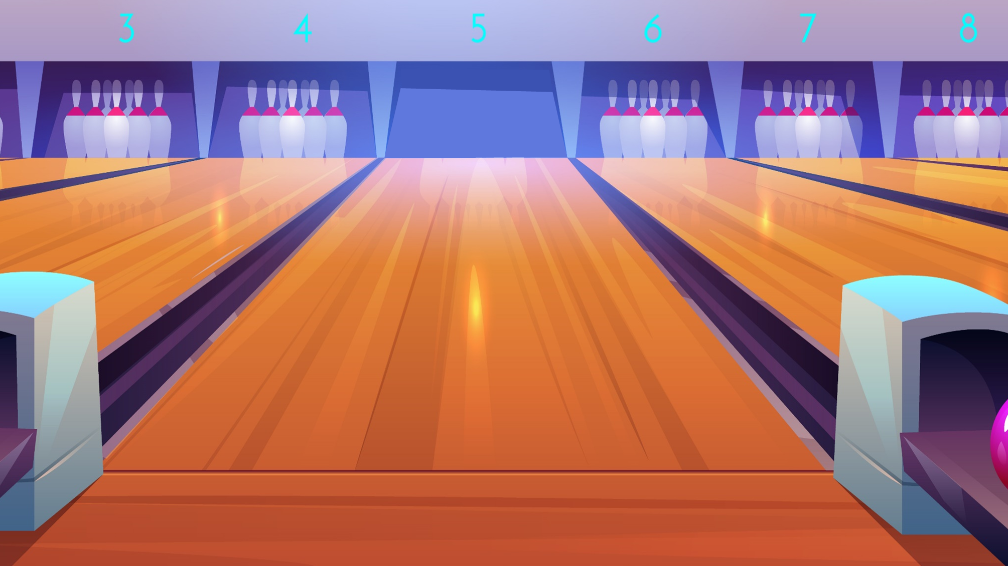
I think I'll explore
the caves.
I think I'll swim
in the sea.
I think I'll take a boat trip around the islands
What will you do at Ha Long Bay?
Next
Notes:
Ms Huyền Phạm - 0936.082.789 – YOUTUBE: MsPham. Facebook: Dạy và học cùng công nghệ.

Slide 12
I may take a boat trip around the islands.
I think I'll explore
the caves.
I may build sandcastles.
What will you do at Ha Long Bay?
I don't know. ______
Next
explore
the caves
swim
in the sea
take a boat trip
around the islands
build sandcastles
on the beach
Notes:
Ms Huyền Phạm - 0936.082.789 – YOUTUBE: MsPham. Facebook: Dạy và học cùng công nghệ.

Slide 13
I think I'll ate seafood.
I think I'll eat seafood.
I think I'll eats seafood.
What will you do at Ha Long Bay?
Next
Notes:
Ms Huyền Phạm - 0936.082.789 – YOUTUBE: MsPham. Facebook: Dạy và học cùng công nghệ.

Slide 14
I think I'll explore
the caves.
I think I'll take a boat trip around the islands.
I think I'll build sandcastles
on the beach.
What will you do at Ha Long Bay?
Next
Notes:
Ms Huyền Phạm - 0936.082.789 – YOUTUBE: MsPham. Facebook: Dạy và học cùng công nghệ.

Slide 15
I don't know. I may
I don't know. I did
What will you do at Ha Long Bay?
_________ explore
the caves.
I don't know. I my
Notes:
Ms Huyền Phạm - 0936.082.789 – YOUTUBE: MsPham. Facebook: Dạy và học cùng công nghệ.

Slide 16
I don’t know. I may sang and danced.
I don’t know. I sang and danced.
What will you do at Ha Long Bay?
I don’t know. I may sing and dance.
Next
Notes:
Ms Huyền Phạm - 0936.082.789 – YOUTUBE: MsPham. Facebook: Dạy và học cùng công nghệ.

Slide 17
I don’t know. I may explore the cave.
I don’t know. I may explored the cave.
What will you do at Ha Long Bay?
I don’t know. I may explores the cave.
Next
Notes:
Ms Huyền Phạm - 0936.082.789 – YOUTUBE: MsPham. Facebook: Dạy và học cùng công nghệ.

Slide 18
What will you do
Where will you do
________ in the countryside?
I think I’ll go for a picnic.
When will you do
Notes:
Ms Huyền Phạm - 0936.082.789 – YOUTUBE: MsPham. Facebook: Dạy và học cùng công nghệ.

Slide 19
What do you do
_______at Ha Long Bay?
I think I will take a boat trip around the islands.
What will you do
What did you do
Next
Notes:
Ms Huyền Phạm - 0936.082.789 – YOUTUBE: MsPham. Facebook: Dạy và học cùng công nghệ.

Slide 20
Good job!
EXIT
Notes:
Ms Huyền Phạm - 0936.082.789 – YOUTUBE: MsPham. Facebook: Dạy và học cùng công nghệ.

Slide 21
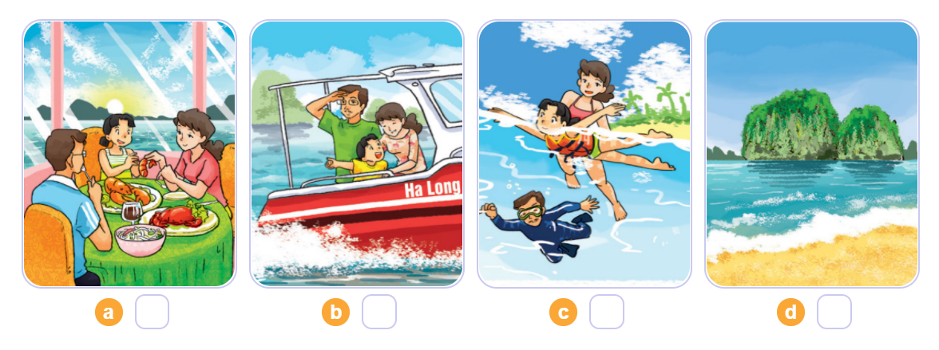
4. Listen and number
3
2
4
1
1
2
3
4

Slide 22
5. Write about your daily routines.
Where will you be tomorrow?
____________________________________.
2. What will you do?
____________________________________.

Slide 23
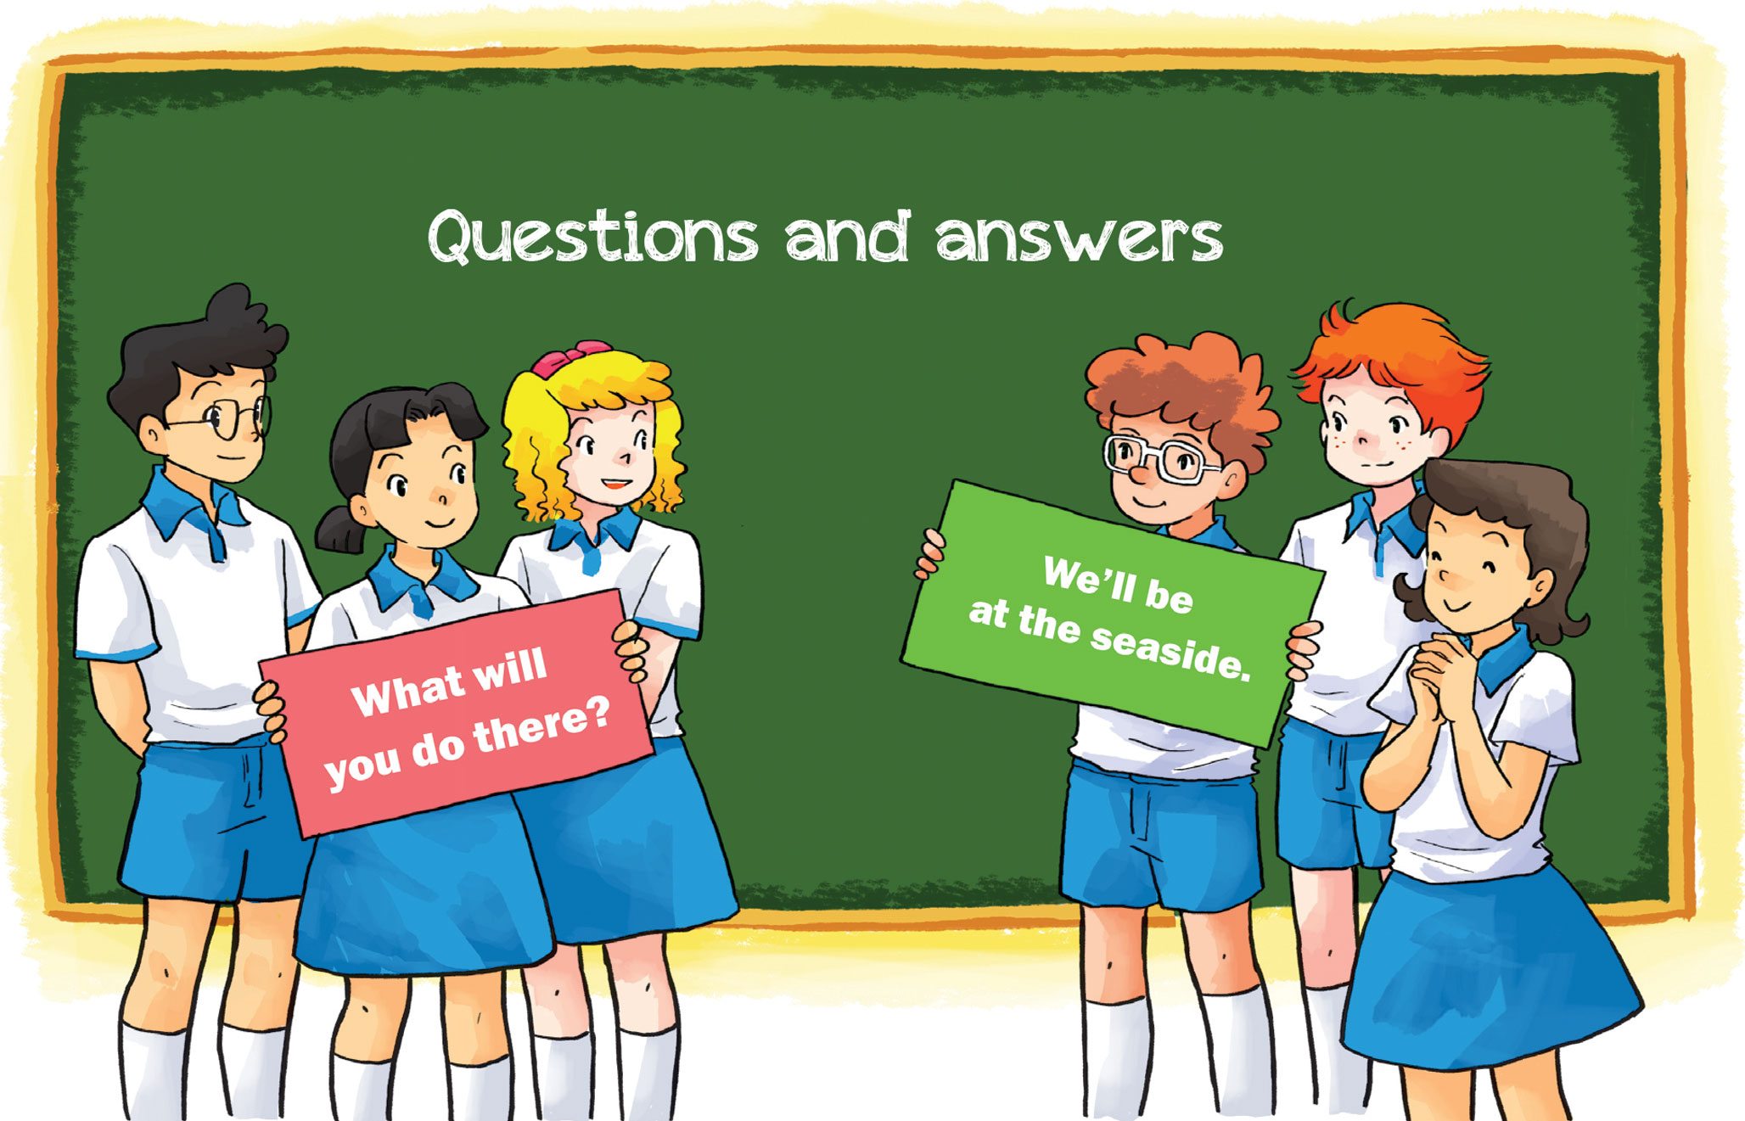
6. Let’s play.

