Slide 1
Lesson 1
Notes:
Click on the words, they will move and match up with the pictures.

Slide 2
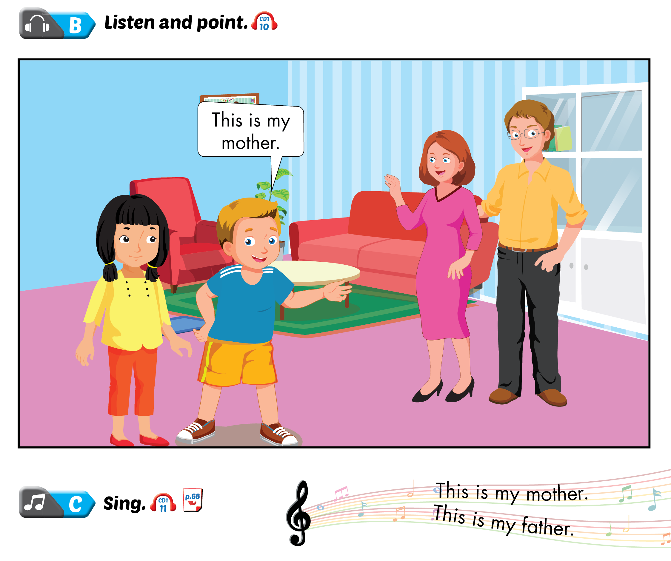
Lesson 1

Slide 3
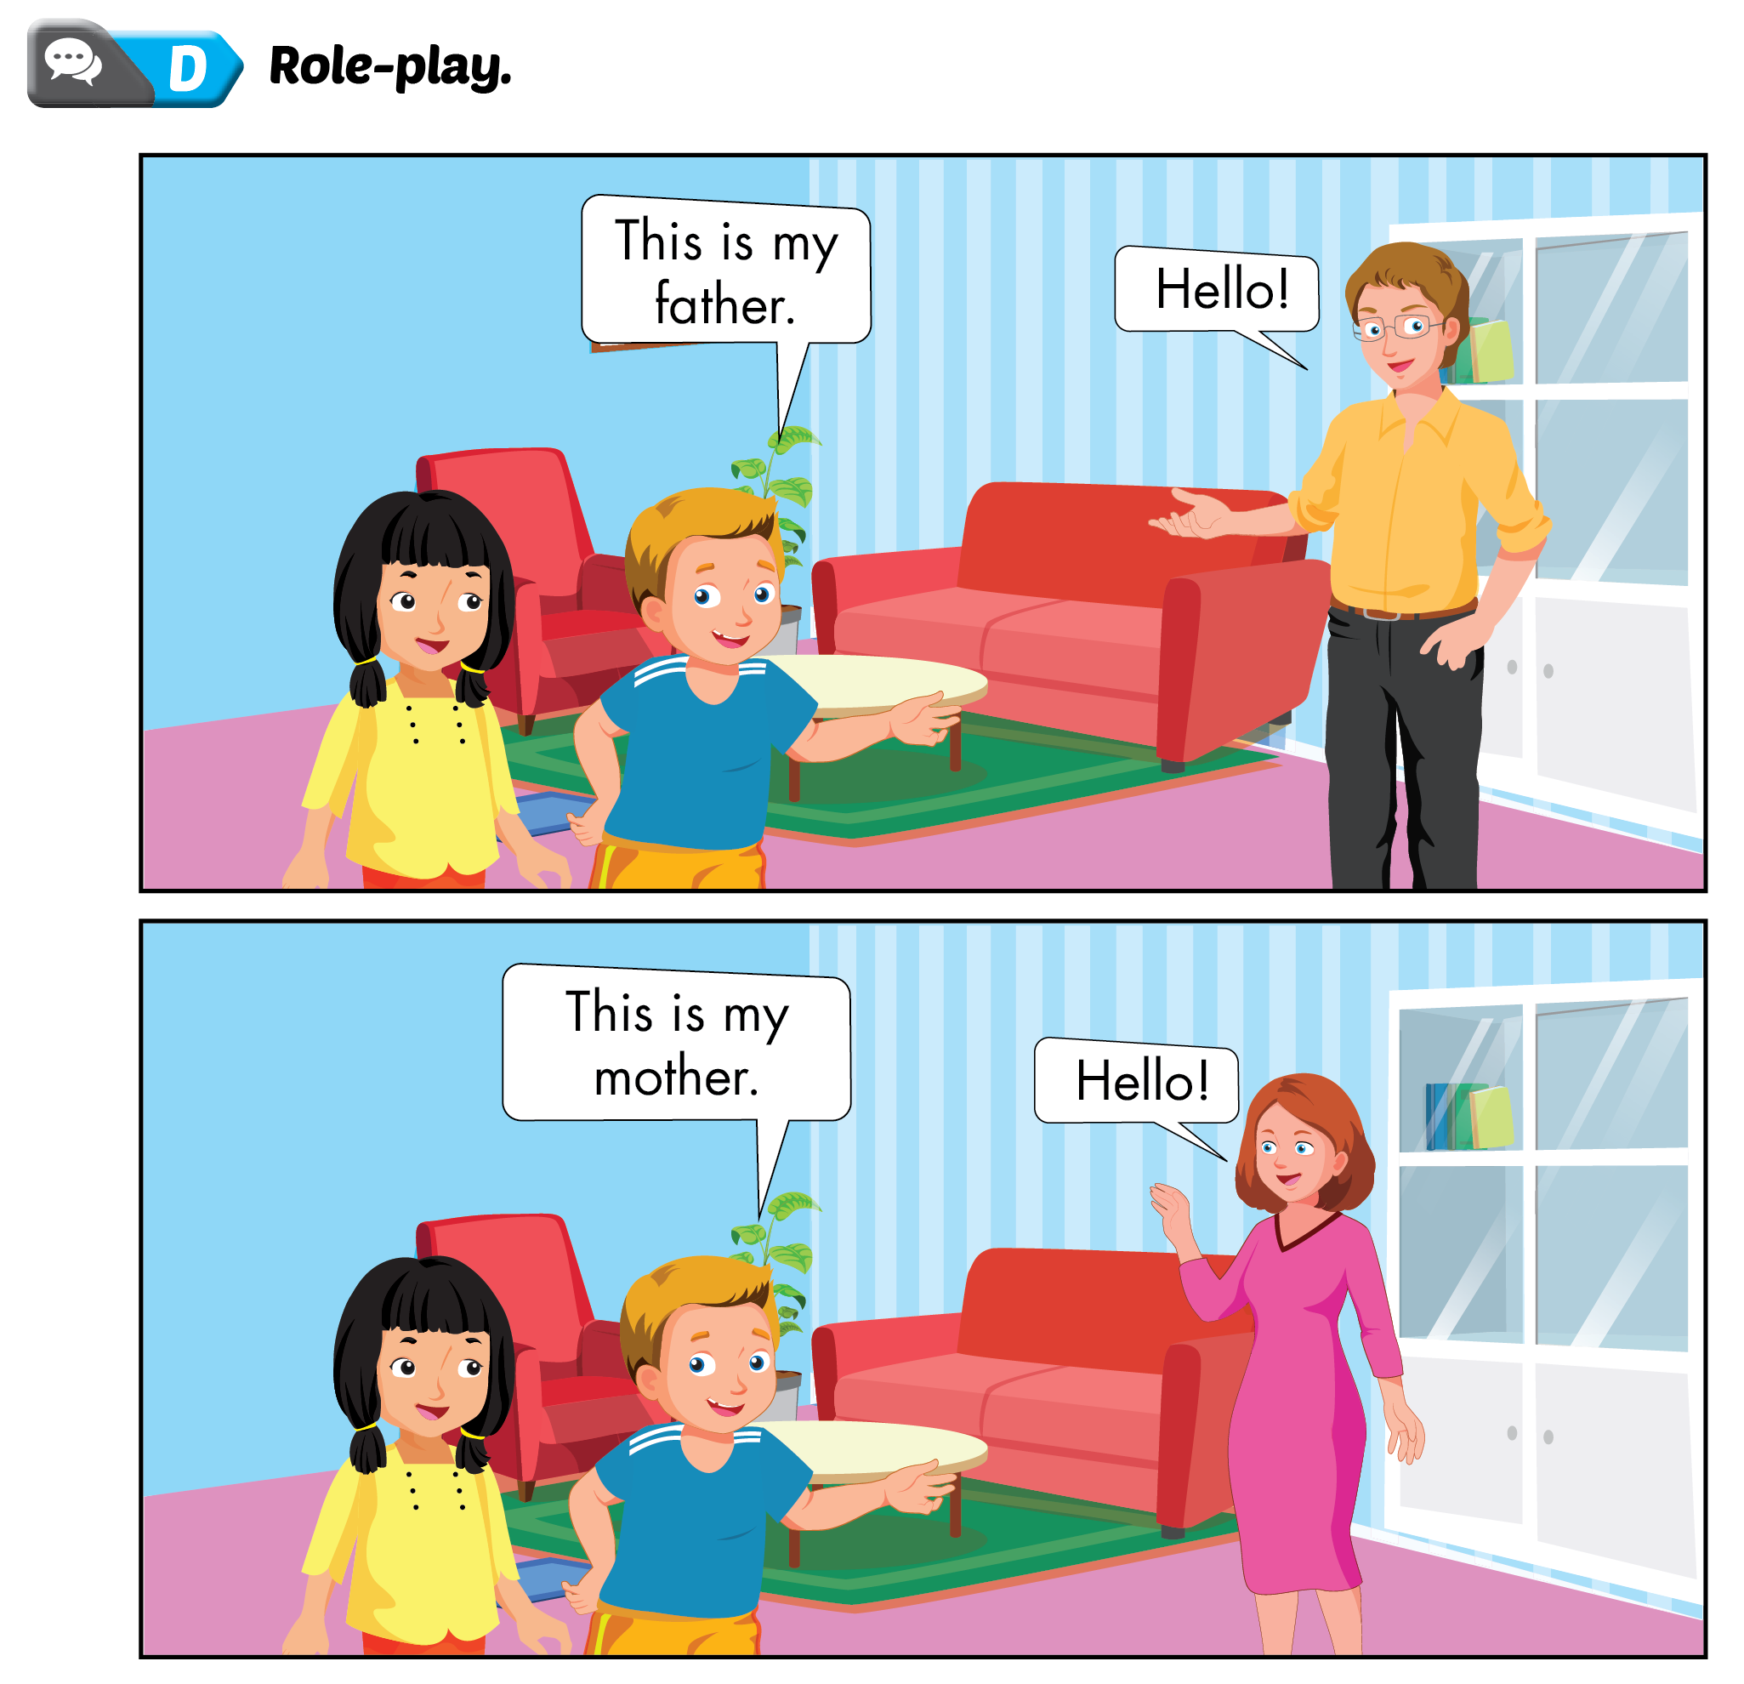
Lesson 1

Slide 4
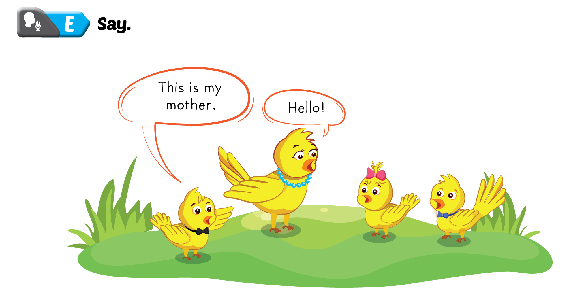
Lesson 1

Slide 6
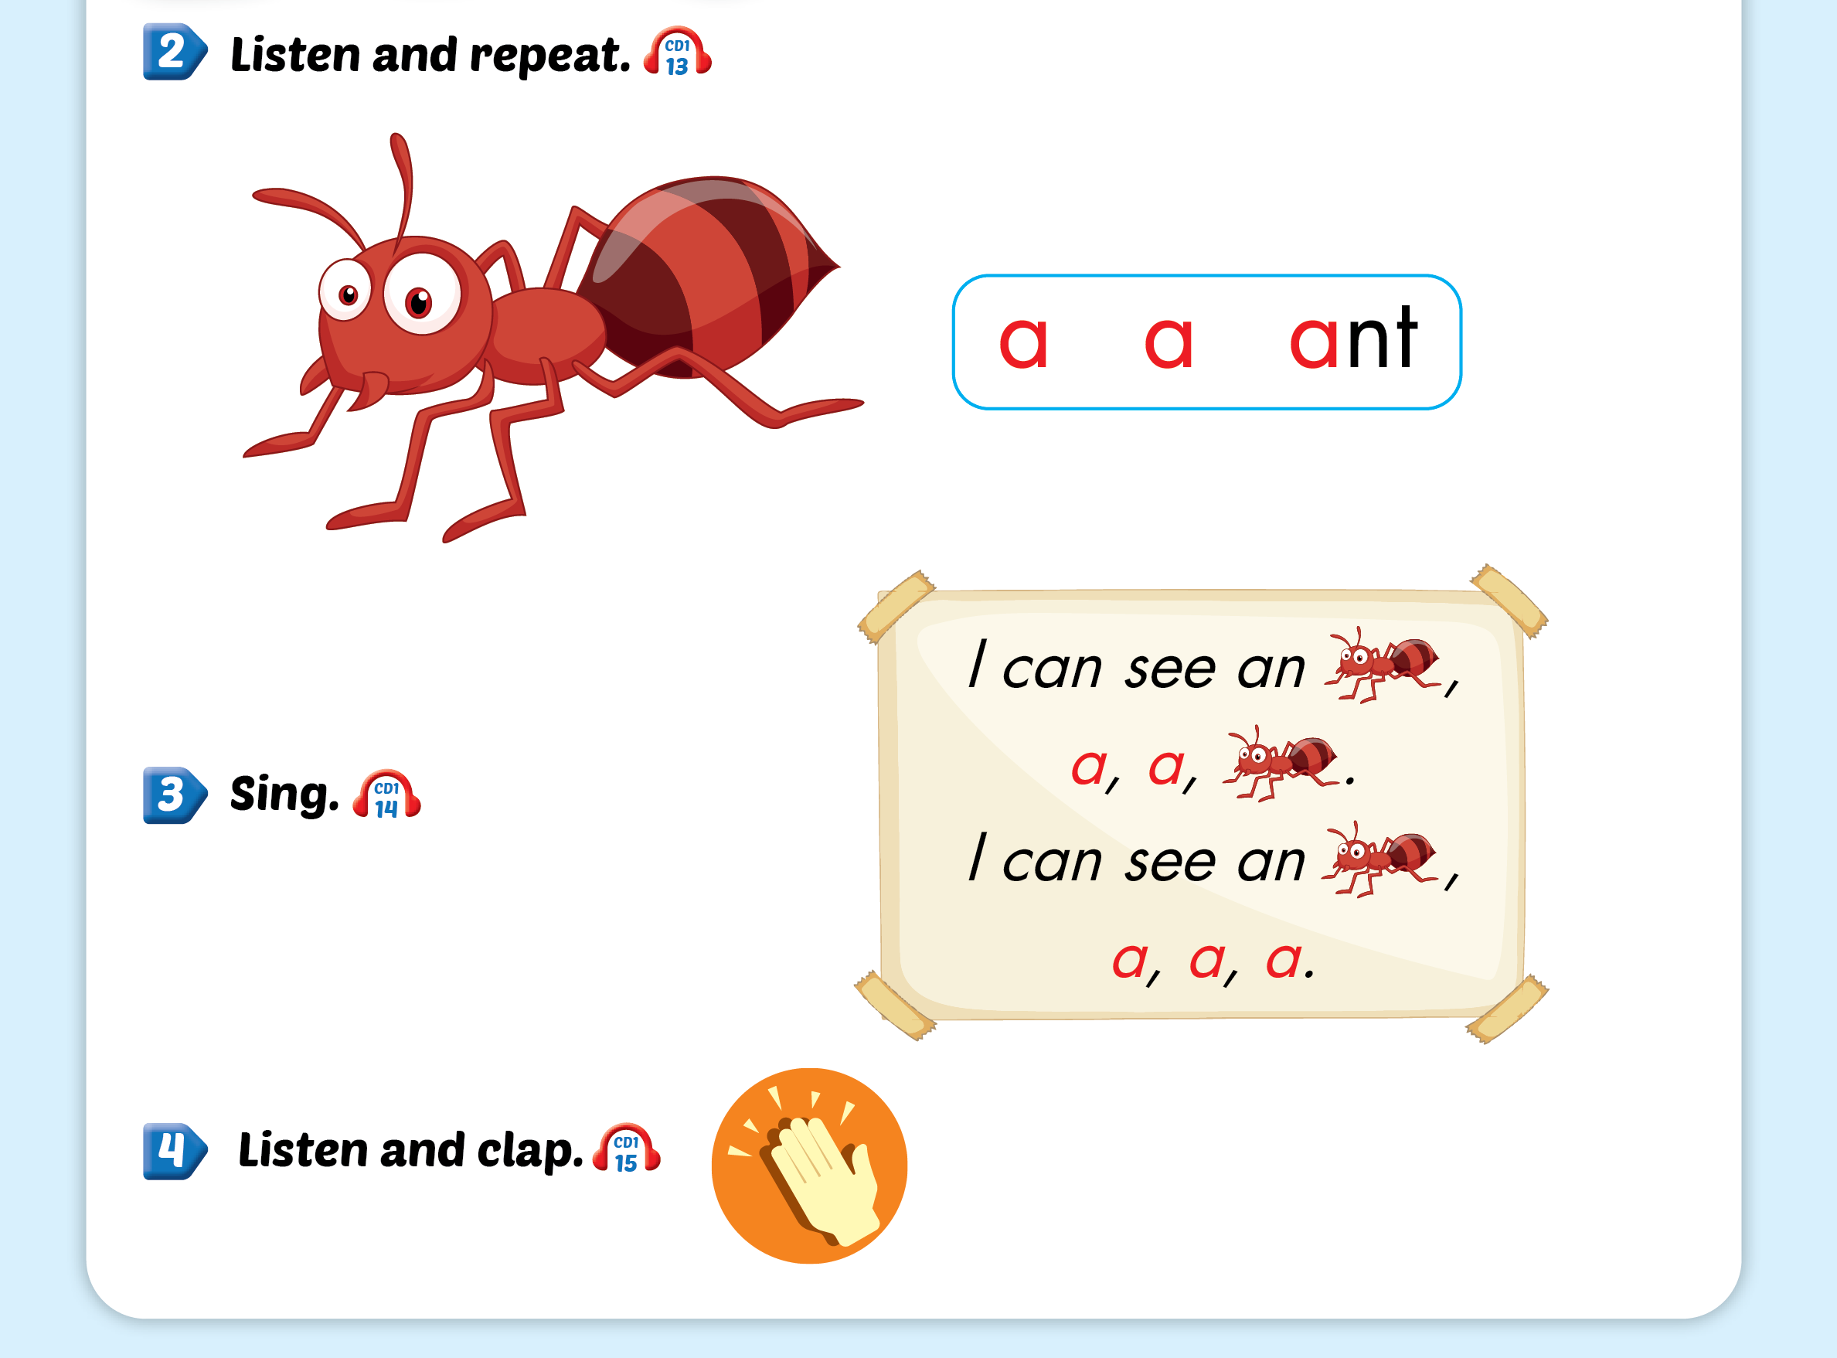
Lesson 2

Slide 7
Lesson 2

Slide 8
Lesson 2

Slide 9
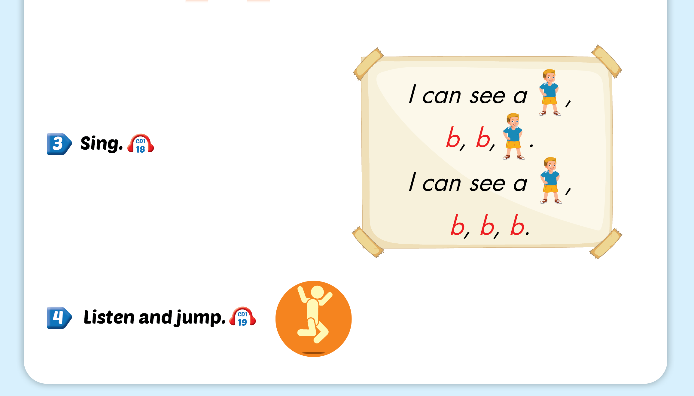
Lesson 2

Slide 11
Lesson 3

Slide 12
Lesson 3

Slide 13
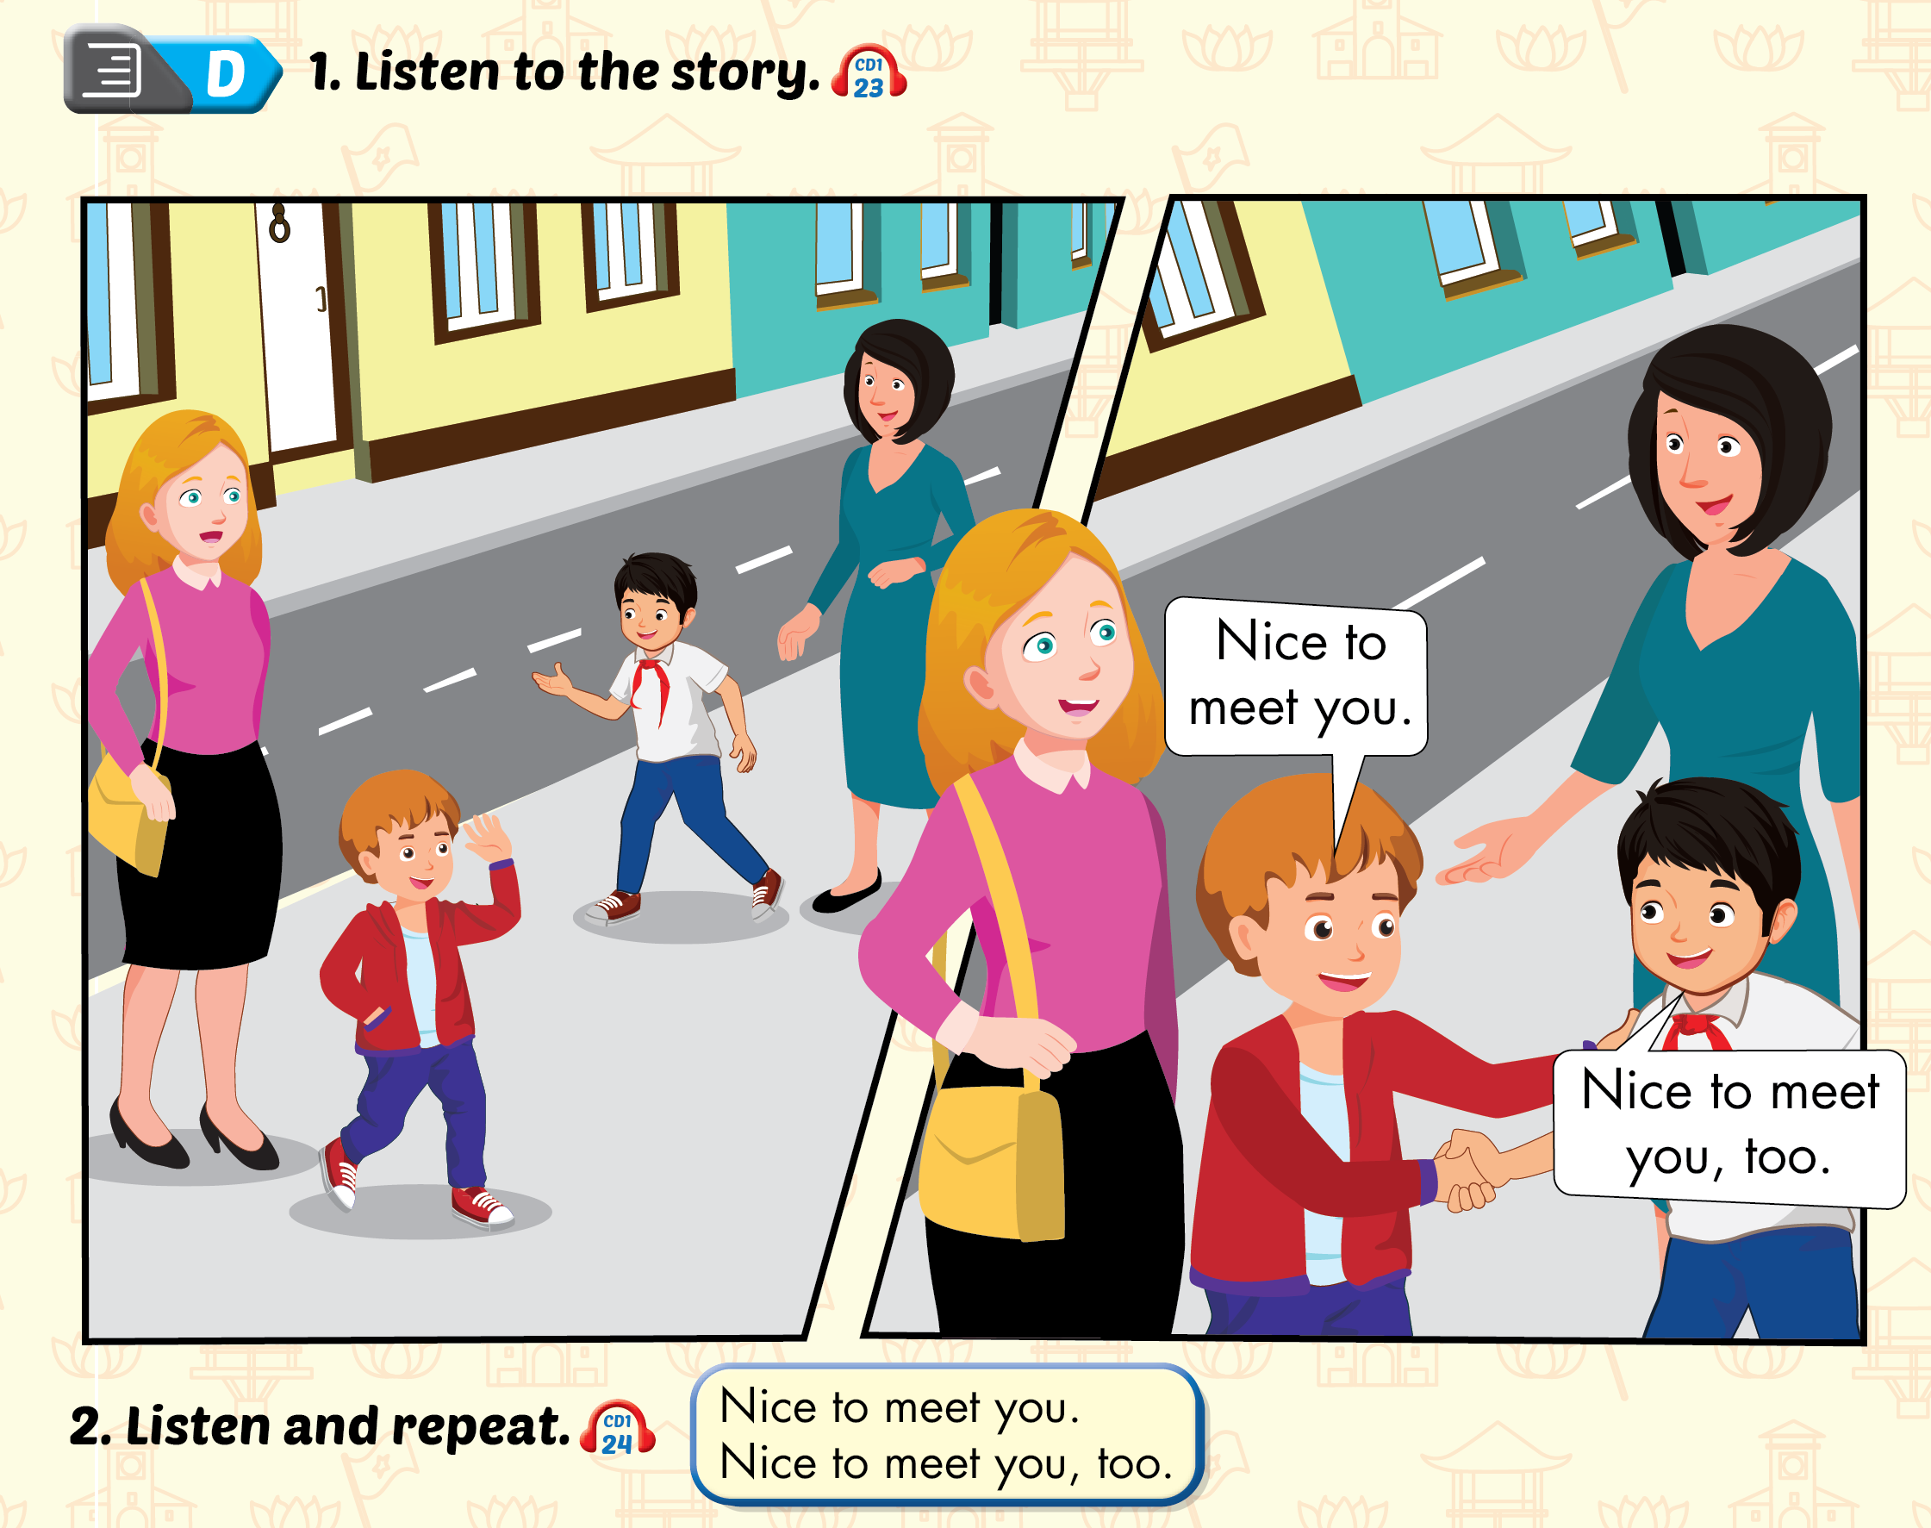
Lesson 3

Slide 14
Lesson 3

