Slide 2
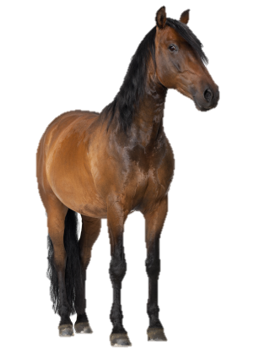
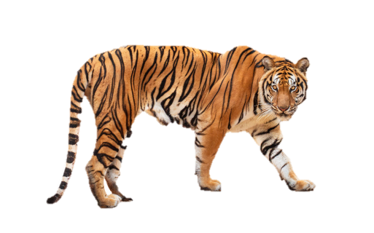
At the zoo
20
LESSON 3
Period 6

Slide 3
01
Warm up

Slide 4
Notes:
Sing a song

Slide 5
02
Read and tick
Notes:
Step 1: Tell the class the goal of this activity and how to complete the task. Tell pupils that the text is about a visit to a zoo and what some animals are doing. Check comprehension and give feedback.
Step 2: Do Sentence 1 as an example. First, have pupils read the sentence and identify where Linh and her mother are. Then have them read the text and find the appropriate information to tick in the True box or False box. Check comprehension.
Step 3: Set a time limit for pupils to do the activity independently. Go around the classroom and offer help where necessary.
Step 4: Let pupils swap and check the answers. Correct the answers if necessary.
Extension: If time allows, select one or two pupils to read the text in front of the class. You may ask pupils to correct the false sentences with the information from the text.

Slide 6
Notes:
Key: 1. True 2. False 3. True 4. True

Slide 7
Notes:
Key: 1. True 2. False 3. True 4. True

Slide 8
Choose the correct word.
elephant zoo climbing counting
peacock swinging parrot
1
2
3
4
5
Notes:
Choose the correct word.

Slide 9
elephant zoo climbing counting
peacock swinging parrot

Slide 10
03
Let’s write
Notes:
Step 1: Tell the class the goal of this activity: Pupils read the gapped text and fill in the gaps with their own experience. Explain that the first gap should be animals, the second gap should be what the monkey is doing, the next gap can be an animal and the last gap can be what the pupils think about the animals at the zoo. Check comprehension.
Step 2: Give pupils time to complete the text independently. Go around the classroom and offer help where necessary.
Step 3: In pairs or groups, ask pupils to swap their complete text before checking as a class. Praise them when they do the task well

Slide 12
animals
swinging
peacock
like

Slide 13
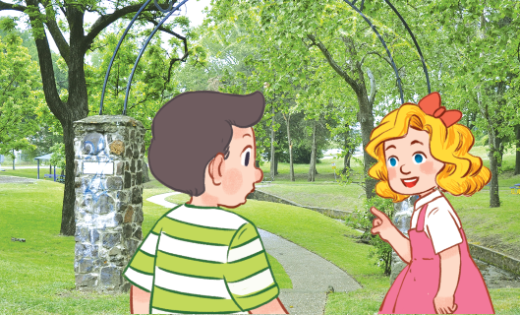
My day at the zoo
Notes:
Speaking: My day at the zoo.
Ask pupils to work in group of 4.
Pupils will listen and answer their friend ‘s questions about their day at the zoo (based on their writing)
For example:
How many friends are there at the zoo with you?
How many animals at the zoo?
What animal is dancing?
What is the mokey doing?
Do you like animals at the zoo?

Slide 14
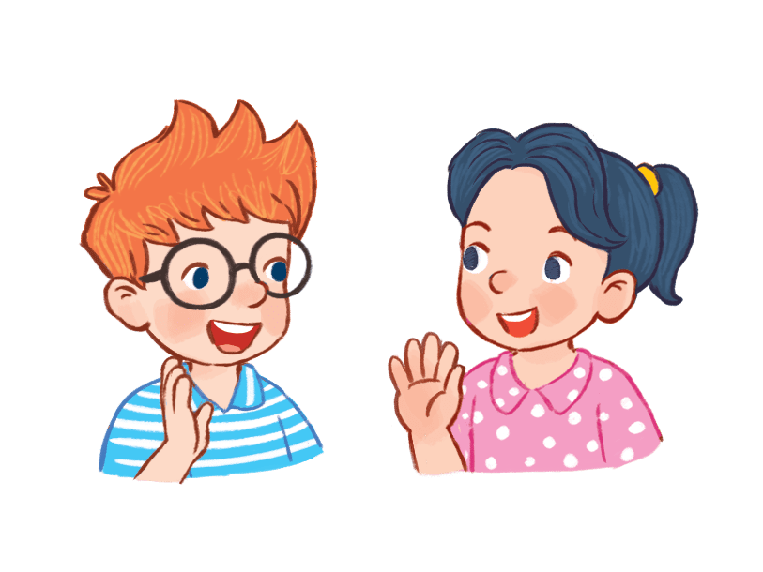
What animal
is dancing?
The elephant
is dancing
Notes:
What animal is dancing?

Slide 15
What is the monkey doing?
The mokey is climbing tree.
Notes:
What is the mokey doing?

Slide 16
Do you like animals at the zoo?
Yes, I do
Notes:
Do you like animals at the zoo?

Slide 17
04
Project
Notes:
Step 1: Tell pupils about the goal of the activity. Explain that they are going to show some photos of animals (at home or at the zoo) which they have found as homework and tell the class about them.
Step 2: Have pupils work in groups. Each member shows his / her photos and introduces them, e.g. I can see a dog at home. I can see two monkeys at the zoo. Go around and praise pupils when they perform well.
Step 3: Invite one or two pupils to show their photos to the class and say what animals they can see at home or / and at the zoo.

Slide 19
05
Fun corner and wrap up
Notes:
Game: Go to the zoo
Divide classroom into 6 corners. There is a zoo keeper and a picture of an animal at each corner.
Pupils go around classroom. Look at the picture, talk to their friends about that animal.
Example: What can you see? I can see a ___
What is the ___ doing? The ___ is ____
Then put a tick to show that you have visited that corner.

Slide 20
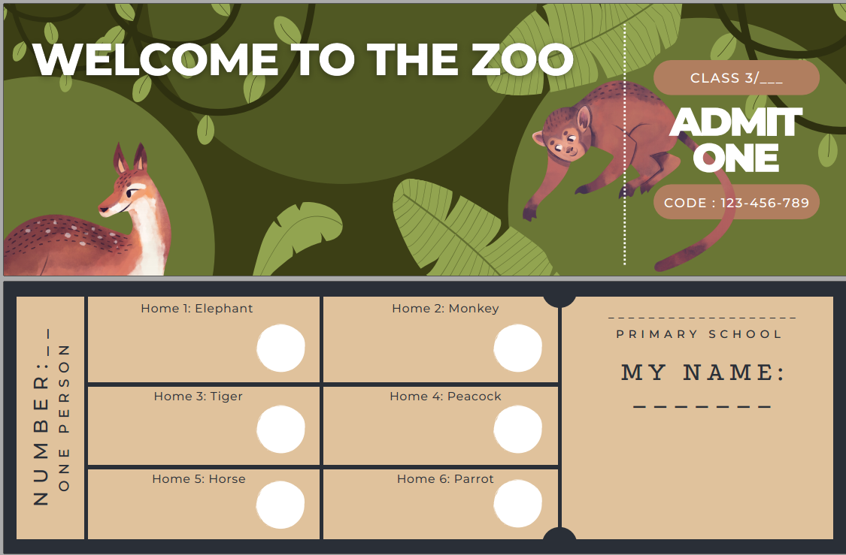
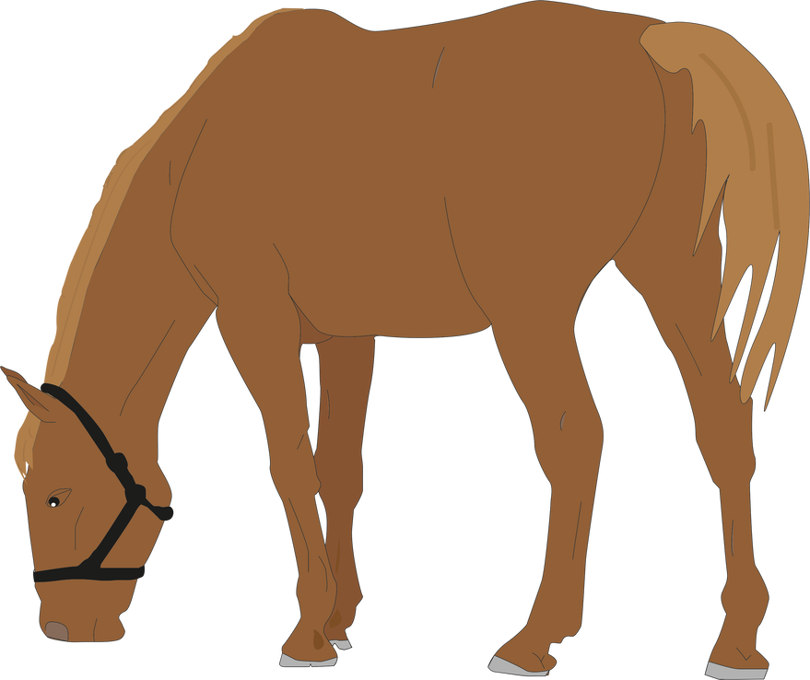

Slide 21
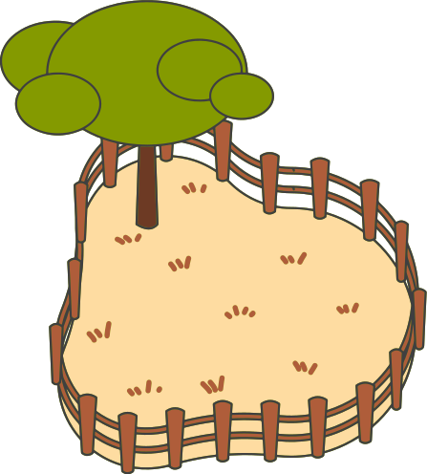
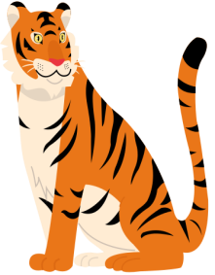
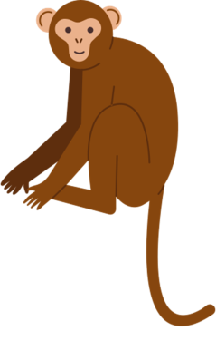

Slide 22
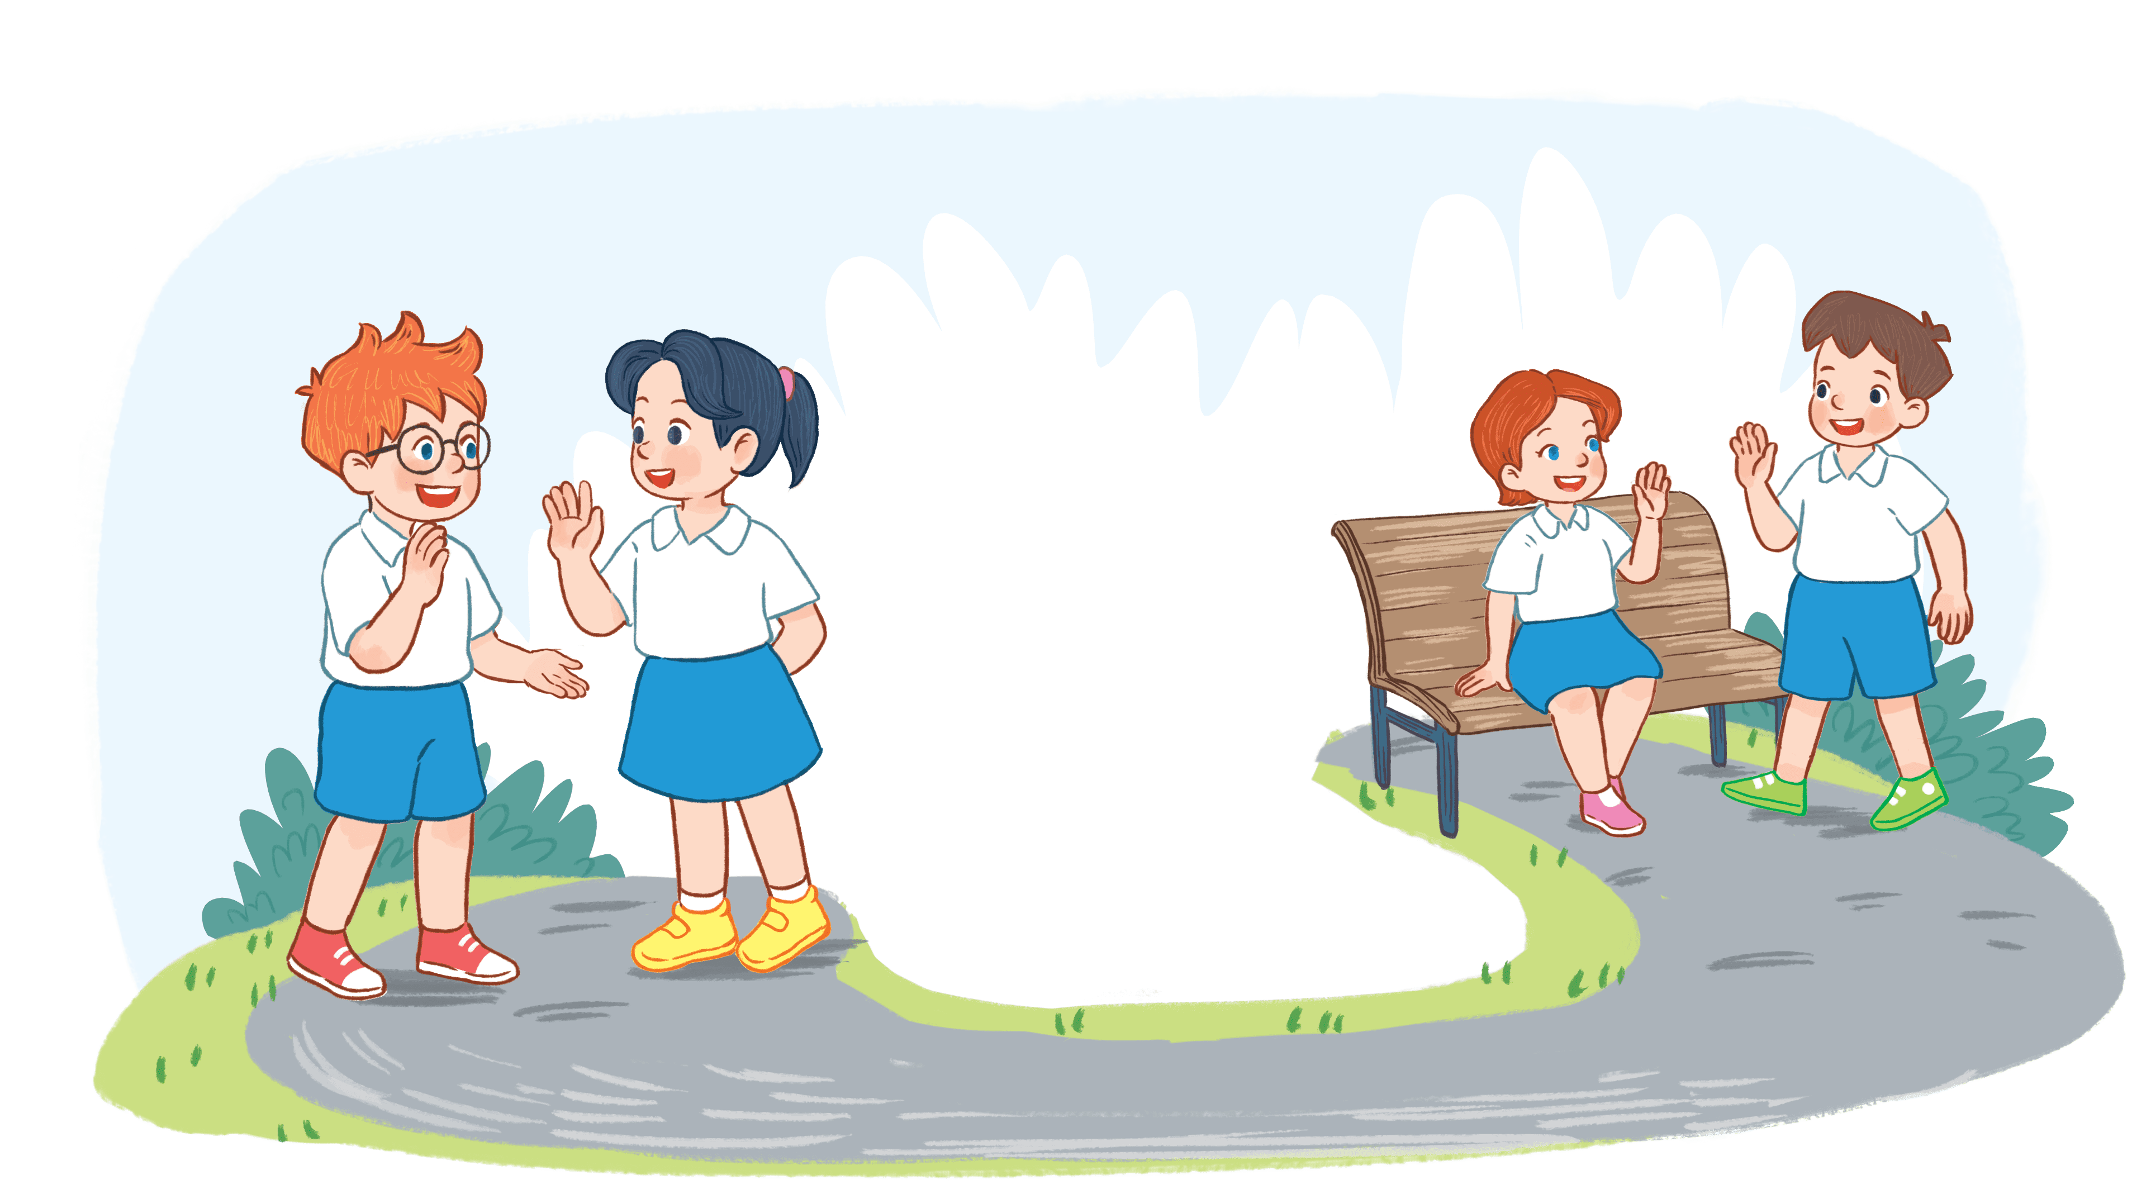
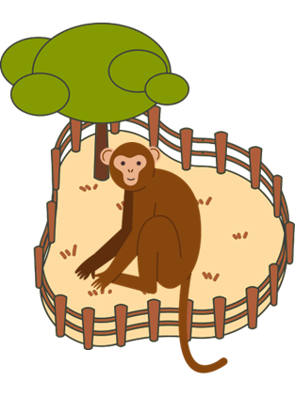
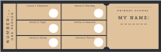
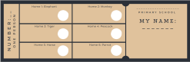
What can you see?
I can see a monkey.
What is the parrot doing?
The parrot is counting.

Slide 23
It’s
amazing!

Slide 24
Goodbye!

Slide 25
Homework
Workbook, page …

Slide 26
THANK YOU

