Slide 1


Slide 2



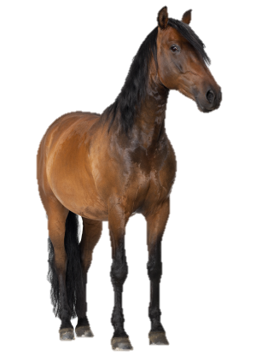
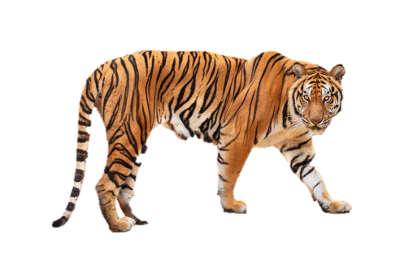


At the zoo
20
LESSON 2
Period 3

Slide 3










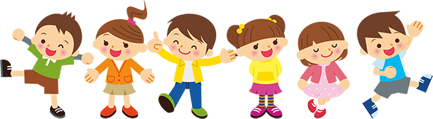

01
Warm up

Slide 4

















Team A
Team B
Next
Notes:
Game: Animal quiz

Slide 5



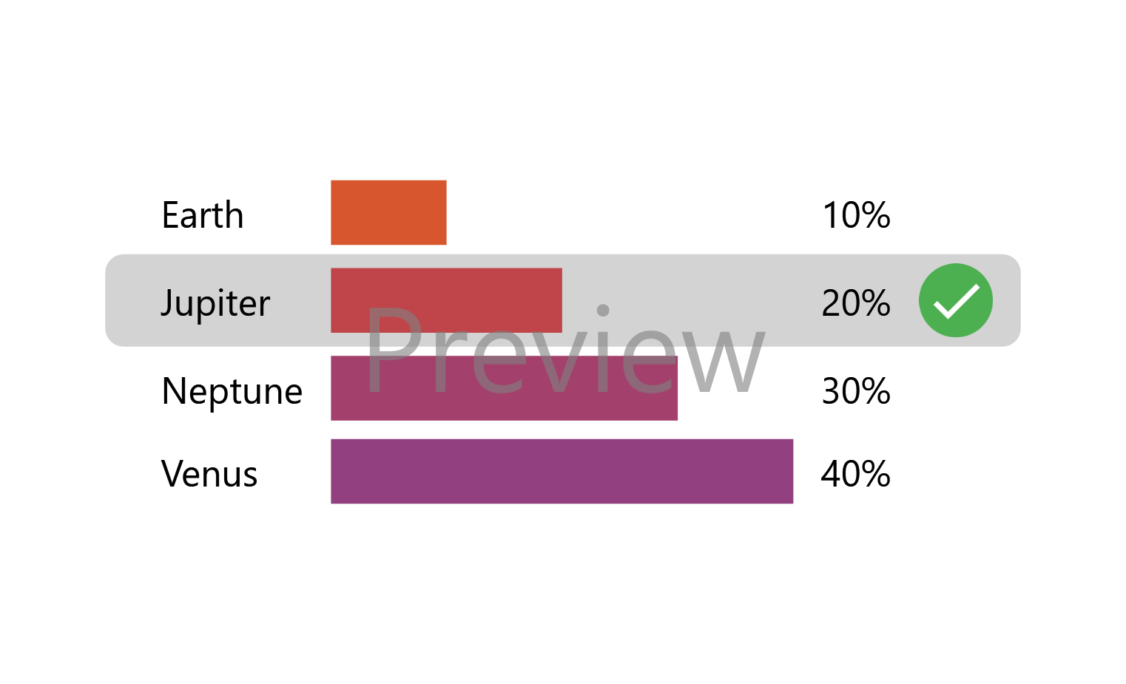
Question 1
This animal is orange and black.
It has sharp teeth and big claws.
tiger
lion
parrot
chicken
Notes:
red

Slide 6
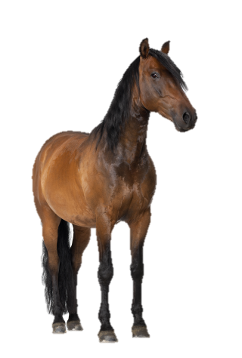
Question 2
This animal is brown, black or white.
It can run very fast.
bird
elephant
crocodile
horse
Notes:
green

Slide 7
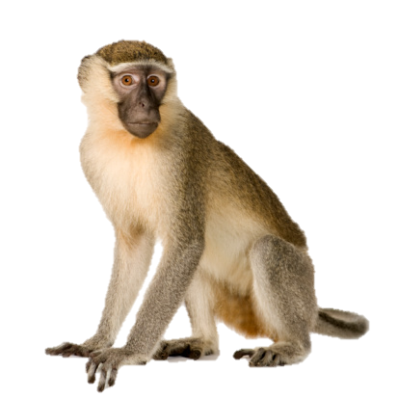
Question 3
This animal is brown or black.
It can jump and climb trees. It likes bananas.
hippo
peacock
monkey
bear
Notes:
yellow

Slide 8

Question 4
This animal is big and grey.
It has a long nose and two big ears .
bird
elephant
crocodile
horse
Notes:
blue

Slide 9
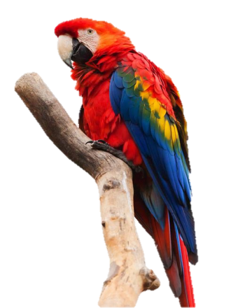
Question 5
This animal is red, yellow and blue. It has a peak and two wings. It can fly very high.
parrot
zebra
deer
panda
Notes:
red

Slide 10

Question 6
This animal is blue and green.
It has a large, beautiful tail.
giraffe
peacock
horse
snake
Notes:
blue

Slide 11
02
Look, listen
and repeat
Notes:
Step 1: Have pupils look at Context a. Ask them some questions such as Where’s Mai?, What
can she see?. Remind them that the question What can you see? and the answer I can see an
elephant. are used to ask and answer about what someone can see.
Step 2: Get pupils to look at Context a. Play the recording once for pupils to listen and repeat the
language. Point at the sentences while speaking. Go around the classroom and offer help if
necessary.
Step 3: Repeat Step 2 for Context b. Draw their attention to the question What is the elephant
doing? and the answer It’s dancing. Explain that they have learnt about an action happening at
the moment of speaking in Unit 19 (He’s / She’s + verb-ing). In this unit they use with It’s + verbing.
Step 4: Invite a few pairs to listen to the recording, to point at the characters and say the
language in front of the class.
Extension: For a more able class, let pupils read aloud the conversation in the two contexts
after listening and repeating

Slide 12
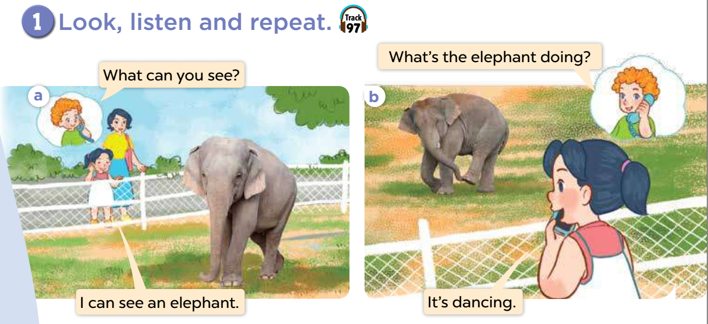

Slide 15
03
Listen, point
and say
Notes:
Step 1: Have pupils point at the words under the pictures, listen to the recording and repeat a few times until they feel confident. Explain the meaning of the words. Check comprehension.
Step 2: Model by getting pupils to point at Picture a and elicit the name of the animal (e.g.
elephant). Have them look at the question in the first bubble, listen to the recording and repeat it a few times. Then have them look at the gapped answer It's ___. and fill the gap with the ing
form of the verb under the picture (e.g. dancing), listen to the recoding and say the complete answer a few times.
Step 3: Give pupils a time limit to practise asking and answering the questions, using the ing form of the verbs under the pictures as cues. Go around and offer help where necessary.
Step 4: Invite a few pairs of pupils to point at the the pictures, ask and answer questions about what an animal is doing at the zoo in front of the class.

Slide 16

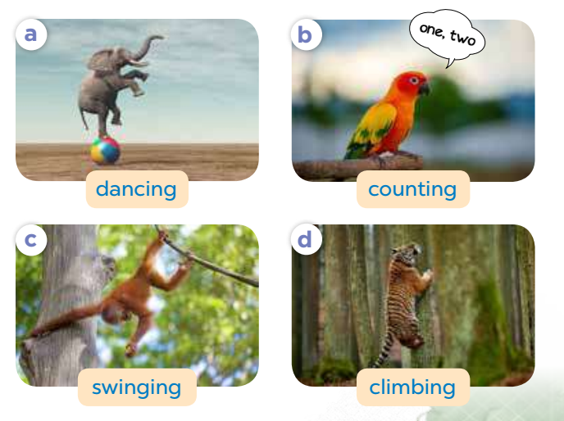
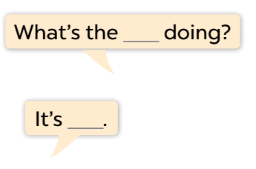


Slide 21
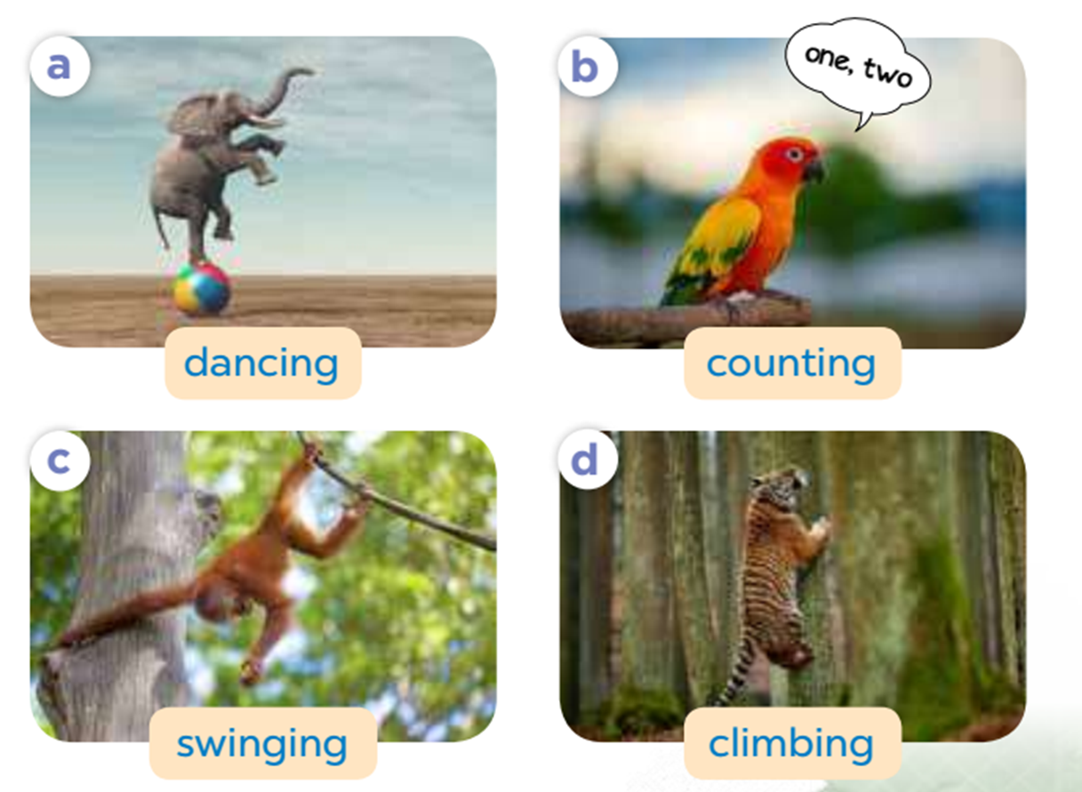
Look and match
1
2
3
4
swinging
dancing
climbing
counting
running
Notes:
Look and match
Ask pupils to look at the pictures, then match them with correct verb.

Slide 22
04
Let’s talk!
Notes:
Step 1: Tell the class the goal of this activity. Get them to point at the monkey and ask What is the monkey doing? Then have them complete the exchange by saying: It's swinging. Ask one pair of pupils to role-play the exchange in front of the class. Check comprehension.
Step 2: Give the pupils time to practise asking and answering the questions in pairs or groups. Go around the classroom and offer help or correct the pronunciation where necessary.
Step 3: Invite a few pairs of pupils to point at each animal, asking and answering the question in front of the class.

Slide 23

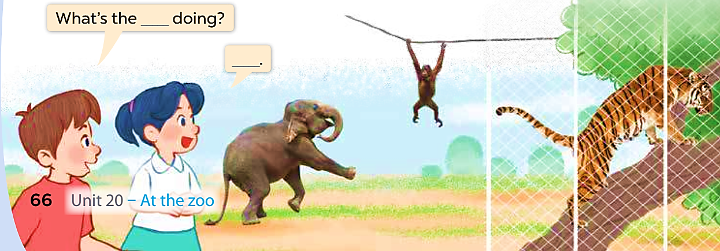

Slide 24
05
Fun corner
Notes:
Game: Who is faster?
- Divide class into 2 groups: A and B
- Teacher will click to open the box.
- Pupils in each group will guess what the verb –ing is. Then run and write the answer on the board as fast as they can.
- The fastest group has a correct answer is the winner.

Slide 25

d
a
n
i
ANSWER
n
g
c
NEXT
Notes:
dancing

Slide 26
dancing
NEXT

Slide 27
s
i
n
n
ANSWER
w
i
g
g
NEXT
Notes:
swinging

Slide 28
swinging
NEXT

Slide 29
o
g
u
c
n
ANSWER
n
i
t
NEXT
Notes:
counting

Slide 30
counting
NEXT

Slide 31
c
n
i
m
ANSWER
l
b
g
i
NEXT
Notes:
climbing

Slide 32
climbing
NEXT

Slide 33
o
n
d
ANSWER
i
g
NEXT
Notes:
doing

Slide 34
doing
NEXT

Slide 35
i
n
s
g
ANSWER
i
w
g
n
NEXT
Notes:
swinging

Slide 36
swinging
NEXT

Slide 37
t
n
c
u
o
ANSWER
i
n
g
NEXT
Notes:
counting

Slide 38
counting

Slide 39
d
n
c
a
ANSWER
i
n
g
NEXT
Notes:
dancing

Slide 40
dancing
NEXT

Slide 41





Goodbye!

Slide 42
Homework
Workbook, page …

Slide 43





THANK YOU

