Slide 1


Slide 2
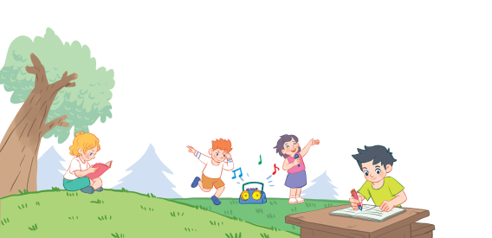
1. Warm-up

Slide 3
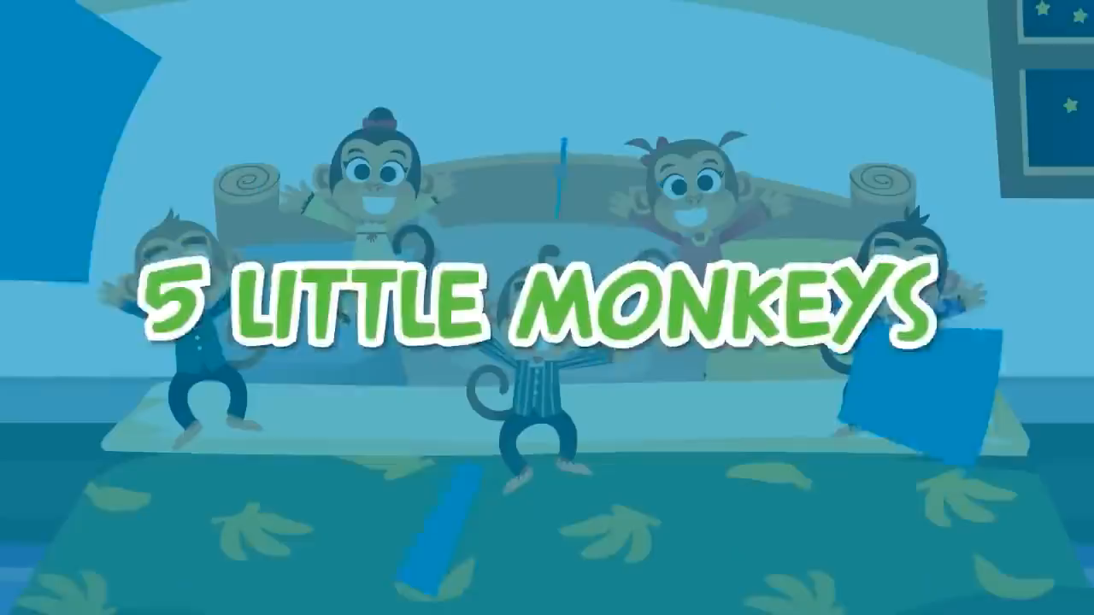

Slide 4



18
Period 1

Slide 5
1. Look, listen and repeat.

Slide 6

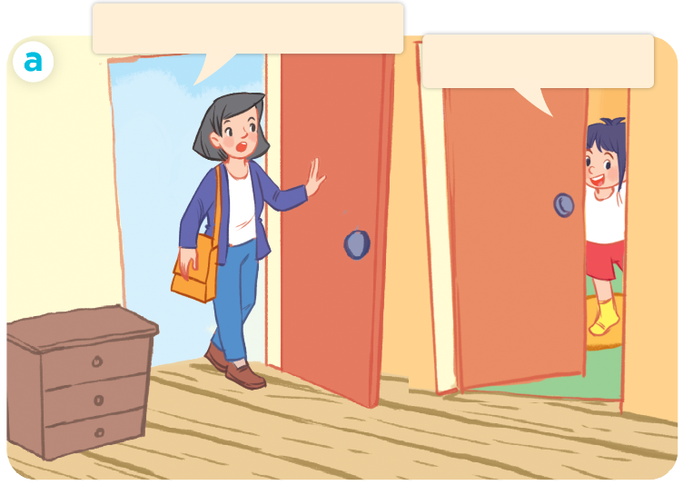
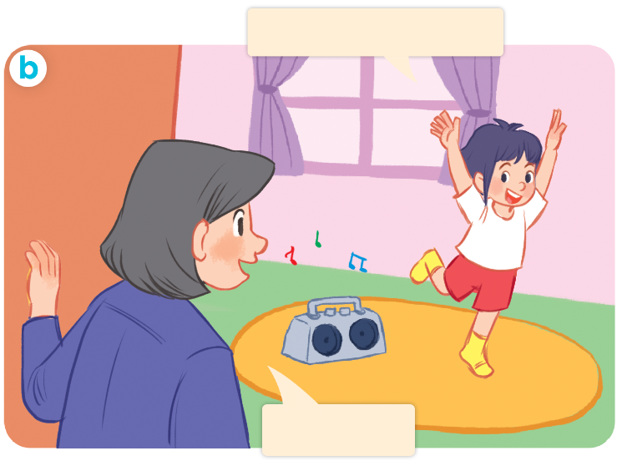
1. Look, listen and repeat.
Where are you, Linh?
Mum, I’m dancing.
I’m in my room.
Have fun!
Who are they?
Where are they?
What are they doing?

Slide 7
Sentence pattern:
I’m dancing.
I’m= I am

Slide 8
2. Listen, point and say.

Slide 9
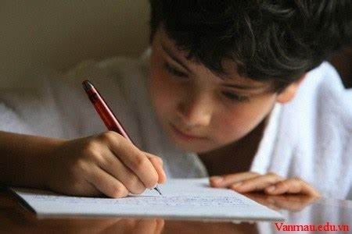
writing
/ˈraɪ.tɪŋ/
viết

Slide 10
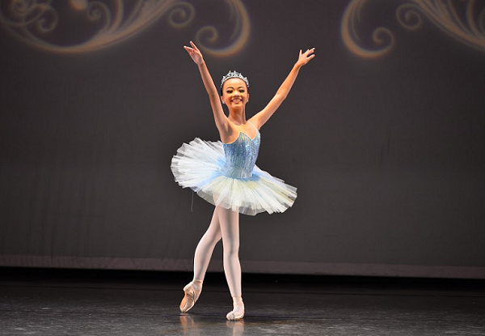
dancing
/dɑːnsɪŋ/
nhảy, múa

Slide 11
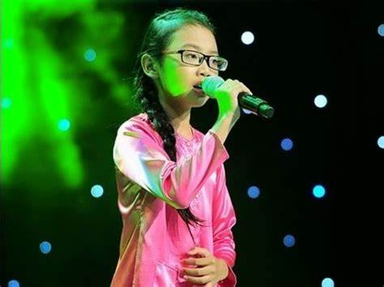
singing
/ˈsɪŋ.ɪŋ/
hát

Slide 12

reading
/ˈriː.dɪŋ/
đọc

Slide 13
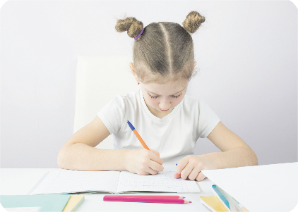
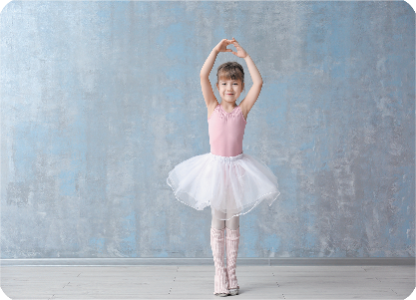
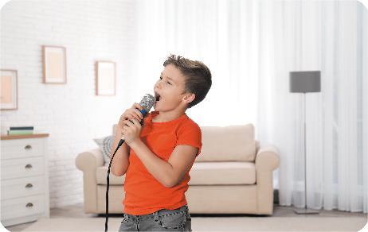
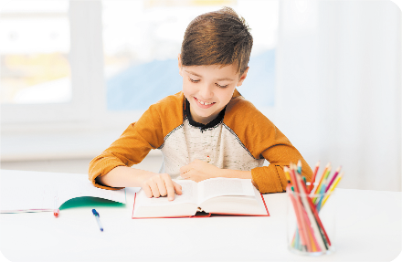
Review
writing
dancing
singing
reading

Slide 14
Checking vocabulary
writing
viết
dancing
nhảy, múa
singing
hát
reading
đọc

Slide 15
Structures

Slide 16
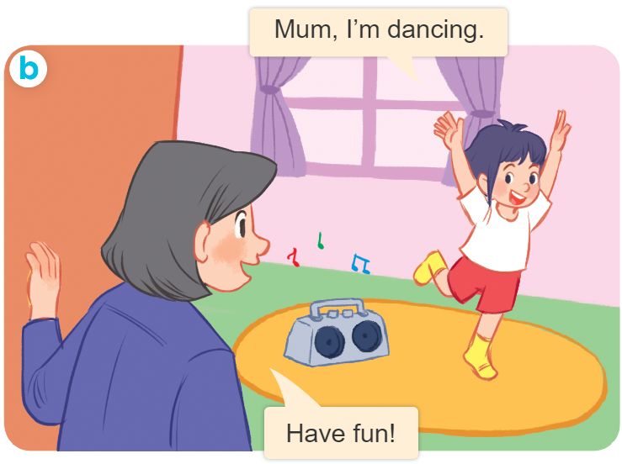
Structures
Cách nói tôi/tớ đang làm gì.
I’m _____________.
I’m = I am

Slide 17






Slide 18


singing
dancing

Slide 19
cooking
reading

Slide 20
reading
dancing

Slide 21
writing
playing

Slide 22
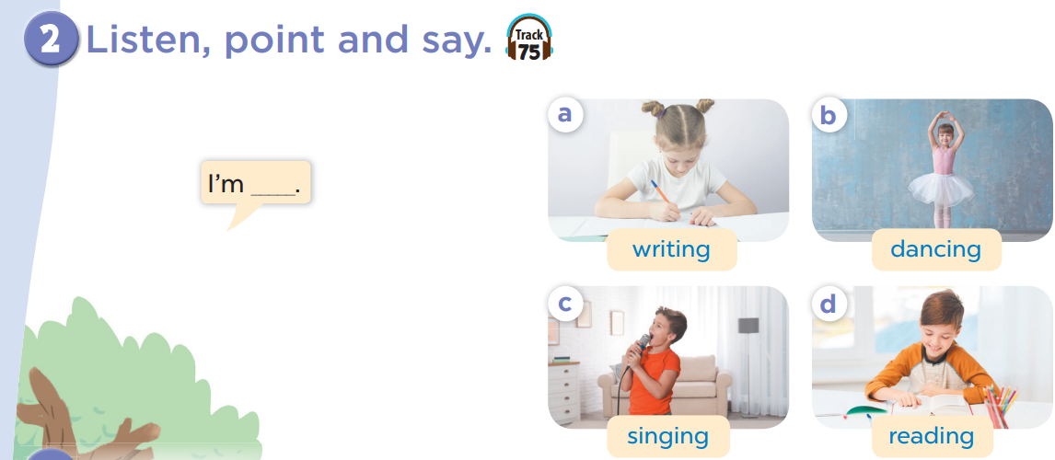


Slide 28
3. Let’s talk.

Slide 29
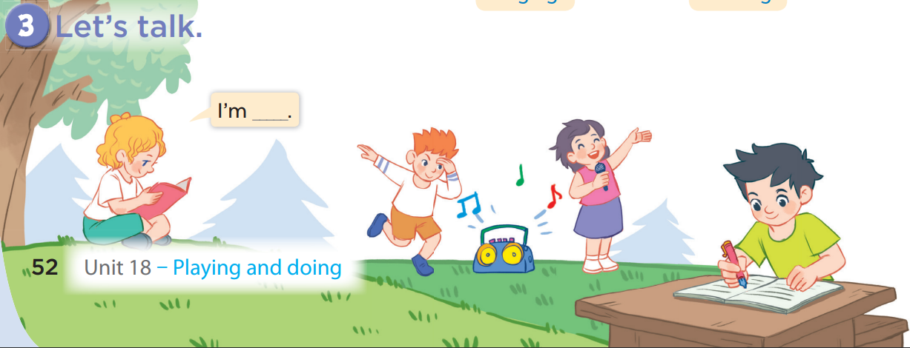
I am singing.
I am reading.

Slide 30
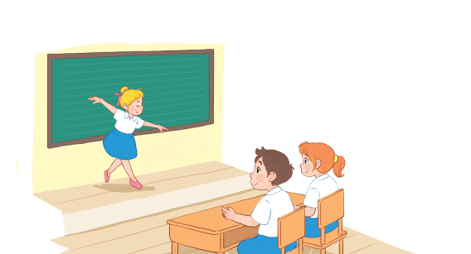
Guess what?
Notes:
Game: Guess what?
T asks some pupils come to the board and do some actions to describe words (dancing, singing, writing, reading) and the others will give their guesses. If pupils can say the answer correctly, they will get points for their teams.

Slide 31
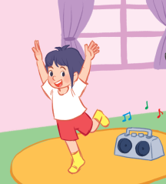


Guess what?
+4
+4
I’m dancing.
Notes:
Game: Do and Guess:
-T asks some pupils come to the board and do some actions to describe words(dancing, singing, writing, reading) and the others will give their guess.

Slide 32
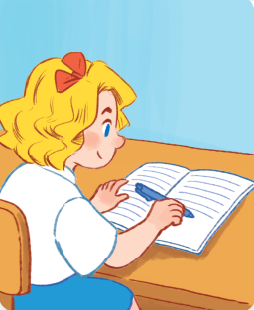

Guess what?
I’m writing.
Notes:
Game: Do and Guess:
-T asks some pupils come to the board and do some actions to describe words(dancing, singing, writing, reading) and the others will give their guess.

Slide 33
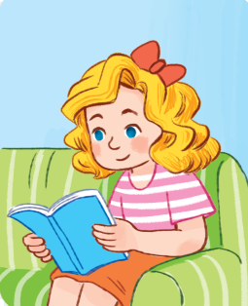

Guess what?
+3
+3
I’m reading.
Notes:
Game: Do and Guess:
-T asks some pupils come to the board and do some actions to describe words(dancing, singing, writing, reading) and the others will give their guess.

Slide 34

Guess what?
+3
+3
I’m singing.
Notes:
Game: Do and Guess:
-T asks some pupils come to the board and do some actions to describe words(dancing, singing, writing, reading) and the others will give their guess.

Slide 35
Guess what?
+3
+3
I’m writing.
Notes:
Game: Do and Guess:
-T asks some pupils come to the board and do some actions to describe words(dancing, singing, writing, reading) and the others will give their guess.

Slide 36
Guess what?
+3
+3
I’m reading.
Notes:
Game: Do and Guess:
-T asks some pupils come to the board and do some actions to describe words(dancing, singing, writing, reading) and the others will give their guess.

Slide 37
Guess what?
+4
+4
I am dancing.
Notes:
Game: Do and Guess:
-T asks some pupils come to the board and do some actions to describe words(dancing, singing, writing, reading) and the others will give their guess.

Slide 38
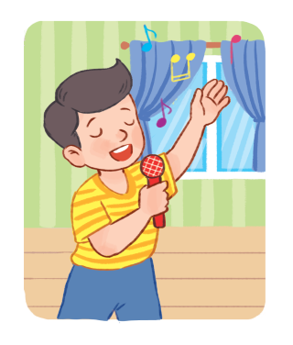
Guess what?
+3
+3
I am singing.
Notes:
Game: Do and Guess:
-T asks some pupils come to the board and do some actions to describe words(dancing, singing, writing, reading) and the others will give their guess.

Slide 39
18
Period 1

