Slide 1






NGUYEN CONG SAU PRIMARY SCHOOL
WELCOME TO CLASS 3E
Teacher: Ngo Thi Thu Hang
O
O
N
G
O
T
R
O
D
A
E
N
F

Slide 2

Warm-up

Slide 3
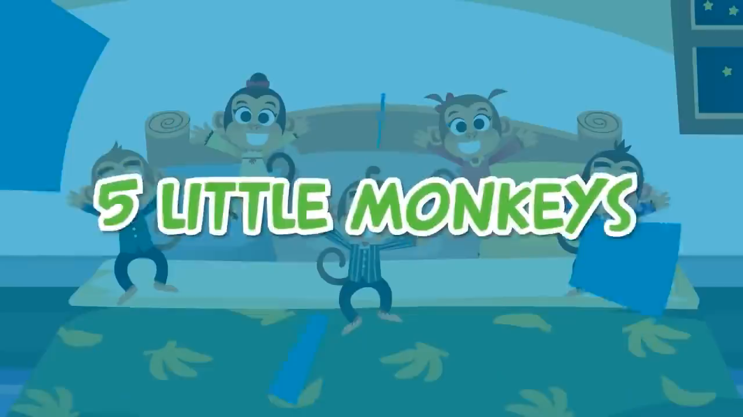

Slide 4
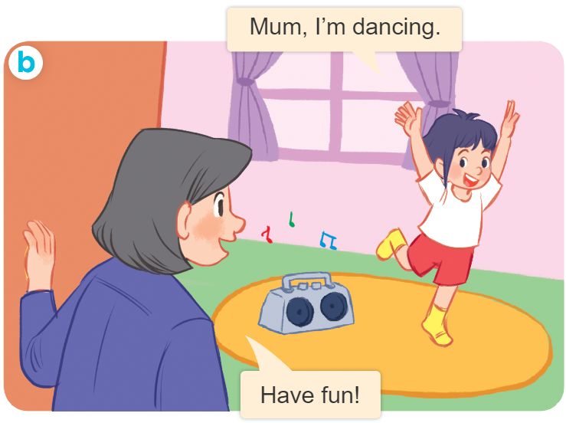
Wednesday, April 11th, 2023
Playing and doing
Unit
18
Lesson 1 (1+2+3)
Facebook : Bùi Liễu
0968142780

Slide 5



Contents
Facebook : Bùi Liễu
0968142780
Look, listen and repeat.
Listen, point and say.
Let’s talk.

Slide 6

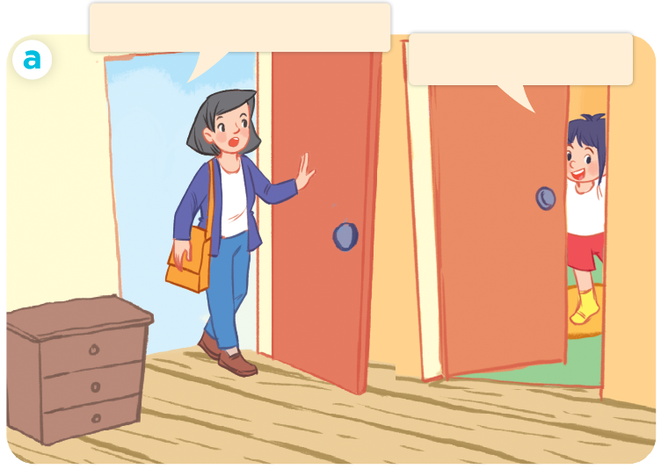
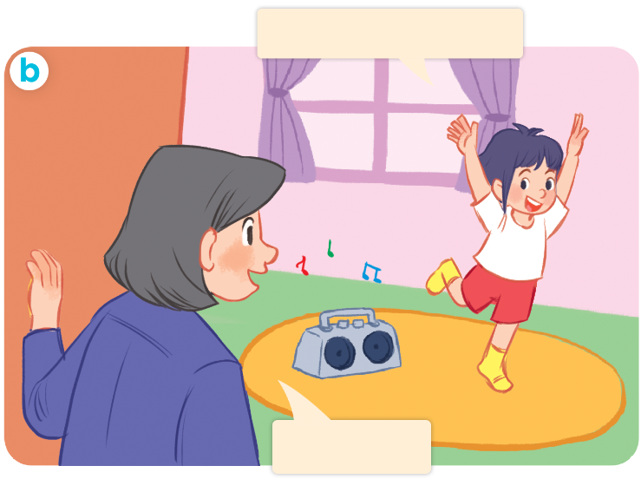
1. Look, listen and repeat.
Where are you, Linh?
Mum, I’m dancing.
I’m in my room.
Have fun!

Slide 7
Vocabulary

Slide 8

writing :
viết

Slide 9

dancing:
nhảy, múa

Slide 10

hát
singing:

Slide 11

reading:
đọc

Slide 12
Vocabulary
writing :
viết
dancing:
nhảy, múa
singing :
hát
reading :
đọc

Slide 13






Slide 14
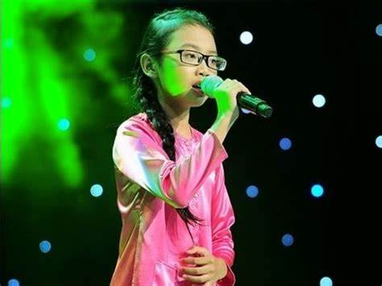


singing
dancing

Slide 15

cooking
reading

Slide 16
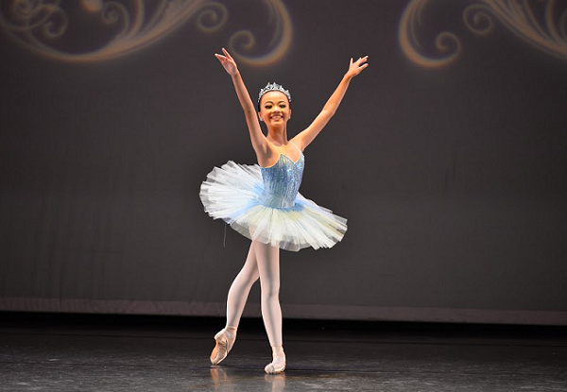
reading
dancing

Slide 17
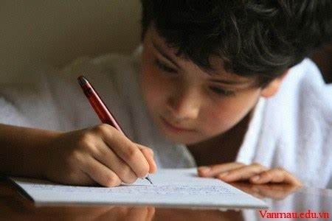
writing
playing

Slide 18
Sentence pattern
dancing
I’m ..................
I’m = I am

Slide 19
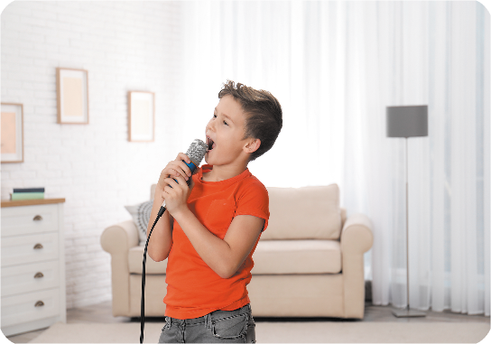
Sentence pattern
singing
I’m ..................
I’m = I am

Slide 20



2. Listen, point and say.
a
b
I’m ____________.
writing
dancing
c
d
singing
reading

Slide 21
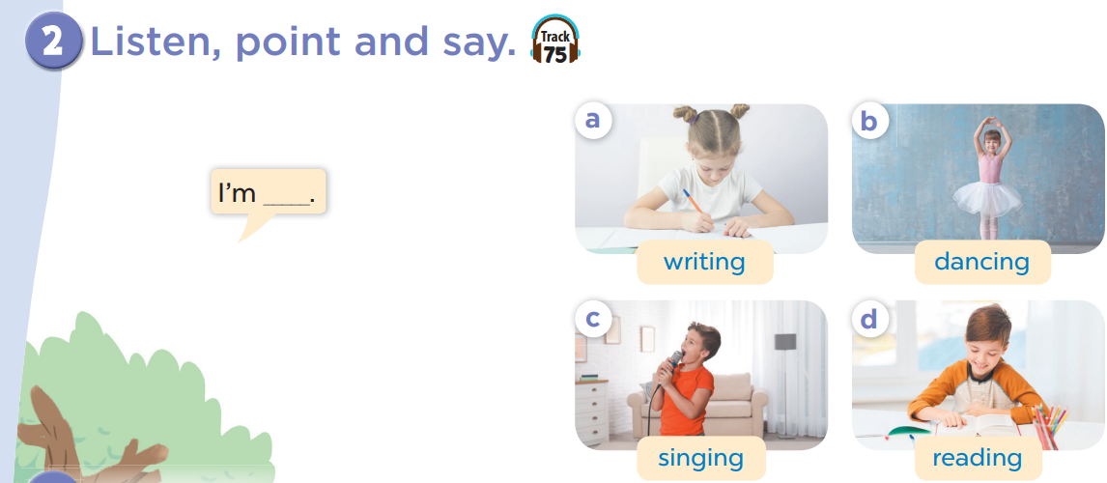
writing
I’m __________.

Slide 23
dancing
I’m __________.

Slide 24
singing
I’m __________.

Slide 25
reading
I’m __________.

Slide 26


Where is it ?

Slide 27



Who's a millionaire?
I’m ______ .
A. dancing
B. writing
C. singing
D. reading

Slide 28

Who's a millionaire?
I’m .........................
A. writing
B. dancing
C. singing
D. reading

Slide 29

Who's a millionaire?
I am......................
A. dancing
B. cooking
C. painting
D. reading

Slide 30
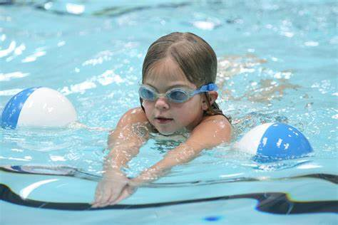

Who's a millionaire?
I am ............................
A. swimming
B. cooking
C. reading
D. reading

Slide 31
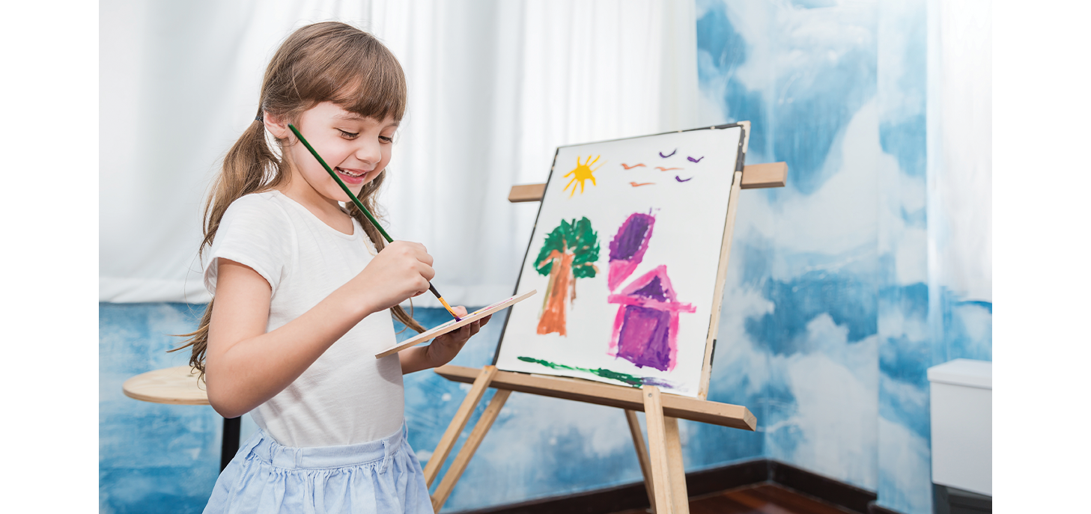

Who's a millionaire?
I’m .......................
A. singing
B. reading
C. drawing
D. writing

Slide 32
Who's a milionaire?
Leave me out: wrriting
writing
A. i
B. t
C. r
D. w
C. r

Slide 33

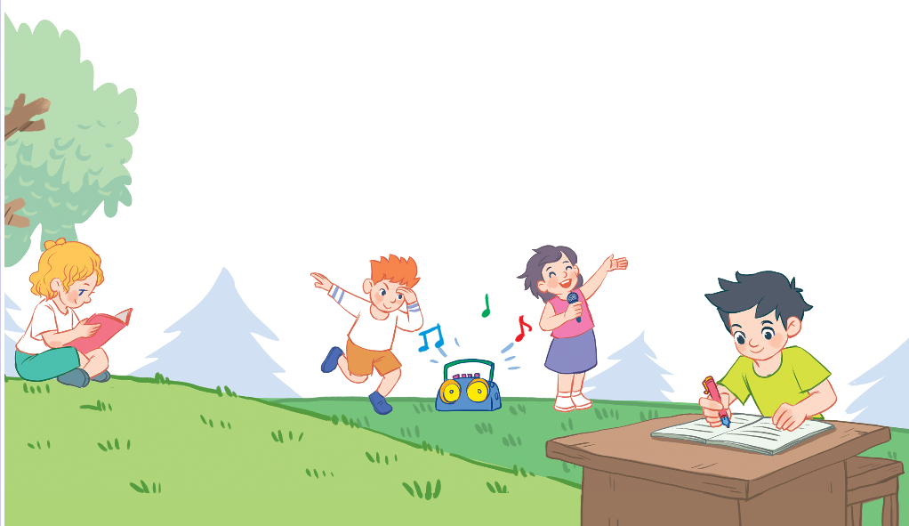
3. Let’s talk
I’m ______.

Slide 34

Facebook : Bùi Liễu
0968142780
Let’s play!

Slide 35


















Picking
apples
Facebook : Bùi Liễu
Mobile phone: 0968142780
Notes:
Facebook : Bùi Liễu
Mobile phone: 0968142780

Slide 36


drawing
A
Facebook : Bùi Liễu
Mobile phone: 0968142780
singing
B
dancing
C
Notes:
Facebook : Bùi Liễu
Mobile phone: 0968142780

Slide 37

dancing
A
drawing
B
singing
C
Notes:
Facebook : Bùi Liễu
Mobile phone: 0968142780

Slide 38

dancing
A
Facebook : Bùi Liễu
Mobile phone: 0968142780
singing
B
reading
C
Notes:
Facebook : Bùi Liễu
Mobile phone: 0968142780

Slide 39
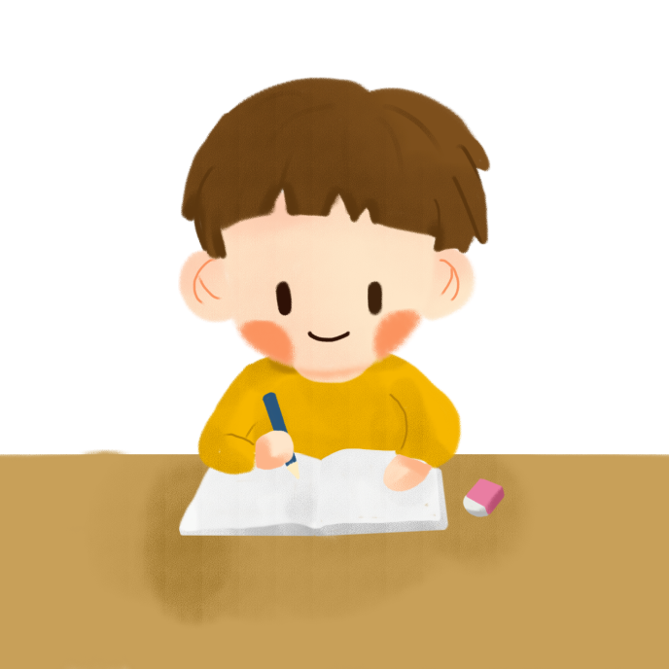
writing
A
singing
B
dancing
C
Notes:
Facebook : Bùi Liễu
Mobile phone: 0968142780

Slide 40


A
Facebook : Bùi Liễu
Mobile phone: 0968142780
B
Notes:
Facebook : Bùi Liễu
Mobile phone: 0968142780

Slide 41

A
Facebook : Bùi Liễu
Mobile phone: 0968142780
B
Notes:
Facebook : Bùi Liễu
Mobile phone: 0968142780

Slide 42

I __ dancing.
am
A
is
B
are
C

Slide 43

ae
r _ _ding
A
Facebook : Bùi Liễu
Mobile phone: 0968142780
ea
B
ie
C
Notes:
Facebook : Bùi Liễu
Mobile phone: 0968142780

Slide 44

wri_ _ng
ti
A
ii
B
ei
C
Notes:
Facebook : Bùi Liễu
Mobile phone: 0968142780

Slide 45

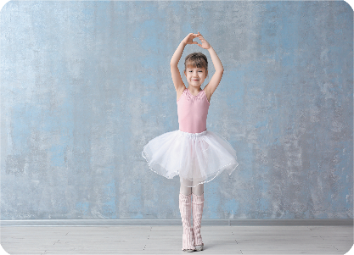


Vocabulary
writing
dancing
singing
reading

Slide 46
Sentence pattern:
I’m dancing.
I’m = I am

Slide 47
Wednesday, April 12th, 2023
Unit 18:
Playing and doing
Lesson 1 (1+2+3)
1. Vocabulary
writing :
viết
dancing:
nhảy, múa
singing :
Facebook : Bùi Liễu
0968142780
hát
reading :
đọc
2. Sentence pattern
dancing
I’m ..................
I’m = I am

Slide 48
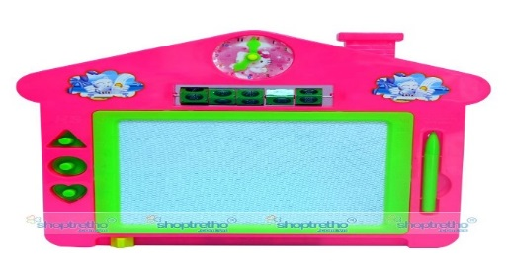
Wednesday, April 12th, 2023
Playing and doing
Unit
18
Lesson 1 (1+2+3)
- Learn the words and sentence by heart - Prepare for Lesson 1- part 4,5,6
Facebook : Bùi Liễu
0968142780
3.HOMELINK

Slide 49



Good bye
Thanks For Your Attention!
Thanks for your attention!

