Slide 1
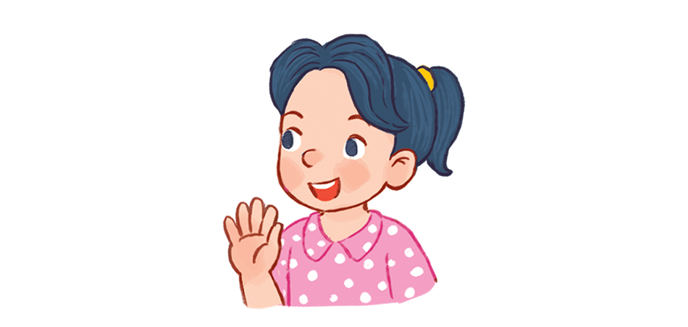

Monday, October 10th 2022
Hello
Unit
1
Lesson 2
Facebook : Bùi Liễu
0968142780
Notes:
Facebook : Bùi Liễu
Mobile phone: 0968142780

Slide 2

Warm-up

Slide 3

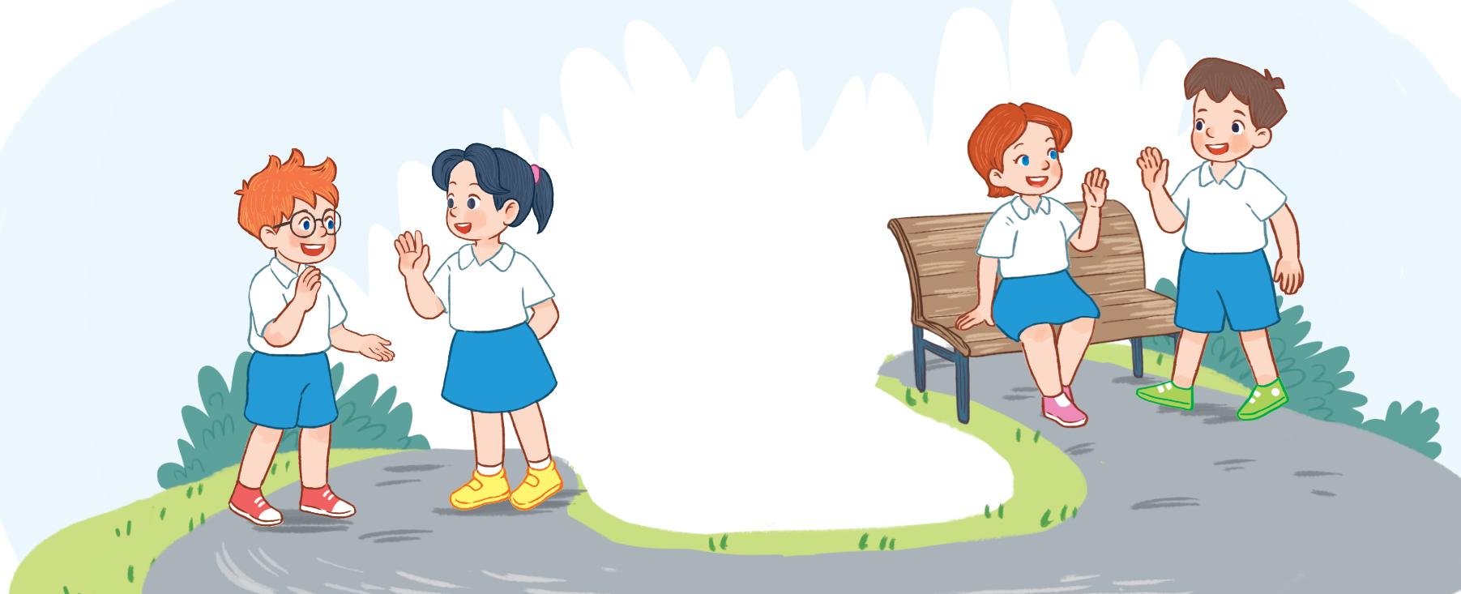
Let’s sing.
Hello
Hello.
Hello.
I’m Ben.
Hi, Ben.
Hi, Ben.
I’m Mai.
Hello.
Hello.
I’m Minh.
Hi, Minh.
Hi, Minh.
I’m Lucy.
Notes:
Facebook : Bùi Liễu
Mobile phone: 0968142780

Slide 4






Contents
Facebook : Bùi Liễu
0968142780
Look, listen and repeat.
Listen, point and say.
Let’s talk.
Listen and number.
Read and match.
Let’s play.
Notes:
Facebook : Bùi Liễu
Mobile phone: 0968142780

Slide 5
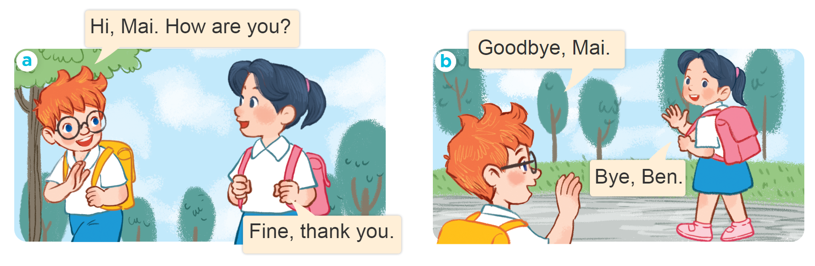
1. Look, listen and repeat.
Facebook : Bùi Liễu
0968142780
Notes:
Facebook : Bùi Liễu
Mobile phone: 0968142780

Slide 6




1. Look, listen and repeat.
Facebook : Bùi Liễu
0968142780
Fine, thank you.
Hi, Mai. How are you?
Facebook : Bùi Liễu
0968142780
Notes:
Facebook : Bùi Liễu
Mobile phone: 0968142780

Slide 7



1. Look, listen and repeat.
Goodbye, Mai.
Bye, Ben.
Facebook : Bùi Liễu
0968142780
Notes:
Facebook : Bùi Liễu
Mobile phone: 0968142780

Slide 8
Facebook : Bùi Liễu
0968142780
Vocabulary

Slide 9
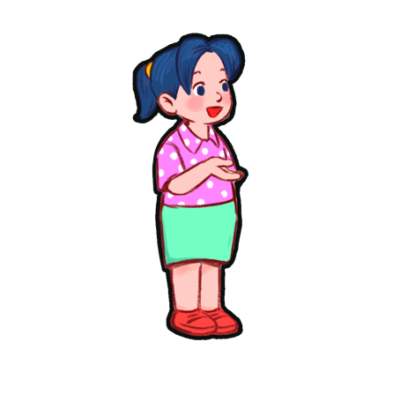

Vocabulary
you
Facebook : Bùi Liễu
0968142780
you
/juː/
bạn

Slide 10
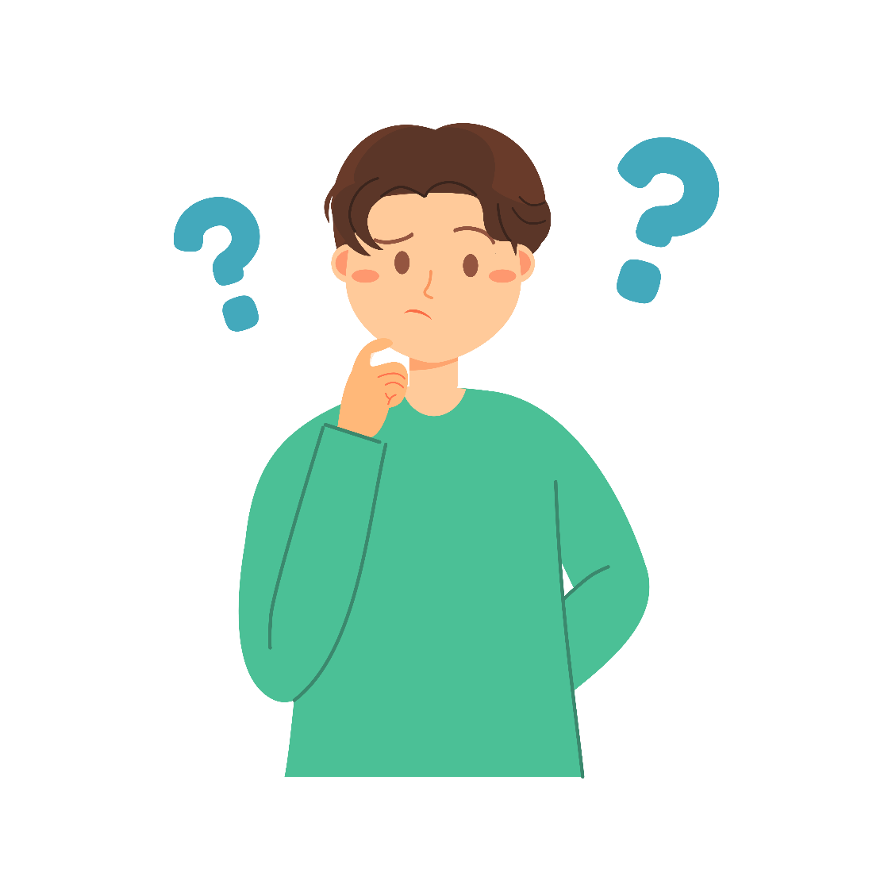
Vocabulary
Facebook : Bùi Liễu
0968142780
How
/ haʊ /
như thế nào

Slide 11

Vocabulary
Facebook : Bùi Liễu
0968142780
How are you?
/haʊ ɑː juː/
Bạn có khỏe không?

Slide 12
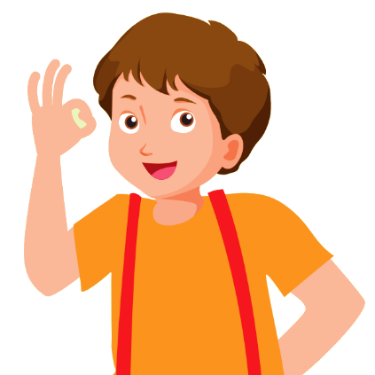
Vocabulary
Facebook : Bùi Liễu
0968142780
fine
/faɪn/
khỏe, tốt

Slide 13
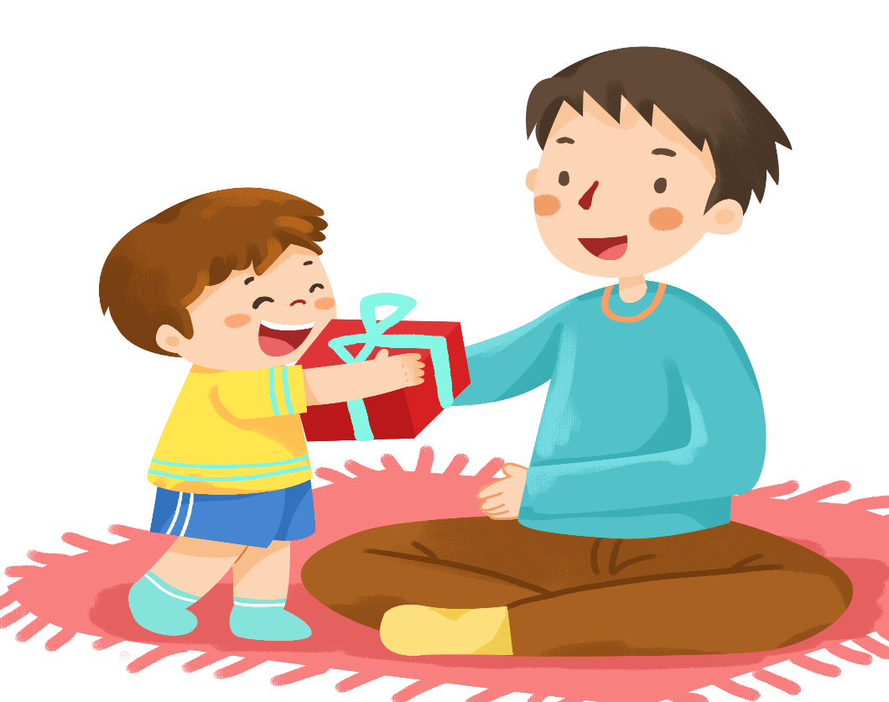

Vocabulary
Facebook : Bùi Liễu
0968142780
Thank you
= Thanks
/θæŋk juː/
/θæŋks/
Cảm ơn bạn
Cảm ơn

Slide 14
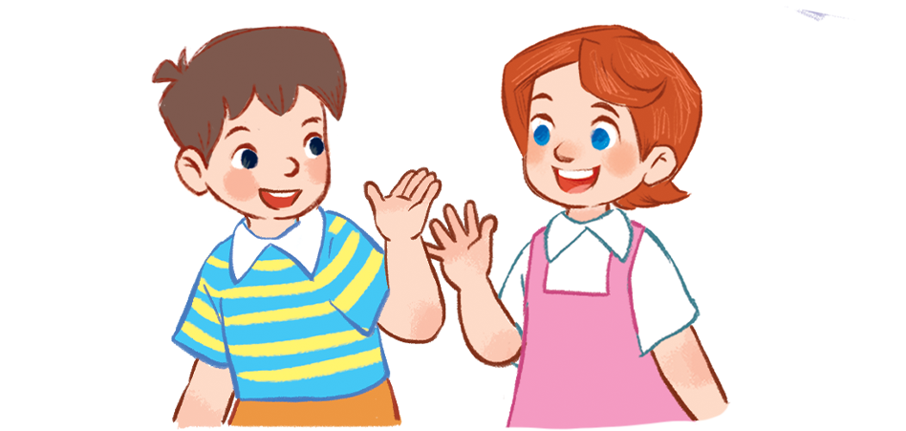
Vocabulary
Facebook : Bùi Liễu
0968142780
Goodbye
= Bye
/ˌɡʊdˈbaɪ/
/baɪ/
Tạm biệt
Tạm biệt

Slide 15
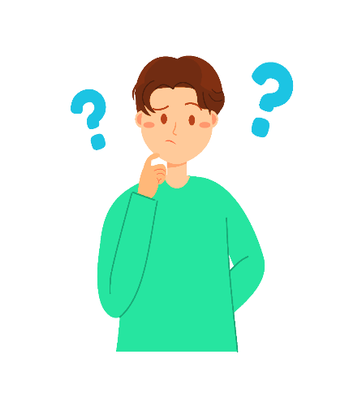



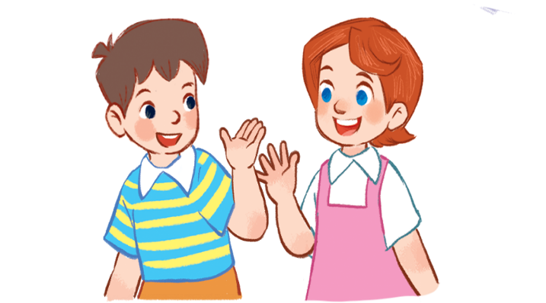
Review
Facebook : Bùi Liễu
0968142780
you
you
how
How are you
fine
Thank you= thanks
Goodbye = bye

Slide 16
Vocabulary
Facebook : Bùi Liễu
0968142780
- you
bạn
- how
như thế nào
- How are you?
Bạn có khỏe không?
- fine
khỏe, tốt
- Thank you
Cảm ơn bạn.
- Thanks
Cảm ơn.
- Goodbye
Tạm biệt.
- Bye
Tạm biệt.

Slide 17
Facebook : Bùi Liễu
0968142780
Let’s play!
Notes:
Facebook : Bùi Liễu
Mobile phone: 0968142780

Slide 18
Facebook : Bùi Liễu
0968142780
Can you guess?
Notes:
Facebook : Bùi Liễu
Mobile phone: 0968142780

Slide 19

1
2
3
Facebook : Bùi Liễu
0968142780
4
5
6
7
8
9
next
neb
Ben

Slide 20
1
2
3
Facebook : Bùi Liễu
0968142780
4
5
6
7
8
9
next
Mai
ima

Slide 21
1
2
3
Facebook : Bùi Liễu
0968142780
4
5
6
7
8
9
next
inhm
Minh

Slide 22

1
2
3
Facebook : Bùi Liễu
0968142780
4
5
6
7
8
9
next
cylu
Lucy

Slide 23
1
2
3
Facebook : Bùi Liễu
0968142780
4
5
6
7
8
9
next
beydgoo
goodbye

Slide 24
1
2
3
you
4
5
6
Facebook : Bùi Liễu
0968142780
7
8
9
next
you
uyo

Slide 25
1
2
3
Facebook : Bùi Liễu
0968142780
4
5
6
7
8
9
next
hwo aer ouy
How are you?

Slide 26
1
2
3
Facebook : Bùi Liễu
0968142780
4
5
6
7
8
9
next
how
hwo

Slide 27
1
2
3
4
5
6
7
8
9
Facebook : Bùi Liễu
0968142780
next
oodg bey
Goodbye

Slide 28
1
2
3
Facebook : Bùi Liễu
0968142780
4
5
6
7
8
9
end
fine
ifne

Slide 29
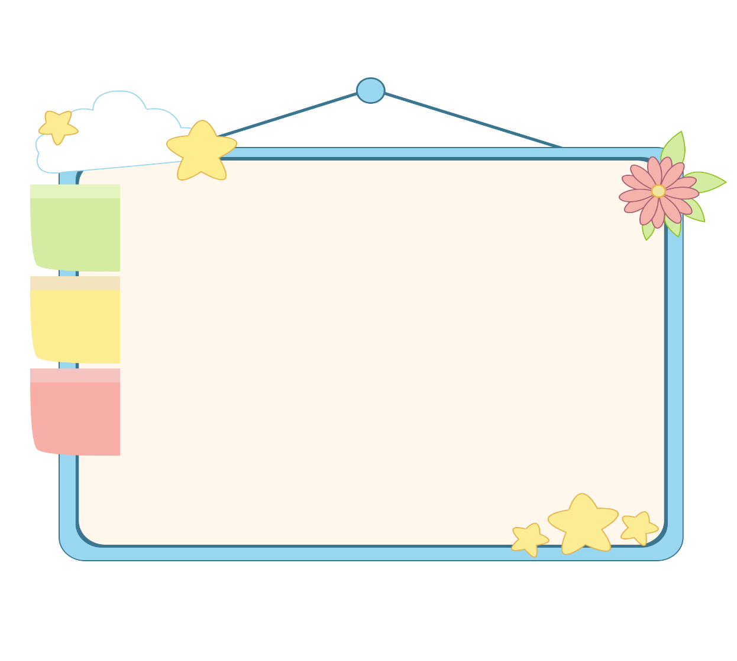
Facebook : Bùi Liễu
0968142780
WELL DONE!

Slide 30
Facebook : Bùi Liễu
0968142780
Structures

Slide 31
Grammar
Facebook : Bùi Liễu
0968142780
1. Chào và hỏi sức khỏe.
Question: Hello/Hi. How are you?
(Xin chào. Bạn có khỏe không?)
Answer: Fine. Thank you.
(Mình khỏe. Mình cảm ơn.)
2. Chào tạm biệt.
Goodbye / bye.
(Tạm biệt.)

Slide 32
2. Listen, point and say.
Facebook : Bùi Liễu
0968142780
Hi. How are you?
Good bye.
______, _________.
_________.
a
b

Slide 33
2. Listen, point and say.
Facebook : Bùi Liễu
0968142780
Hi. How are you?
_____, __________.
Fine thank you
a

Slide 34
2. Listen, point and say.
Facebook : Bùi Liễu
0968142780
Good bye.
Bye
____.
b

Slide 35



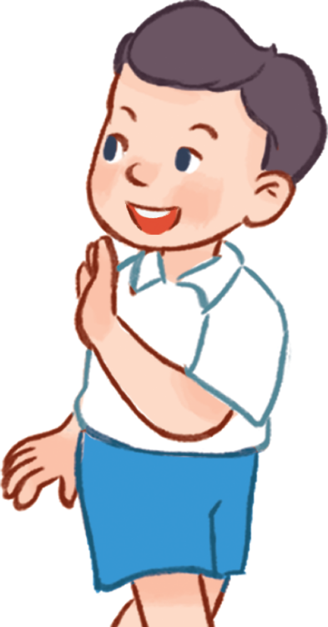
3. Let’s talk.
Facebook : Bùi Liễu
0968142780
Hi. How are you?
Good bye / bye.
______, _________.
_________.
a
b

Slide 36
3. Let’s talk.
Facebook : Bùi Liễu
0968142780
Hi. How are you?
_____, __________.
Fine thank you
a

Slide 37

3. Let’s talk.
Facebook : Bùi Liễu
0968142780
Good bye / bye.
_____________.
Goodbye / Bye
b

Slide 38
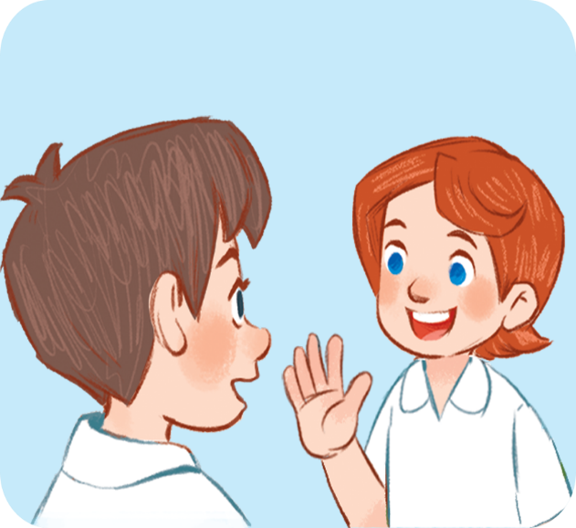







4. Listen and number.
3
4
2
1
a
b
c
d

Slide 39
5. Look, complete and read.
Facebook : Bùi Liễu
0968142780
1. Hi. I’m Mai.
a. Fine, thank you.
2. Goodbye, Mai.
b. Hello, Mai. I’m Ben.
3. How are you, Mai?
c. Bye, Ben.
Facebook : Bùi Liễu
0968142780
1 - b
2 - c
3 - a
Notes:
Facebook : Bùi Liễu
Mobile phone: 0968142780

Slide 40
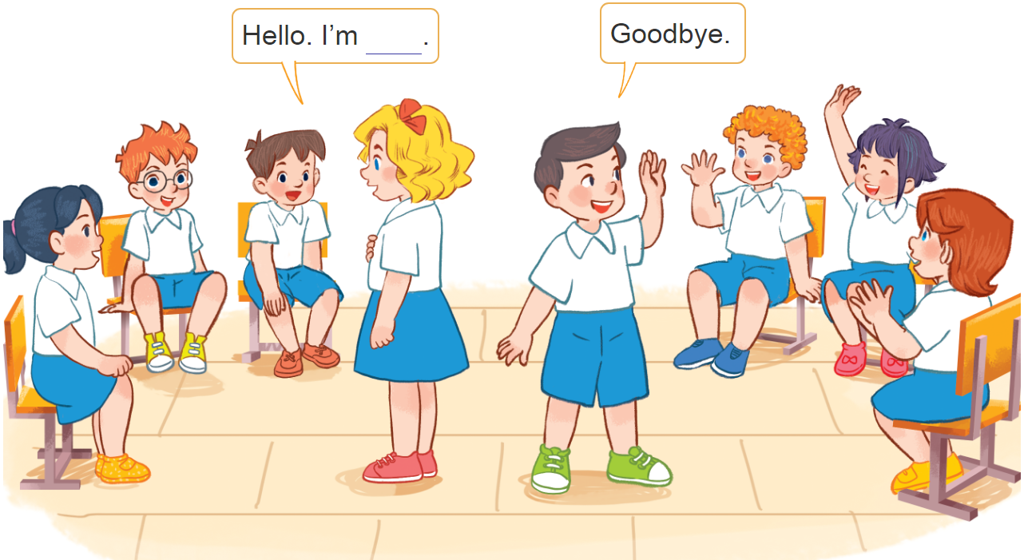
6. Let’s play.
Hello and goodbye
Notes:
Facebook : Bùi Liễu
Mobile phone: 0968142780

Slide 41
Wrap up

Slide 42
Wrap up
Facebook : Bùi Liễu
0968142780
you
you
how
How are you
fine
Thank you= thanks
Goodbye = bye

Slide 43
Grammar
Facebook : Bùi Liễu
0968142780
1. Chào và hỏi sức khỏe.
Question: Hello/Hi. How are you?
(Xin chào. Bạn có khỏe không?)
Answer: Fine. Thank you.
(Mình khỏe. Mình cảm ơn.)
2. Chào tạm biệt.
Goodbye / bye.
(Tạm biệt.)

Slide 44
Homework
Learn by heart all the new words.
Read again the dialogue in part 1.

Slide 45

Facebook : Bùi Liễu
0968142780
Thank you!
Facebook : Bùi Liễu
0968142780
Notes:
Facebook : Bùi Liễu
0968142780

