Slide 1
Monday, October 10th 2022
Hello
Unit
1
Lesson 1
Facebook : Bùi Liễu
0968142780
Notes:
Facebook : Bùi Liễu
Mobile phone: 0968142780

Slide 2
Contents
Facebook : Bùi Liễu
0968142780
Look, listen and repeat.
Listen, point and say.
Let’s talk.
Listen and tick.
Look, complete and read.
Let’s sing.
Notes:
Facebook : Bùi Liễu
Mobile phone: 0968142780

Slide 3
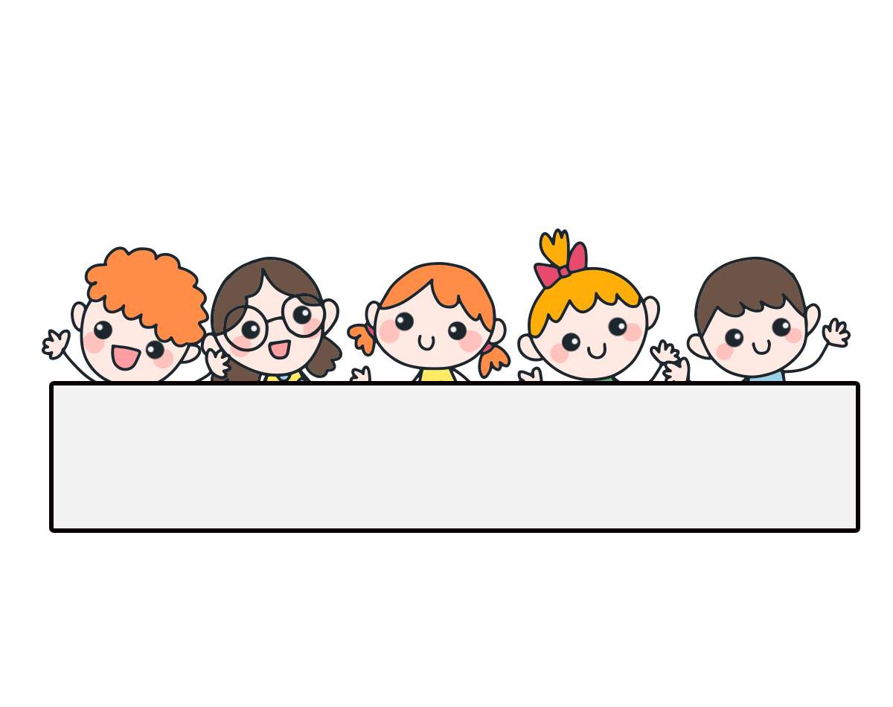
Warm-up

Slide 4
Let’s sing.

Slide 5
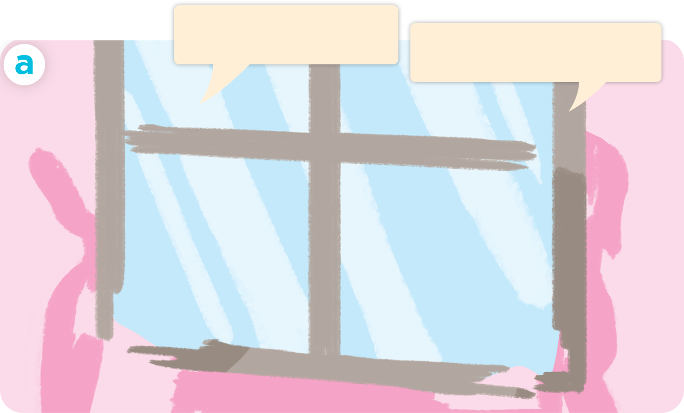
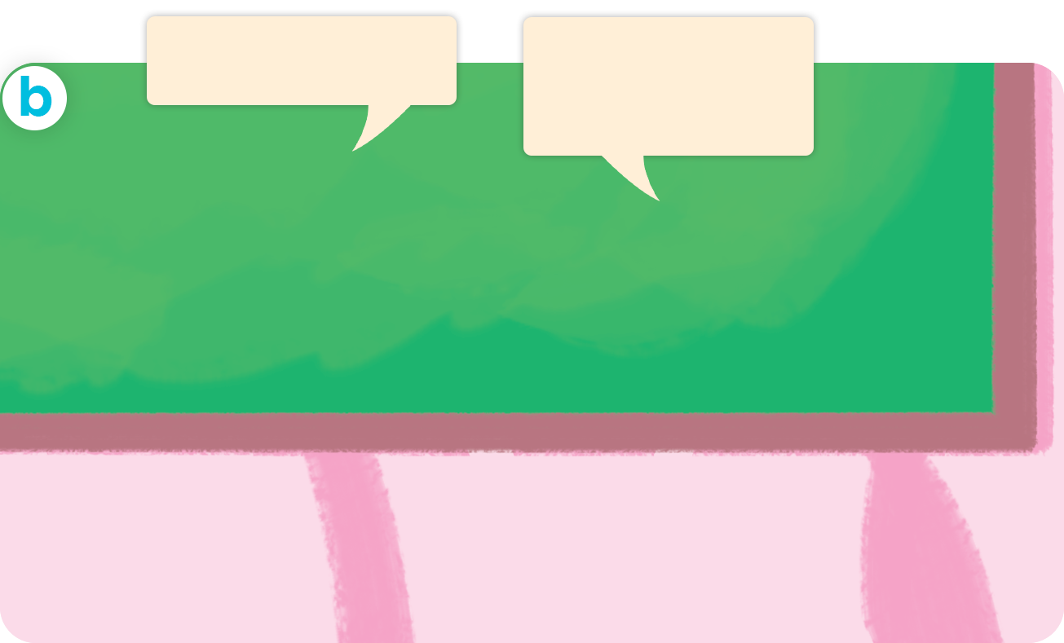
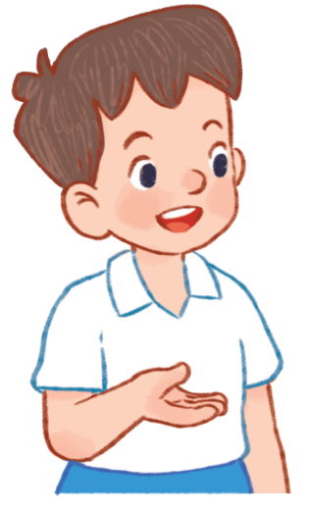
1. Look, listen and repeat.
Hello. I’m Ben
Hi. I’m Minh.
Hello, Minh.
I’m Lucy.
Hi, Ben. I’m Mai.
Notes:
Facebook : Bùi Liễu
Mobile phone: 0968142780

Slide 6
1. Look, listen and repeat.
Hello. I’m Ben
Hi, Ben. I’m Mai.
Facebook : Bùi Liễu
0968142780
Notes:
Facebook : Bùi Liễu
Mobile phone: 0968142780

Slide 7
1. Look, listen and repeat.
Hi. I’m Minh.
Hello, Minh.
I’m Lucy.
Facebook : Bùi Liễu
0968142780
Notes:
Facebook : Bùi Liễu
Mobile phone: 0968142780

Slide 8
Vocabulary
Notes:
Facebook : Bùi Liễu
Mobile phone: 0968142780

Slide 9
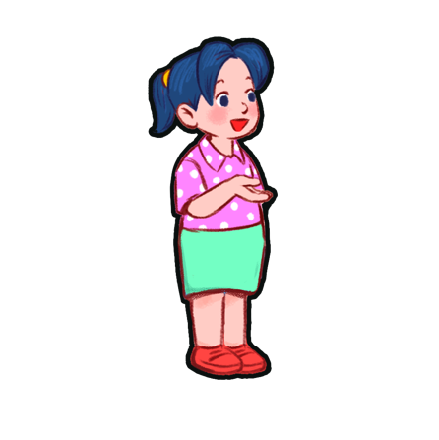
Vocabulary
Facebook : Bùi Liễu
0968142780
Ben
Lucy
Mai
Minh

Slide 10
Vocabulary
Hello
Hi
hello
= hi
/heˈləʊ/
/haɪ/
xin chào
I
/aɪ/
tôi, tớ

Slide 11
Vocabulary
hello : xin chào
hi : xin chào
I : tôi, tớ....

Slide 12
Structures

Slide 13
Structures
1. Chào khi gặp nhau.
Hello/Hi
2. Giới thiệu tên mình.
I’m + name
(I am = I’m)
Ví dụ:
I'm Mai. (Mình tên là Mai.)
Hi, I'm Mai. (Xin chào, mình tên là Mai.)

Slide 14
2. Listen, point and say.
Hello. / Hi. I’m ____.
Hello, / Hi, ____. I'm ____.

Slide 15
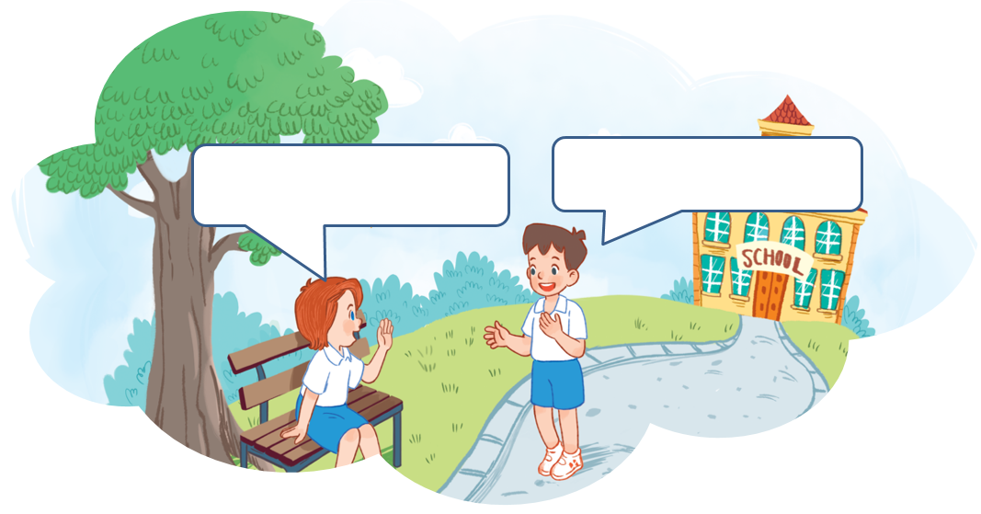
3. Let’s talk.
Hello. I’m ______.
Hello./Hi. I’m _____.
Minh
Lucy
Hello = Hi

Slide 16
Facebook : Bùi Liễu
0968142780
Let’s play!
Notes:
Facebook : Bùi Liễu
Mobile phone: 0968142780

Slide 17
______. I’m Mai.
Hi. I’m Lucy.
A. Hello
B. Bye

Slide 18
Hello. I’m Mai.
Hello. I’m ____ .
A. hi
B. Minh

Slide 19
Hello. I’m ____.
Hello. I’m Minh .
A. Lucy
B. Mai

Slide 20
Hello. ____ Ben.
Hello. I’m Minh .
A. Hi
B. I’m

Slide 21
Hello. I’m ____.
Hi. I’m Lucy.
A. Lucy
B. Linh

Slide 22
Hello. I’m ____.
Hello. I’m Lucy.
A. Mary
B. Mai

Slide 23
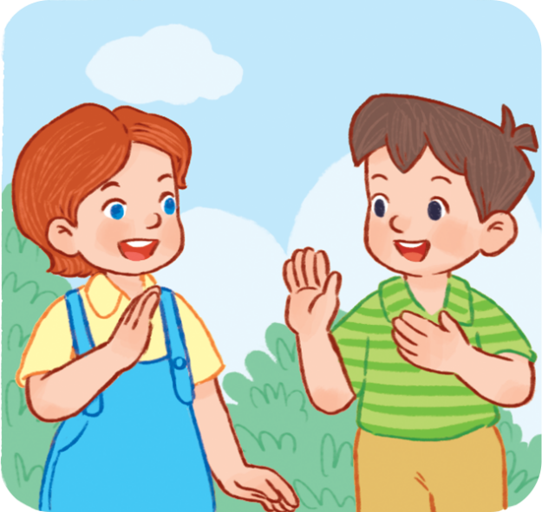
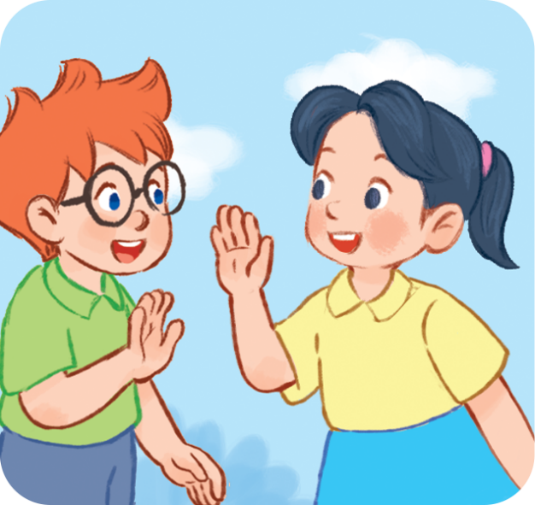
4. Listen and circle
1
2

Slide 24
4. Listen and circle.
1

Slide 25
4. Listen and circle.
2

Slide 26
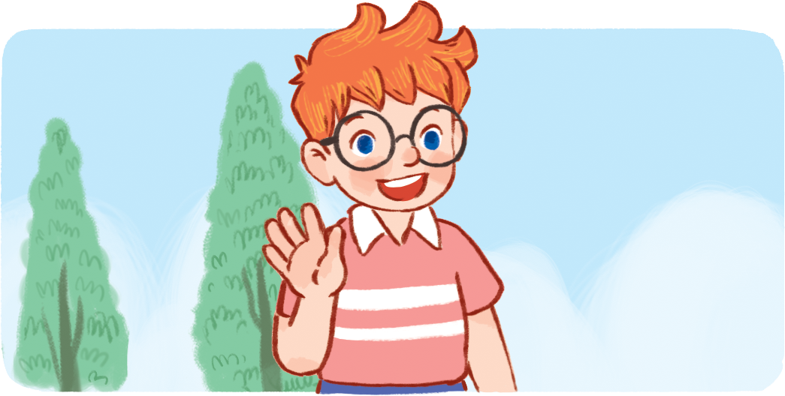
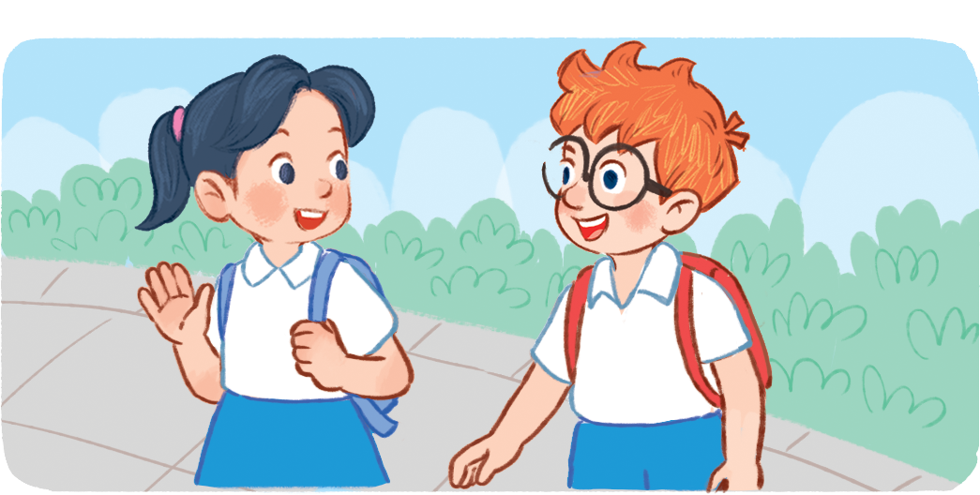
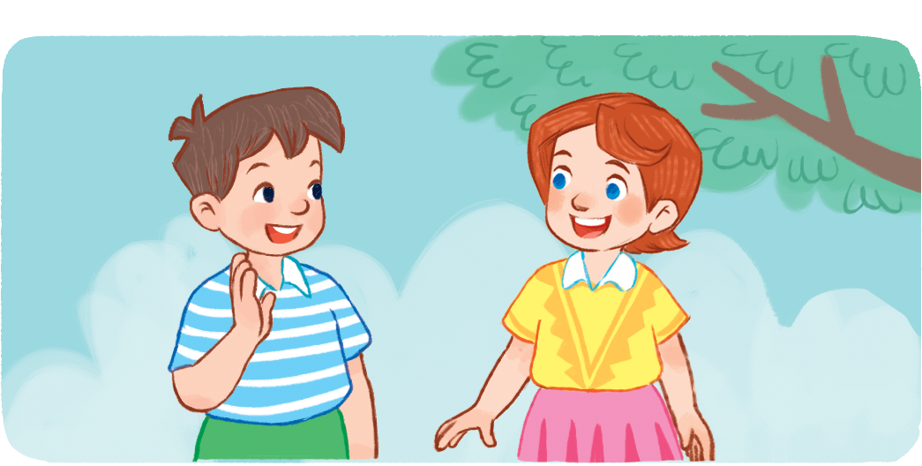
Hello
5. Look, complete and read.
Hi
1. ____. I’m Ben.
2. ____. I’m Lucy.
I’m
Hello
I’m
3. Hi, Ben. ____Mai.
4. _____, Lucy. ____ Minh.
Notes:
Facebook : Bùi Liễu
Mobile phone: 0968142780

Slide 27
6. Let’s sing.
Hello
Hello.
Hello.
I’m Ben.
Hi, Ben.
Hi, Ben.
I’m Mai.
Hello.
Hello.
I’m Minh.
Hi, Minh.
Hi, Minh.
I’m Lucy.
Notes:
Facebook : Bùi Liễu
Mobile phone: 0968142780

Slide 28
6. Let’s sing.
Hello
Hello.
Hello.
I’m Ben.
Hi, Ben.
Hi, Ben.
I’m Mai.
Hello.
Hello.
I’m Minh.
Hi, Minh.
Hi, Minh.
I’m Lucy.
Notes:
Facebook : Bùi Liễu
Mobile phone: 0968142780

Slide 29
Wrap up

Slide 30
Vocabulary
Facebook : Bùi Liễu
0968142780
Ben
Lucy
Mai
Minh

Slide 31
Vocabulary
Hello
Hi
hello
= hi
/heˈləʊ/
/haɪ/
xin chào
I
/aɪ/
tôi, tớ

Slide 32
Grammar
1. Chào khi gặp nhau.
Hello/Hi
2. Giới thiệu tên mình.
I’m + name
(I am = I’m)
Ví dụ:
I'm Mai. (Mình tên là Mai.)
Hi, I'm Mai. (Xin chào, mình tên là Mai.)

Slide 33
Homework
Learn by heart all the new words.
Read again the dialogue in part 1.

Slide 34
Facebook : Bùi Liễu
0968142780
Thank you!
Notes:
Facebook : Bùi Liễu
0968142780

