Slide 1


Slide 2




18
Period 3

Slide 3
Contents
1
Warm-up and review
2
3
4
Look, listen and repeat.
Listen, point and say.
Let’s talk.
5
Fun corner and wrap up

Slide 4
1. Warm-up and review

Slide 5

REMEMBER THAT!
You have 30 seconds to look at the pictures.
Try to remember what you see!
1 point for each picture..
Notes:
Game: Remember that!
T divides the class into 4 teams.
T put pupils in teams look at pictures in 30 seconds and try to remember as many pictures as they can.
T asks pupils to write the words they remember on the board to get points.
CLICK to the BLUE CIRCLE to set the time.

Slide 6




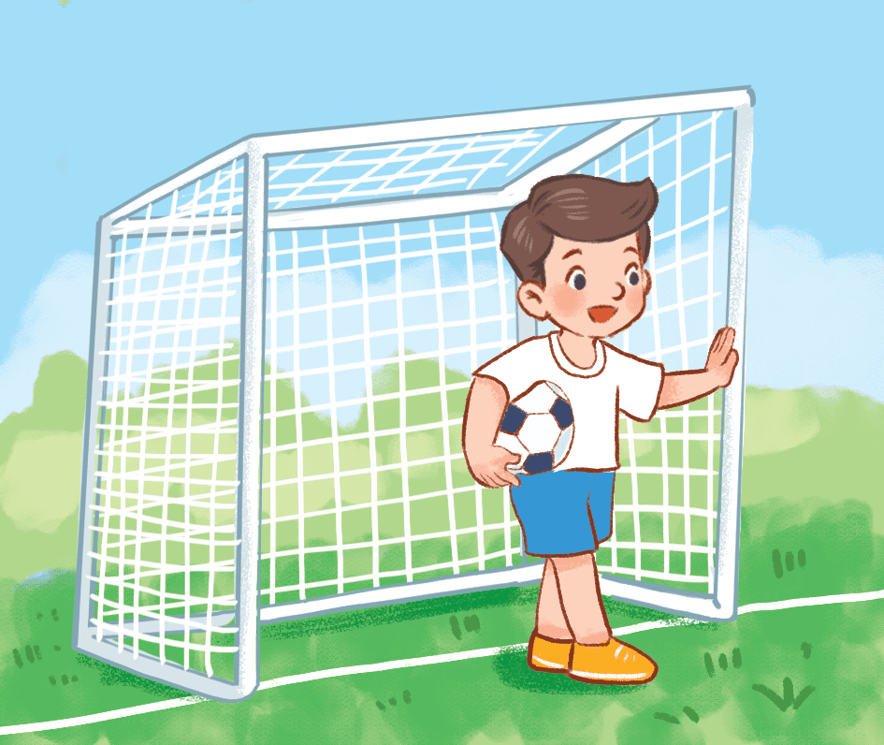
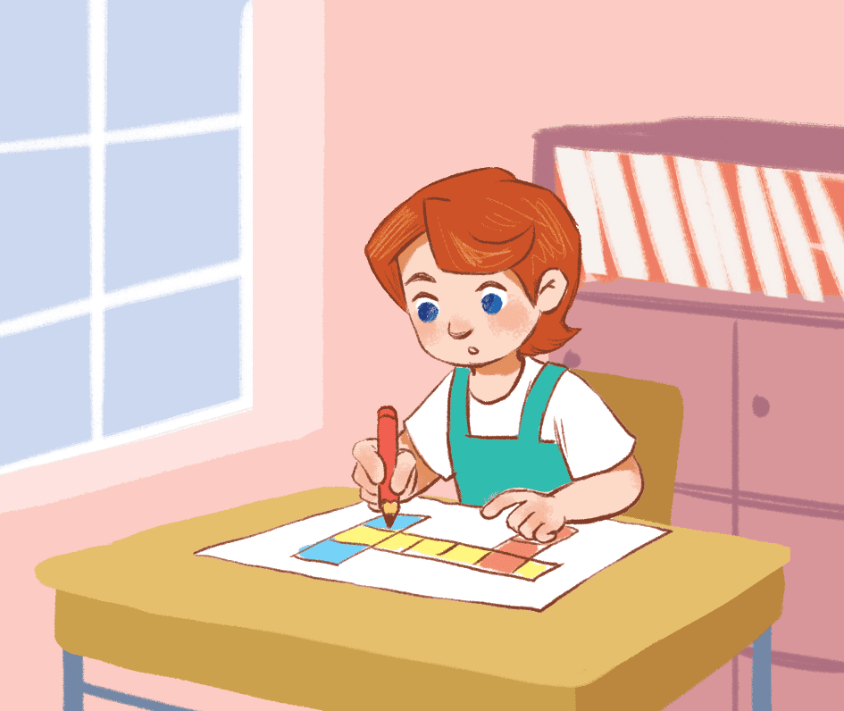

30 seconds

Slide 7


Write what you
1 minute

Slide 8
reading
singing
writing
drawing
dancing
playing football

Slide 9
2. Look, listen and repeat.

Slide 10
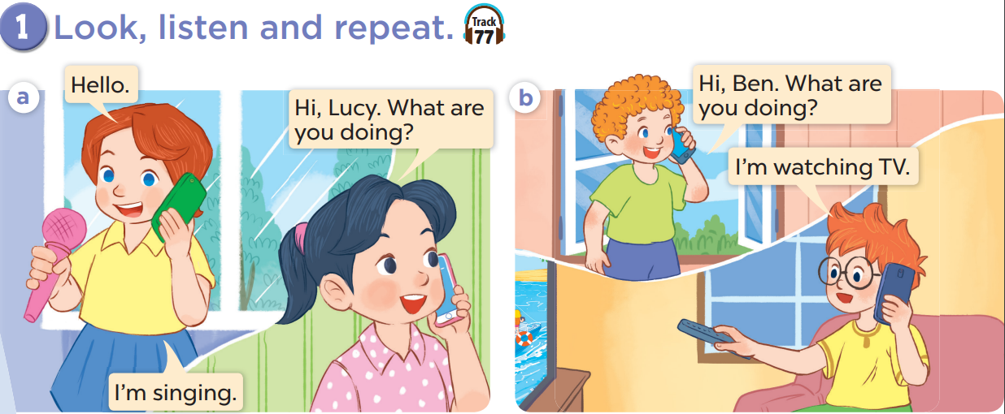


Slide 12
3. Listen, point and say.

Slide 13
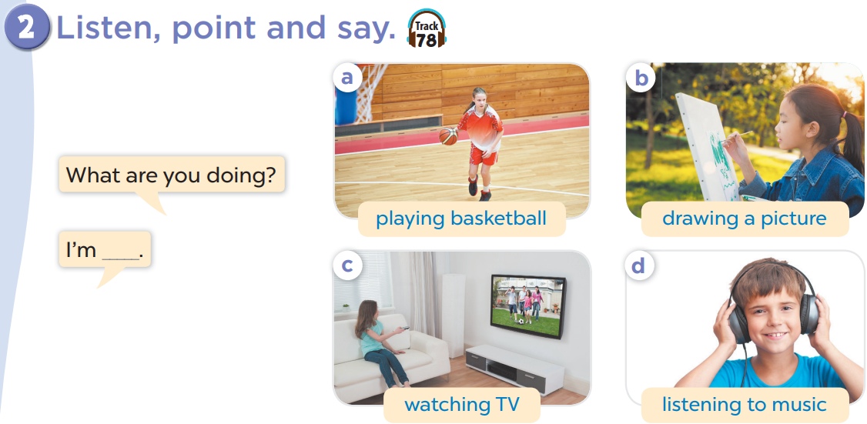

Slide 14


Slide 15




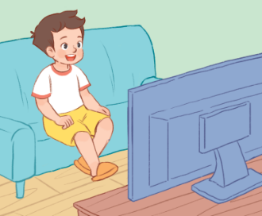
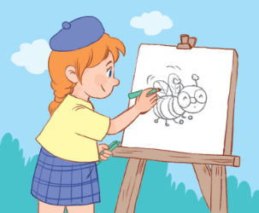




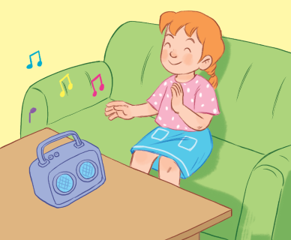




Notes:
Game: Spin and Say
T calls some pupils to say the sentences with the pictures after they spin the wheel.
T asks: What are you doing?
Pupils answer: I’m…………

Slide 16









Notes:
Game: Spin and Say
-T calls some pupils to say the sentences with the pictures when spinning
-T asks: What are you doing?
-Pupils answer: I’m…………

Slide 17







Slide 18





Slide 20


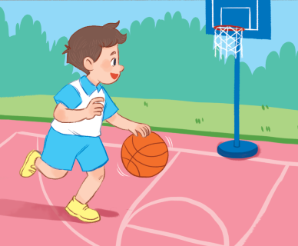

Slide 21





Slide 22


Slide 29
4. Let’s talk.

Slide 30
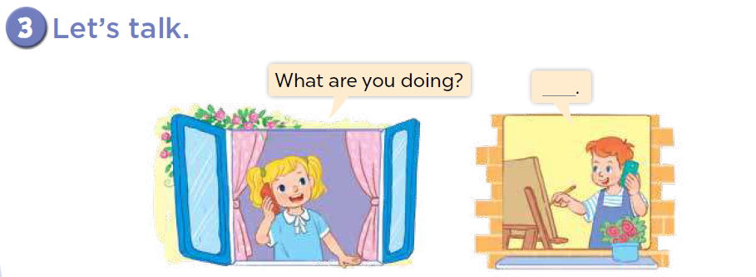

Slide 31
5. Fun corner and wrap up

Slide 32



The chosen one
I’m dancing.S
What are you doing?
Notes:
Game: Act out and guess
Let the class sit or stand in a circle.
One person is choosen to be in charge of doing the action by starting an action (such as playing basketball, then change to singing, next is dancing, then reading…) for the rest to follow and copy.
Another students will stand outside and guess who is the choosen one.

Slide 33

Website: sachmem.vn
Fanpage: www.facebook.com/sachmem.vn

