Slide 2
Our toys
17
LESSON 3
Period 5

Slide 3
Contents
1
Warm-up and review
2
Listen and repeat.
3
Listen and circle.
4
Let’s chant.
5
Fun corner and wrap up

Slide 4
Warm-up and review
1
1
Game: Chasing the thief

Slide 5
Notes:
Step 1: Divide the class into 4 teams.
Step 2: Invite 1 pupil to go to the board and look at the picture, then say aloud which one is missing.
Step 3: Encourage pupil to join in the game.
Step 4: Give points for pupils.

Slide 6
He wants to steal…
Click on the right option
Trains
Buses
Cars
TIME’S UP

Slide 7
He wants to steal…
Click on the right option
plane
car
doll
TIME’S UP

Slide 8
He wants to steal…
Click on the right option
doll
train
kite
TIME’S UP

Slide 9
He wants to steal…
Click on the right option
planes
trucks
buses
TIME’S UP

Slide 10
He wants to steal…
Click on the right option
cars
trucks
kites
TIME’S UP

Slide 11
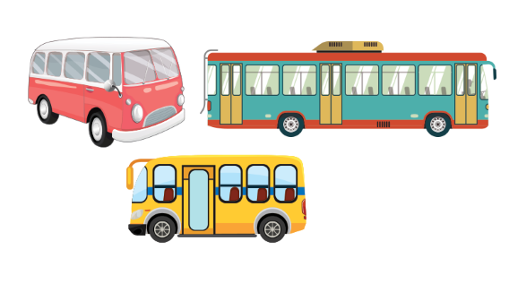
He wants to steal…
Click on the right option
dolls
planes
buses
TIME’S UP

Slide 12
He wants to steal…
Click on the right option
balls
bus
dolls
TIME’S UP

Slide 13
He wants to steal…
Click on the right option
Teddy bears
kites
Cars
TIME’S UP

Slide 15
Listen and repeat.
2
2

Slide 17
Listen and circle.
3
3

Slide 20
Listen and choose
She has _______.

Slide 21
Listen and choose
He has a ________.

Slide 22
Listen and choose
They have three _____.

Slide 23
Listen and choose
She has a _____.

Slide 24
Listen and choose
They have ____.

Slide 25
Listen and choose
He has ____.

Slide 26
Listen and choose
They have two _____.

Slide 27
Let’s chant.
4
4

Slide 28
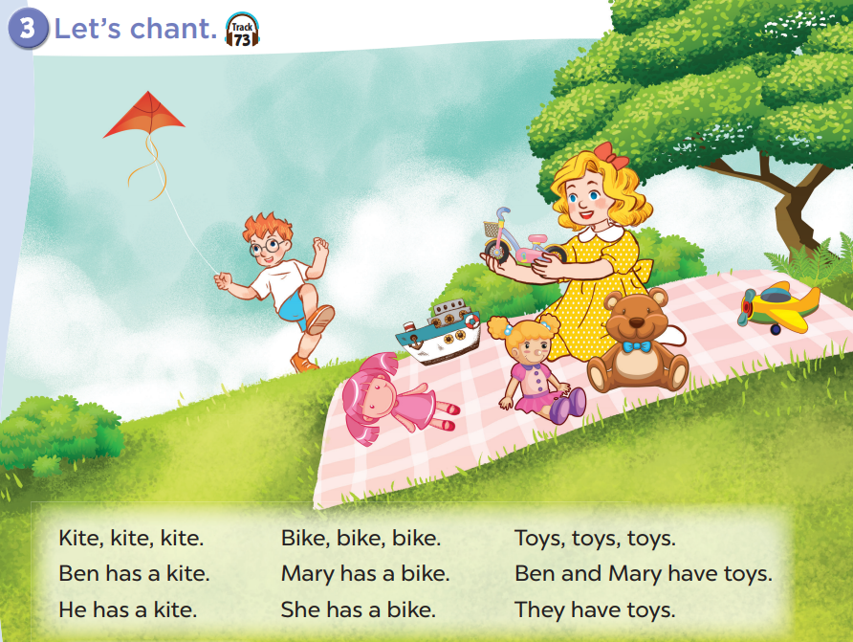

Slide 30
Fun corner and wrap up
5
5

Slide 31
Guessing game
Notes:
Step 1: Divide the class into 2 teams.
Step 2: Invite each pupil from each team to look at the phonics words or pictures and say them aloud. The faster pupil with correct answer will get points for his/her team.
Step 3: Encourage pupils to practice speaking English.
Step 4: Give points for pupils.

Slide 32
kite

Slide 33
i
i

Slide 34
toy

Slide 35
oy
oy

Slide 36
Website: sachmem.vn
Fanpage: www.facebook.com/sachmem.vn

