Slide 1



Slide 2


My pets
Lesson 3 Period 6
16

Slide 3
1
2
3
Warm-up and review
4
5
Fun corner and wrap-up
Read and complete.
Let’s write.
Project

Slide 4
1
Warm-up and review

Slide 5
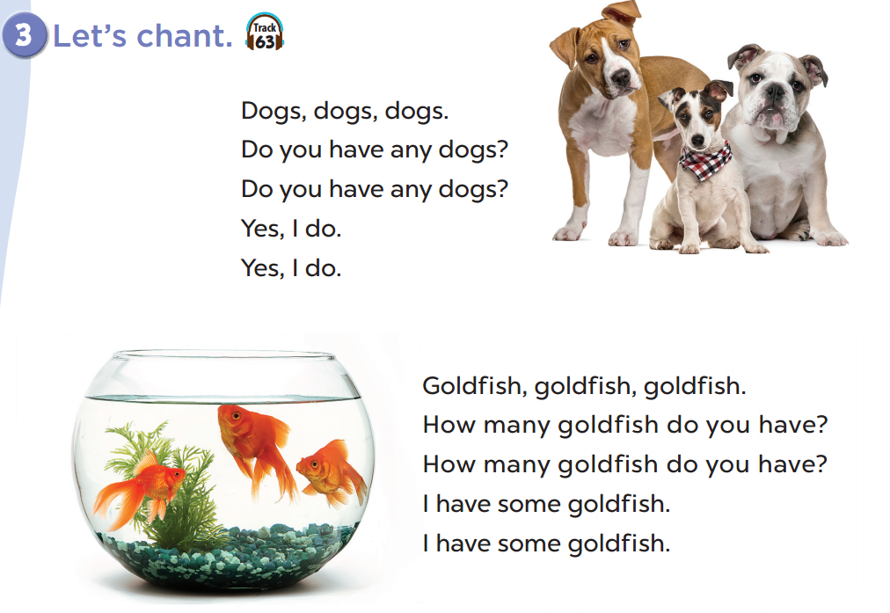


Slide 6
2
Read and complete.

Slide 7
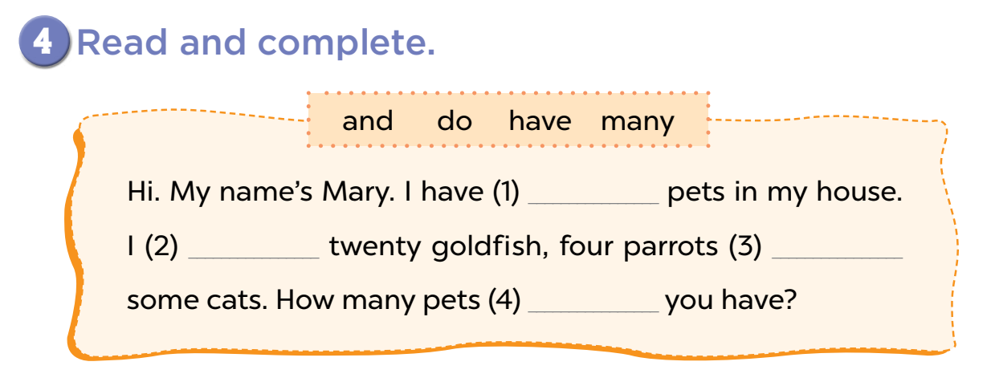
many
have
and
do

Slide 8
3
Let’s write.

Slide 9
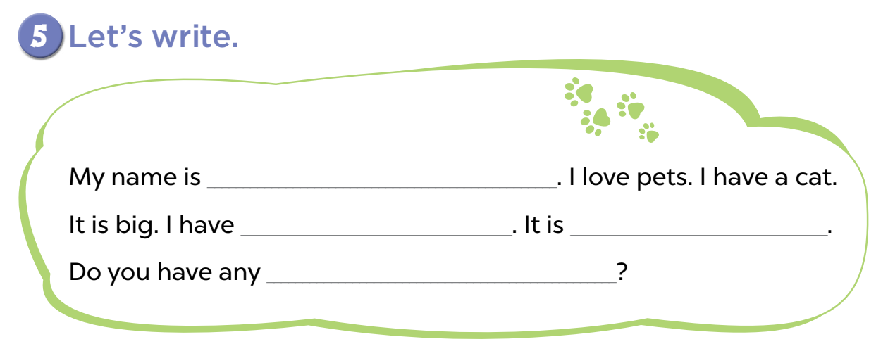
Tam
one cat
black
pets/ cats

Slide 10
4
Project

Slide 11
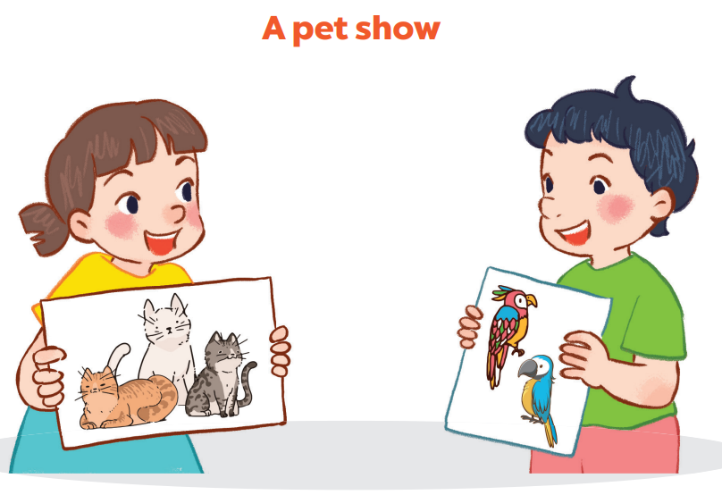

Slide 12
5
Fun corner and wrap-up

Slide 13
0
0
0
O
O
O
X
X
X
1
2
3
X
X
X
0
0
0
O
O
O
X
X
X
4
5
6
X
X
X
0
0
0
O
O
O
X
X
X
7
8
9
X
X
X
Notes:
Divide the class into 2 teams.
Each team chooses a number, answer the questions in relevant number(s). (Giáo viên chuẩn bị câu hỏi riêng về bài cũ ở ngoài)
Each player takes a turn to add either an O or a X to the board. The first player to line up three of their symbols in a row wins.

Slide 14

Website: sachmem.vn
Fanpage: www.facebook.com/sachmem.vn

