Slide 1
Unit 16
WHERE’S THE POST OFFICE?
Lesson 3

Slide 2
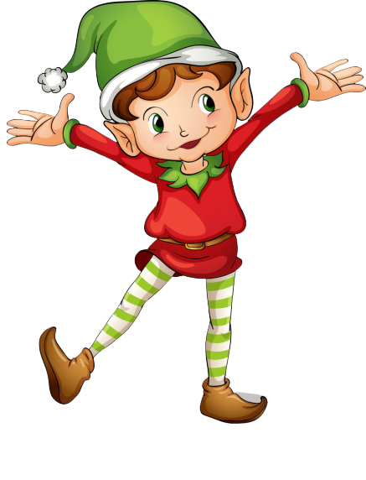
RING THE GOLDEN BELL
PLAY
Notes:
Ms Huyền Phạm - 0936.082.789 – YOUTUBE: MsPham. Facebook: Dạy và học cùng công nghệ.

Slide 3
Ring The Golden Bell
Question 1
Answer
Where’s the ____?
pharmacy
1
2
3
4
5
6
7
8
9
10
Next
Notes:
Ms Huyền Phạm - 0936.082.789 – YOUTUBE: MsPham. Facebook: Dạy và học cùng công nghệ.

Slide 4
Ring The Golden Bell
Question 2
Answer
It’s _____ the cinema.
opposite
1
2
3
4
5
6
7
8
9
10
Next
Notes:
Ms Huyền Phạm - 0936.082.789 – YOUTUBE: MsPham. Facebook: Dạy và học cùng công nghệ.

Slide 5
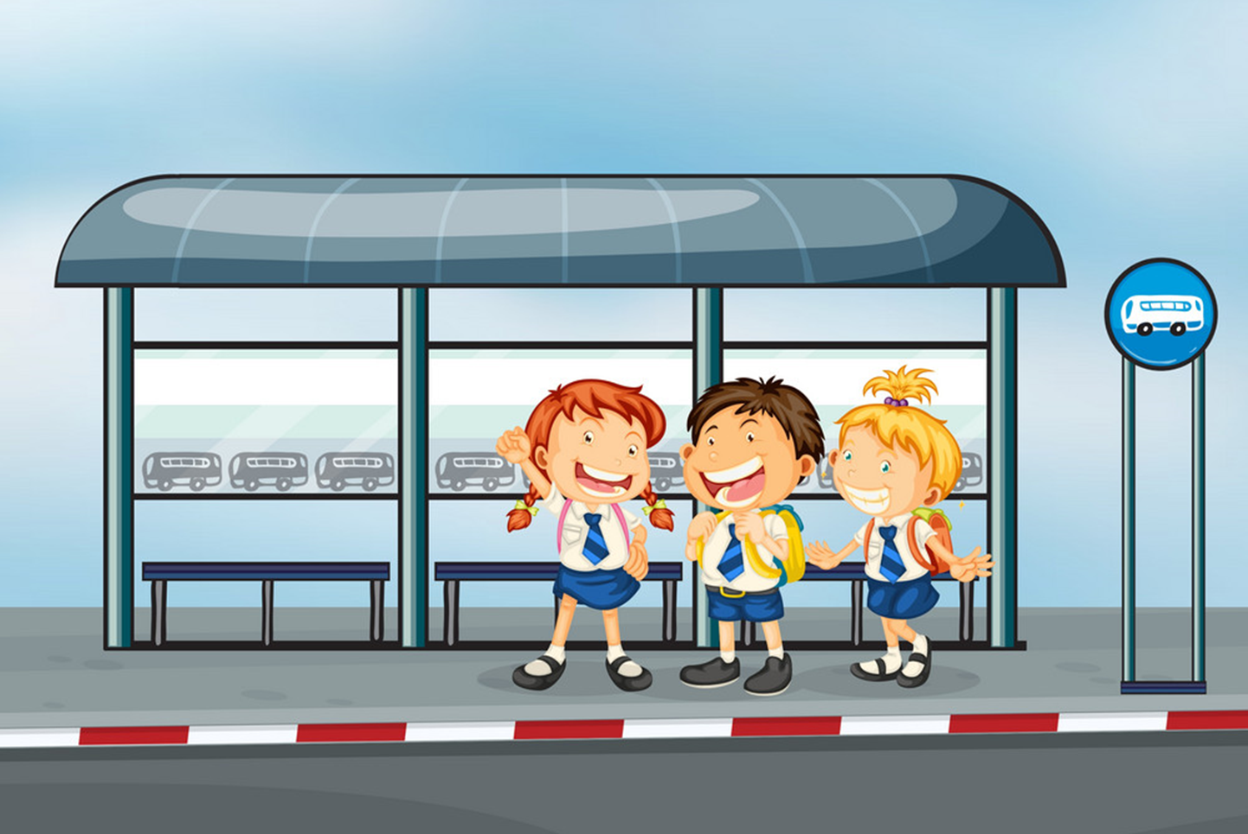
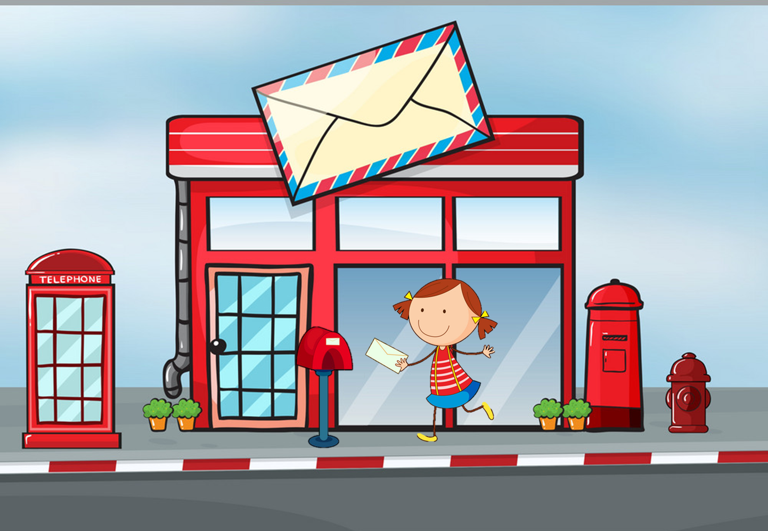
Ring The Golden Bell
Question 3
Answer
Where’s the post office?
It’s next to the bus stop
1
2
3
4
5
6
7
8
9
10
Next
Notes:
Ms Huyền Phạm - 0936.082.789 – YOUTUBE: MsPham. Facebook: Dạy và học cùng công nghệ.

Slide 6
Ring The Golden Bell
Question 4
Answer
______?
The theatre is near the museum.
Where is the theatre?
1
2
3
4
5
6
7
8
9
10
Next
Notes:
Ms Huyền Phạm - 0936.082.789 – YOUTUBE: MsPham. Facebook: Dạy và học cùng công nghệ.

Slide 7
Ring The Golden Bell
Question 5
Answer
Where’s the stadium?
It’s is ____ the post office and bus stop.
between
1
2
3
4
5
6
7
8
9
10
Next
Notes:
Ms Huyền Phạm - 0936.082.789 – YOUTUBE: MsPham. Facebook: Dạy và học cùng công nghệ.

Slide 8
Ring The Golden Bell
Question 6
Answer
How can I get to the theatre?
You can walk.
1
2
3
4
5
6
7
8
9
10
Next
Notes:
Ms Huyền Phạm - 0936.082.789 – YOUTUBE: MsPham. Facebook: Dạy và học cùng công nghệ.

Slide 9
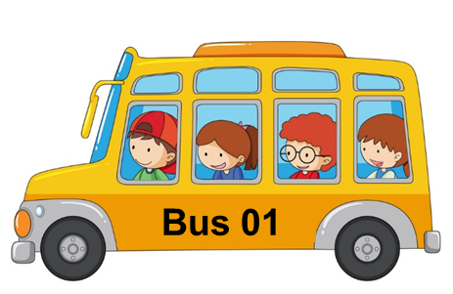
Ring The Golden Bell
Question 7
Answer
How can I get to the market?
You can take a bus
1
2
3
4
5
6
7
8
9
10
Next
Notes:
Ms Huyền Phạm - 0936.082.789 – YOUTUBE: MsPham. Facebook: Dạy và học cùng công nghệ.

Slide 10
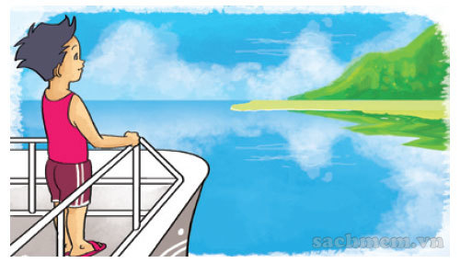
Ring The Golden Bell
Question 8
Answer
How can I get to Cat Ba Island?
You can take a boat
1
2
3
4
5
6
7
8
9
10
Next
Notes:
Ms Huyền Phạm - 0936.082.789 – YOUTUBE: MsPham. Facebook: Dạy và học cùng công nghệ.

Slide 11
Ring The Golden Bell
Question 9
Answer
____ Da Nang?
You can go by plane.
How can I get to
1
2
3
4
5
6
7
8
9
10
Next
Notes:
Ms Huyền Phạm - 0936.082.789 – YOUTUBE: MsPham. Facebook: Dạy và học cùng công nghệ.

Slide 12
Ring The Golden Bell
Question 10
Answer
____ Ho Chi Minh city?
They can take a coach.
How can they get to
1
2
3
4
5
6
7
8
9
10
Next
Notes:
Ms Huyền Phạm - 0936.082.789 – YOUTUBE: MsPham. Facebook: Dạy và học cùng công nghệ.

Slide 13
Rung chuông

Slide 14
Pronunciation

Slide 15
1. Listen and repeat.
1. | Where's the post office? ↷ It's opposite the stadium. ↷
2. | Where's the cinema? ↷ It's next to the post office. ↷
3. | Where's the supermarket? ↷ It's on the corner of the street. ↷

Slide 16
2. Listen and circle a or b.
a. It's opposite the museum.
b. It's opposite the library.
1. Where's the cinema?
a. It's next to the supermarket.
b. It's next to the stadium.
2. Where's the restaurant?
a. It's on the corner of the street.
b. It's at the end of the street.
3. Where's the park?

Slide 17
Practise

Slide 18
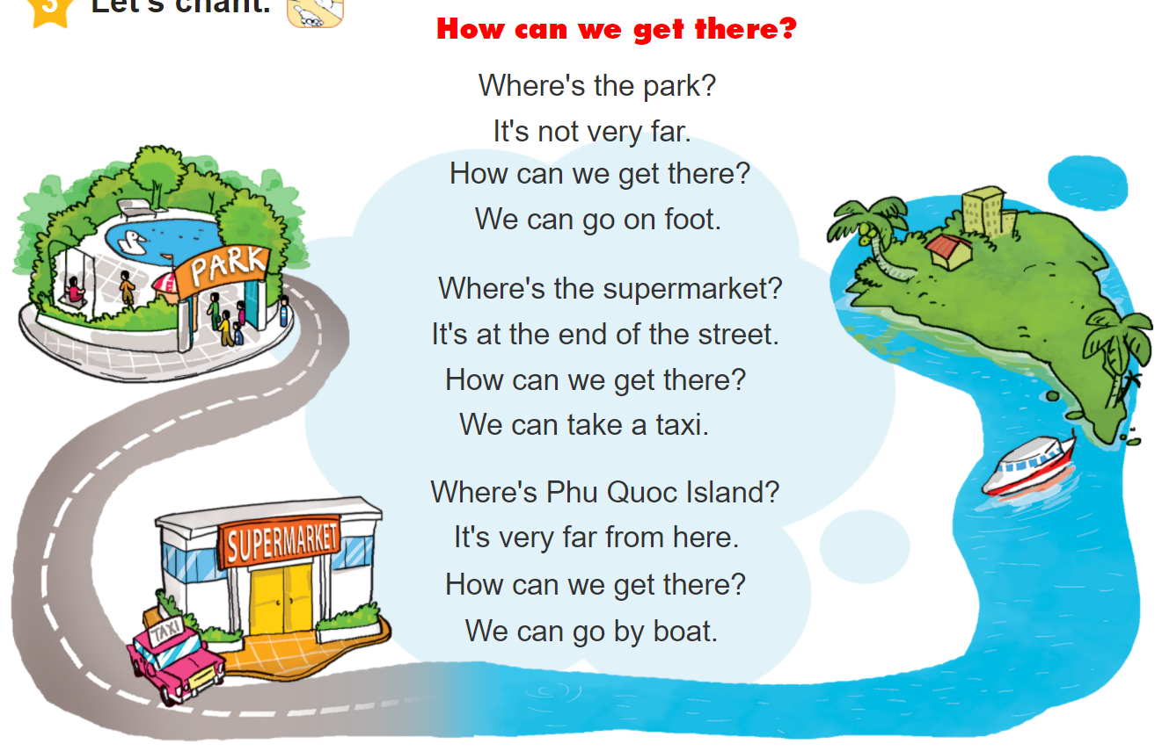
3. Let’s chant.

Slide 19
Vocabulary
Get off
: Xuống
Stop
: Điểm dừng
On the left/right
: ở bên trái/phải
fence
: Hàng rào

Slide 20
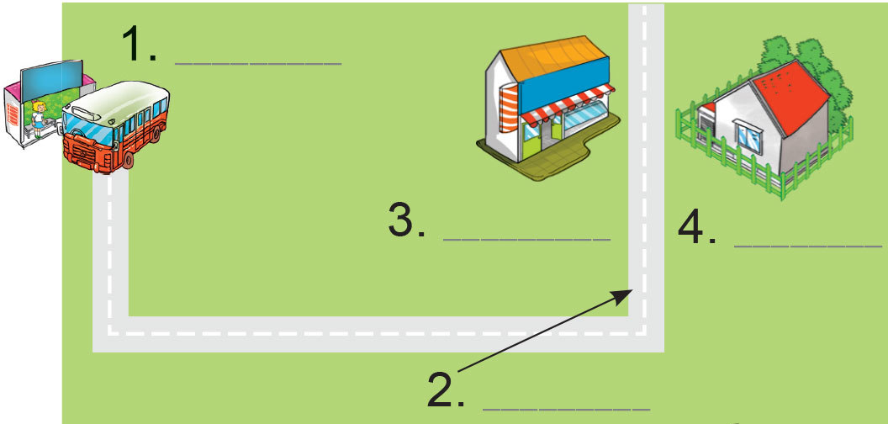
4.1. Label the places.
Dear Linda,
I'm happy you're going to visit me. You can take bus Number 12 at West Street and get off at the fifth stop. Then walk along the street for five minutes. You will see Pear Street at the end of the street. Turn left and you will see a pharmacy on the left. My house is opposite the pharmacy. It is behind a green fence.
See you!
Tony
1. _____________
2. _____________
3. _____________
4. _____________
bus stop
Pear Street
pharmacy
Tony's house

Slide 21
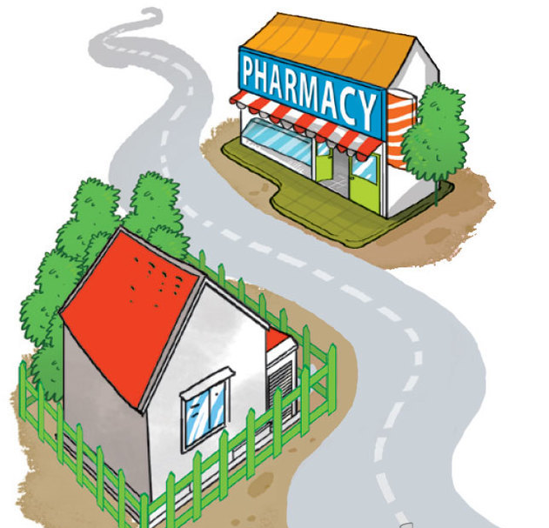
4.2. Answer the questions.
1. What bus should Linda take?
She should take bus Number 12.
2. Where should she get off the bus?
She should get off at the fifth stop.
3. What's the name of the road at the end of the street?
It's Pear Street.
4. What's opposite Tony's house?
A pharmacy is opposite his house.
Dear Linda,
I'm happy you're going to visit me. You can take bus Number 12 at West Street and get off at the fifth stop. Then walk along the street for five minutes. You will see Pear Street at the end of the street. Turn left and you will see a pharmacy on the left. My house is opposite the pharmacy. It is behind a green fence.
See you!
Tony

Slide 22
5. Write the directions.
1
A: Where's the park?
B: You are here, at Lemon Street. Go _____________________
________________________
________________________
___________________________.
straight ahead.
Turn right at Orange Street.
The park is on the corner of
Orange Street and Apple Street.

Slide 23
5. Write the directions.
2
A: Where's the pharmacy?
B: Go ______________________
___________________________
___________________________
___________________________.
straight ahead.
Turn right at Pear Street.
The pharmacy is on the corner of
Pear Street and Apple Street.

Slide 24
5. Write the directions.
2
A: Where's the pharmacy?
B: Go ______________________
___________________________
___________________________
___________________________.
straight ahead.
Turn right at Pear Street.
The pharmacy is opposite the
cinema.

Slide 25
6. Project

