Slide 1
Unit 14
What does he look like?
Lesson 3

Slide 2
REVIEW

Slide 3
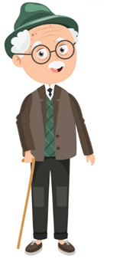
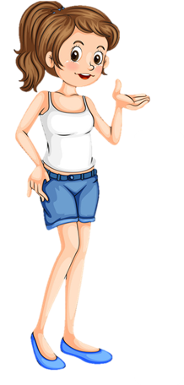
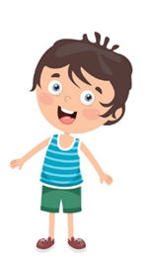
What does she / he look like?
She / He ____________.
old
slim
tall
short
young

Slide 4
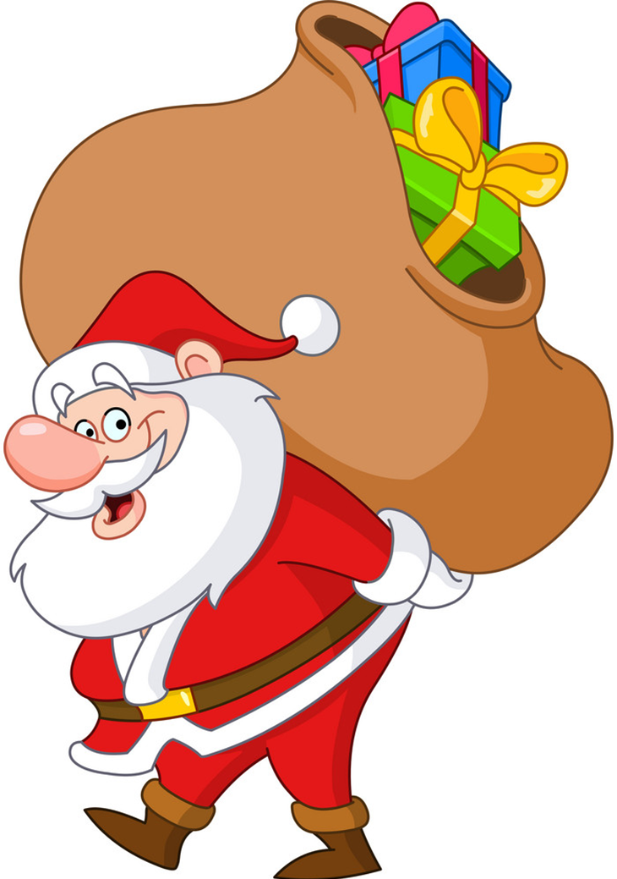
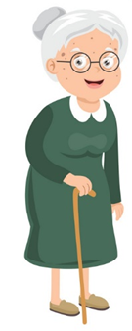
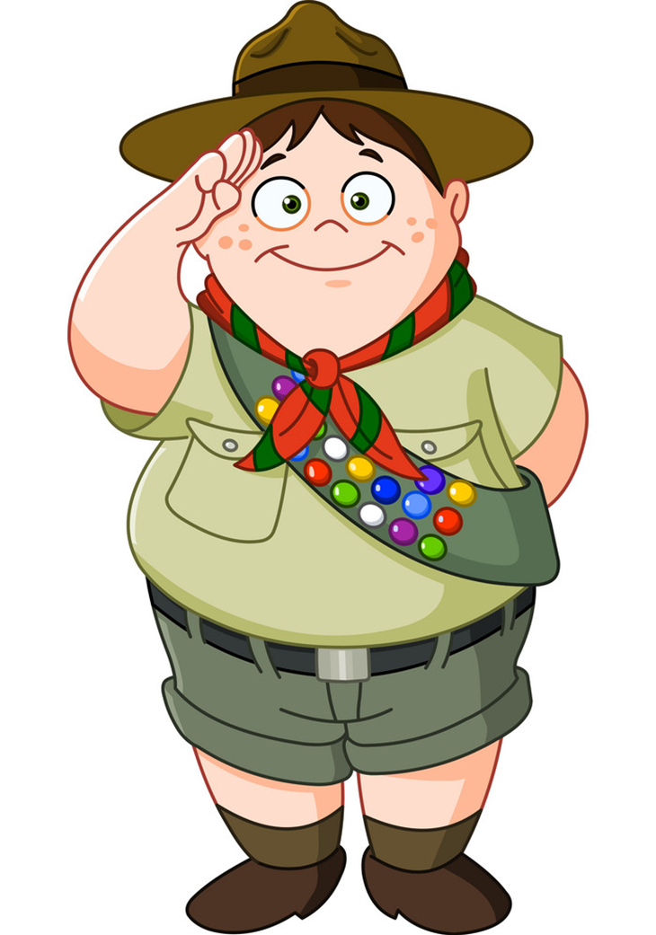
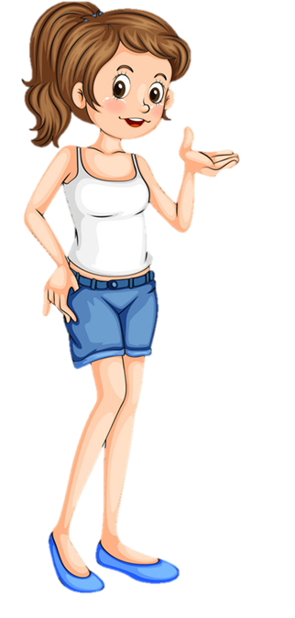
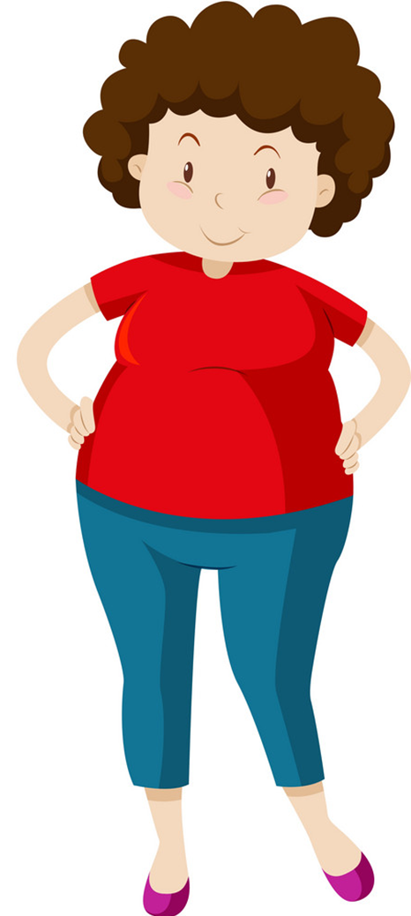
Who's ________?
_______ is _____ than ______.
younger
stronger
older
bigger
taller
shorter

Slide 5
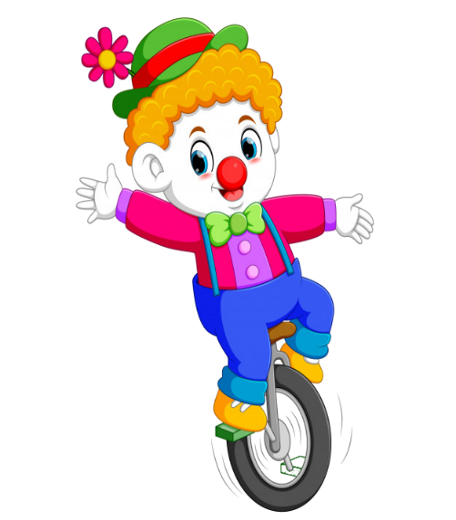
Notes:
Ms Huyền Phạm - 0936.082.789 – YOUTUBE: MsPham. Facebook: Dạy và học cùng công nghệ.

Slide 6
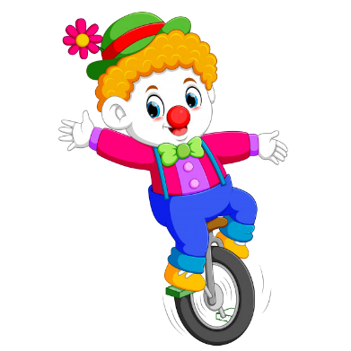
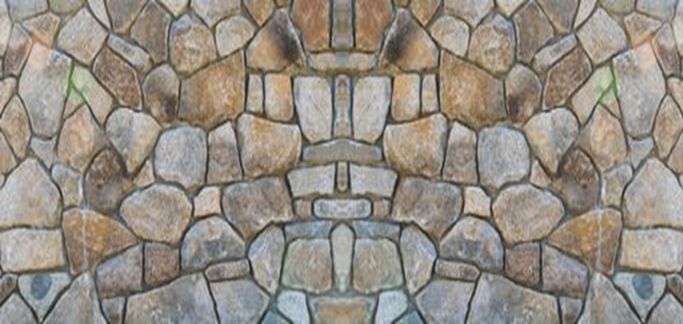
Tony is _____ than his father.
Shorter
Bigger
Taller
Tronger
Notes:
Ms Huyền Phạm - 0936.082.789 – YOUTUBE: MsPham. Facebook: Dạy và học cùng công nghệ.

Slide 7
My mother’s thirty-three years old. She’s ___________ than my father.
slimmer
older
younger
stronger
Notes:
Ms Huyền Phạm - 0936.082.789 – YOUTUBE: MsPham. Facebook: Dạy và học cùng công nghệ.

Slide 8
My sister’s slim. She’s _____ than my mother.
shorter
slimmer
taller
limmer
Notes:
Ms Huyền Phạm - 0936.082.789 – YOUTUBE: MsPham. Facebook: Dạy và học cùng công nghệ.

Slide 9
I’m not very tall, but I’m taller than my ______.
brother
friend
mother
sister
Notes:
Ms Huyền Phạm - 0936.082.789 – YOUTUBE: MsPham. Facebook: Dạy và học cùng công nghệ.

Slide 10
A: ___ does your father look like?
B: He’s tall and strong.
What
How
Who
When
Notes:
Ms Huyền Phạm - 0936.082.789 – YOUTUBE: MsPham. Facebook: Dạy và học cùng công nghệ.

Slide 11
A: What does your ____ look like?
B: She’s small and short.
brother
grandfather
mother
father
Notes:
Ms Huyền Phạm - 0936.082.789 – YOUTUBE: MsPham. Facebook: Dạy và học cùng công nghệ.

Slide 12
My sister is shorter _____ me.
then
than
them
the
Notes:
Ms Huyền Phạm - 0936.082.789 – YOUTUBE: MsPham. Facebook: Dạy và học cùng công nghệ.

Slide 13
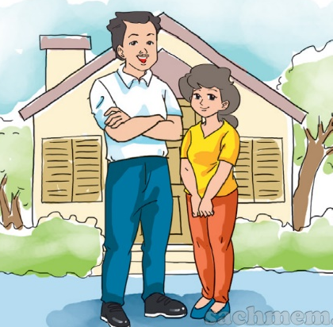
The mother is shorter
than the father.
What does your father look like?
How old is your mother?
Who’s that man?
Who’s shorter?
Notes:
Ms Huyền Phạm - 0936.082.789 – YOUTUBE: MsPham. Facebook: Dạy và học cùng công nghệ.

Slide 14
Notes:
Ms Huyền Phạm - 0936.082.789 – YOUTUBE: MsPham. Facebook: Dạy và học cùng công nghệ.

Slide 15
PHONICS

Slide 16
1. Listen and repeat.
th | this | This is my mother.
 | that | That is my father.
th | thin | The book is thin.
 | thick | The dictionary is thick.

Slide 17
2. Listen and circle.
1. My brother is ___________.
a. thin b. there
2. My sister is ___________.
a. There b. three
3. ___________ books are on the table.
a. Their b. The
4. Their books are ___________.
a. Thin b. thick

Slide 18
PRACTISE

Slide 19
3. Let's chant

Slide 20
4. Read and write
Dear Jane,
My name's Marie. I'm nine years old and I live in Can Tho. There are four people in my family: my father, my mother, my brother and me. My father's 34 years old. He's a teacher, and he's tall and slim. My mother's 31 years old. She's a doctor. I think she's very beautiful! My brother and I are pupils at Hoa Sen Primary School. I'm older than my brother but he's taller than me.
Best wishes, Marie.
1. What does Marie's father do?
2. What does her father look like?
3. What does her mother look like?
4. Who is younger, Marie or her brother?
5. Who is shorter, Marie or her brother?
______________________.
______________________. ______________________. ______________________. ______________________.
He is a teacher
He is tall and slim
Her mother is beautiful
Her brother is younger
Marie is shorter

Slide 21
5. Write
Dear,
My name's ____________. I'm ________ years old.
There are ____________ people in my family.
My father's ____________.
My mother's ____________.
Best wishes.

Slide 22
6. Project
Bring a photo of your family.
Describe your family members to the class.

