Slide 2
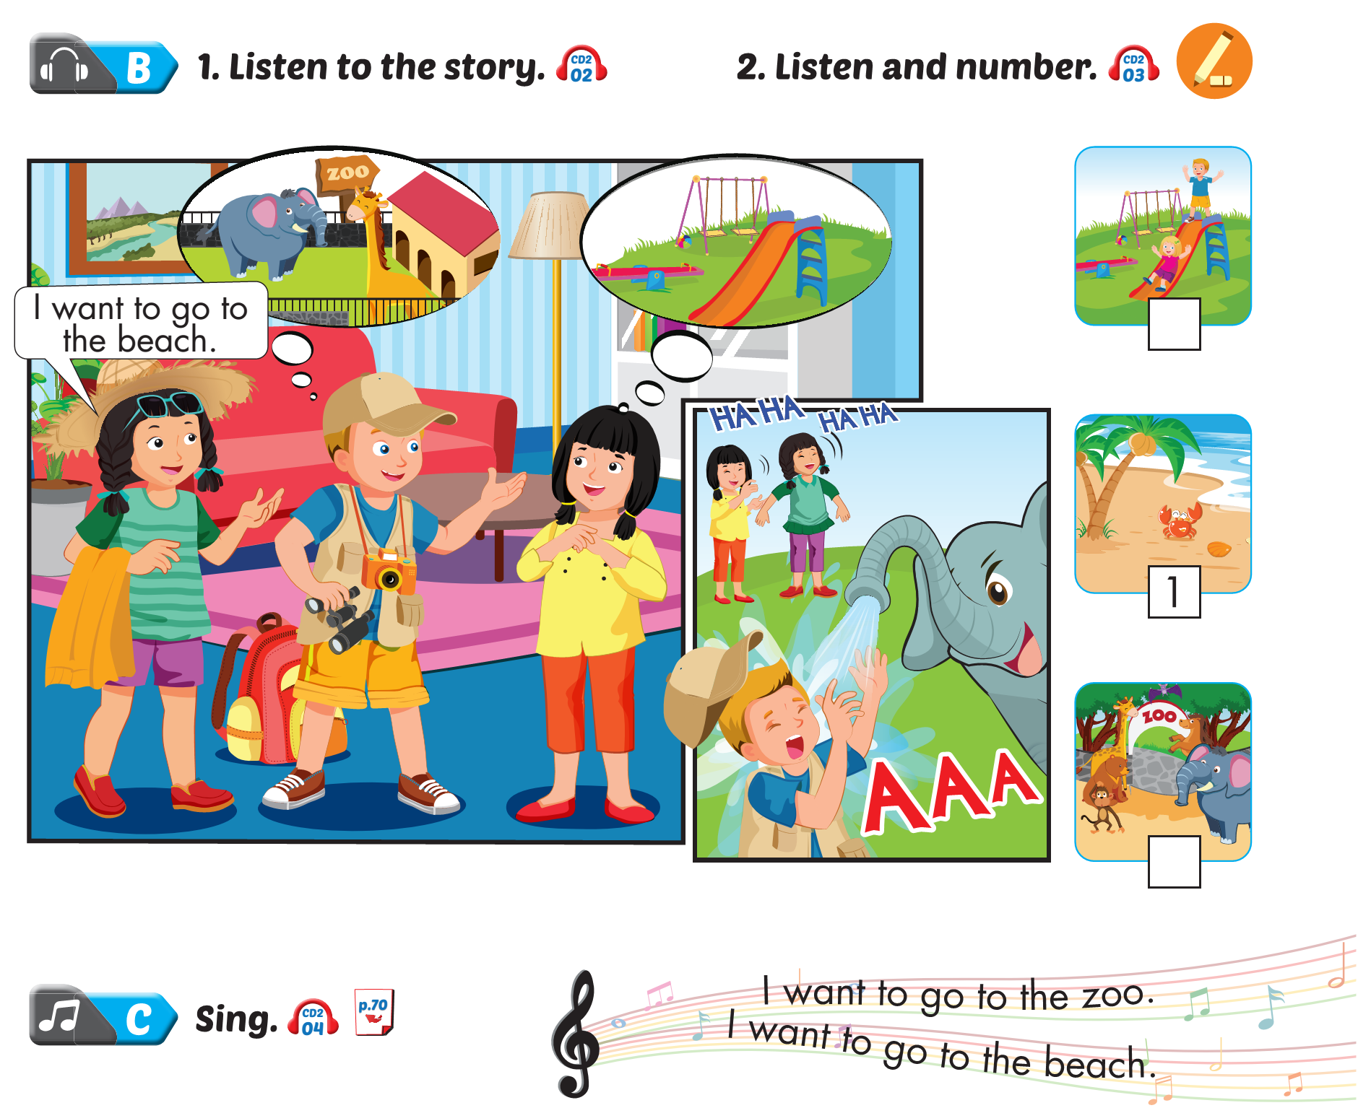
Lesson 1
2
3

Slide 3
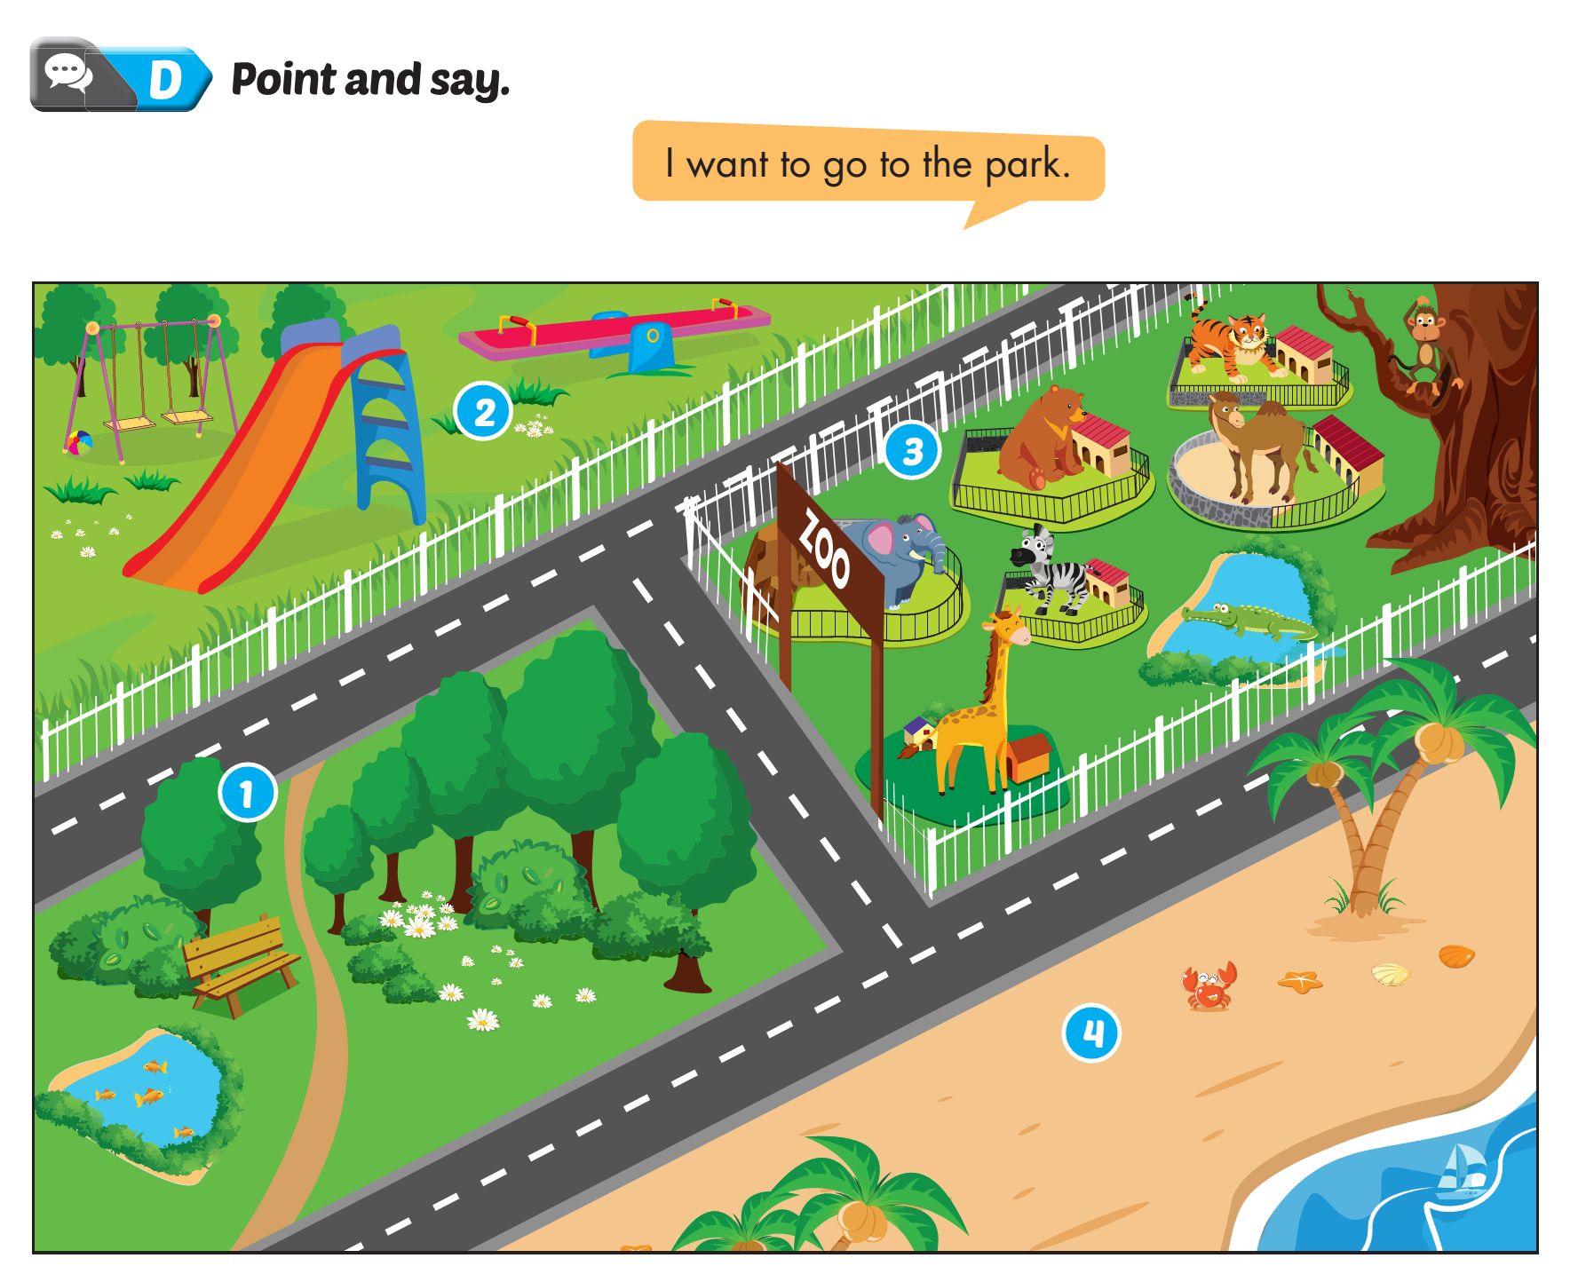
Lesson 1

Slide 4
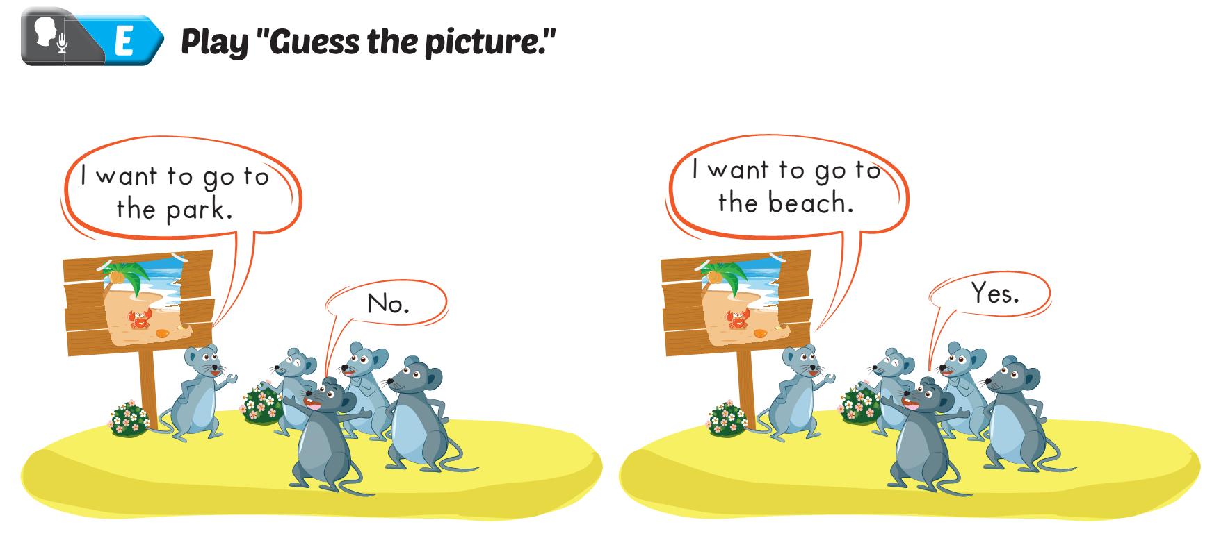
Lesson 1

Slide 6
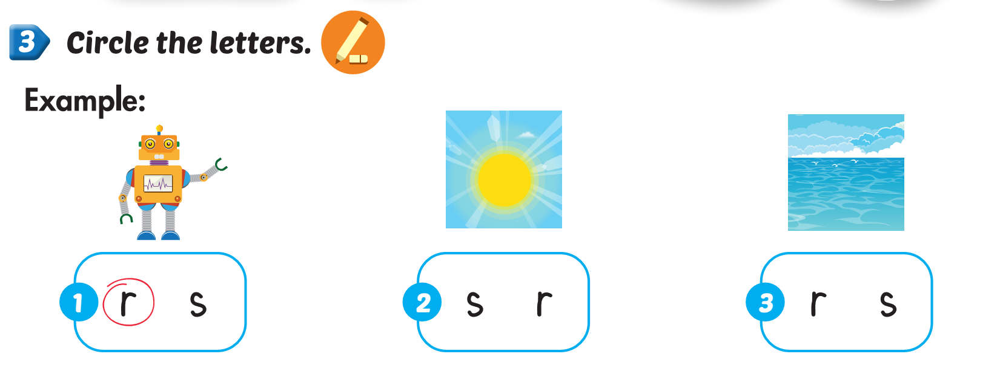
Lesson 2

Slide 7
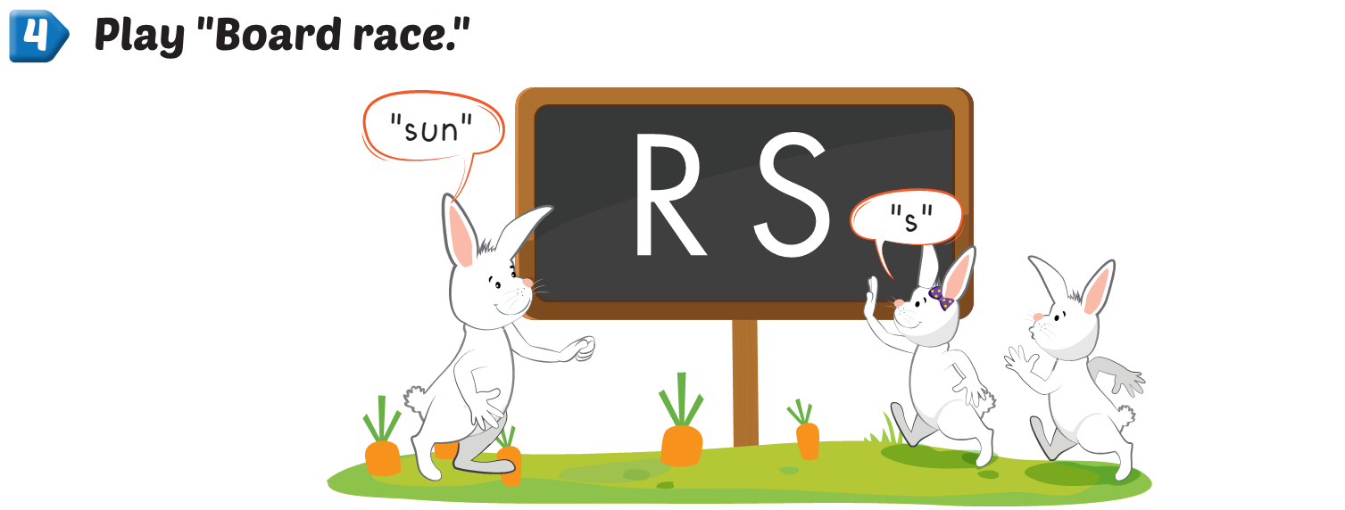
Lesson 2

Slide 8
Lesson 2

Slide 9
Lesson 2

Slide 11
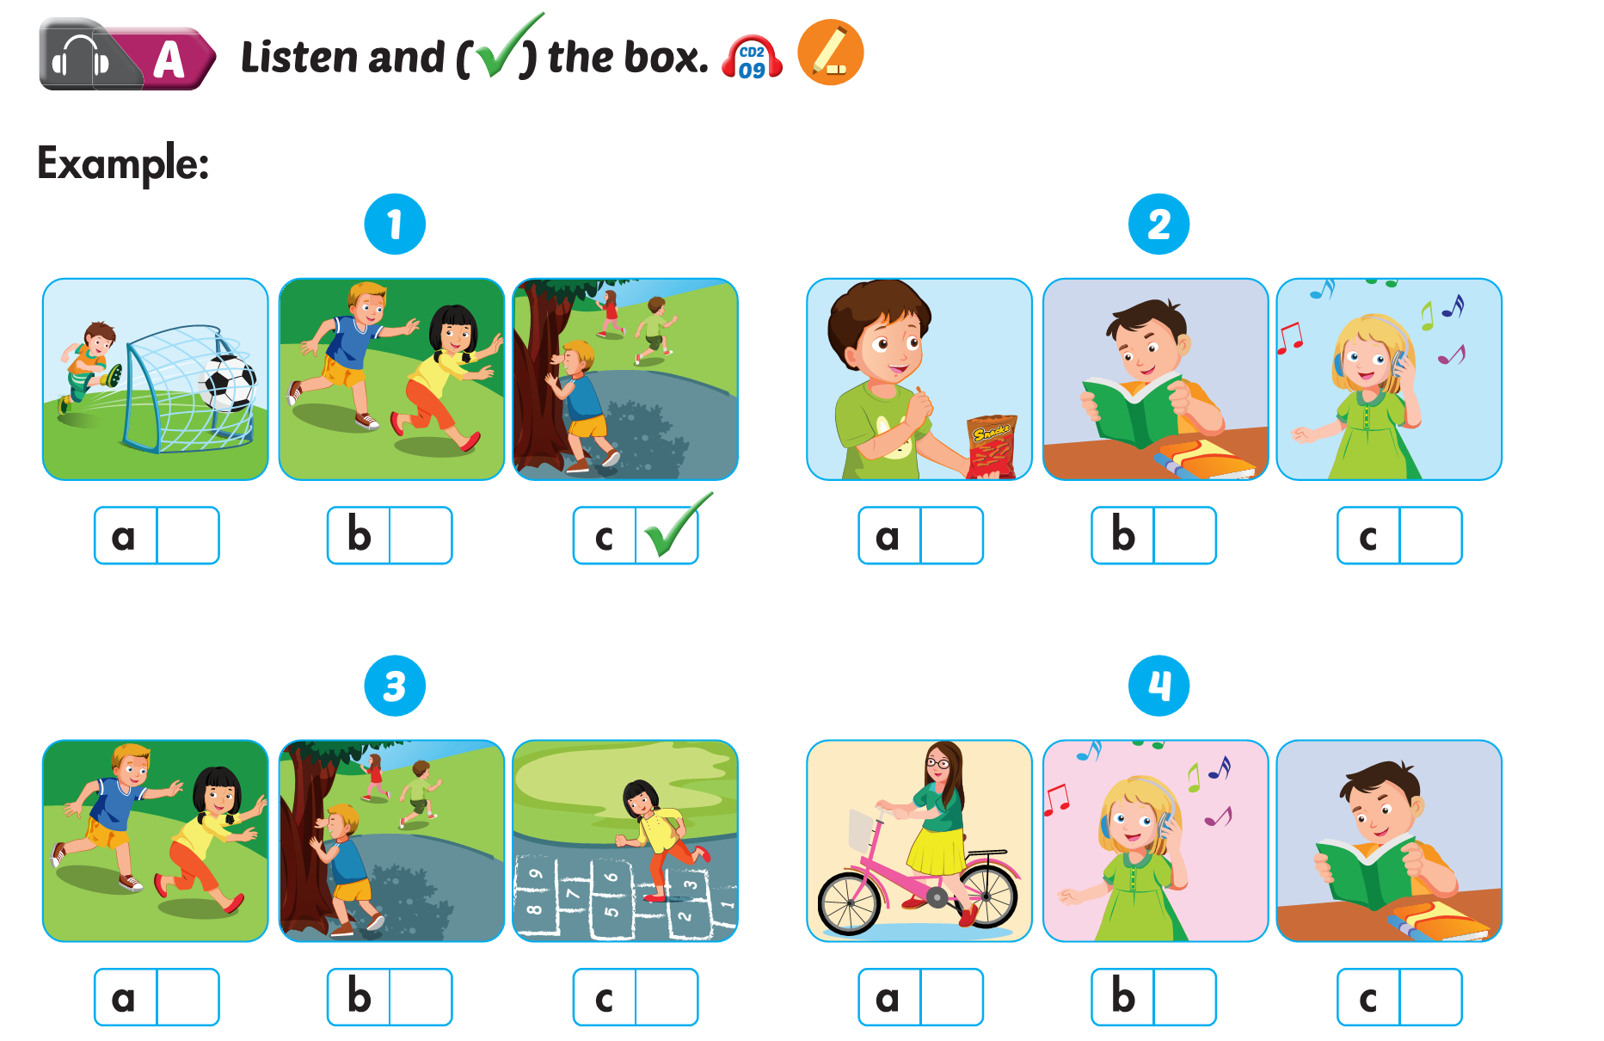

Slide 13
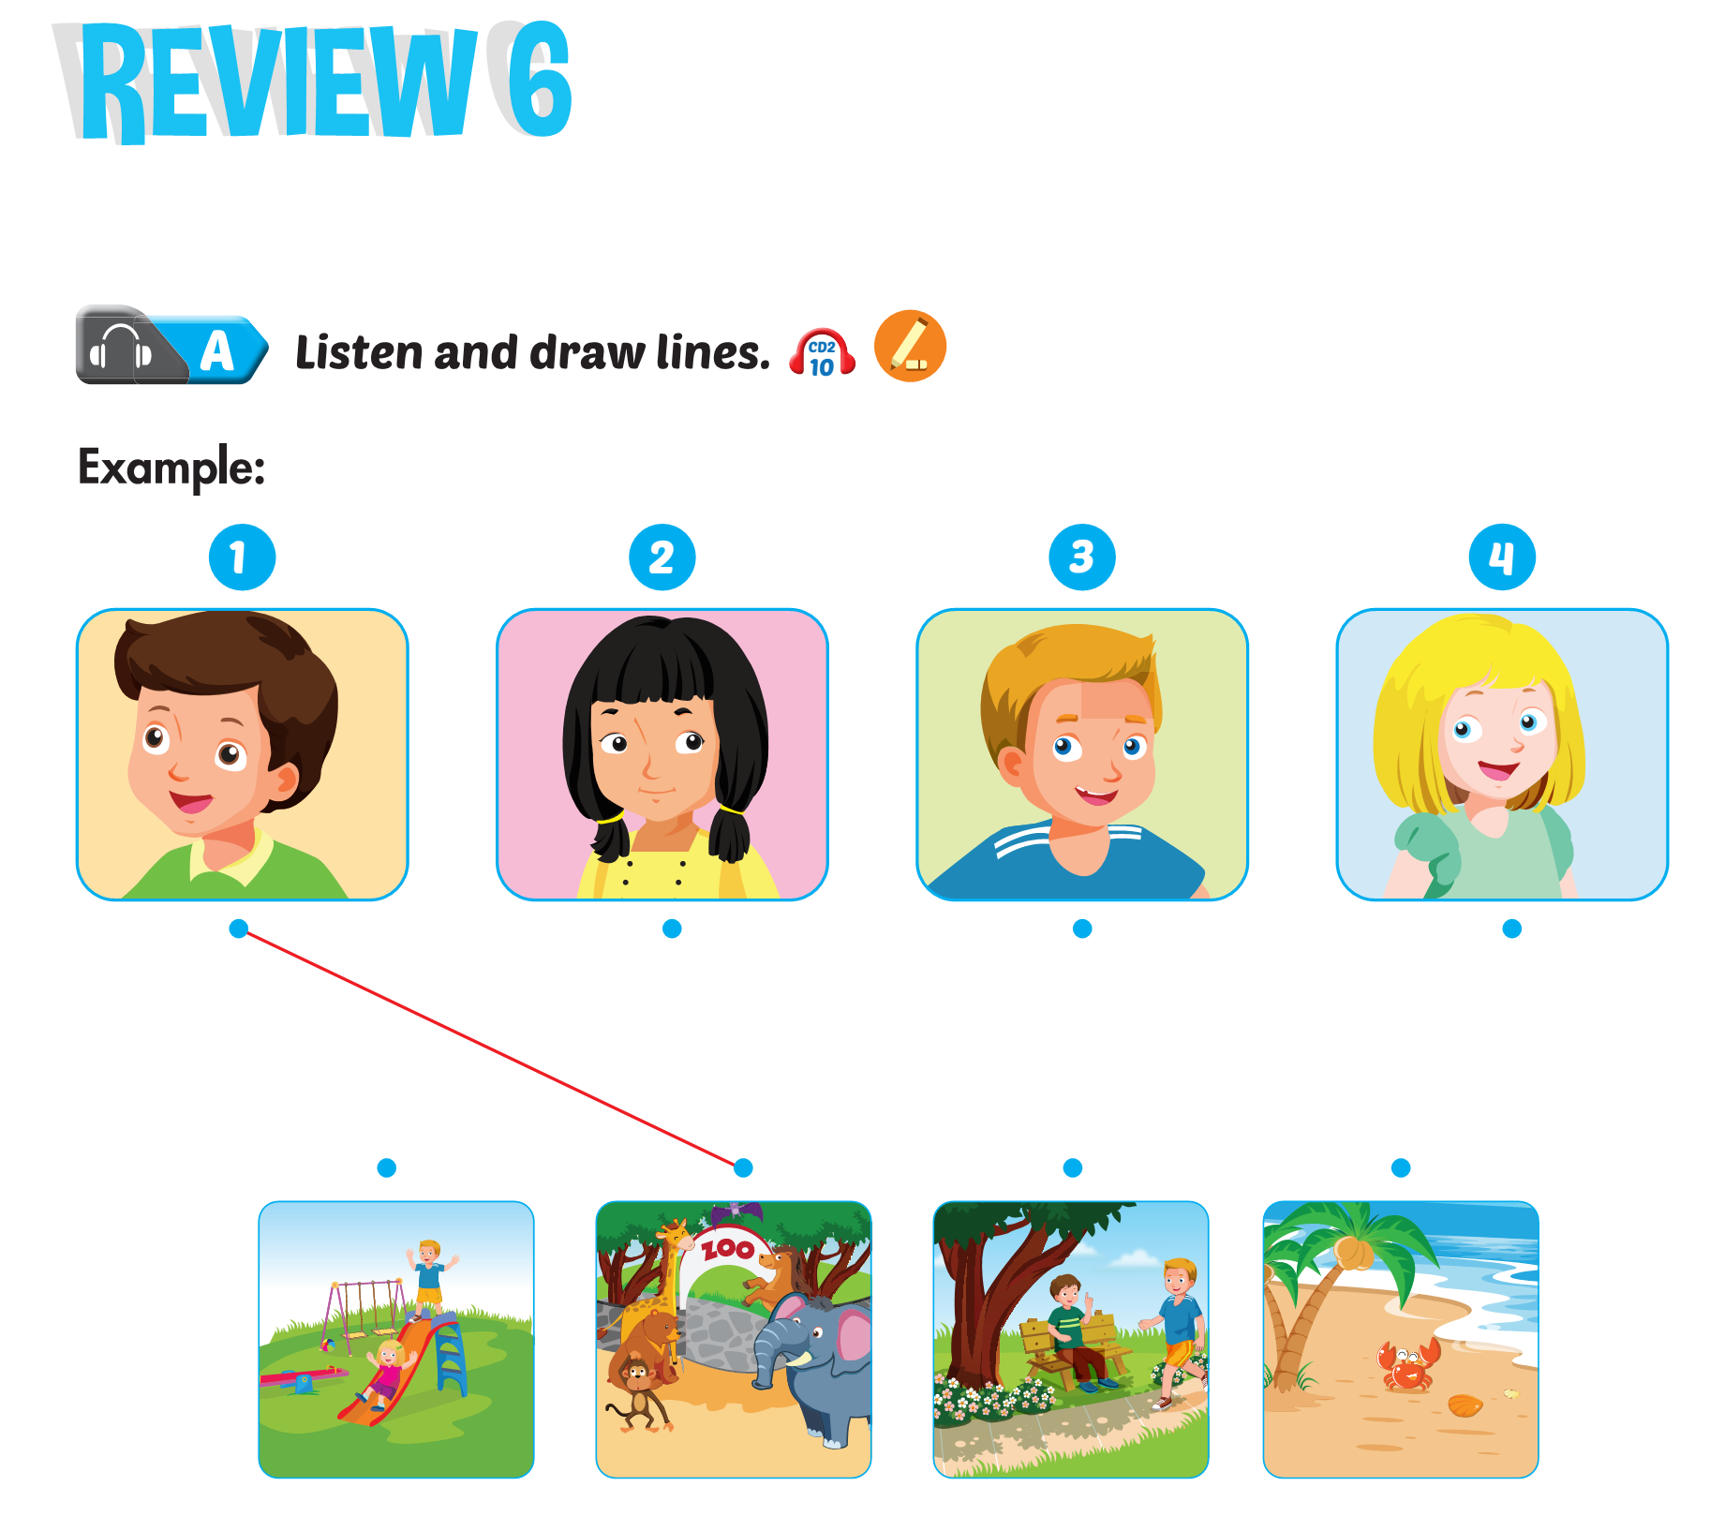

Slide 14
