Slide 1


UNIT 13 – LESSON 1

Slide 2
VOCABULARY

Slide 3

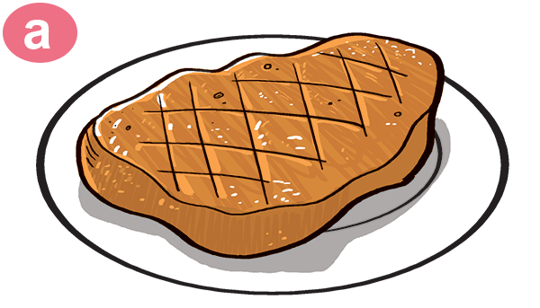
Vocabulary
beef
/biːf/

Slide 4
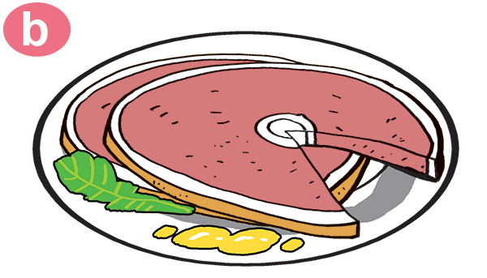
Vocabulary
Pork
/pɔːk/

Slide 5

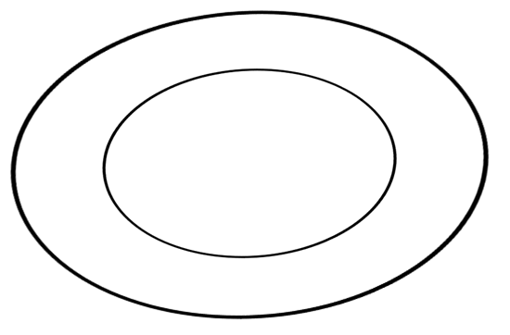
Vocabulary
chicken
/ˈtʃɪkɪn/

Slide 6
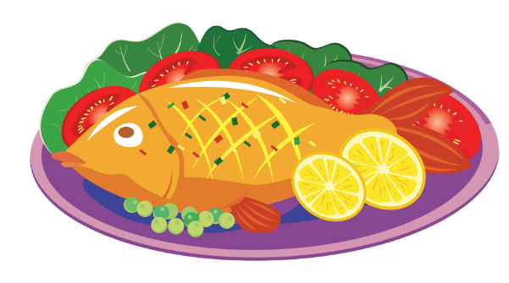
Vocabulary
fish
/fɪʃ/

Slide 7

Vocabulary
food
/fuːd/

Slide 8
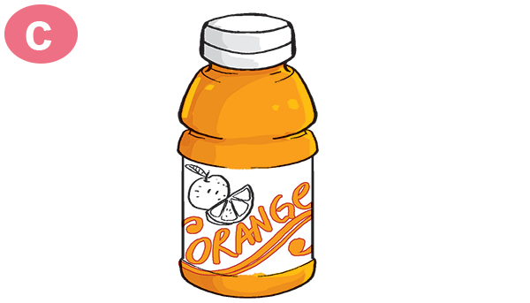
Vocabulary
Orange juice
/ˈɔːrɪndʒ dʒuːs/

Slide 9
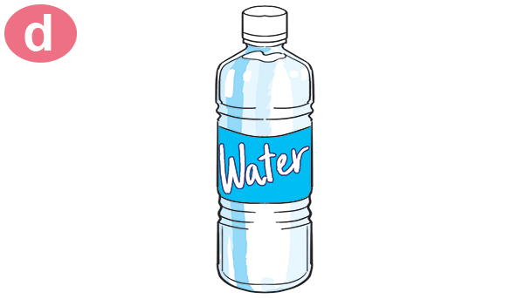
Vocabulary
water
/ˈwɔːtər/

Slide 10
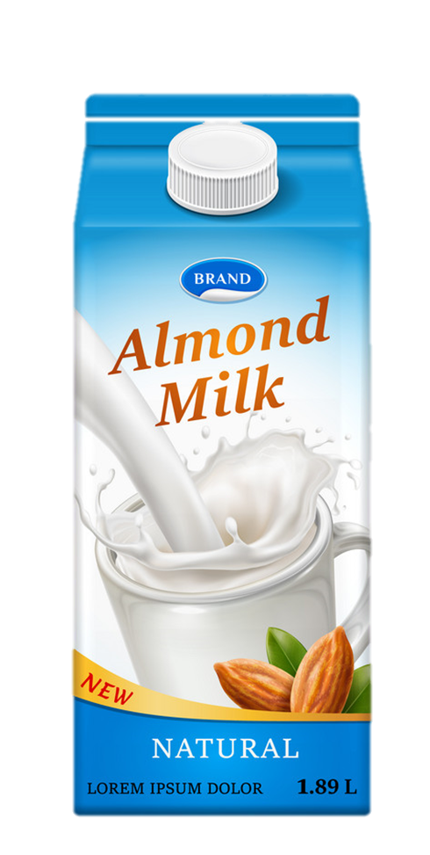
Vocabulary
milk
/mɪlk/

Slide 11
Vocabulary
drink
/drɪŋk/

Slide 12
Vocabulary
favourite
/ˈfeɪvərɪt/

Slide 13


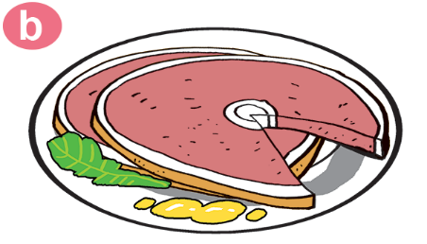
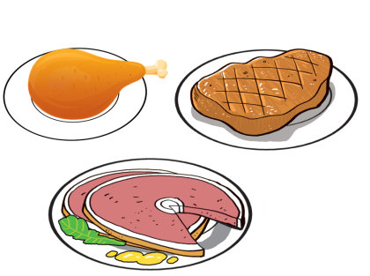

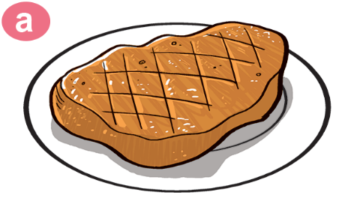


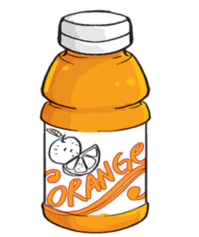
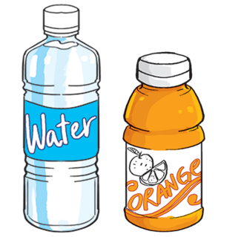

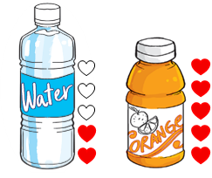
Vocabulary
1
2
3
4
5
chicken
pork
beef
fish
food
6
7
8
9
milk
water
orange juice
drink
favourite
10

Slide 14






Slide 15




Chicken
beef

Slide 16
Fish
beef

Slide 17

She’s Tom’s grandfather.
She’s Tom’s grandmother.

Slide 18

Food
Fish

Slide 19

Who is she?
Water
Orange juice

Slide 20
Who is she?
beef
Pork

Slide 21

Drink
Fish

Slide 22
Favourite
Orange juice

Slide 23

Orange juice
Water

Slide 24

Orange juice
Milk

Slide 25


Slide 26
GRAMMAR

Slide 27
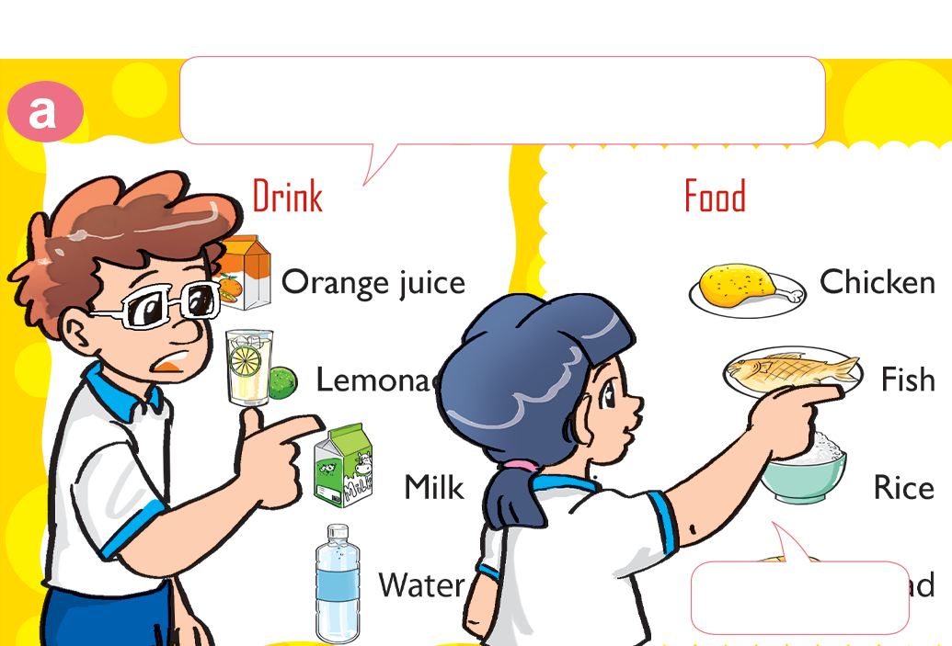
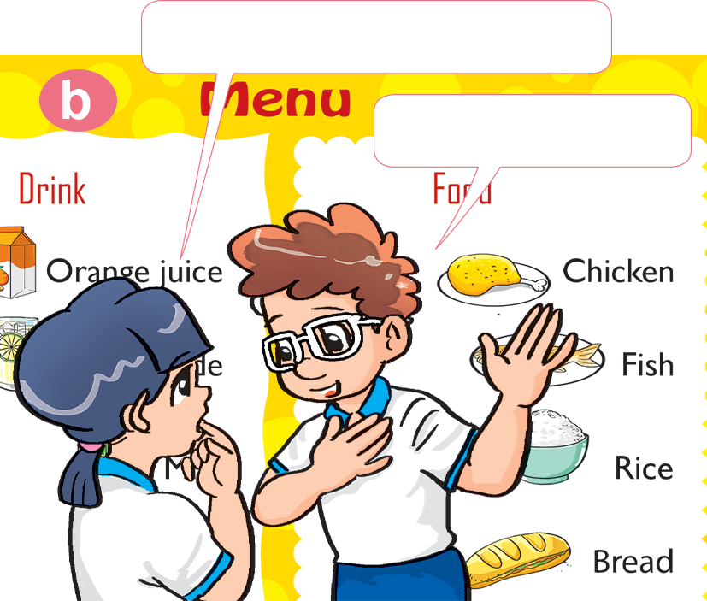

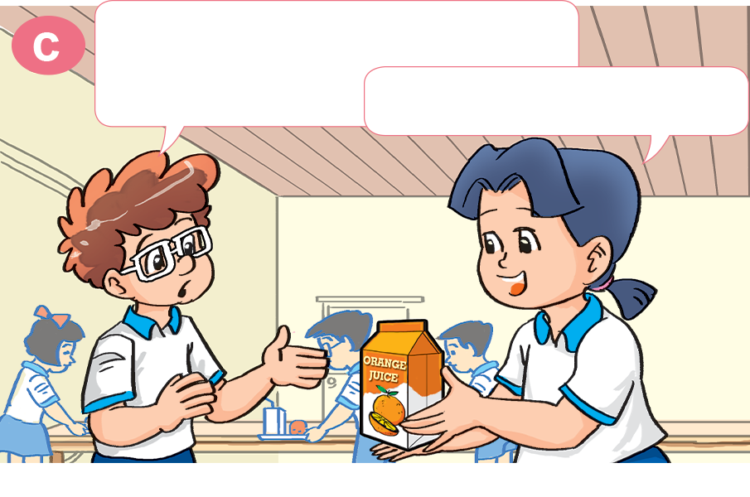
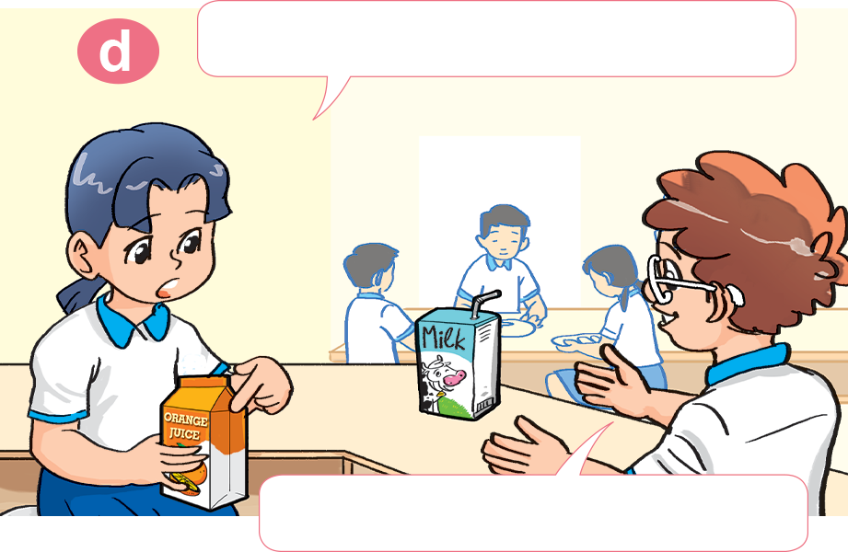
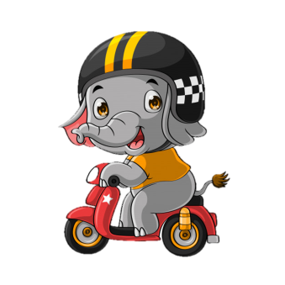
1. Look, listen and repeat
How about you, Tom?
What's your favourite food?
I like chicken.
It's fish.
What's your favourite drink, Mai?
Do you like orange juice?
It's orange juice.
No, I don't. I like milk.

Slide 28
2. Point and say.
What's your favourite __________?
It's ___________.
food
beef

Slide 29
2. Point and say.
What's your favourite __________?
It's ___________.
food
pork

Slide 30
2. Point and say.
What's your favourite __________?
It's ______________.
drink
orange juice

Slide 31
2. Point and say.
What's your favourite __________?
It's ___________.
drink
water

Slide 32

Model sentence
What's your favourite food/drink?
It's ___________.
orange juice
chicken
pork
water
beef
fish
milk

Slide 33

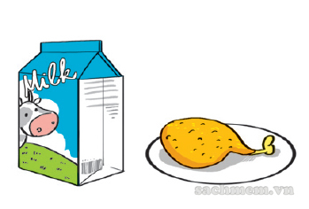
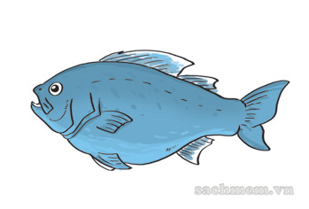
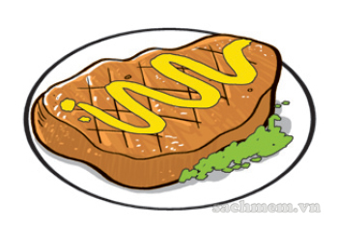
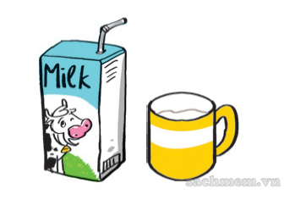
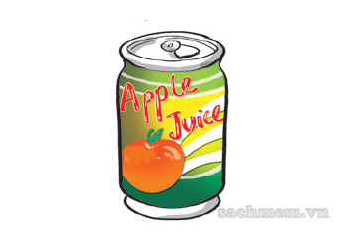
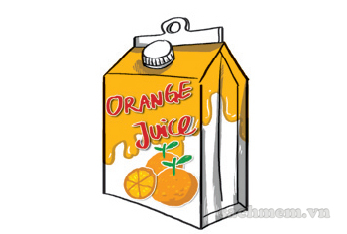
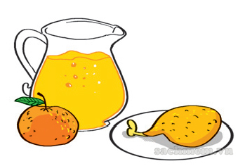
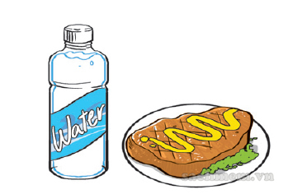
3. Listen and tick.
1. What's his favourite food?
a
b
c
✔
2. What's his favourite drink?
a
b
c
✔
3. What is her favourite food and drink?
a
b
c
✔

Slide 34
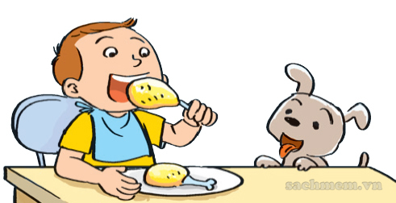
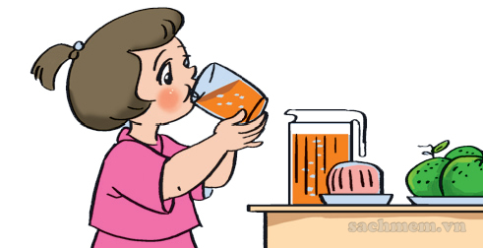
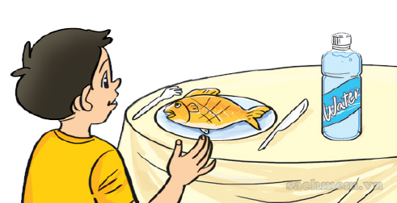
4. Look and write.
1. A: What's his favourite food?
B: _______________________.
It's chicken
2. A: What's her favourite drink?
B: _______________________.
It's orange juice
3. A: What's his favourite food and drink?
B: _______________________.
It's fish and water

Slide 35



What’s your favourite drink?
a. It’s beef.
b. It’s water.
c. It’s juice.
Next

Slide 36
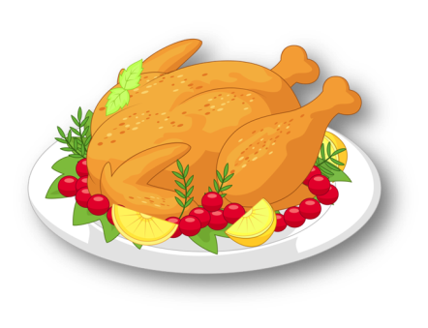
What’s your favourite food?
a. It’s chicken.
b. It’s beef.
c. It’s fish.
Next

Slide 37
What’s your favourite food?
a. It’s pork.
b. It’s fish.
c. It’s beef.
Next

Slide 38
What’s your favourite food?
a. It’s beef.
b. It’s pork.
c. It’s milk.
Next

Slide 39
What’s your favourite drink?
a. It’s chicken.
b. It’s water.
c. It’s milk.
Next

Slide 40
What’s your favourite food?
a. It’s fish.
b. It’s water.
c. It’s pork.
Next

Slide 41

What’s your favourite drink?
a. It’s orange juice.
b It’s chicken.
c. It’s milk.
Next

Slide 42
What’s your favourite food?
____________ beef.
a. I’m.
b. I
c. It’s
Next

Slide 43
What’s your favourite _____?
a. orange juice.
b. food.
c. drink.
Next

Slide 44
What’s your ______ drink?
a. favourite
b. drink
c. milk
Next

Slide 45
______ your favourite food?
It’s chicken.
a. What
b. what’s
c. What are
Next

Slide 46
What’s your favourite _____?
a. drink
b. food
c. like
Next

Slide 47

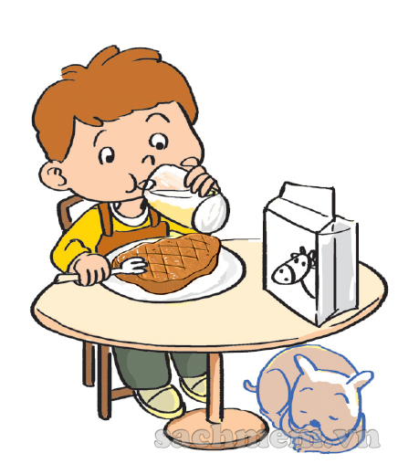
5. Let’s sing.
My favourite food and drink
What's your favourite food? What's your favourite food?
Hey ho, hey ho, my favourite food is beef.
What's your favourite drink? What's your favourite drink?
Hey ho, hey ho, my favourite drink is milk.
Beef and milk, beef and milk.
Hey ho, hey ho, they're my favourite food and drink

